Slide 1
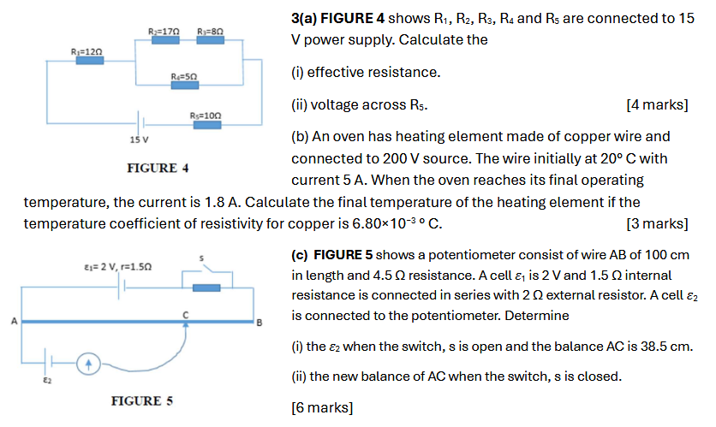
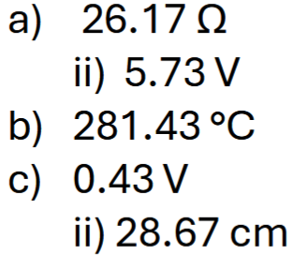
Notes:
C

Slide 2
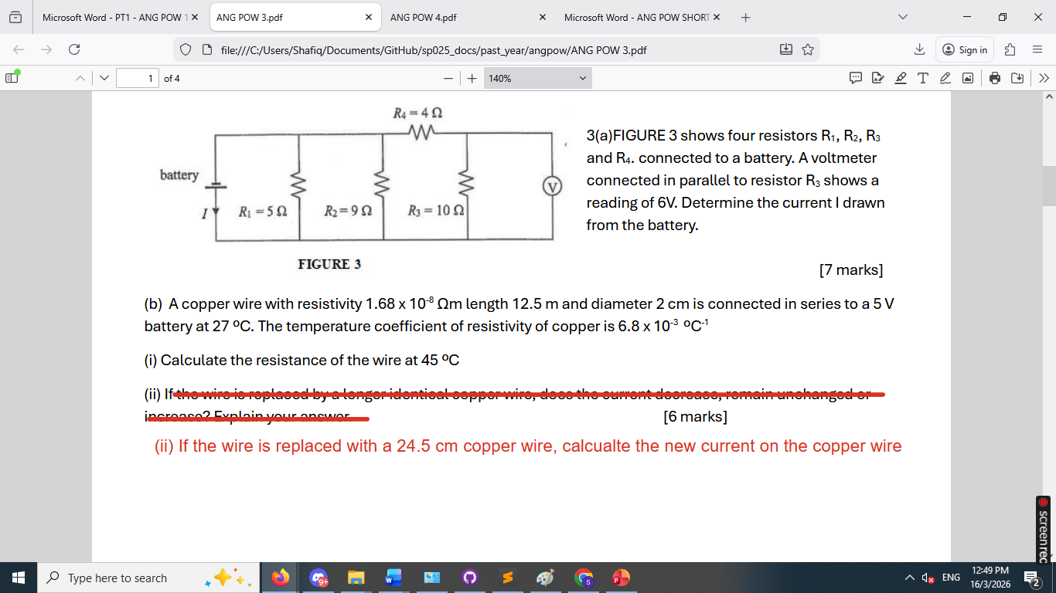
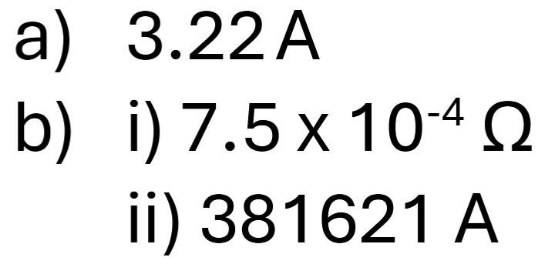

Slide 3
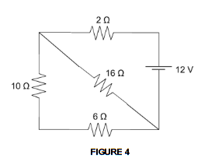
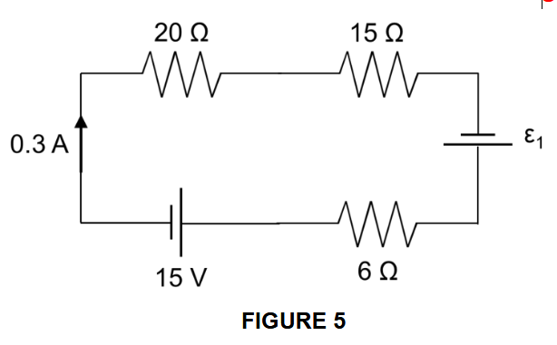
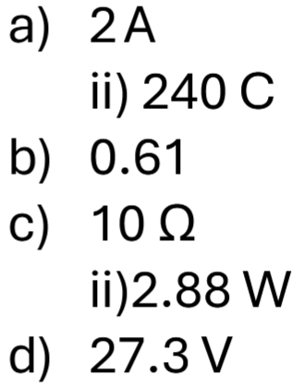
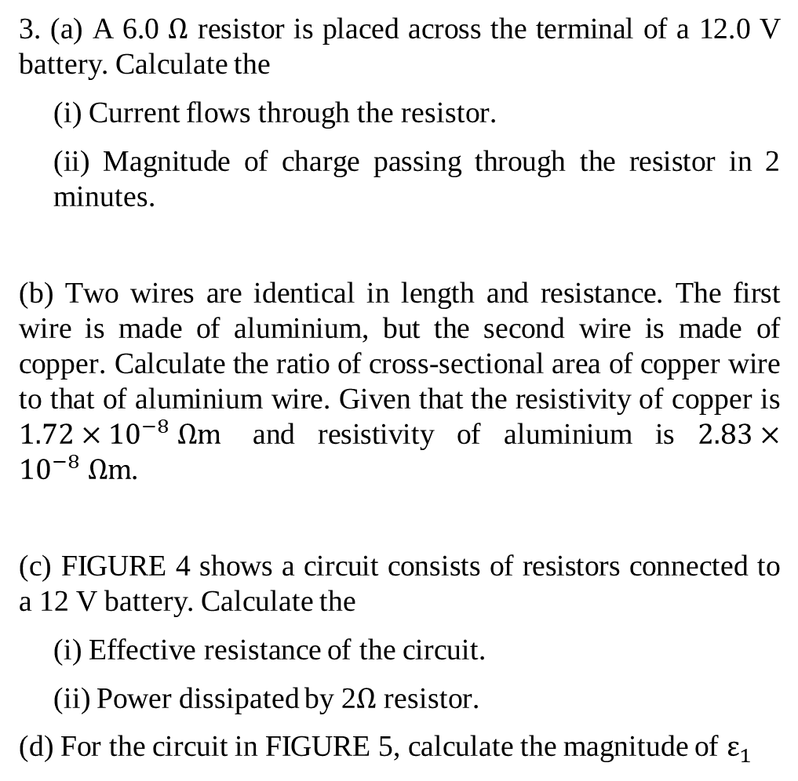
3. (a) A 6.0 $Ω$ resistor is placed across the terminal of a 12.0 V battery. Calculate the
(i) Current flows through the resistor.
(ii) Magnitude of charge passing through the resistor in 2 minutes.
(b) Two wires are identical in length and resistance. The first wire is made of aluminium, but the second wire is made of copper. Calculate the ratio of cross-sectional area of copper wire to that of aluminium wire. Given that the resistivity of copper is $1.72×{10}^{−8} Ω\text{m}$ and resistivity of aluminium is $2.83×{10}^{−8} Ω\text{m}$.
(c) FIGURE 4 shows a circuit consists of resistors connected to a 12 V battery. Calculate the
(i) Effective resistance of the circuit.
(ii) Power dissipated by 2$Ω$ resistor.
(d) For the circuit in FIGURE 5, calculate the magnitude of $ε_{1}$
Notes:
C

Slide 4

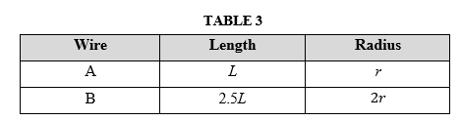
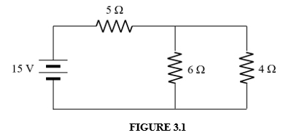
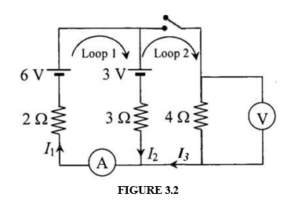
(a) The dimensions of two copper wires, A and B are given in TABLE 3.
Calculate the ratio of resistance of B to A. [3 marks]
(b) A battery with an emf ε of 15 V is connected to three resistors with resistance of 5 Ω, 6 Ω and 4 Ω as shown in FIGURE 3.1. Calculate the
(i) total current flow in the circuit. [2 marks]
(ii) current that flows through the 4 Ω resistor. [3 marks]
(c) FIGURE 3.2 shows a circuit with two batteries, three resistors and a switch. Using the given labelled circuit diagram, determine the ammeter and voltmeter readings when the switch in the circuit is closed. [5 marks]

Slide 5
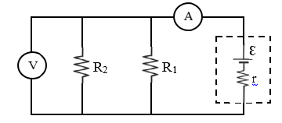
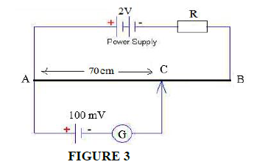
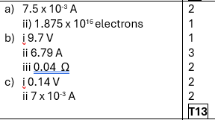
3 (a) In 400 ms, a charge of 3000 μC passes each point of a wire. Calculate
the current. ii. the number of electrons flow through the point. [3 marks]
(b) The circuit in FIGURE 2 shows a battery emf,= 10 V with unknown internal resistance, r that is connected to a circuit includes resistor R₁ = 2 Ω and R₂ = 5 Ω. The reading on the ideal voltmeter is 9.7 V.
What is the terminal voltage?
What is the reading of ammeter?
Determine the internal resistance, r.
[6 marks]
(c) FIGURE 3 shows a potentiometer used to determine the emf of a cell. The sliding wire is 100 cm long and has resistance of 20 Ω. The internal resistance for power supply and the cell is negligible. AC is 70 cm long at equilibrium.
Calculate
the voltage in sliding wire AB.
the value of current across resistor R. [4 marks]

Slide 6
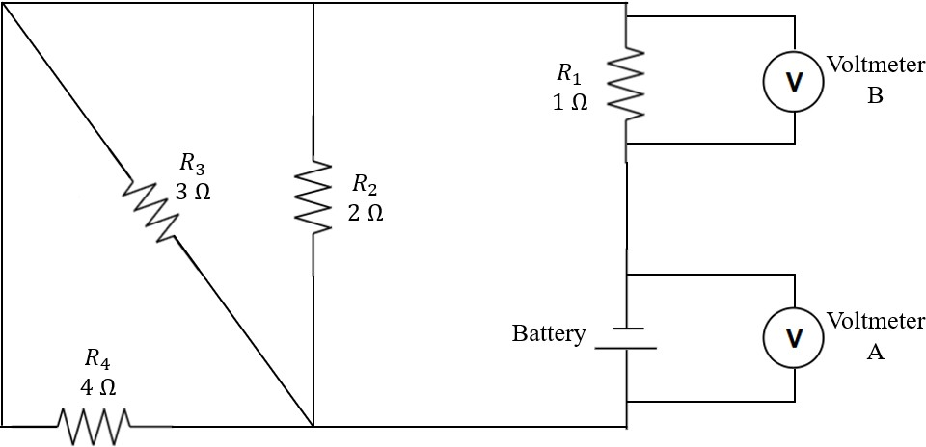
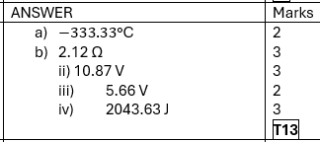
(a) Constantan is commonly used in resistors and potentiometers due to its stable resistance. The temperature coefficient of resistivity of constantan is 4 × 10⁻⁵ °C⁻¹. If the resistance of a constantan wire becomes 148 Ω from 150 Ω when its temperature changes, calculate the change in temperature of the constantan wire.
[2 marks]
(b) FIGURE 3 shows a circuit consisting of four resistors and a battery. Voltmeter A is connected across the battery, while voltmeter B is connected in parallel to the resistor R1. If the battery has an emf of 12 V with internal resistance 0.2 Ω,
Calculate the effective resistance of the circuit.
Calculate the reading of voltmeter A.
Calculate the reading of voltmeter B.
Calculate the energy dissipated by the resistor 𝑅₄ in 5 minutes.
[11 marks]

Slide 7
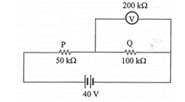
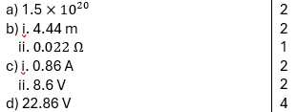
3. a) Current of 0.4 A flows in a light bulb. Calculate the number of electrons that enter the light bulb every minute.
[2 marks]
b) A wire of cross-sectional area 0.8 mm² is connected to a variable voltage, V and the current, I in the wire is measured. At 27 °C, the resistance of the wire is 0.25 Ω and the resistivity is 4.5 × 10⁻⁸ Ω m. Calculate the:
length of the wire.
change in the resistance of the wire when it is heated to 50 °C. The temperature coefficient of resistivity of the wire is 3.9 × 10⁻³ °C⁻¹.
[3 marks]
c) A battery of internal resistance 0.5 Ω has a terminal voltage of 9.0 V when no current flows. A 10.0 Ω resistor is connected across the battery terminals. Calculate the:
current through the 10.0 Ω resistor
new terminal voltage
[4 marks]
FIGURE 3 shows a voltmeter with resistance 200 kΩ connected across a resistor Q. Determine the voltmeter reading.
[4 marks]

Slide 8
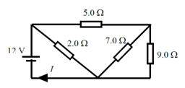
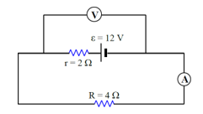
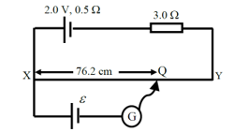
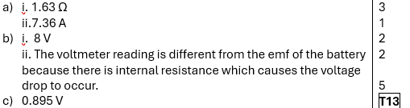
3. a) FIGURE 2a shows a combination of four resistors connected to 12 V battery. Calculate the:
i) equivalent resistance of the resistors.
ii) current I.
[4 marks]
b) A battery with ε = 12 V and internal resistance, r = 2 Ω is connected to a resistor, R = 4 Ω as shown in FIGURE 2b.
i) What is the reading of the voltmeter in the circuit?
ii) Is the voltmeter reading different from the e.m.f. of the battery? Justify your answer.
[4 marks]
c) FIGURE 2c shows a potential divider consisting of a wire XY of length 1.0 m and resistance 5.0 Ω. A cell of emf 2.0 V with internal resistance 0.5 Ω is connected in series with a 3.0 Ω resistor. When another cell with emf ε is connected to the potential divider, the balance length XQ is 76.2 cm. Calculate ε.
[5 marks]

Slide 9
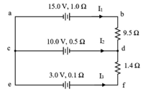
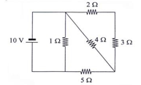

3. a) FIGURE 3a shows a circuit with ξ₁ = 15.0 V, r₁ = 1.0 Ω, ξ₂ = 10.0 V, r₂ = 0.5 Ω, ξ₃ = 3.0 V, r₃ = 0.1 Ω, R₁ = 9.5 Ω and R₂ = 1.4 Ω. Determine:
I₁, I₂ and I₃
Potential difference between point b to e
[7 marks]
b) FIGURE 3b shows a circuit consists of resistors connected to a 10 V battery. Calculate the:
effective resistance of the circuit.
power delivered by the battery.
[6 marks]

