Slide 1
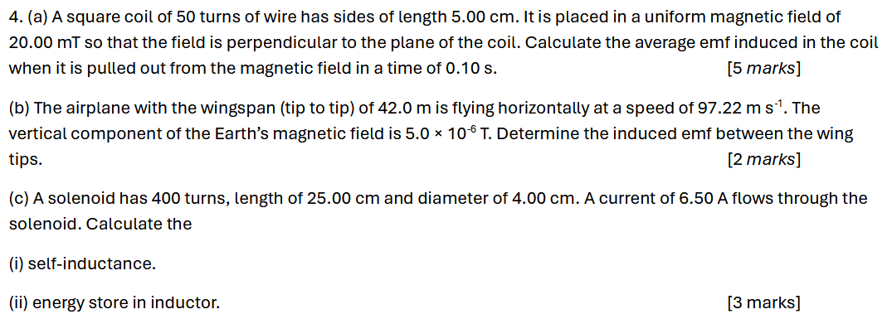
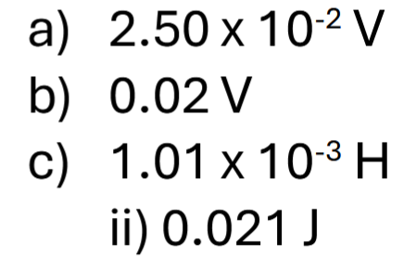
Notes:
C

Slide 2
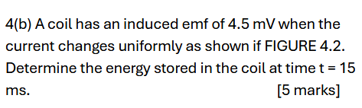
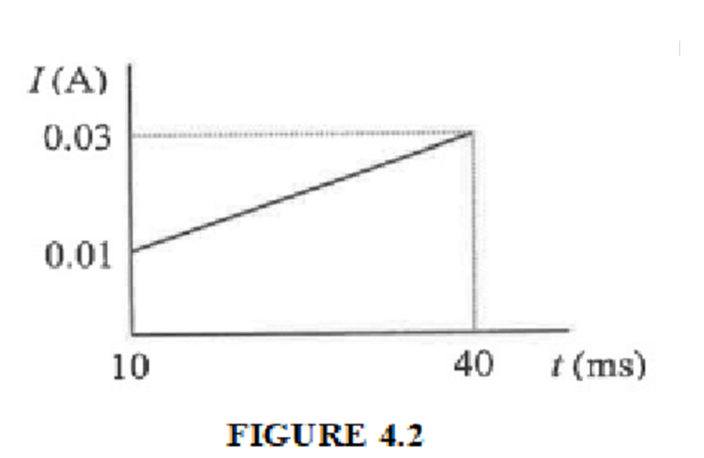

$$0.6μJ$$
Notes:
$$0.6μJ$$

Slide 3
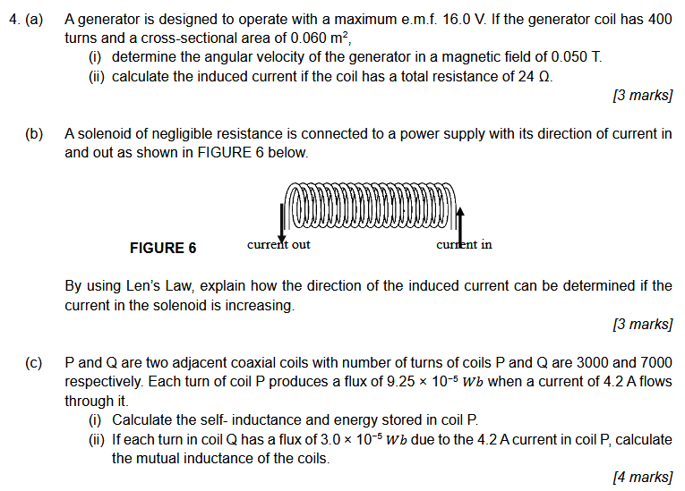
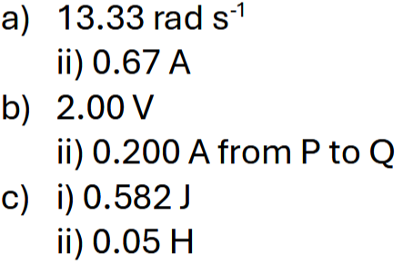
Notes:
C

Slide 4
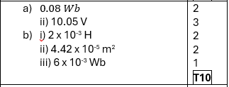
4(a) A circular coil of 100 turns with a plane area 8.0 × 10⁻³ m² is placed in a magnetic field of 0.2 T.
(i) Calculate the magnetic flux linkage through the coil when the plane of the coil makes an angle of 30° to the magnetic field. [2 marks]
(ii) The coil is then rotated about an axis of rotation perpendicular to the uniform magnetic field at a constant speed of 10.0 revolutions per second. Calculate the maximum value of the emf induced. [3 marks]
(b) A 600 turns solenoid is 0.01 m long. When the current is decreased from 3 to 0 A in 0.4 s, the induced emf is 0.015 V. Calculate the
(i) self-inductance. [2 marks]
(ii) cross-sectional area of the solenoid. [2 marks]
(iii) magnetic flux linkage passing through the solenoid when the current is 3A. [1 marks]

Slide 5
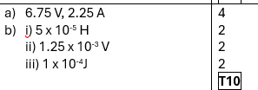
4 (a) A square coil of sides 15 cm and 300 turns has a resistance of 3.0 Ω. A uniform magnetic field is applied perpendicular to the plane of the coil. The magnitude of this field is increased uniformly from zero to 0.8 Wb m⁻² in a time of 0.8 s. Determine the magnitude of the induced emf and current in the coil. [4 marks]
(b) A steady current of 2 A in a coil of 400 turns causes a flux linkage of 10⁻⁴ Wb. Calculate the
inductance of the coil.
average induced emf in the coil if the current reduces to zero in 0.08 s.
energy stored in the coil.
[6 marks]

Slide 6
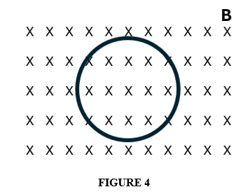
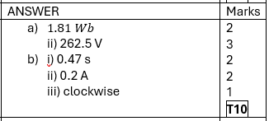
4(a) A 20 turns coil with cross-sectional area of 5.8 x 10⁻² m² is placed in a uniform magnetic field of 1.8 T.
Calculate the magnetic flux linkage in the coil when the plane of the coil makes an angle of 60° to the magnetic field.
If the coil rotates about an axis perpendicular to the uniform magnetic field at a constant angular velocity of 20 revolutions per second, calculate the maximum induced e.m.f. in the coil.
[5 marks]
(b) FIGURE 5 shows a single loop of radius 10 cm with resistance of 0.4 Ω is placed perpendicularly in a uniform magnetic field of 1.6 T.
(i) Calculate the time taken for the magnetic field to reduce by 1.2 T if the induced e.m.f produced is 0.08 V.
(ii) Calculate the induced current in the loop when the magnetic field decreases.
(iii) By using Len’z law, state the direction of induced current in (b) (ii).
[5 marks]

Slide 7
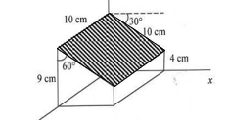

4. a) FIGURE 4 shows a model box placed in a uniform magnetic field of 0.2 T directed in the +x axis. Determine the magnetic flux through the shaded surface.
[3 marks]
b) A single turn coil of radius 10 cm rotates at 20 revolutions per second in a uniform magnetic field of 0.6 T. Calculate the induced emf when the plane of the coil makes an angle of 25° with the magnetic field.
[3 marks]
c) A coil of self-inductance 5.0 H is connected in series with a switch to a 12 V battery. The total resistance in the circuit is 6.0 Ω. Calculate the:
rate of current increase at the instant the switch is closed.
final value of the current.
energy stored in the inductor when the current is maximum.
[4 marks]

Slide 8
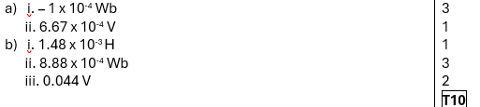
4. a) A loop of area 0.50 cm² with its plane perpendicular to a uniform magnetic field of 2.0 T is turned through 90° so that its plane is parallel to the magnetic field in 0.15 s. Calculate the:
i) change of magnetic flux in the coil.
ii) induced emf.
[4 marks]
b) A long ideal solenoid is connected in series to a battery of emf 12 V with negligible internal resistance and a resistor of 20 Ω. A coil is tightly wound over the central portion of the solenoid. The solenoid has a diameter of 5.0 cm and 60 turns per cm of length. The coil has 100 turns. Determine the:
i) mutual inductance of the combination.
ii) magnetic flux linkage through the coil.
iii) average emf induced in the coil when the circuit is switched off and the current drops to zero in 20 ms.
[6 marks]

Slide 9
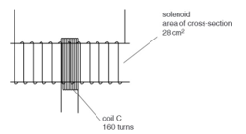

4. a) A rectangular coil of 60 turns, dimensions 0.100 m by 0.200 m, and resistance 10.0 Ω rotates with angular speed 287 rpm about the y-axis in a region where a 1.00 T magnetic field is directed along the x-axis. Calculate the:
maximum induced emf in the coil
maximum induced current in the coil
induced emf at t = 0.05 s
[7 marks]
b) A 10 cm long solenoid has 150 turns and an area of cross-section of 28 cm² as shown in the FIGURE 4. Coil C consists of 160 turns of insulated wire and is wound tightly around the centre of the solenoid. Calculate the flux linkage in the coil C for a current of 3.5 A in the solenoid.
[3 marks]

