Slide 1
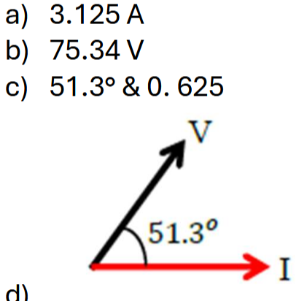
5. An AC circuit contains a 15 Ω resistor, a 3.0 μF capacitor, and a 3.1 mH inductor connected in series to an AC
power supply with a 75.0 V and frequency of 2.2 kHz.
(a) Calculate the rms current [4 marks]
(b) Calculate the rms voltage across the capacitor. [1 marks]
(c) Calculate the power factor and phase angle for this circuit [3 marks]
(d) Sketch a label phasor diagram to show the current and the supply voltage. [2 marks]
Notes:
C

Slide 2
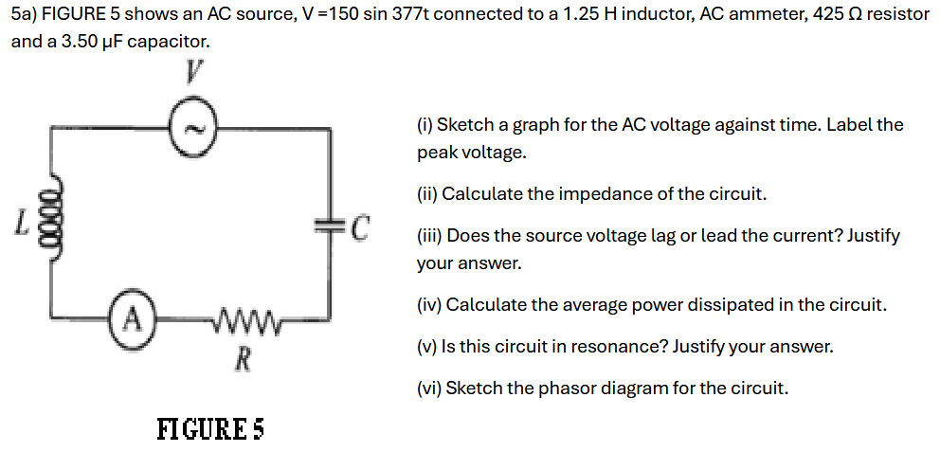
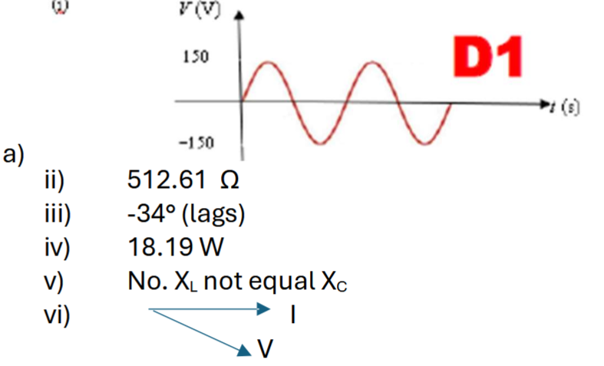
Notes:
$$0.6μJ$$

Slide 3
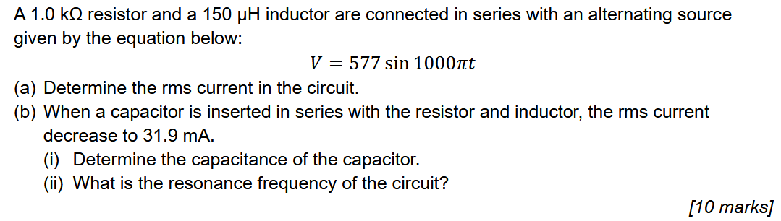
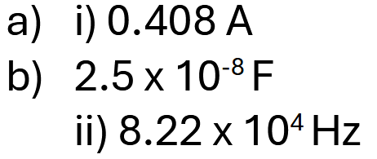
Notes:
C

Slide 4

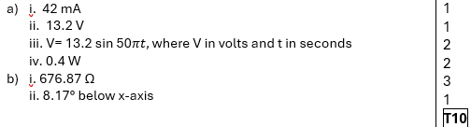
5. a) FIGURE 5 shows a graph of alternating current through a 220 Ω resistor.
Calculate the rms current through the resistor
Calculate the peak voltage across the resistor
Write the equation of voltage across the resistor iv) Calculate the average power dissipated by the resistor
[6 marks]
b) A sinusoidal voltage V(t) = 20 sin (50πt) is applied to a series RLC circuit with R = 670 Ω, L = 250 mH and C = 47 μF.
Calculate the impedance of the circuit
Calculate the phase angle of the circuit
[4 marks]

Slide 5
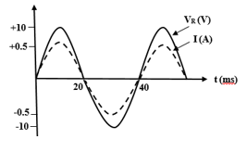
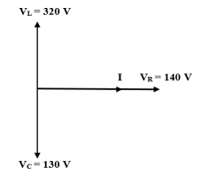

5. a) FIGURE 5a shows graphs of sinusoidal alternating current (AC) and a sinusoidal alternating voltage against time across a resistor R.
Calculate the resistance R.
Express the sinusoidal voltage equation.
[4 marks]
b) FIGURE 5b shows the values of root means square voltage across the resistor R, inductor, L and capacitor, C. Calculate the
i) source voltage and phase angle of the source voltage with respect to the current. Does the source voltage lag or lead the current?
ii) power factor of the circuit.
[6 marks]

Slide 6
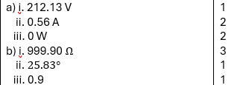
5. a) An AC source has an output voltage of V = 300 sin 100 πt. The source is connected to a 1.20 H inductor. Calculate the:
rms voltage
rms current in the inductor
average power
[5 marks]
b) An AC source that has a peak voltage of 120 V and a frequency of 50.0 Hz is connected in series to a 900 Ω resistor, a 2.40 H inductor and a 10.0 μF capacitor. Calculate the:
impedance of the circuit
phase angle of the circuit
the power factor of the circuit
[5 marks]

Slide 7
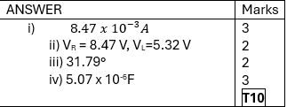
5 An AC source of 10 V and frequency 50 Hz is connected to a circuit which consists of an inductor of inductance 2 H and a resistor of 1 kΩ. Find
the current flows in the circuit.
the voltage across the resistor and the inductor
the phase angle between the voltage and current
the value of the capacitance should be added so that the voltage of the circuit is in phase with the current of the circuit.
[10 marks]

Slide 8
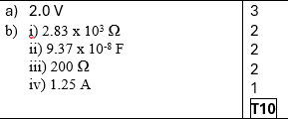
5 (a) An AC current of angular frequency of 1.0 x 10⁴ rad s⁻¹ flows through a 10 kΩ resistor and a 0.10 µF capacitor which are connected in series. Calculate the rms voltage across the capacitor if the rms voltage across the resistor is 20 V. [3 marks]
(b) A 200 Ω resistor, a 0.75 H inductor and a capacitor of capacitance C are connected in series to an alternating source 250 V, 600 Hz. If the current in the circuit is maximum, calculate the
(i) capacitive reactance.
(ii) the capacitance C.
(iii) the impedance of the circuit at resonance.
(iv) the current flows through the circuit at resonance. [7 marks]

Slide 9
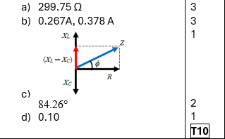
5 A resistor of resistance, 𝑅 = 30 Ω, is connected in series with an inductor, 𝐿 = 50 mH, and a capacitor of capacitance, 𝐶 = 10 μF. An alternating voltage, 𝑉rms = 80 V, and frequency, 1 kHz is connected across the circuit. Calculate the
(a) impedance in this circuit. [3 marks]
(b) rms current and peak current flowing through the circuit. [3 marks]
(c) phase angle by referring to the phasor diagram. [3 marks]
(d) power factor. [1 marks]

