Slide 1
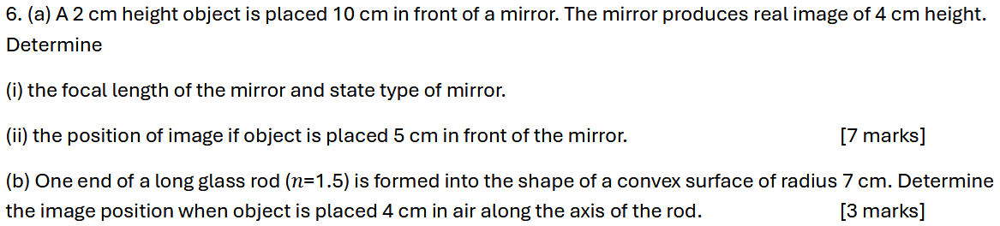
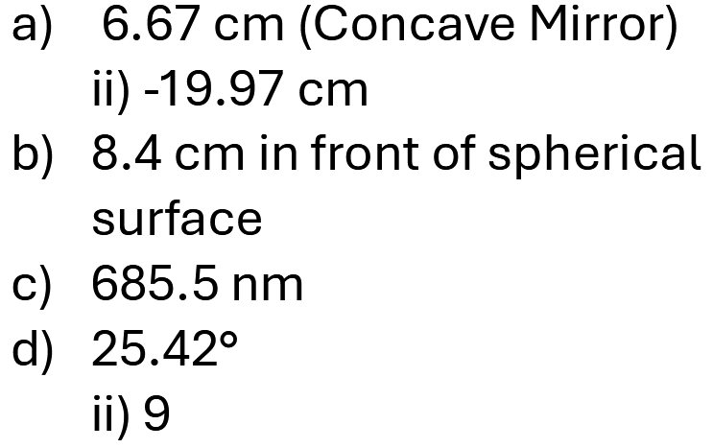
Notes:
C

Slide 2
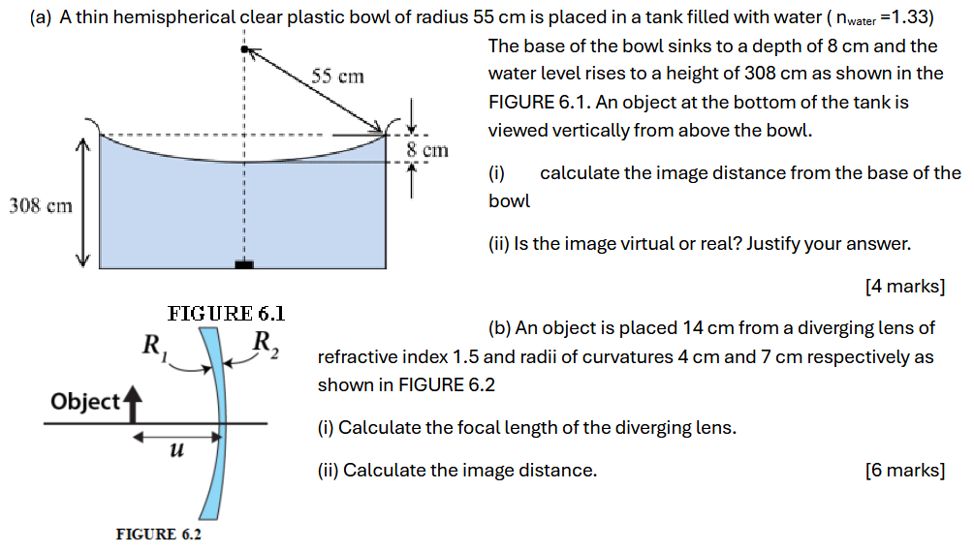
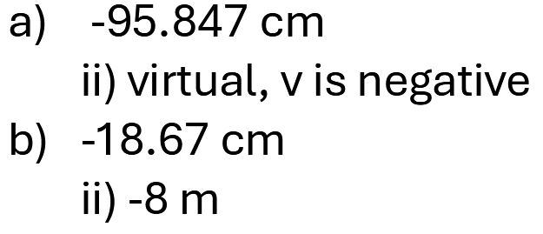
Notes:
$$0.6μJ$$

Slide 3
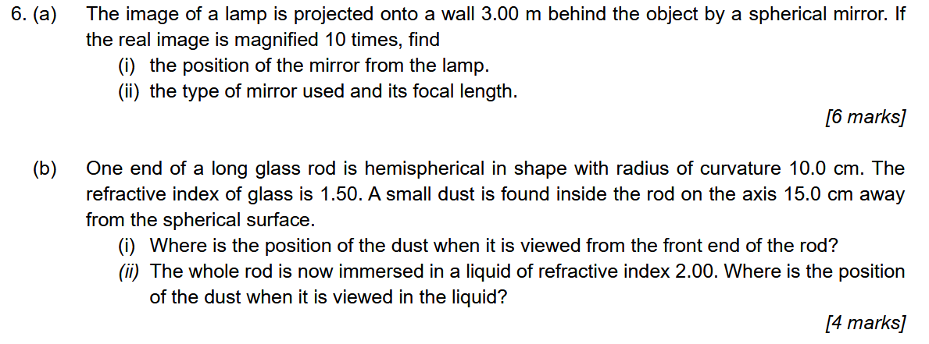
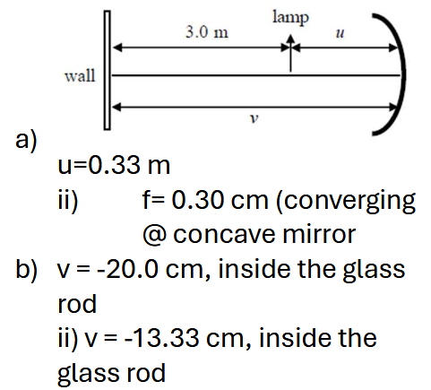
Notes:
C

Slide 4


6. a) A concave mirror has a radius of curvature 30 cm. An object of height 12 cm forms an enlarged image 20 cm behind the mirror.
Calculate the object distance.
Calculate the height of the image.
State two characteristics of the image.
[5 marks]
b) FIGURE 6 shows a glass rod with a convex surface of radius of curvature 6 cm at one end. The refractive index of the glass is 1.5. A point object, O is located at 20 cm from the curved end.
Determine the location of the image.
If the glass rod is immersed in water with a refractive index of 1.33, determine the location of the image. State ONE characteristic of the image.
[5 marks]

Slide 5

6. a) An object 4.0 cm high is placed 15.0 cm from a concave mirror of focal length 5.0 cm. Determine
i) the position of the image from the mirror.
ii) if the object is moved 10 cm towards the concave mirror, where is the position of the image formed?
[5 marks]
b) Focal length of a converging biconvex glass lens (n = 1.5) is 20 cm.
Calculate the radius of curvature of the lens.
When an object is placed in front of the lens, an image is formed on the same side as the object, at a distance 5 cm from the lens. Calculate the object distance.
[5 marks]

Slide 6
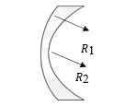
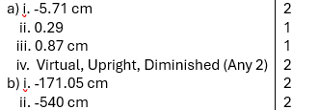
6. a) An object 3 cm high is placed 20 cm from a convex mirror which has a focal length of 8 cm.
Determine the position of the image.
Determine the magnification of the mirror.
Determine the height of the image.
State two characteristics of the image.
[6 marks]
b) FIGURE 5 shows a lens made from glass with refractive index of 1.57. The radius of curvature R₁ and R₂ are 15.0 cm and 13.0 cm respectively.
i) Calculate the focal length.
ii) If the lens immersed in water with refractive index of 1.33, calculate its new focal length.
[4 marks]

Slide 7

(a) A makeup artist uses a spherical mirror to apply makeup. Initially, when she is 20 cm in front of the mirror, it produces an inverted image 60 cm from the mirror. Determine the new position she should be in to obtain an upright image that is three times of her actual size.
[5 marks]
(b) A convex meniscus lens is made from glass with a refractive index of 1.50 and has radii of curvature of 20 cm and 40 cm.
Determine the focal length of the lens in air.
The same lens is now immersed in a liquid with a refractive index of 1.80. Determine whether the lens behaves as a converging or diverging lens in the liquid.
[5 marks]

Slide 8
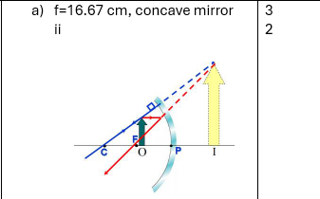

6 (a) A makeup mirror has a focal length of f. If the mirror produces a magnification of 2.5 when someone looking at the mirror from 10 cm away,
Determine the type of the mirror.
Sketch a ray diagram to show the formation of the image.
[5 marks]
(b) An object is placed 20 cm in front of a converging lens with a focal length of 15 cm.
i Determine the image distance.
ii. Determine the magnification of the image. [3 marks]
(c) In a Young's double slit experiment, an interference pattern is formed 1.00 m away from the double slits. The double slits are separated by 0.25 mm and the wavelength of light used is 550 nm. Determine the distance between the central bright to the 5th bright fringe, [2 marks]

Slide 9
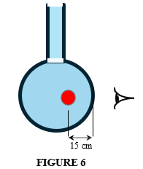

6(a) A concave mirror has a radius curvature of 40.5 cm and is positioned at a distance such that the upright image of a person’s face is 1.5 times the size of his face. How far is the mirror from the person’s face? [4 marks]
(b) A rubber ball is submerged in a round bottom flask containing water (𝑛 = 1.33 cm) and is 15 cm from the wall of the flask as shown in FIGURE 6. The spherical section of the flask has a 44 cm diameter. What should the image distance of the ball be if the person is standing right next to the flask? (The walls of the flask are very thin, so ignore refraction caused by them.) [3 marks]
(c) An object of height 2.5 cm is placed 15.0 cm from a diverging lens with a focal length, 10.0 cm. Determine the height for the image formed. [3 marks]

