Slide 1
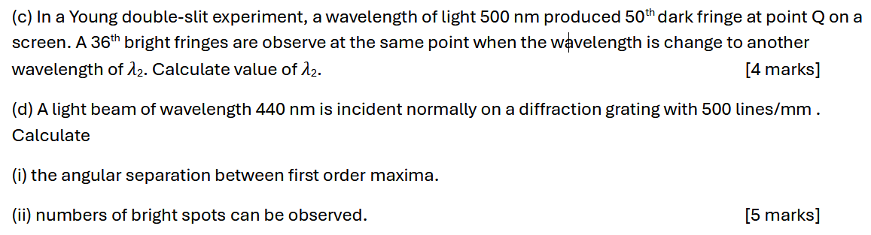
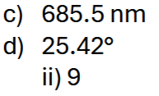
Notes:
C

Slide 2
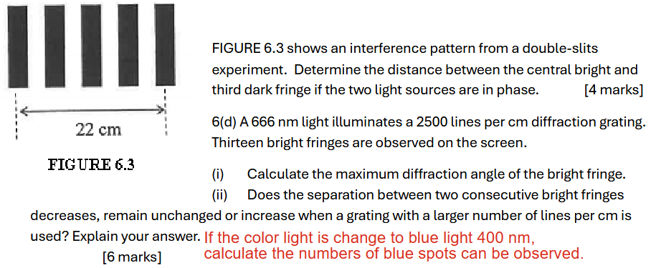
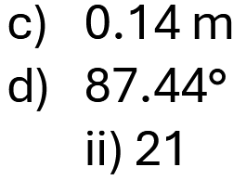
Notes:
$$0.6μJ$$

Slide 3
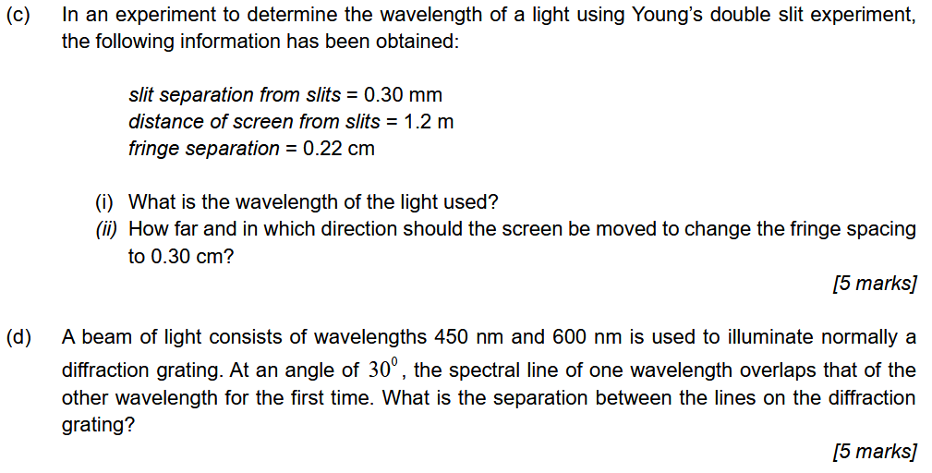
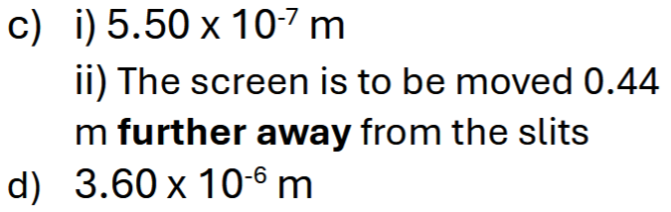
Notes:
$$0.6μJ$$

Slide 4
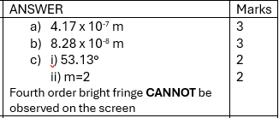
7(a) In a double-slit experiment, monochromatic light passes through two narrow slits separated by 0.500 mm. The interference pattern is observed on a screen
1.20 m away. The distance between the second and fifth dark fringes is measured to be 3.00 mm. Determine the wavelength of the light used.
[3 marks]
(b) A thin oil film with a refractive index of 1.45 floats on water with a refractive index of 1.33 and is illuminated by white light. When viewed from above, it appears bright blue, with a wavelength of 480 nm in air. Determine the minimum thickness of the oil film required to produce this effect.
[3 marks]
(c) A diffraction grating with 800 lines per mm is illuminated by monochromatic light of wavelength 500 nm.
Determine the diffraction angle of the second order bright fringe.
Determine whether a fourth-order bright fringe can be observed. Explain your answer.
[4 marks]

Slide 5

7. a) A screen is separated from a double slit source by 1.20 m. The distance between the two slits is 0.03 mm. The second order bright fringe is measured to be 4.50 cm from the centerline. Determine the:
i) wavelength of the light.
ii) distance between adjacent bright fringes.
[4 marks]
b) A tank of gasoline (n=1.40) is open to the air (n=1.00). A thin film of liquid floats on the gasoline and has a refractive index that is between 1.00 and 1.40. Light has a wavelength of 570 nm shines perpendicularly down through the air onto this film, and in this light the film looks bright due to constructive interference. The thickness of the film is 242 nm and is the minimum nonzero thickness for which constructive interference to occur. What is the refractive index of the film?
[3 marks]
c) A slit has a width of 2.3 × 10⁻⁶ m. When light of wavelength 580 nm passes through the slit, it creates a central bright fringe on a flat observation screen 1.62 m away. If the slit is then illuminated with light of a longer wavelength 660 nm, to where will the screen need to be moves in order to create a central bright fringe of the same width as the first experiment?
[3 marks]

Slide 6

7. a) Semiconductors such as silicon are used to fabricate solar cells, devices that generate electric energy when exposed to sunlight. A silicon solar cell (n = 3.50) is coated with a transparent thin film, such as silicon monoxide (SiO; n = 1.45). Determine the minimum thickness of the film that will produce no reflection at a wavelength of 552 nm.
[3 marks]
b) Find the width of a single slit that will produce first order diffraction minima at an angle of 21° from the central maximum when red light (λ = 680 nm) is used.
[2 marks]
c) Monochromatic light from a helium-neon laser with λ = 632.8 nm is incident normally on a diffraction grating containing 6.00 × 10³ lines/cm. Find the angles at which one would observe the first-order maximum and second-order maximum.
[5 marks]

Slide 7

7. a) Two parallel slits are illuminated by light composed of two wavelengths. One wavelength is λA = 656 nm. The other wavelength is λB is unknown. On a viewing screen, the light with λA produces its third-order bright fringe at the same place where the light with λB produces its fourth dark fringe. What is the unknown wavelength?
[3 marks]
b) Light of wavelength 580 nm is incident on a slit of width 0.3 mm. The observing screen is placed 2.0 m from the slit.
Find the position of the first dark fringe.
Calculate the width of the central bright fringe.
[4 marks]
c) A monochromatic light 483 nm is incident on a diffraction grating with 560 lines per cm. The second order maximum produced at angle of 3.1°. Calculate the number of diffraction pattern that can be formed.
[3 marks]

Slide 8
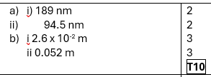
7(a) An oil film (n =1.38) floats on the water puddle (n = 1.33). You notice that green light (λ = 521 nm) is absent in the reflection. What is the minimum thickness of the oil film when
(i) You notice that green light (λ = 521 nm) is absent in the reflection
(ii) You notice that green light (λ = 521 nm) is present in the reflection [4 marks]
(b) A monochromatic light of wavelength, 650 nm fell upon a single slit 4 x 10⁻⁶ . If the screen is placed at 8 cm from the slit, calculate
the width of the central bright fringe.
the distance of the fourth dark fringe from the central bright fringe. [6 marks]

Slide 9

7(a) In a Young’s double slit experiment, the separation between the slits is 0.10 mm and the screen is placed at a distance 2.0 m from the slits. If a monochromatic light is incident on slits, the distance between the 10th bright fringe and the 5th dark fringe is 40.0 mm. Determine the wavelength of the light. [5 marks]
(b) A diffraction grating of length 0.025 m has 20 000 slits. If a monochromatic light with a wavelength of 590 nm is incident on the grating determine the
(i) number of slit per unit length. [2 mark]
(ii) position of the 1st order maximum. [3 marks

