Slide 1
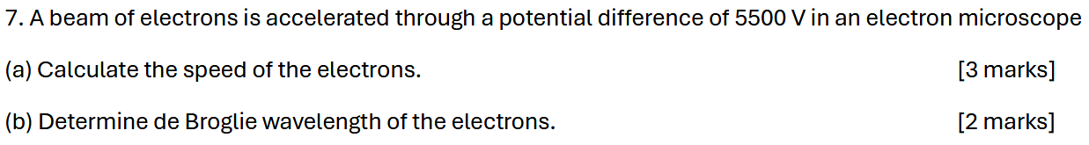
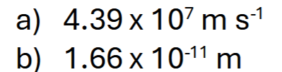
Notes:
C

Slide 2
8. An electron has energy of 200 eV. Calculate the de Broglie wavelength associated with the electron.
[3 marks]

Slide 3
An electron and a proton are accelerated through the same voltage. If the de Broglie wavelength of the electron is 0.12 nm, what is the de Broglie wavelength of the proton?
[3 marks]

Slide 4
8. The de Broglie wavelength of an electron is 1.00 nm. What is the kinetic energy of the electron?
[3 marks]

Slide 5

8 An electron beam S is accelerated from rest through a potential difference of 500 V. Another electron beam, T is also accelerated from rest through a potential difference of 1000 V. Find the ratio between the wavelengths of S to T.

Slide 6

8 (a) What is the wavelength of a photon that has the same momentum as an electron moving with a speed of 1100 ms⁻¹ ? [2 marks]
(b) The non-relativistic electron beam in an electron microscope is formed by a setup similar to the electron gun used in the Davisson–Germer experiment. What is the voltage needed to accelerate an electron which has de Broglie wavelength of 0.25 nm? [1 marks]

Slide 7

8(a) What is the wavelength of a photon that has the same momentum as an electron moving with a speed of 2300 m s⁻¹? [2 marks]
(b) The electron beam in an electron microscope is formed by a set up similar to the electron gun used in the Davisson-Germer experiment. What is the voltage needed to accelerate an electron which has de Broglie wavelength of 0.50 nm? [1 marks]

Slide 8
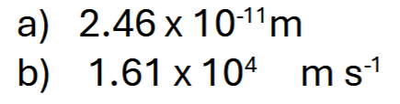
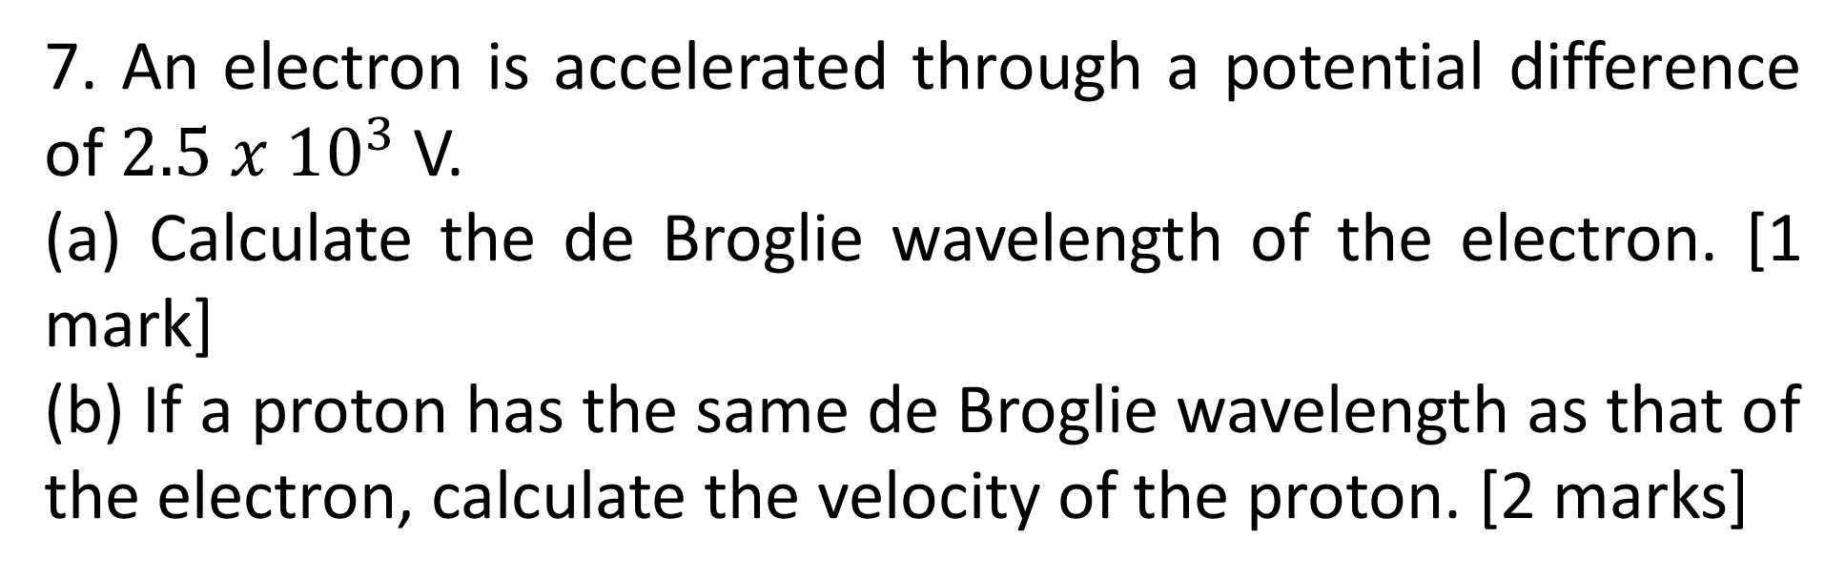
7. An electron is accelerated through a potential difference of $2.5 x {10}^{3}$ V.
(a) Calculate the de Broglie wavelength of the electron. [1 mark]
(b) If a proton has the same de Broglie wavelength as that of the electron, calculate the velocity of the proton. [2 marks]
Notes:
$$0.6μJ$$

Slide 9

An electron carries an energy of 200 eV. What is the de Broglie wavelength associated with the electron?
Notes:
$$0.6μJ$$

