Slide 1
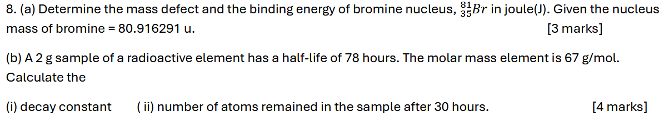
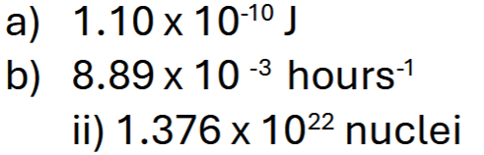
Notes:
C

Slide 2
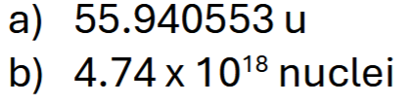
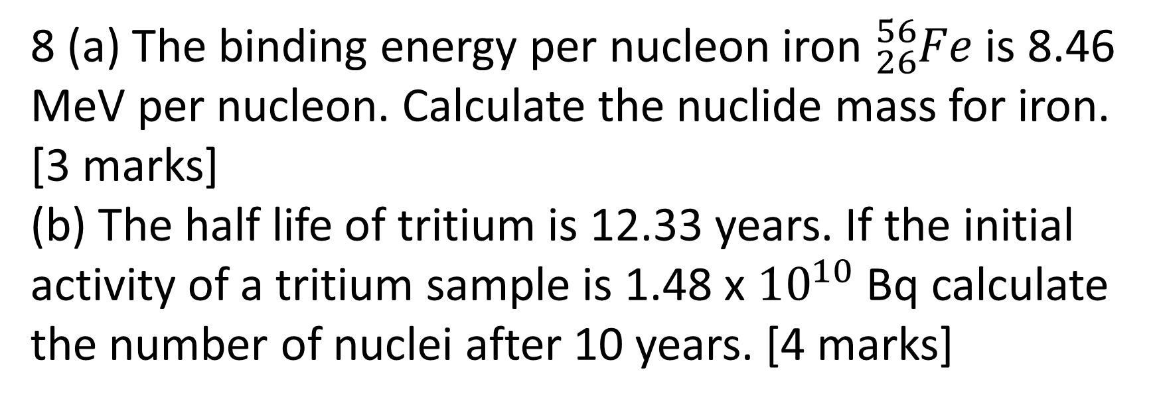
8 (a) The binding energy per nucleon iron ${}_{26}^{56}{Fe}$ is 8.46 MeV per nucleon. Calculate the nuclide mass for iron.
[3 marks]
(b) The half life of tritium is 12.33 years. If the initial activity of a tritium sample is 1.48 x ${10}^{10}$ Bq calculate the number of nuclei after 10 years. [4 marks]
Notes:
$$0.6μJ$$

Slide 3
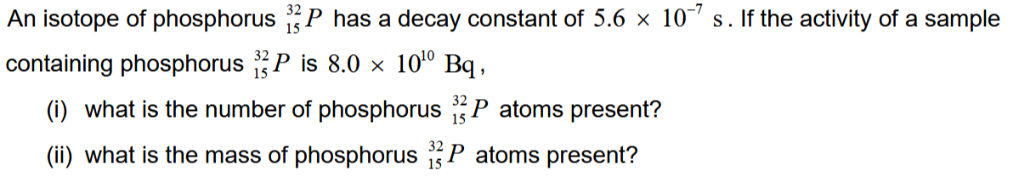
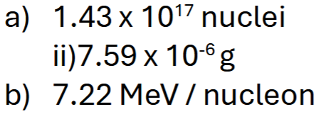
Notes:
$$0.6μJ$$

Slide 4

9. a) The nuclear mass of Radon, ²²⁶₈₈Rn is 226.02544 u. Determine the mass defect in atomic mass units (u) and kilograms for Radon.
[2 marks]
b) A sample of uranium-238 contains 2.5 × 10²³ atoms. Given that the half-life of uranium-238 is 1.42 × 10¹⁷ s, calculate:
the initial activity of the sample in Becquerel.
the number of uranium-238 atoms remaining after 3 × 10¹⁸ s.
[5 marks]

Slide 5

$9. a) {}_{90}^{234}{Th}$ element decays by emitting beta particle negative producing a new element K. Write an equation for this reaction.
[2 mark]
b) After a plant or animal dies, its Carbon-14 content decreases with a half-life of 5730 year. If an archaeologist finds an ancient fire pit containing partially consumed firewood and the Carbon-14 content of the wood is only 12.5% that of an equal carbon sample from a present-day tree, calculate the age of the ancient site.
[5 marks]

Slide 6

9. a) The mass of ⁶³₂₉Cu nucleus is 62.5219u. Calculate the binding energy per nucleon of ⁶³₂₉Cu nucleus.
[3 marks]
b) A radioactive source contains 1 × 10⁻⁶ g ²³⁹Pu. If this source contains 2300 alpha particles per second, calculate:
i) its decay constant.
ii) the time required for the source so that its activity decreases to one decay per second.
[3 marks]

Slide 7
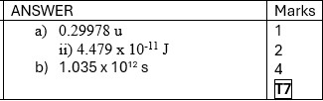
9(a) An isotope of ${}_{64}^{151}{Gd}$ (Gadolinium) has a nucleus mass 151.919803 u. Calculate the
mass defect.
binding energy in Joule.
[3 marks]
(b) A sample of an isotope with mass number 114 decays at a rate of 0.550 Ci. Calculate the half-life of the isotope if 5.75 g of the sample is used. (1 Ci = 3.7 × 10¹⁰ Bq)
[4 marks]

Slide 8

9 (a) Calculate the binding energy per nucleon for${}_{3}^{6}{Li}$.
(Given mass of nucleus Li = 6.015123 u and mass of H = 1.007825u) [3 marks ]
(b) A radioactive sample has an initial activity 9 mCi. After 16 hours, its activity reduces to 7 mCi. Calculate
(i) the half life.
(ii) intial number of nuclei.
(1 Ci = 3.7 × 10¹⁰ Bq) [ 4 marks ]

Slide 9

9(a) Calculate the binding energy per nucleon for ${}_{116}^{293}{Lv}$ in MeV per nucleon. (Given atomic mass of ${}_{116}^{293}{Lv}$ is 293.205 u) [3 marks]
(b) The half-life of ${}_{27}^{60}{Co}$ is 5.26 years. Calculate the
decay constant of this atom [2 marks]
Activity of 1.00 g of ${}_{27}^{60}{Co}$ [2 marks]

