Slide 1
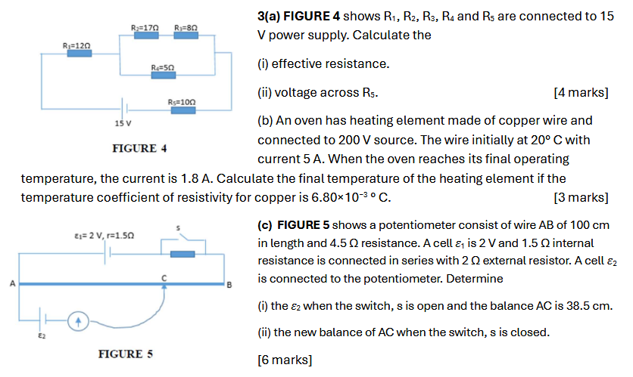
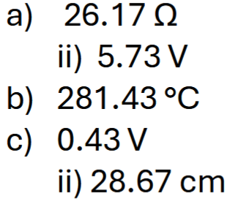
Notes:
C

Slide 2
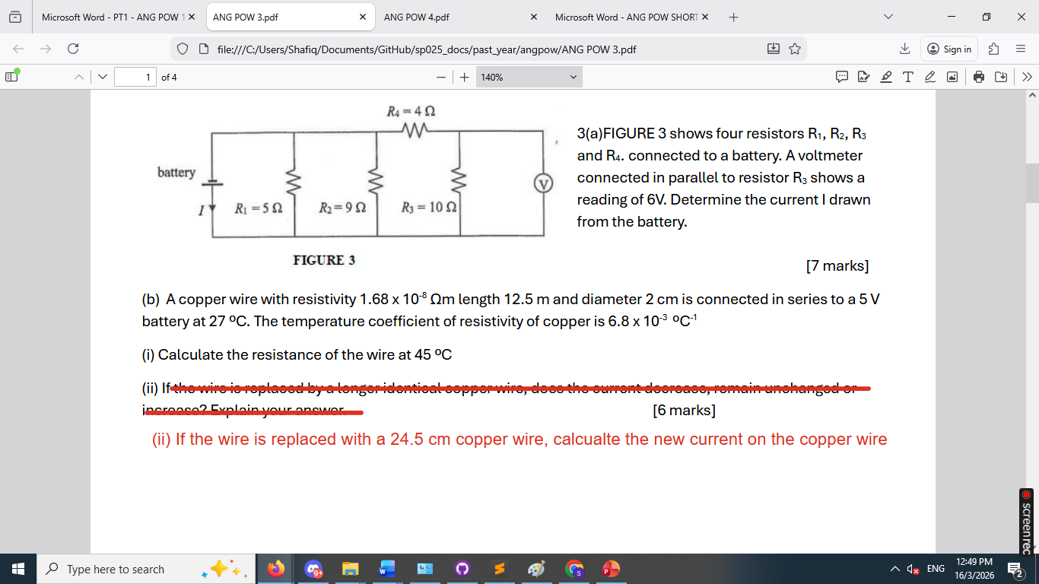
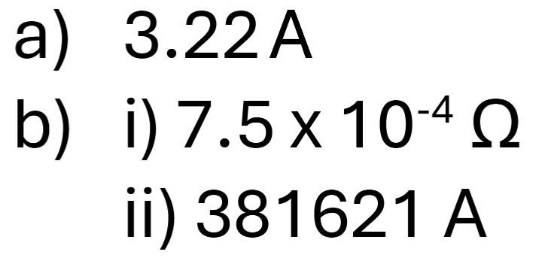

Slide 3
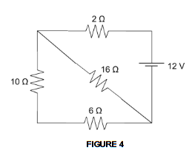
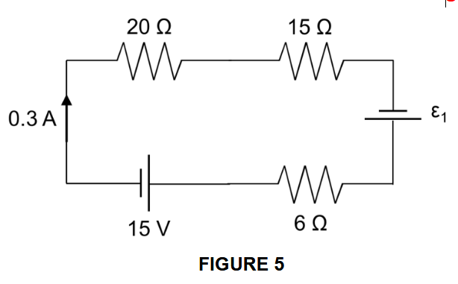
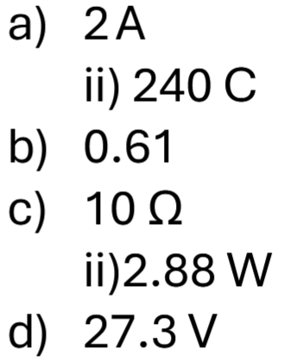
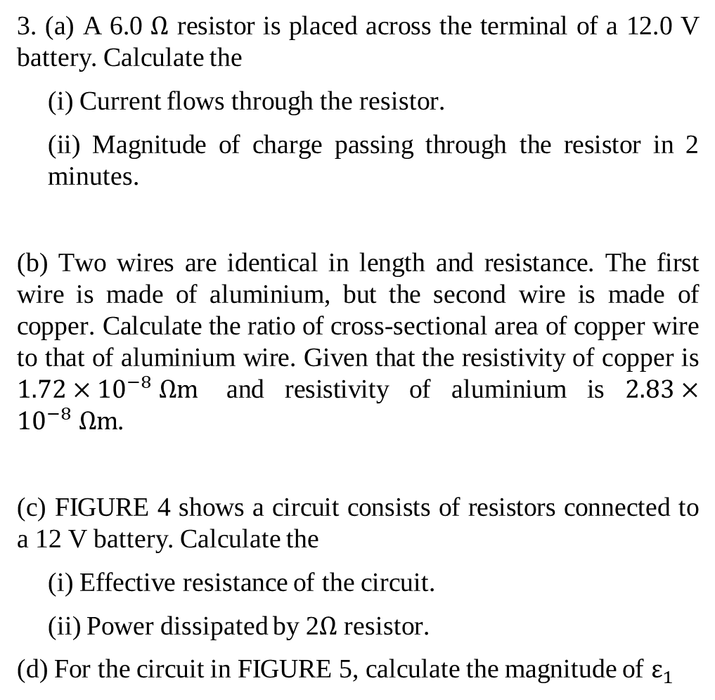
3. (a) A 6.0 $Ω$ resistor is placed across the terminal of a 12.0 V battery. Calculate the
(i) Current flows through the resistor.
(ii) Magnitude of charge passing through the resistor in 2 minutes.
(b) Two wires are identical in length and resistance. The first wire is made of aluminium, but the second wire is made of copper. Calculate the ratio of cross-sectional area of copper wire to that of aluminium wire. Given that the resistivity of copper is $1.72×{10}^{−8} Ω\text{m}$ and resistivity of aluminium is $2.83×{10}^{−8} Ω\text{m}$.
(c) FIGURE 4 shows a circuit consists of resistors connected to a 12 V battery. Calculate the
(i) Effective resistance of the circuit.
(ii) Power dissipated by 2$Ω$ resistor.
(d) For the circuit in FIGURE 5, calculate the magnitude of $ε_{1}$
Notes:
C

