Slide 1
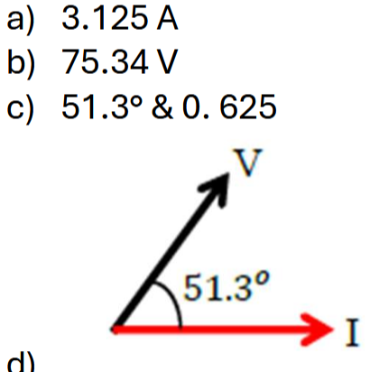
5. An AC circuit contains a 15 Ω resistor, a 3.0 μF capacitor, and a 3.1 mH inductor connected in series to an AC
power supply with a 75.0 V and frequency of 2.2 kHz.
(a) Calculate the rms current [4 marks]
(b) Calculate the rms voltage across the capacitor. [1 marks]
(c) Calculate the power factor and phase angle for this circuit [3 marks]
(d) Sketch a label phasor diagram to show the current and the supply voltage. [2 marks]
Notes:
C

Slide 2
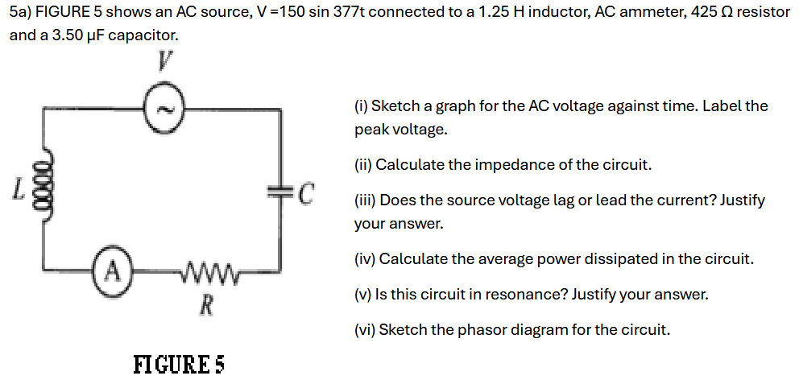
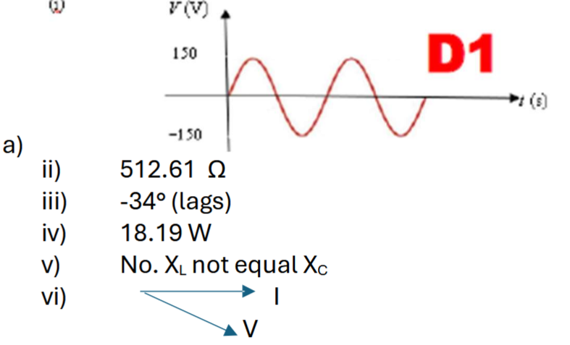
Notes:
$$0.6μJ$$

Slide 3
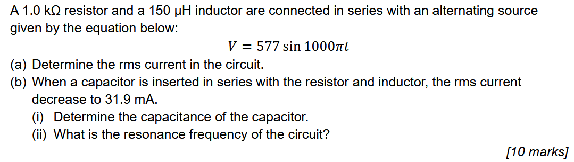
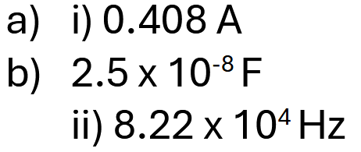
Notes:
C

