Slide 1
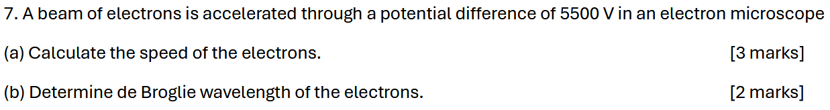
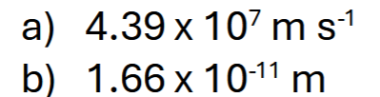
Notes:
C

Slide 2
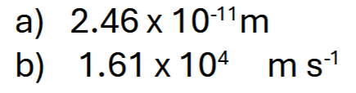
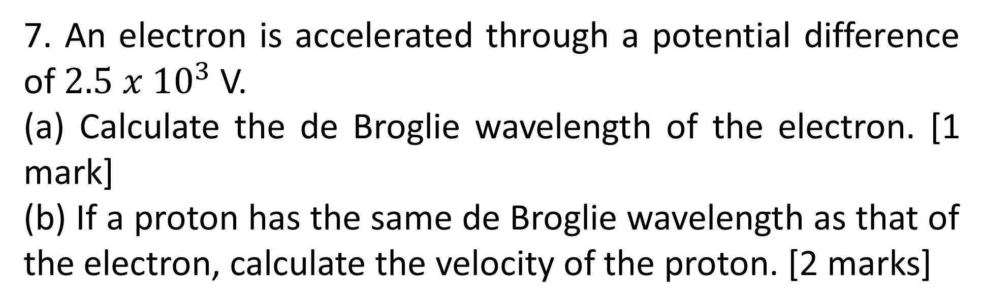
7. An electron is accelerated through a potential difference of $2.5 x {10}^{3}$ V.
(a) Calculate the de Broglie wavelength of the electron. [1 mark]
(b) If a proton has the same de Broglie wavelength as that of the electron, calculate the velocity of the proton. [2 marks]
Notes:
$$0.6μJ$$

Slide 3

An electron carries an energy of 200 eV. What is the de Broglie wavelength associated with the electron?
Notes:
$$0.6μJ$$

