Slide 1
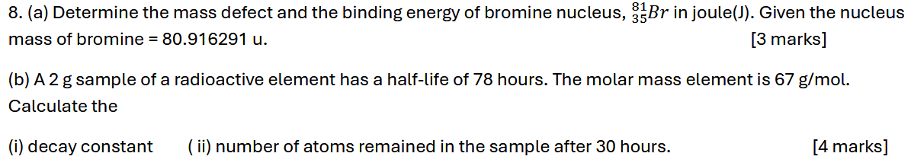
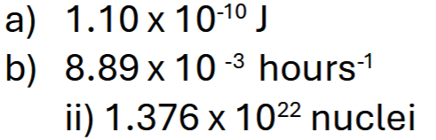
Notes:
C

Slide 2
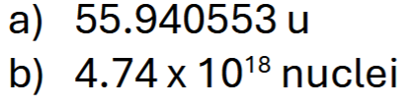
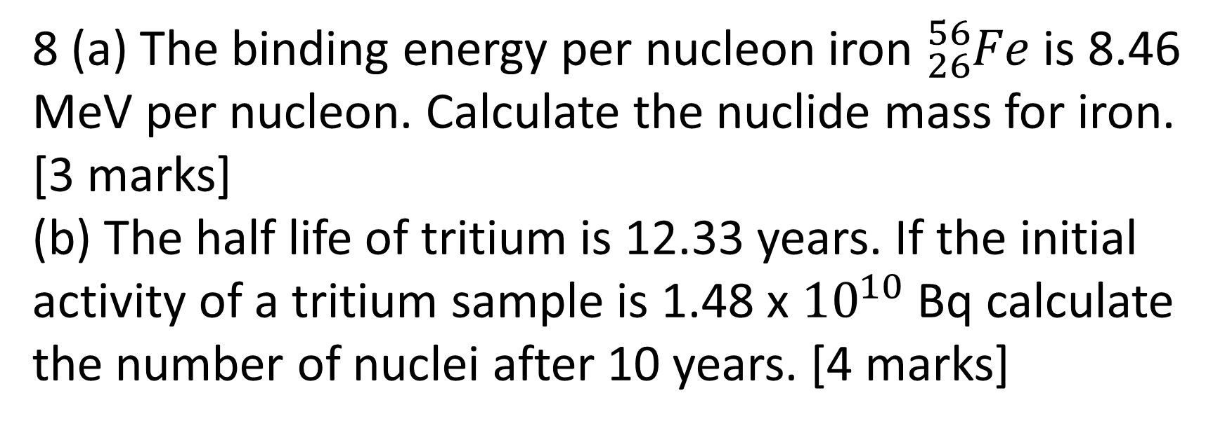
8 (a) The binding energy per nucleon iron ${}_{26}^{56}{Fe}$ is 8.46 MeV per nucleon. Calculate the nuclide mass for iron.
[3 marks]
(b) The half life of tritium is 12.33 years. If the initial activity of a tritium sample is 1.48 x ${10}^{10}$ Bq calculate the number of nuclei after 10 years. [4 marks]
Notes:
$$0.6μJ$$

Slide 3
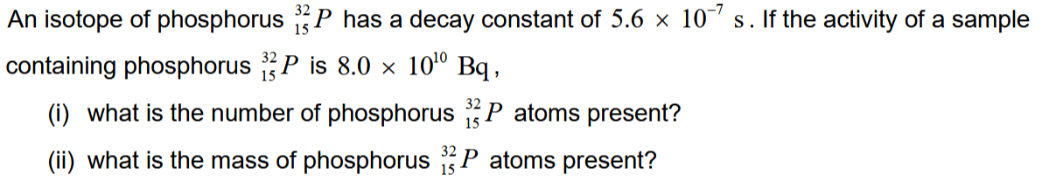
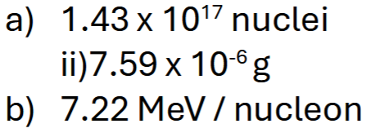
Notes:
$$0.6μJ$$

