Slide 1
The Physics of ٱلصَّلَاةُ
Exploring the Science Behind Islamic Prayer Movements

Slide 2
Introduction
ٱلصَّلَاةُ: A fundamental pillar of Islam

Slide 3
Introduction
ٱلصَّلَاةُ: A fundamental pillar of Islam
"O ye who believe! bow down, prostrate yourselves, and adore your Lord; and do good; that ye may prosper." (Quran 22:77)

Slide 4
Introduction
ٱلصَّلَاةُ: A fundamental pillar of Islam
"O ye who believe! bow down, prostrate yourselves, and adore your Lord; and do good; that ye may prosper." (Quran 22:77)
Goal today?
Bite Sized Scientific Backed Chunks for you to bring home and Ponder.

Slide 5
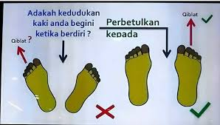
Mechanics of Solat, قِيَام
Notes:
Knee Joint: When the body is fully straight in Qiyam, the knees are in a more neutral position with less flexion. This reduces the moment arm (distance from the knee to the point where force is applied) and thus the torque acting on the knee. The smaller the angle of flexion, the less torque is created at the knee joint.
Hip Joint: In a fully straight posture, the body's center of mass is more aligned over the hips. This reduces any forward lean (the angle θ) and decreases the torque on the hip joint. The more upright the body, the shorter the distance from the hip to the center of mass, and the smaller the force component acting around the joint, which results in lower torque.

Slide 6
Mechanics of Solat, قِيَام
But why?
Why is this the recommended position?
Notes:
Knee Joint: When the body is fully straight in Qiyam, the knees are in a more neutral position with less flexion. This reduces the moment arm (distance from the knee to the point where force is applied) and thus the torque acting on the knee. The smaller the angle of flexion, the less torque is created at the knee joint.
Hip Joint: In a fully straight posture, the body's center of mass is more aligned over the hips. This reduces any forward lean (the angle θ) and decreases the torque on the hip joint. The more upright the body, the shorter the distance from the hip to the center of mass, and the smaller the force component acting around the joint, which results in lower torque.

Slide 7
Mechanics of Solat, قِيَام
But why?
Why is this the recommended position?
Torsional
Force
Notes:
Knee Joint: When the body is fully straight in Qiyam, the knees are in a more neutral position with less flexion. This reduces the moment arm (distance from the knee to the point where force is applied) and thus the torque acting on the knee. The smaller the angle of flexion, the less torque is created at the knee joint.
Hip Joint: In a fully straight posture, the body's center of mass is more aligned over the hips. This reduces any forward lean (the angle θ) and decreases the torque on the hip joint. The more upright the body, the shorter the distance from the hip to the center of mass, and the smaller the force component acting around the joint, which results in lower torque.

Slide 8

Mechanics of Solat, قِيَام
Knee Direction
Ankle Direction
$$θ$$
But why?
Why is this the recommended position?
Torsional
Force
Notes:
Knee Joint: When the body is fully straight in Qiyam, the knees are in a more neutral position with less flexion. This reduces the moment arm (distance from the knee to the point where force is applied) and thus the torque acting on the knee. The smaller the angle of flexion, the less torque is created at the knee joint.
Hip Joint: In a fully straight posture, the body's center of mass is more aligned over the hips. This reduces any forward lean (the angle θ) and decreases the torque on the hip joint. The more upright the body, the shorter the distance from the hip to the center of mass, and the smaller the force component acting around the joint, which results in lower torque.

Slide 9
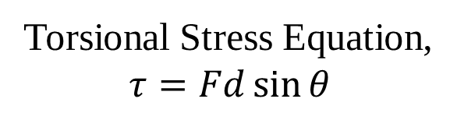
Mechanics of Solat, قِيَام
Knee Direction
Ankle Direction
$$θ$$
But why?
Why is this the recommended position?
Torsional Stress Equation,
$$τ=Fd\sin{θ}$$
Torsional
Force
Notes:
Knee Joint: When the body is fully straight in Qiyam, the knees are in a more neutral position with less flexion. This reduces the moment arm (distance from the knee to the point where force is applied) and thus the torque acting on the knee. The smaller the angle of flexion, the less torque is created at the knee joint.
Hip Joint: In a fully straight posture, the body's center of mass is more aligned over the hips. This reduces any forward lean (the angle θ) and decreases the torque on the hip joint. The more upright the body, the shorter the distance from the hip to the center of mass, and the smaller the force component acting around the joint, which results in lower torque.

Slide 10
Mechanics of Solat, قِيَام
Knee Direction
Ankle Direction
$$θ$$
But why?
Why is this the recommended position?
Torsional Stress Equation,
$$τ=Fd\sin{θ}$$
Torsional
Force
Larger Angle,
Larger Stress.
Notes:
Knee Joint: When the body is fully straight in Qiyam, the knees are in a more neutral position with less flexion. This reduces the moment arm (distance from the knee to the point where force is applied) and thus the torque acting on the knee. The smaller the angle of flexion, the less torque is created at the knee joint.
Hip Joint: In a fully straight posture, the body's center of mass is more aligned over the hips. This reduces any forward lean (the angle θ) and decreases the torque on the hip joint. The more upright the body, the shorter the distance from the hip to the center of mass, and the smaller the force component acting around the joint, which results in lower torque.

Slide 11
Mechanics of Solat, قِيَام
Knee Direction
Ankle Direction
$$θ$$
Osteoarthritis
But why?
Why is this the recommended position?
Torsional Stress Equation,
$$τ=Fd\sin{θ}$$
Torsional
Force
Larger Angle,
Larger Stress.
Notes:
Knee Joint: When the body is fully straight in Qiyam, the knees are in a more neutral position with less flexion. This reduces the moment arm (distance from the knee to the point where force is applied) and thus the torque acting on the knee. The smaller the angle of flexion, the less torque is created at the knee joint.
Hip Joint: In a fully straight posture, the body's center of mass is more aligned over the hips. This reduces any forward lean (the angle θ) and decreases the torque on the hip joint. The more upright the body, the shorter the distance from the hip to the center of mass, and the smaller the force component acting around the joint, which results in lower torque.

Slide 12
Mechanics of Solat, قِيَام
Knee Direction
Ankle Direction
$$θ$$
But why?
Why is this the recommended position?
Torsional Stress Equation,
$$τ=Fd\sin{θ}$$
Torsional
Force
Larger Angle,
Larger Stress.
Increasing Risks of Osteoarthritis
Notes:
Knee Joint: When the body is fully straight in Qiyam, the knees are in a more neutral position with less flexion. This reduces the moment arm (distance from the knee to the point where force is applied) and thus the torque acting on the knee. The smaller the angle of flexion, the less torque is created at the knee joint.
Hip Joint: In a fully straight posture, the body's center of mass is more aligned over the hips. This reduces any forward lean (the angle θ) and decreases the torque on the hip joint. The more upright the body, the shorter the distance from the hip to the center of mass, and the smaller the force component acting around the joint, which results in lower torque.

Slide 13
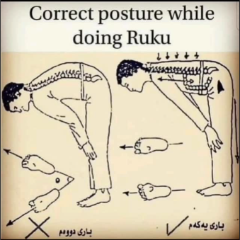
Mechanics of Solat, رُكوع
Why is it important to keep your back straight?
Notes:
Abu Mas`ud Al-Badri, who said: The Messenger of Allah (peace and blessings be upon him) said: "A man's Salah is not valid until he straightens his back in bowing and prostration."
Reported by Abu Dawud (855), At-Tirmidhi (265) who said it is sound and authentic, An-Nasa’i (1027), and Ibn Majah (870).

Slide 14
Mechanics of Solat, رُكوع
Abu Mas`ud Al-Badri, who said: The Messenger of Allah (peace and blessings be upon him) said: "A man's Salah is not valid until he straightens his back in bowing and prostration."
Reported by Abu Dawud (855), At-Tirmidhi (265) who said it is sound and authentic, An-Nasa’i (1027), and Ibn Majah (870).
Why is it important to keep your back straight?
Notes:
Abu Mas`ud Al-Badri, who said: The Messenger of Allah (peace and blessings be upon him) said: "A man's Salah is not valid until he straightens his back in bowing and prostration."
Reported by Abu Dawud (855), At-Tirmidhi (265) who said it is sound and authentic, An-Nasa’i (1027), and Ibn Majah (870).

Slide 15
Mechanics of Solat, رُكوع
Why is it important to keep your back straight?
Notes:
proper spinal alignment during Ruku (i.e., keeping the back straight and neutral) minimizes the torque acting on the lumbar spine, which reduces muscular strain and the risk of injury. When the spine is curved (e.g., during lumbar flexion), the moment arm increases, resulting in higher torque that the back muscles must resist. This highlights the importance of maintaining a straight back during Ruku to optimize biomechanical efficiency and minimize strain on the spine.
In summary, the center of mass in the Ruku position is located close to the pelvic area, slightly above the sacrum, and about 0.5 meters from the lumbar spine. This is an approximation for an average adult person during Ruku, and the distance can vary slightly depending on individual body proportions.

Slide 16
Mechanics of Solat, رُكوع
Spinal Alignment in Ruku, Torque on Spine
Hip Flexion vs Lumbar Flexion
Why is it important to keep your back straight?
Notes:
proper spinal alignment during Ruku (i.e., keeping the back straight and neutral) minimizes the torque acting on the lumbar spine, which reduces muscular strain and the risk of injury. When the spine is curved (e.g., during lumbar flexion), the moment arm increases, resulting in higher torque that the back muscles must resist. This highlights the importance of maintaining a straight back during Ruku to optimize biomechanical efficiency and minimize strain on the spine.
In summary, the center of mass in the Ruku position is located close to the pelvic area, slightly above the sacrum, and about 0.5 meters from the lumbar spine. This is an approximation for an average adult person during Ruku, and the distance can vary slightly depending on individual body proportions.

Slide 17
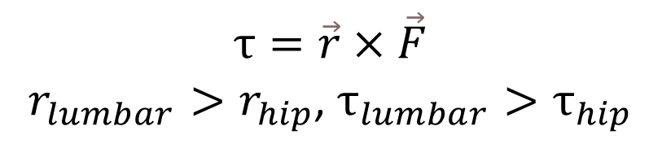
Mechanics of Solat, رُكوع
Spinal Alignment in Ruku, Torque on Spine
Hip Flexion vs Lumbar Flexion
$$τ=\vec{r}×\vec{F}$$
$r_{lumbar}>r_{hip}$, $τ_{lumbar}>τ_{hip}$
Why is it important to keep your back straight?
Notes:
proper spinal alignment during Ruku (i.e., keeping the back straight and neutral) minimizes the torque acting on the lumbar spine, which reduces muscular strain and the risk of injury. When the spine is curved (e.g., during lumbar flexion), the moment arm increases, resulting in higher torque that the back muscles must resist. This highlights the importance of maintaining a straight back during Ruku to optimize biomechanical efficiency and minimize strain on the spine.
In summary, the center of mass in the Ruku position is located close to the pelvic area, slightly above the sacrum, and about 0.5 meters from the lumbar spine. This is an approximation for an average adult person during Ruku, and the distance can vary slightly depending on individual body proportions.

Slide 18
Mechanics of Solat, رُكوع
Spinal Alignment in Ruku, Torque on Spine
Hip Flexion vs Lumbar Flexion
Slipped Disc
$$τ=\vec{r}×\vec{F}$$
$r_{lumbar}>r_{hip}$, $τ_{lumbar}>τ_{hip}$
Why is it important to keep your back straight?
Notes:
proper spinal alignment during Ruku (i.e., keeping the back straight and neutral) minimizes the torque acting on the lumbar spine, which reduces muscular strain and the risk of injury. When the spine is curved (e.g., during lumbar flexion), the moment arm increases, resulting in higher torque that the back muscles must resist. This highlights the importance of maintaining a straight back during Ruku to optimize biomechanical efficiency and minimize strain on the spine.
In summary, the center of mass in the Ruku position is located close to the pelvic area, slightly above the sacrum, and about 0.5 meters from the lumbar spine. This is an approximation for an average adult person during Ruku, and the distance can vary slightly depending on individual body proportions.

Slide 19
Mechanics of Solat, رُكوع
Spinal Alignment in Ruku, Torque on Spine
Hip Flexion vs Lumbar Flexion
$$τ=\vec{r}×\vec{F}$$
$r_{lumbar}>r_{hip}$, $τ_{lumbar}>τ_{hip}$
Less strain on the spine
Slipped Disc
Why is it important to keep your back straight?
Notes:
proper spinal alignment during Ruku (i.e., keeping the back straight and neutral) minimizes the torque acting on the lumbar spine, which reduces muscular strain and the risk of injury. When the spine is curved (e.g., during lumbar flexion), the moment arm increases, resulting in higher torque that the back muscles must resist. This highlights the importance of maintaining a straight back during Ruku to optimize biomechanical efficiency and minimize strain on the spine.
In summary, the center of mass in the Ruku position is located close to the pelvic area, slightly above the sacrum, and about 0.5 meters from the lumbar spine. This is an approximation for an average adult person during Ruku, and the distance can vary slightly depending on individual body proportions.

Slide 20
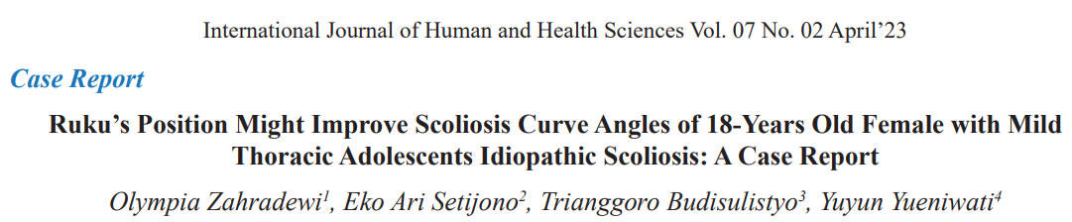
Mechanics of Solat, رُكوع
Maintaining straight back in ruku’ is so important that…
From the study:
“In this study, it was found that doing daily prayer in everyday life and performing the movement of Ruku’ properly can improve vertebral column position.”
“With the correlation of the data above that shows the consistency and lots of amount, it will deform scoliosis back to the normal shape faster than the ones that didn’t. ”

Slide 21
Mechanics of Solat, رُكوع
Maintaining straight back in ruku’ is so important that…
Sakit Skoliosis boleh sembuh
From the study:
“In this study, it was found that doing daily prayer in everyday life and performing the movement of Ruku’ properly can improve vertebral column position.”
“With the correlation of the data above that shows the consistency and lots of amount, it will deform scoliosis back to the normal shape faster than the ones that didn’t. ”

Slide 22
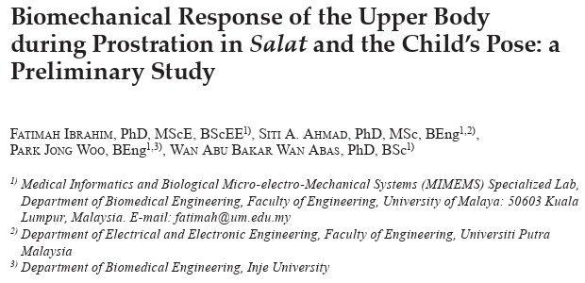
Mechanics of Solat, سُجُود
https://eprints.um.edu.my/9267/
Notes:
EMG activity higher than that during the child’s pose was generated in the triceps brachii during prostration. This is expected as prostration requires one to bend the elbows, which would generate higher muscle activity.
We observed that the muscles were activated when there was a change from the sitting position (initial posture) to prostration. This action may help to strengthen the abdominal and spinal muscles. In fact, postures similar to prostration have been suggested as exercise therapy for patients with scoliosis,
Salat has a musculoskeletal effect similar to a stretching exercise.

Slide 23
Mechanics of Solat, سُجُود
Purpose? Sujud
vs
Child’s Pose
https://eprints.um.edu.my/9267/
Notes:
EMG activity higher than that during the child’s pose was generated in the triceps brachii during prostration. This is expected as prostration requires one to bend the elbows, which would generate higher muscle activity.
We observed that the muscles were activated when there was a change from the sitting position (initial posture) to prostration. This action may help to strengthen the abdominal and spinal muscles. In fact, postures similar to prostration have been suggested as exercise therapy for patients with scoliosis,
Salat has a musculoskeletal effect similar to a stretching exercise.

Slide 24
Mechanics of Solat, سُجُود
Purpose? Sujud vs Child’s Pose
Method?
Electromyographic Signals from upper body muscles measured
https://eprints.um.edu.my/9267/
Notes:
EMG activity higher than that during the child’s pose was generated in the triceps brachii during prostration. This is expected as prostration requires one to bend the elbows, which would generate higher muscle activity.
We observed that the muscles were activated when there was a change from the sitting position (initial posture) to prostration. This action may help to strengthen the abdominal and spinal muscles. In fact, postures similar to prostration have been suggested as exercise therapy for patients with scoliosis,
Salat has a musculoskeletal effect similar to a stretching exercise.

Slide 25
Mechanics of Solat, سُجُود
Purpose? Sujud vs Child’s Pose
Method? Electromyographic Signals from upper body muscles measured
Results?
https://eprints.um.edu.my/9267/
Notes:
EMG activity higher than that during the child’s pose was generated in the triceps brachii during prostration. This is expected as prostration requires one to bend the elbows, which would generate higher muscle activity.
We observed that the muscles were activated when there was a change from the sitting position (initial posture) to prostration. This action may help to strengthen the abdominal and spinal muscles. In fact, postures similar to prostration have been suggested as exercise therapy for patients with scoliosis,
Salat has a musculoskeletal effect similar to a stretching exercise.

Slide 26

IKLAN
Harga Kelas Yoga/Pilates di Kuching!
https://eprints.um.edu.my/9267/
Notes:
Harga Kelas Yoga/Pilates di Kuching!

Slide 27
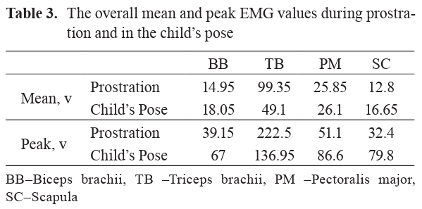
Mechanics of Solat, سُجُود
Purpose? Sujud vs Child’s Pose
Method? Electromyographic Signals from upper body muscles measured
Results?
https://eprints.um.edu.my/9267/
Notes:
EMG activity higher than that during the child’s pose was generated in the triceps brachii during prostration. This is expected as prostration requires one to bend the elbows, which would generate higher muscle activity.
We observed that the muscles were activated when there was a change from the sitting position (initial posture) to prostration. This action may help to strengthen the abdominal and spinal muscles. In fact, postures similar to prostration have been suggested as exercise therapy for patients with scoliosis,
Salat has a musculoskeletal effect similar to a stretching exercise.

Slide 28
Mechanics of Solat, سُجُود
Purpose? Sujud vs Child’s Pose
Method? Electromyographic Signals from upper body muscles measured
Jimat Duit,
Solat je
Results?
https://eprints.um.edu.my/9267/
Notes:
EMG activity higher than that during the child’s pose was generated in the triceps brachii during prostration. This is expected as prostration requires one to bend the elbows, which would generate higher muscle activity.
We observed that the muscles were activated when there was a change from the sitting position (initial posture) to prostration. This action may help to strengthen the abdominal and spinal muscles. In fact, postures similar to prostration have been suggested as exercise therapy for patients with scoliosis,
Salat has a musculoskeletal effect similar to a stretching exercise.

Slide 29
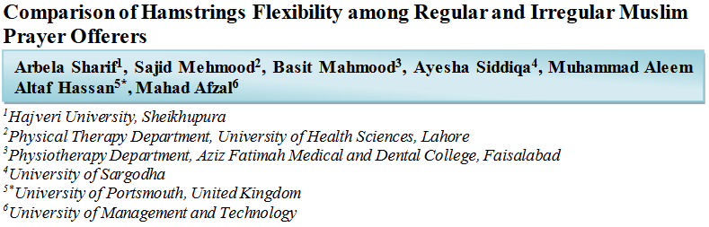
Other studies related to Solat!
The study concluded that Ruku's posture has a significant positive effect on hamstring flexibility.

Slide 30
Other studies related to Solat!
Solat kuatkan Hamstring
The study concluded that Ruku's posture has a significant positive effect on hamstring flexibility.

Slide 31

Other studies related to Solat!
In summary, muscle strength is an important marker and a potential cause of mortality risk in old women. Monitoring the rate of decline in grip and hip flexion strength in addition to the absolute levels may greatly improve the identification of women most at risk of dying.

Slide 32
Other studies related to Solat!
Kaki kuat, risiko mati rendah
In summary, muscle strength is an important marker and a potential cause of mortality risk in old women. Monitoring the rate of decline in grip and hip flexion strength in addition to the absolute levels may greatly improve the identification of women most at risk of dying.

Slide 33
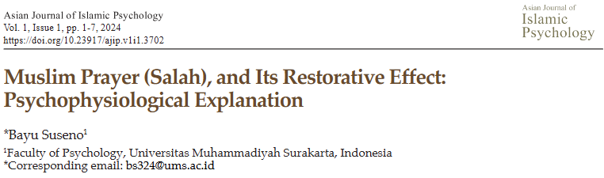
Other studies related to Solat!
Physiologically, salah makes the PNS activity higher and SNS activity lower, and the brainwave, namely alpha, which is part of CNS and related to relaxed conditions, is higher.
Interestingly, the relaxation effect of salah is higher in the prostration position.

Slide 34
Other studies related to Solat!
Relax
Physiologically, salah makes the PNS activity higher and SNS activity lower, and the brainwave, namely alpha, which is part of CNS and related to relaxed conditions, is higher.
Interestingly, the relaxation effect of salah is higher in the prostration position.

Slide 35
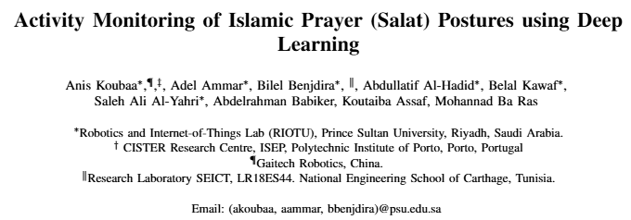
Other studies related to Solat!
We propose to develop an artificial intelligence assistive framework that guides worshippers to evaluate the correctness of the postures of their prayers. This paper represents the first step to achieve this objective and addresses the problem of the recognition of the basic gestures of Islamic prayer using Convolutional Neural Networks (CNN).

Slide 36
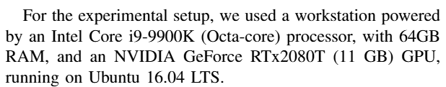
Other studies related to Solat!
What PC set up did they use to achieve this?

Slide 37
Other studies related to Solat!
Mahal, ikut je kelas ustaz
What PC set up did they use to achieve this?

Slide 38
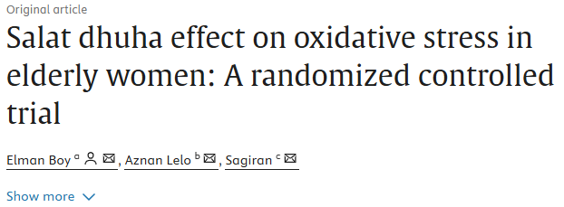
Other studies related to Solat!
The result of this study showed that mild to moderate intensity physical activity in the form of 8 rakaat of Salat dhuha significantly reduces oxidative stress, leading to better antioxidant protection in elderly women.

Slide 39
Other studies related to Solat!
Solat Awet Muda
The result of this study showed that mild to moderate intensity physical activity in the form of 8 rakaat of Salat dhuha significantly reduces oxidative stress, leading to better antioxidant protection in elderly women.

Slide 40
Sekian, Terima Kasih.

