Slide 1
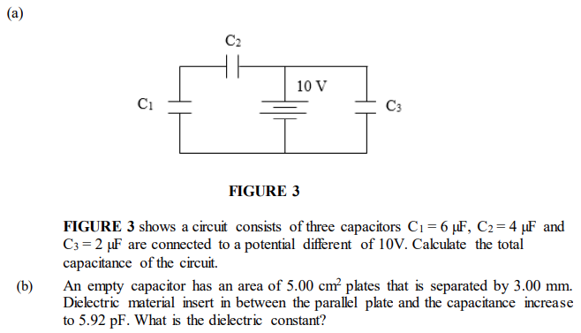
[$4.4μF$; 4]
Notes:
[$4.4μF$; 4]

Slide 2
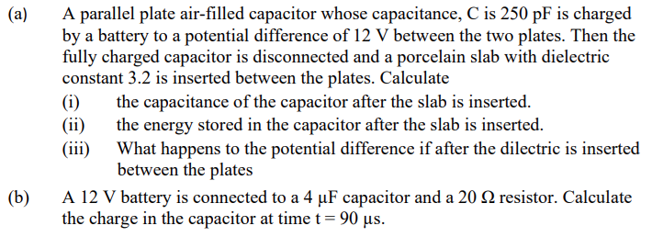
[0.8$nF$; 5.62$nJ$; decrease, 32.5$μC$]
Notes:
[0.8$nF$; 5.62$nJ$; decrease, 32.5$μC$]

Slide 3
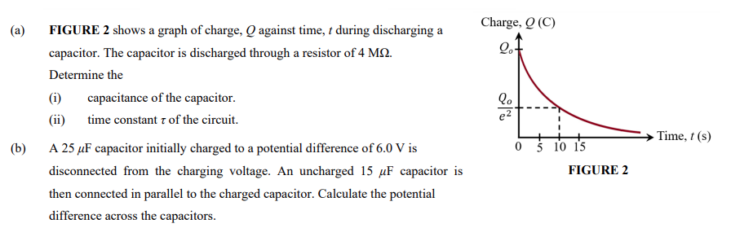
[1.25$μF$; 5s; 3.75V]
Notes:
[1.25$μF$; 5s; 3.75V]

Slide 4
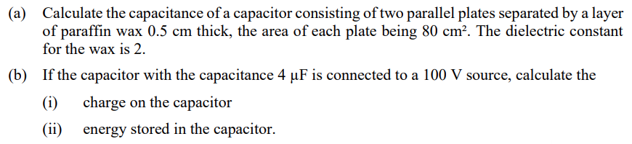
[28.3pF; 0.4mC; 0.02J]
Notes:
[28.3pF; 0.4mC; 0.02J]

Slide 5
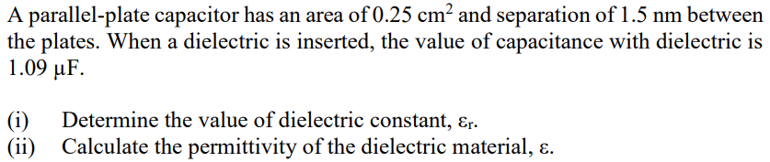
[7.39, $6.54×{10}^{−11}Fm^{−1}$]
Notes:
[7.39, $6.54×{10}^{−11}Fm^{−1}$]

Slide 6
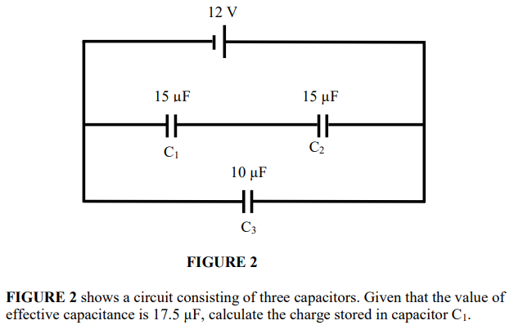
[$0.9×{10}^{−4}C$]
Notes:
[$0.9×{10}^{−4}C$]

Slide 7
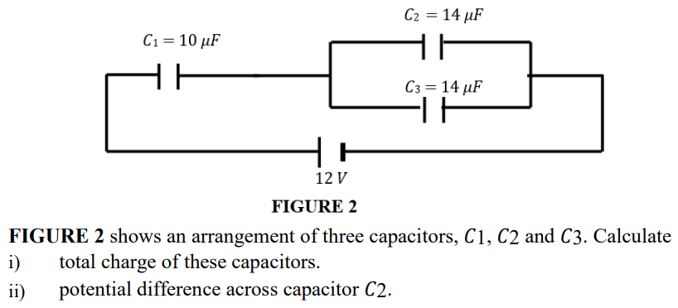
[$88.5μC$, 3.15V]
Notes:
[$88.5μC$, 3.15V]

Slide 8
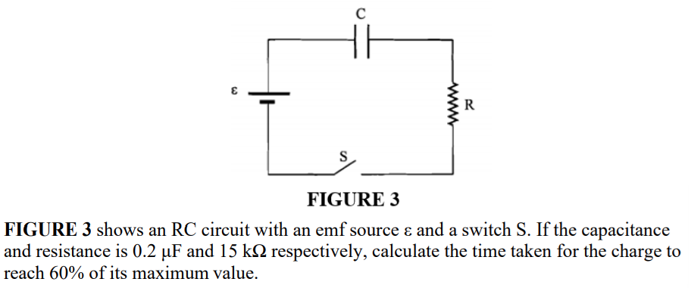
[2.75ms]
Notes:
[2.75ms]

Slide 9
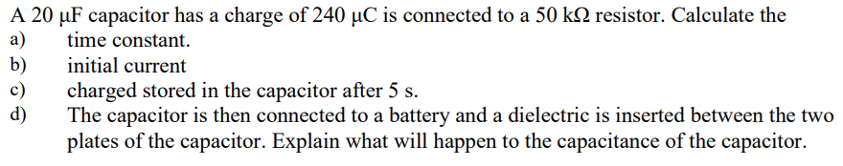
[1s, 0.24mA, 1.62$μC$; increase]
Notes:
[1s, 0.24mA, 1.62$μC$; increase]

Slide 10
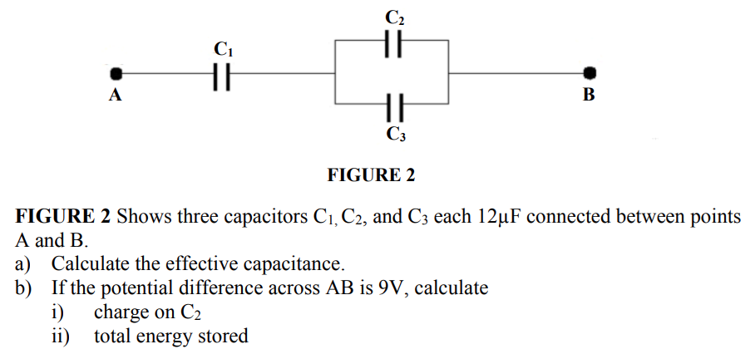
[8$μF$; 36$μC$; 0.324mJ
Notes:
[8$μF$; 36$μC$; 0.324mJ]

