Slide 1
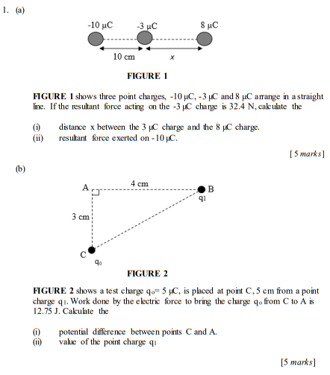
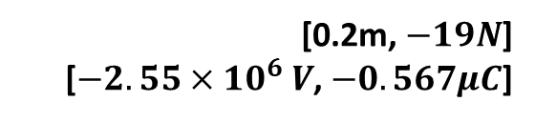
[0.2m, $−19N$]
[$−2.55×{10}^{6} V$, $−0.567μC$]
Notes:
[0.2m, $−19N$]
[$−2.55×{10}^{6} V$, $−0.567μC$]

Slide 2
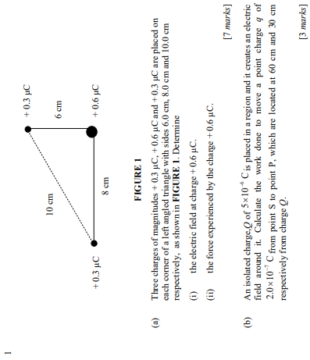
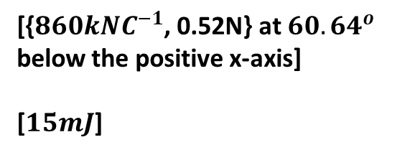
[{$860kNC^{−1}$, 0.52N} at ${60.64}^{o}$ below the positive x-axis]
[$15mJ$]
Notes:
[{$860kNC^{−1}$, 0.52N} at ${60.64}^{o}$ below the positive x-axis]
[$15mJ$]

Slide 3
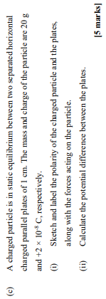
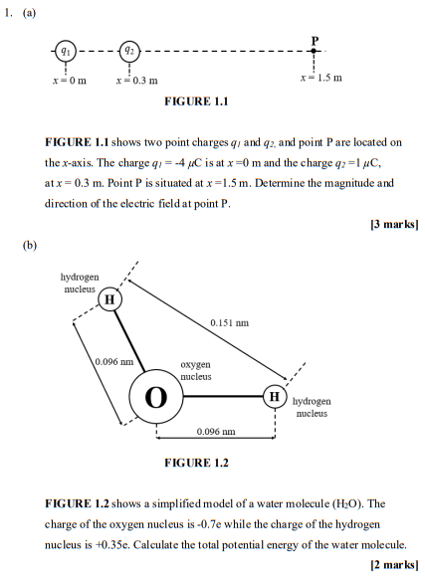
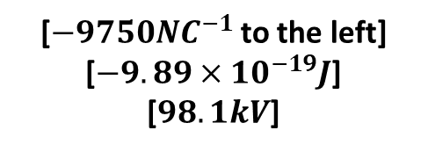
[$−9750NC^{−1}$ to the left]
[$−9.89×{10}^{−19}J$]
[$98.1kV$]
Notes:
[$−9750NC^{−1}$ to the left]
[$−9.89×{10}^{−19}J$]
[$98.1kV$]

Slide 4
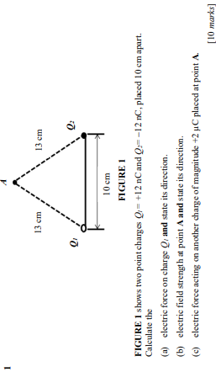
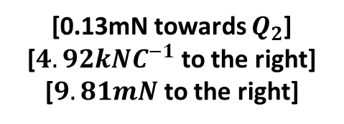
[0.13mN towards $Q_{2}$]
[$4.92kNC^{−1}$ to the right]
[$9.81mN$ to the right]
Notes:
[0.13mN towards $Q_{2}$]
[$4.92kNC^{−1}$ to the right]
[$9.81mN$ to the right]

Slide 5
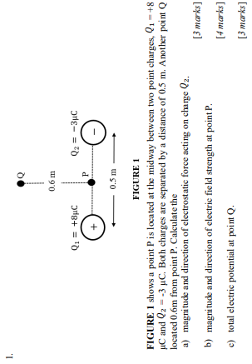
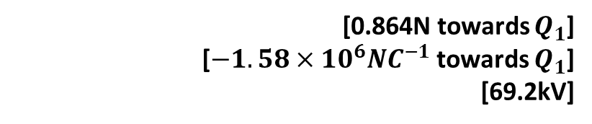
[0.864N towards $Q_{1}$]
[$−1.58×{10}^{6}NC^{−1}$ towards $Q_{1}$]
[69.2kV]
Notes:
[0.864N towards $Q_{1}$]
[$−1.58×{10}^{6}NC^{−1}$ towards $Q_{1}$]
[69.2kV]

