Slide 1
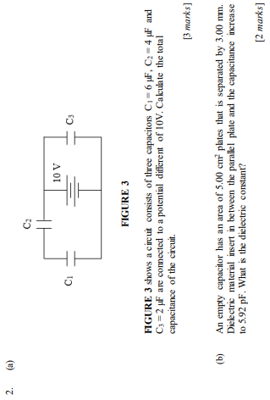

$$[4.4μF, 4]$$
Notes:
[$4.4μF$, 4]

Slide 2
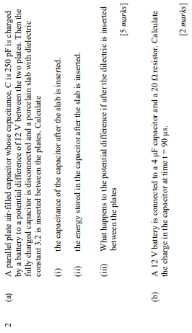
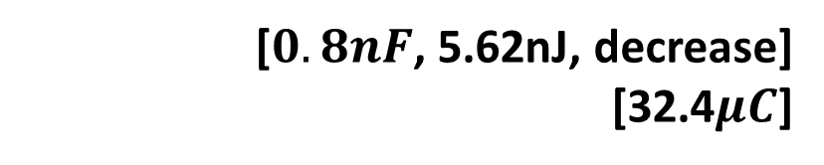
[$0.8nF$, 5.62nJ, decrease]
[32.4$μC$]

Slide 3
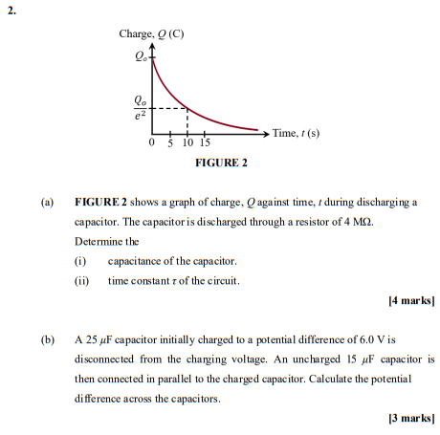
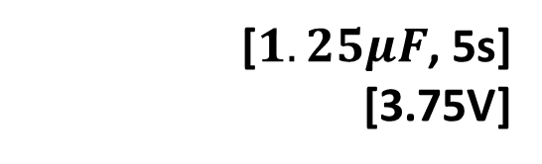
[$1.25μF$, 5s]
[3.75V]

Slide 4
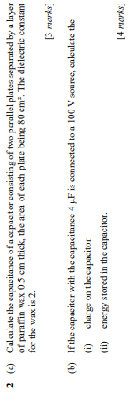
[28.3pF]
[0.4mC, 0.02J]

Slide 5
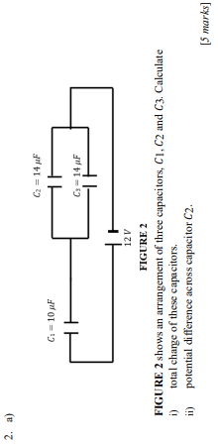
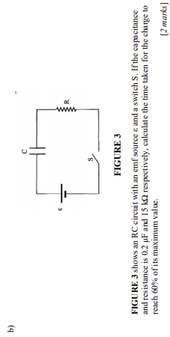
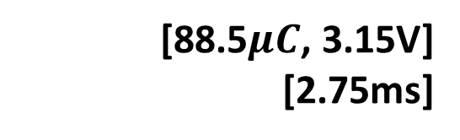
[88.5$μC$, 3.15V]
[2.75ms]

