Slide 1
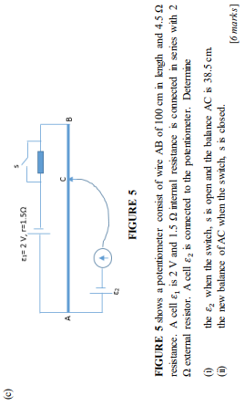
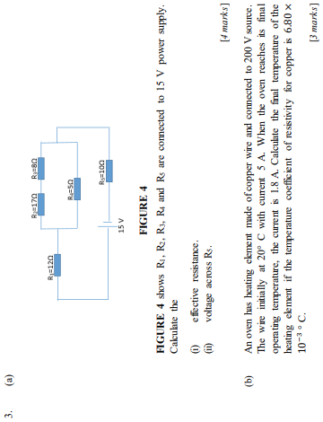
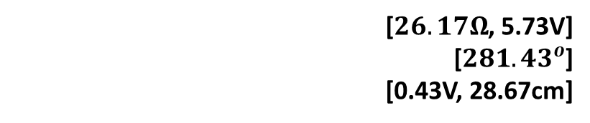
[$26.17Ω$, 5.73V]
[${281.43}^{o}$]
[0.43V, 28.67cm]
Notes:
[$26.17Ω$, 5.73V]
[${281.43}^{o}$]
[0.43V, 28.67cm]

Slide 2
Notes:
[(a) −2.42 × ${10}^{6}$ V (b) 123.25 × ${10}^{6}$ N C−1, −75.1°]

Slide 3
Notes:
[(a) −2.42 × ${10}^{6}$ V (b) 123.25 × ${10}^{6}$ N C−1, −75.1°]

Slide 4
Notes:
[(a) −2.42 × ${10}^{6}$ V (b) 123.25 × ${10}^{6}$ N C−1, −75.1°]

Slide 5
Notes:
[(a) −2.42 × ${10}^{6}$ V (b) 123.25 × ${10}^{6}$ N C−1, −75.1°]

Slide 6
Notes:
[(a) −2.42 × ${10}^{6}$ V (b) 123.25 × ${10}^{6}$ N C−1, −75.1°]

Slide 7
Notes:
[(a) −2.42 × ${10}^{6}$ V (b) 123.25 × ${10}^{6}$ N C−1, −75.1°]

