Slide 1

Perincian Keperluan Jawatankuasa
Jawatankuasa Peraturan & Pertandingan
Notes:
Jawatankuasa Peraturan & Pertandingan

Slide 2
Who can join what?
3 categories:
Open Group - Physical Race
Closed* Group - Physical Race
Closed* Group - Simulator Race
*Closed Group refers to participation by Matriculation students only.

Slide 3

Who will be in charge?
Physical Races $⇒$ Mr Fauzi & Mr Faridzamani
Simulator Races $⇒$ Mr Shafiq & Madam Hamsiah

Slide 4
On Simulator Races
Notes:
Time attack refers to the

Slide 5
How many pilots are we expecting?
30.
2 pilots per participating college

Slide 6
What facility will we have to run our races?
2* PC stations in the CENTEXS game room
*This will depend our collaborators as it will be a shared facility.

Slide 7

How will the simulator race be conducted?
Format $⇒$ Time attack!
Coupon system in taking turns to race.
Notes:
Time attack refers to the

Slide 8
How does the coupon system work?
Every pilot will be provided with 8 coupons.
The coupons allows them to have 1 timed run.
After each coupon usage, the pilot will be asked to re-join the queue from the back.
As a baseline, 1 slot will be allocated for each pilot everyday for the 3 days.
The number of coupons they choose to use every slot will be at their disposal.

Slide 9
Will the pilots have the liberty to change the settings in the races?
No.
Calibrations are fixed and equal for all pilots.

Slide 10
How many volunteers will we need?
4
All 4 as time keepers.
2 on shift at one time.

Slide 11
How are the times judged?
4 out of 8 of the pilot’s timed run will be summed.
Smallest sum ranks first, largest sum ranks last.
In the event of pilots having less than 4 timed races, their ranks will be grouped according to their number of timed races.

Slide 12
Can I have an example?

Slide 13
On Physical Races
Notes:
Time attack refers to the

Slide 14
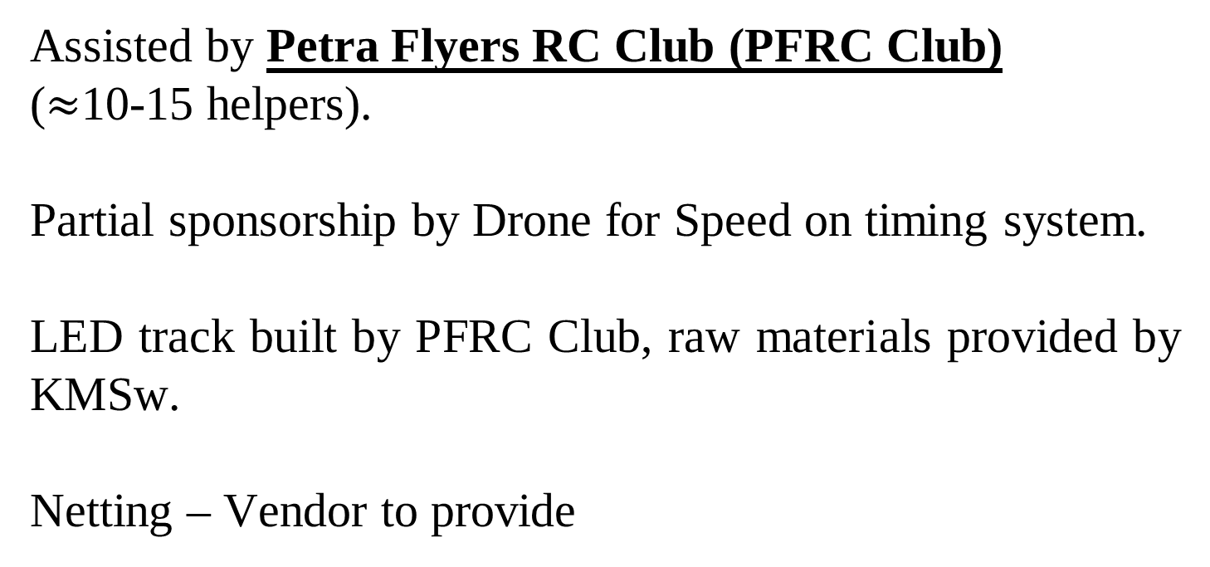
General Info
Assisted by Petra Flyers RC Club (PFRC Club)
($≈$10-15 helpers).
Partial sponsorship by Drone for Speed on timing system.
LED track built by PFRC Club, raw materials provided by KMSw.
Netting – Vendor to provide

Slide 15
Will the run of the races be the same for closed and open category?
Open
Closed
Similarity
2 control practices per pilot
6 heats per pilot
Pilot’s 4 best runs to be considered for next stage
Differences
16 best pilots to next stage (double knockout)
8 best pilots to next stage (single knockout)
Notes:
8 best pilots to next stage (single knockout)

Slide 16
How many volunteers will we need?
8.
4 will be assigned as track martials, to handle drones in the track.
4 will be assigned as mini secretariat, to manage pilots in the waiting area.

Slide 17
Who will be inside the race building?
Track Martials
VIP (should they attend)
JK Dronatrix
Racing Pilots
Next-in-turn Pilots
As there will not be a spectator area, we would like to request for a TV to be provided on the outside of the building for spectators.

Slide 18
What are the prizes like?
Prizes are not included in the original paperwork.
It is requested that the following be the prizes to be awarded:
Ranks | Prize (RM)
First Place | 1000
Second Place | 700
Third Place | 500
Fourth Place | 300
Total | 2500

Slide 19
Schedule Overview
Day | Open Category | Closed Category
1 | No Race Day | Heats for Physical & Simulator
2 | Heats | Heats for Physical & Simulator
3 | Double knockout stage | Semi final for physical race
Closing | Final Races

Slide 20
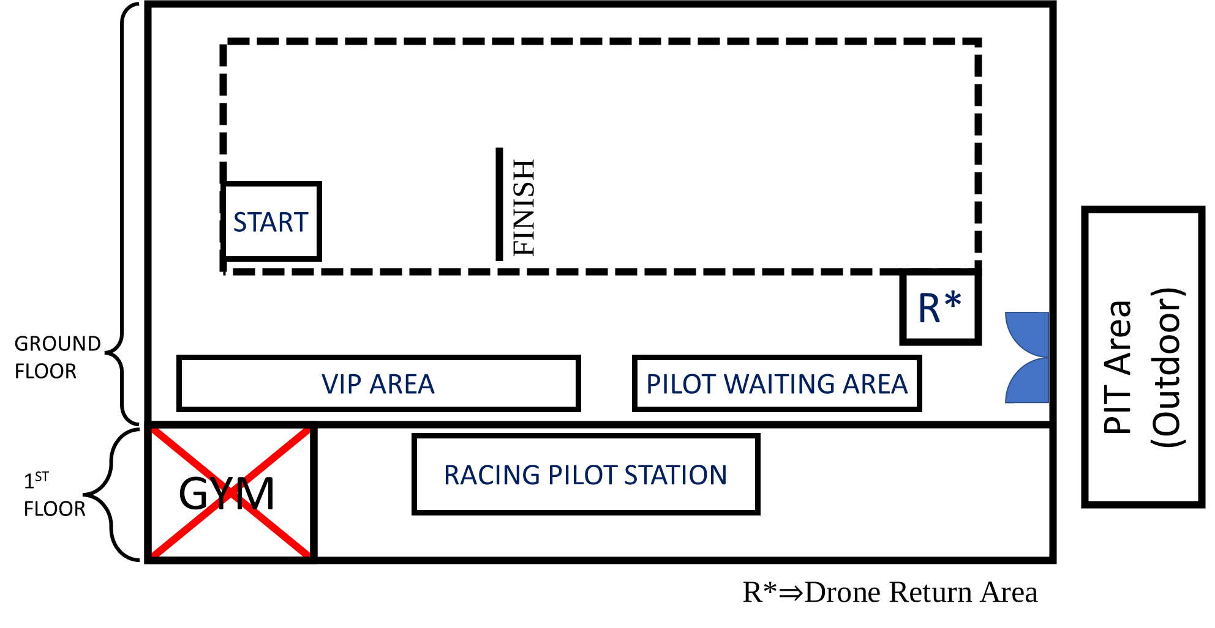
Physical Races Venue Layout

Slide 21
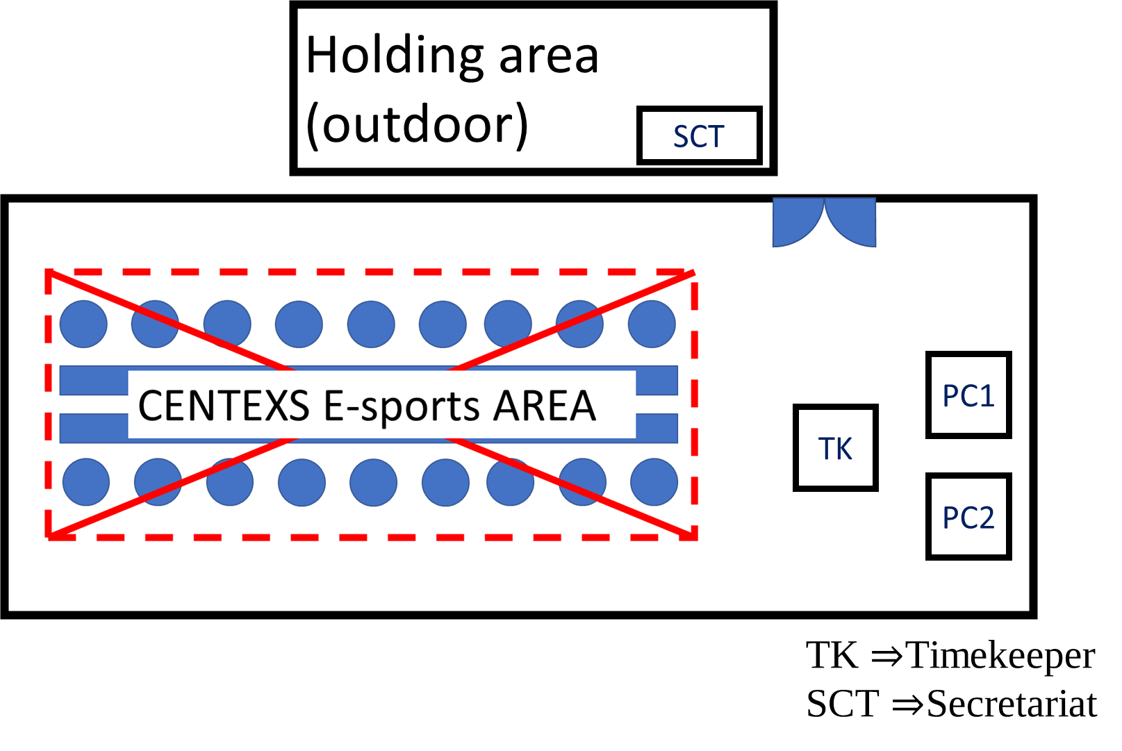
Simulator Races Venue Layout

