Slide 1
Read this document completely before doing anything!
Notes:
Step 1

Slide 2
Part A Questions
Discuss, and make a comparison of, pollution by conventional fossil-fuel power plants and nuclear-fission power plants. Consider thermal pollution, chemical pollution, and radioactive pollution.
A sample has an activity of 0.0061 Bq per gram of carbon.
  Find the age of the sample, assuming that the activity per gram of carbon in a living organism has been constant at a value of 0.23 Bq.
  Evidence suggests that the value of 0.23 Bq might have been as much as 40% larger. Repeat part (a), taking into account this 40% increase.
  A sample is being dated by the radiocarbon technique. If the sample were uncontaminated, its activity would be 0.011 Bq per gram of carbon. Find the true age (in years) of the sample.
  Suppose the sample is contaminated, so that only 98.0% of its carbon is ancient carbon. The remaining 2.0% is fresh carbon, in the sense that the it contains has not had any time to decay. Assuming that the lab technician is unaware of the contamination, what apparent age (in years) would be determined for the sample?
Notes:
Step 1

Slide 3
Part B Questions
For Part B, make sure to type it out in Word and then save as pdf, no handwriting please.
How did using ChatGPT change (or not change) your understanding of the physics concept involved? (Focus on what you understood better, differently, or still found confusing after using ChatGPT.)
When using ChatGPT, were you mainly checking answers, following steps, or actively explaining and questioning ideas? (Describe how you interacted with ChatGPT, not whether you liked it.)
At what point did you realize ChatGPT’s explanation was helpful or insufficient, and what did you do next? (Mention a specific moment when you judged the explanation and how you responded, e.g., asked follow-up questions, stopped using it).)
Did using ChatGPT help you solve similar physics problems on your own afterward? Why or why not? (Think about whether you could apply the idea independently, not just repeat the same steps.)
How did you decide whether ChatGPT’s solution or explanation was correct? (Explain how you checked or evaluated the answer, e.g., equations, logic, units, prior knowledge.)
Notes:
Step 1

Slide 4
How to export your chat?
Notes:
Step 1

Slide 5
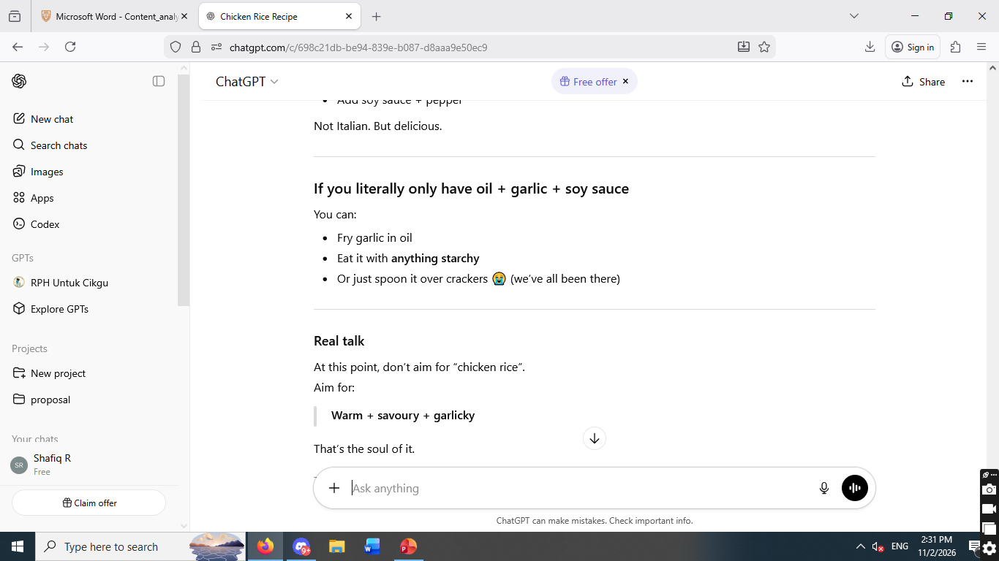
For Part A, Step 1
Notes:
Step 1

Slide 6
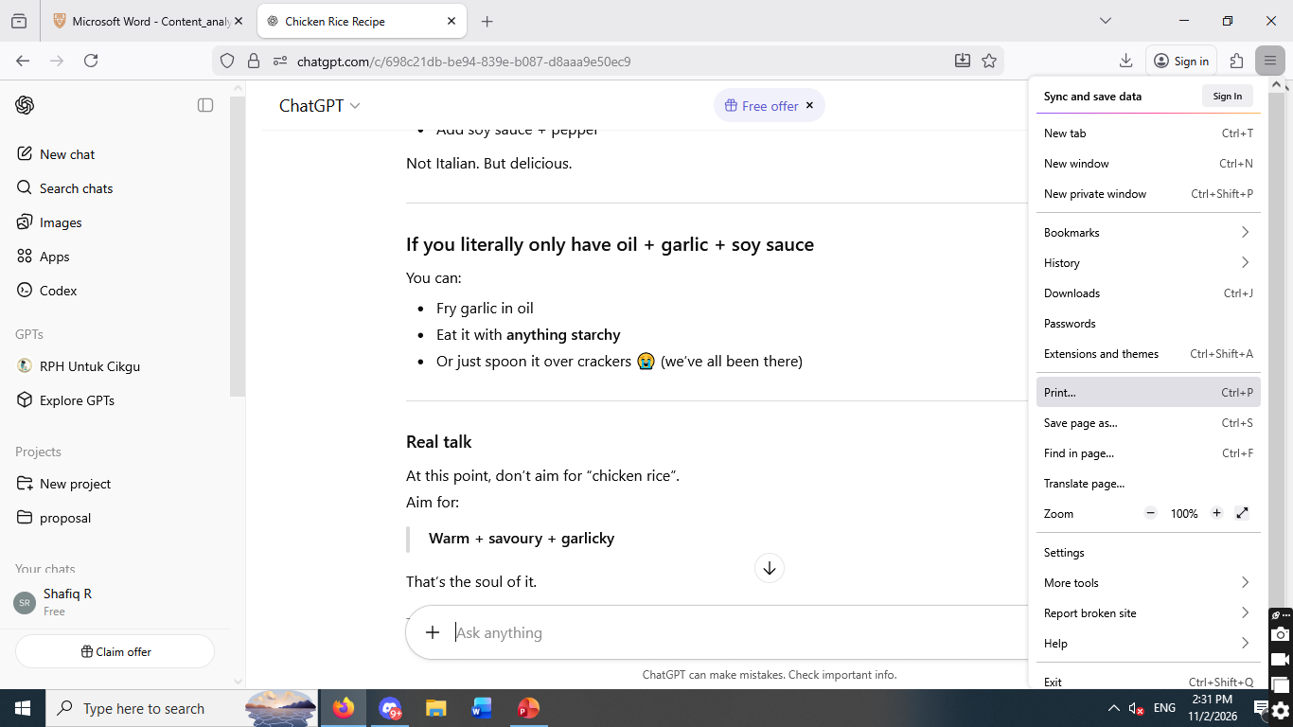
Step 2

Slide 7
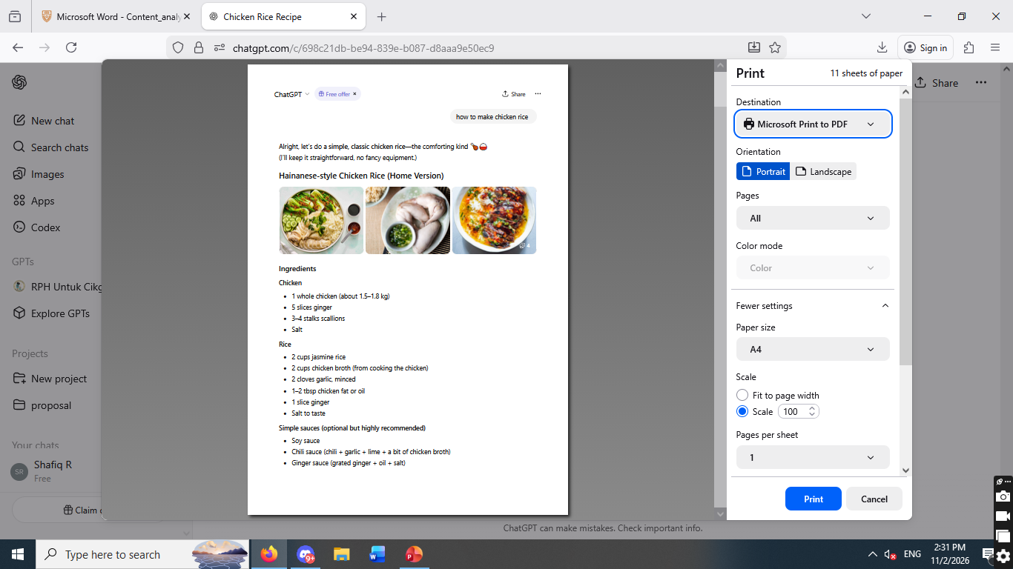
Step 3
Name your file “yourname_partA.pdf”
Notes:
Name your file “yourname_partA.pdf”

Slide 8
For Part B, make sure to type it out in Word and then save as pdf, no handwriting please.

