Slide 1
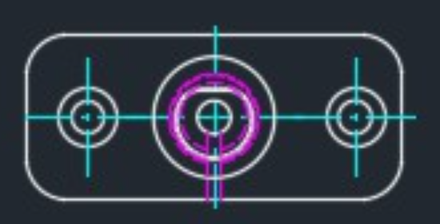
3D Drawing
Feasibility
It is possible to measure different parts of design diagram
But there is no such AI model to detect object from .dwg file
So we can not use any AI model
There is a python lib called “ezdxf” which can detect different types of component like (line, arc, circle, polyline etc.) and measure their length
But “ezdxf” works on “.dxf” file. It can not directly work on “.dwg” file.
So first, we need to convert “.dwg” file to “.dxf” file using “AudoDesk” software.
Then process that file (detect component and measure length) using “ezdxf” lib.
Finally, convert “.dxf” file to original “.dwg” file using “AudoDesk” software.
We, need to apply rule-based methods to handle different scenarios.

Slide 2
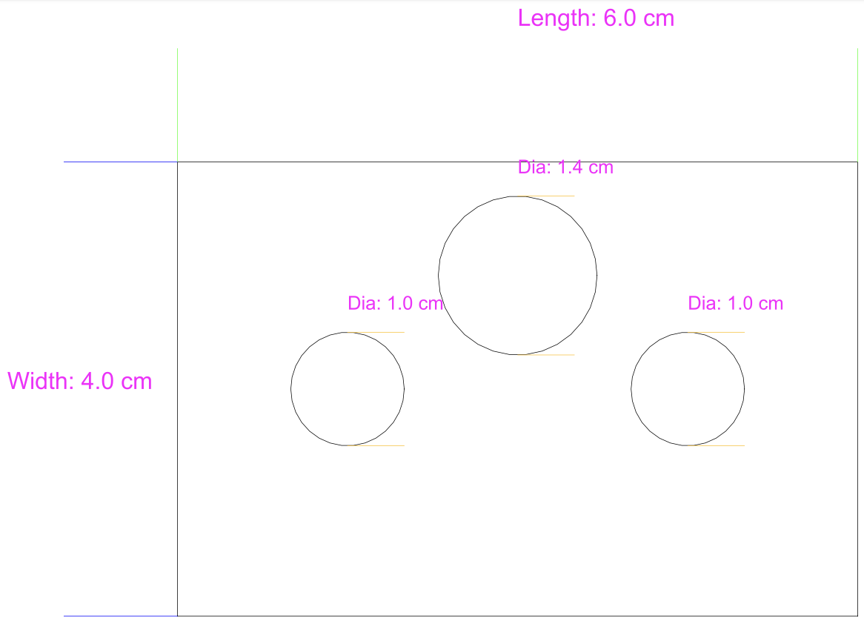
Sample Experiment
I created a sample design diagram using python code and “ezdxf” lib. The diagram consists of a rectangle and 3 circles. Have a look at the right diagram.
I saved the file as .dxf file
Then I load that file in another script and dynamically detected different components (i.e: line, circle) and measured their length.
I put mesurement texts on the components by using bounday lines (green, orange, blue colored lines).
The line weight is very narrow. So it might be difficult to see it.

Slide 3
What is feasible
The following items are feasible to measure:
Line
Cirlcle
Arc
ELLIPSE
POLYLINE
POINT

