Slide 1
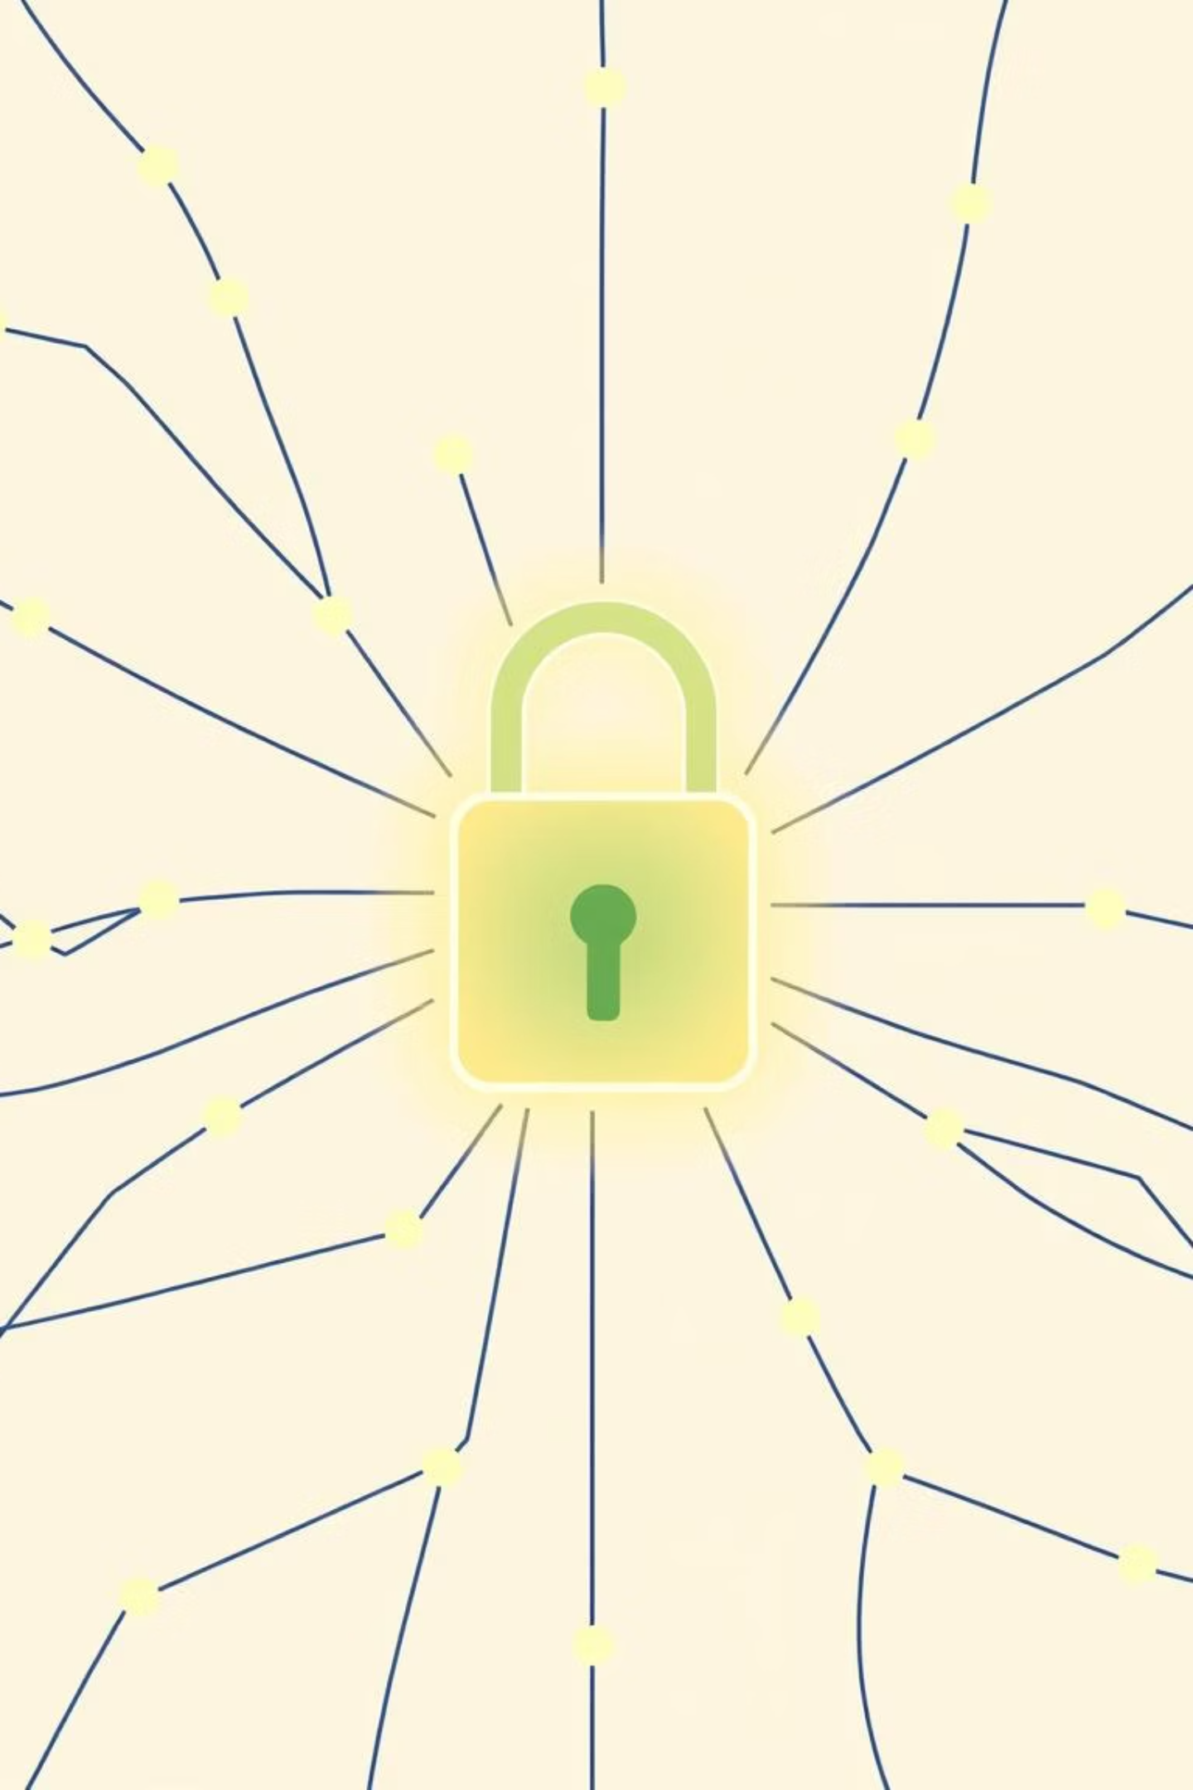
Introduction to Cybersecurity: Protecting Our Digital World
In an increasingly interconnected world, understanding cybersecurity is not just a technical necessity—it's a fundamental life skill. This presentation will guide you through the essentials of protecting our digital lives, from individual devices to global networks.

Slide 2
Why Cybersecurity Matters Today
Expanding Digital Footprint
Economic Imperative
Universal Vulnerability
Cyberattacks are estimated to cost the global economy over $8 trillion annually by 2024, impacting businesses of all sizes and critical infrastructure.
With over 6 billion internet users projected for 2025, our collective attack surface is growing exponentially, making more targets available to malicious actors.
No one is immune. Every individual, organization, and government is a potential target, highlighting the need for robust defenses.

Slide 3



What is Cybersecurity?
Cybersecurity is the comprehensive practice of defending computer systems, networks, and data from digital attacks. It's a continuous effort to ensure the safety and reliability of our digital interactions.
People
Processes
Awareness and vigilance are the first line of defense.
Defined policies and procedures guide secure operations.
Technology
Tools and software provide protective barriers.
The primary goal is to prevent unauthorized access, data theft, damage, and disruption, maintaining the integrity and availability of information.

Slide 4




The Cyber Threat Landscape: Common Attack Types
Malware
Phishing
Viruses, worms, and ransomware designed to damage or hijack computer systems.
Deceptive communications, often emails, used to trick individuals into revealing sensitive information or installing malicious software.
Hacking
Social Engineering
Unauthorized access to computer systems or networks by exploiting vulnerabilities.
Manipulating individuals to perform actions or divulge confidential information.

Slide 5

Real-World Impact: Notable Cyber Incidents
Marriott Data Breach (2018)
Over 500 million guest records exposed, leading to significant reputational damage and financial penalties. This incident highlighted the far-reaching consequences of supply chain vulnerabilities.
Critical Infrastructure Ransomware (2023)
A widespread ransomware attack caused extensive service outages across critical infrastructure, disrupting essential services and demonstrating the impact on public life.
Global Identity Theft
Millions worldwide fall victim to identity theft and financial fraud annually, resulting in lost savings, damaged credit, and prolonged personal distress.

Slide 6








Important Cybersecurity Principles
Confidentiality
Integrity
Protecting sensitive information from unauthorized access and disclosure.
Ensuring data is accurate, consistent, and free from unauthorized modification.
Accountability
Availability
Tracking actions to ensure responsibility for security events.
Guaranteeing authorized users can access systems and data when needed.

Slide 7




How to Protect Yourself and Your Organization
Strong Authentication
Regular Updates
Use unique, complex passwords and enable multi-factor authentication (MFA) wherever possible for an extra layer of security.
Keep all software, operating systems, and applications updated to patch known vulnerabilities that attackers could exploit.
Security Tools
User Education
Deploy firewalls, antivirus, and anti-malware software to detect and prevent malicious activity.
Educate yourself and your team to recognize and avoid phishing attempts, social engineering tactics, and other common threats.

Slide 8
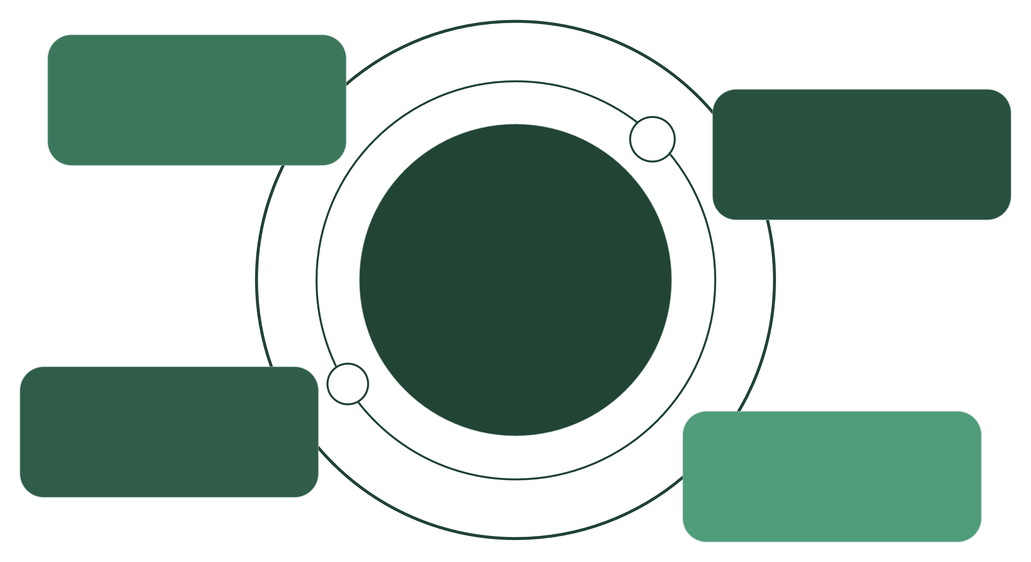
Emerging Trends in Cybersecurity
Cloud Security
Protecting data and workloads in cloud environments
AI-Powered Detection
Using machine learning to spot threats faster
Cybersecurity Trends
Key emerging patterns shaping modern defenses
Zero Trust
Verify every user and device continuously
International Collaboration
Sharing intel and standards across borders
The cybersecurity aspect is constantly evolving and growing. Staying ahead requires understanding these key trends and adapting our defense strategies accordingly.

Slide 9
Conclusion: Cybersecurity is Everyone’s Responsibility
Stay Informed: Cyber threats evolve constantly, so continuous learning and awareness are crucial.
Proactive Measures: Simple actions, consistently applied, can prevent a vast majority of attacks and protect your digital privacy.
Collective Defense: A safer digital future is built through the collective efforts of individuals and organizations.

