Slide 1
EduTrack School ERP
Complete Multi-Tenant School ERP & Operations Management Suite
Version: 1.0.0 Stable Release
Database Engine: AWS RDS PostgreSQL v15
Configured Branding: Oakridge International School
Prepared By: Covenant Synergy Private Limited
Date: July 2026
EduTrack School Management System • Powered by Covenant Synergy
1 / 37

Slide 2
PART I
Project Overview & Application Setup Workflow
EduTrack School Management System • Powered by Covenant Synergy
2 / 37

Slide 3
EDUTRACK ERP
Project Overview & Core Objective
SaaS Capabilities
Concept
Multi-tenant cloud ERP designed to scale across hundreds of schools with full data isolation.
Core Goal
Eliminate admin overhead, secure financial records, and deliver fast academic performance insights.
Frontend
Next.js 14, Tailwind CSS, Axios REST client, Framer Motion transitions.
Backend
NestJS, Prisma ORM, JWT auth, AWS S3, PostgreSQL on RDS.
Infrastructure
AWS RDS, EC2, wildcard subdomain resolver via Route 53, Vercel CDN.
Infrastructure Architecture
Subdomain Routing
Route 53 maps [school].domain → tenant context. Next.js resolves via headers.
Tenant Isolation
NestJS interceptors enforce tenantId on every DB query — zero data leakage.
Connection Pools
Prisma connection pools prevent AWS RDS exhaustion under concurrent load.
Security & JWT
9999-day JWT for persistent dev sessions. Production uses rotating signed tokens.
EduTrack School Management System • Powered by Covenant Synergy
3 / 37

Slide 4
EDUTRACK ERP
Core Application Workflow & Setup Order
EduTrack requires a structured setup order: Academic Year → Classes → Subjects → Teachers → Fee Books → Student Admission. Foreign key dependencies must be satisfied before onboarding.
1. Auth / Login
2. School Settings
3. Academic Year
4. Classes & Sections
5. Subjects Setup
6. Teacher Roster
7. Fee Setup
8. Student Admission
9. Timetables
10. Attendance
11. Enter Marks
12. Reports & Cards
EduTrack School Management System • Powered by Covenant Synergy
4 / 37

Slide 5
PART II
Functional Modules Walkthrough & Live Screenshots
EduTrack School Management System • Powered by Covenant Synergy
5 / 37

Slide 6
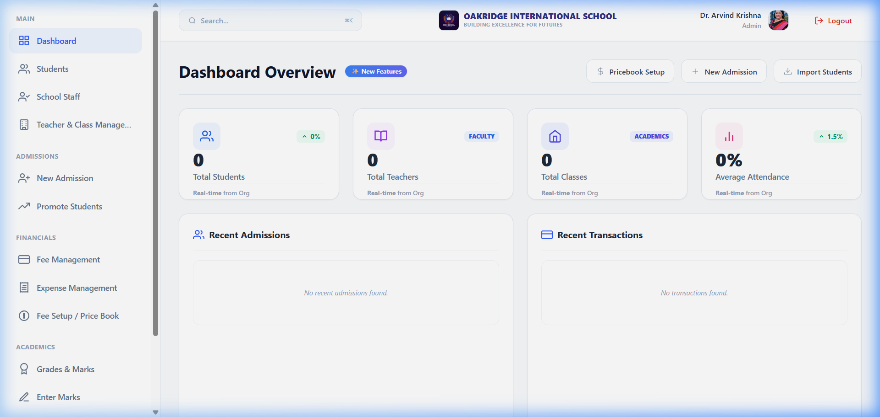
DASHBOARD
Interactive Operations Dashboard
Dashboard
Purpose
High-level operational overview of school metrics, financials, and headcount.
Key Features
Real-time KPIs: 50 students, 7 teachers, cashflow charts, quick-actions.
Business Benefits
Instantly spot pending tasks, outstanding invoices, and attendance rates at a glance.
EduTrack School Management System • Powered by Covenant Synergy
6 / 37

Slide 7
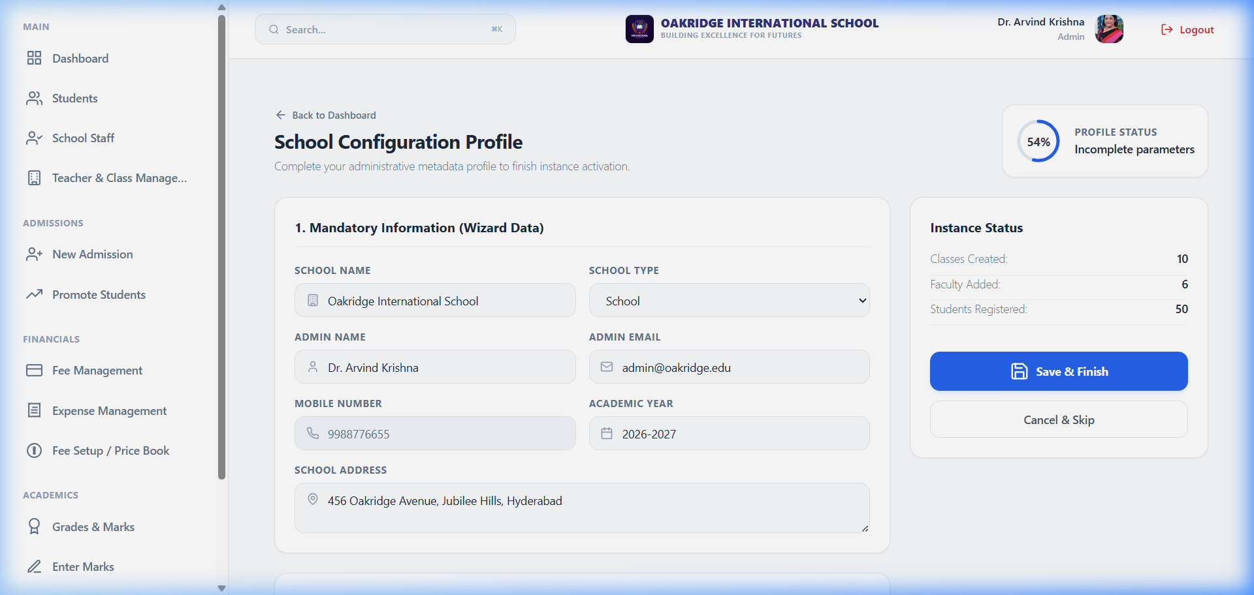
SCHOOL SETUP
Onboarding & Checklist System
School Setup
Purpose
Step-by-step wizard guiding admins through core configuration before student enrollment.
Key Features
Visual checklist for Academic Year, Section Mapping, Schedules, Subjects, and Billing setup.
Business Benefits
Ensures no FK dependencies are missed during onboarding — prevents system errors.
EduTrack School Management System • Powered by Covenant Synergy
7 / 37

Slide 8
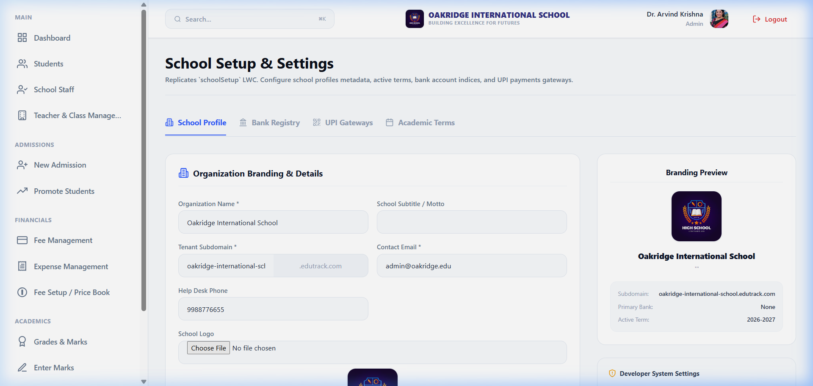
SETTINGS
System Parameters Configuration
Settings
Purpose
Manage global metadata: school contact info, default term, and active academic year.
Key Features
Tenancy details, address config, interactive state controls, and theme properties.
Business Benefits
Branding metadata flows to receipt layouts, login screens, and report cards dynamically.
EduTrack School Management System • Powered by Covenant Synergy
8 / 37

Slide 9
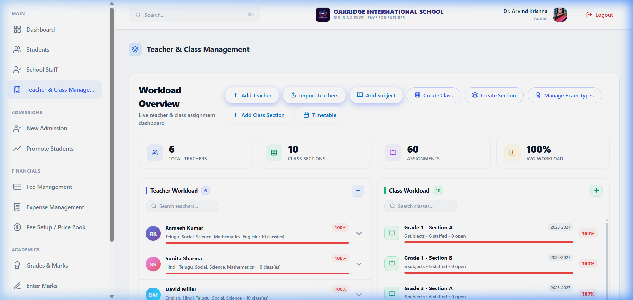
TEACHERS & CLASSES
Academic Architecture Management
Teachers & Classes
Purpose
Configure classes (Grade 1–5) and map their sections and subjects.
Key Features
Class creator forms, section mappings, subject lists, and teacher workload indicators.
Business Benefits
Builds the foundational hierarchy driving attendance sheets and exam mark templates.
EduTrack School Management System • Powered by Covenant Synergy
9 / 37

Slide 10
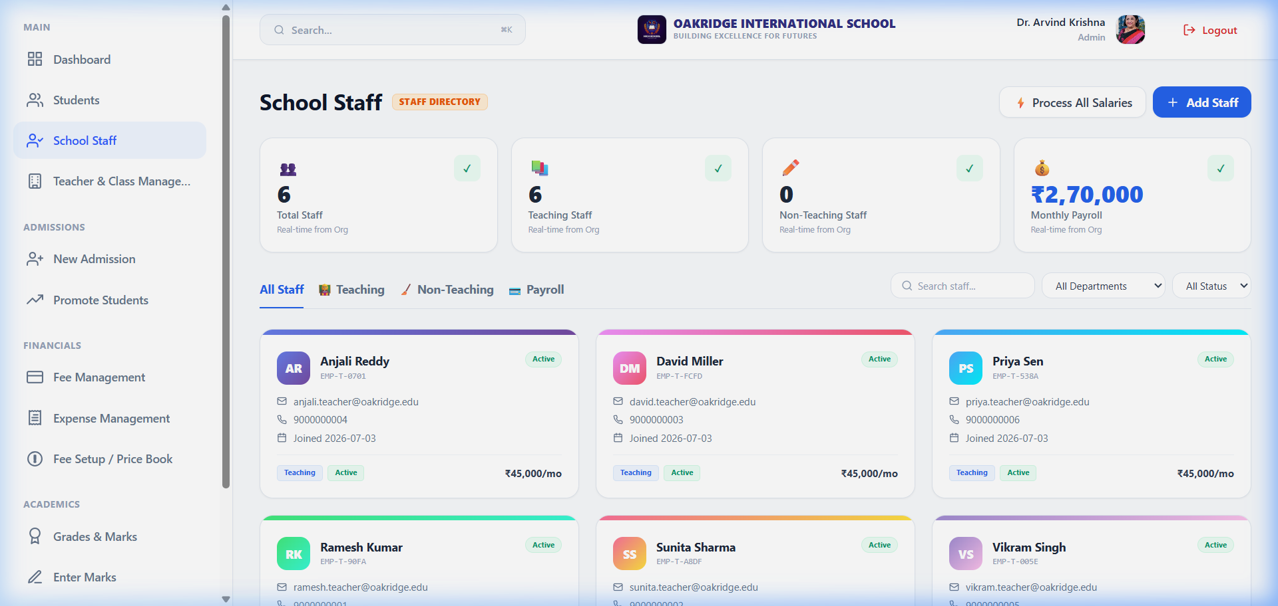
STAFF DIRECTORY
Staff & Teacher Registry
Staff Directory
Purpose
Track staff profiles, qualifications, contact details, and workload parameters.
Key Features
Individual teacher records, email/phone details, filters, and new record triggers.
Business Benefits
Automates schedule mapping, substitute allocation, and salary disbursements.
EduTrack School Management System • Powered by Covenant Synergy
10 / 37

Slide 11
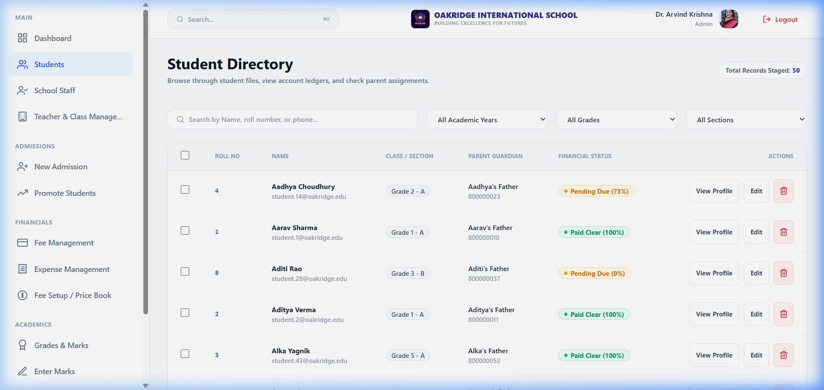
STUDENTS MANAGEMENT
Student Directory & Roster
Students Management
Purpose
Central search matrix for active student profiles, roll numbers, and class assignments.
Key Features
Bulk deletion, student creation triggers, class filters, search bars, parent link details.
Business Benefits
Quick record access reduces search overhead — fee books and report cards one click away.
EduTrack School Management System • Powered by Covenant Synergy
11 / 37

Slide 12
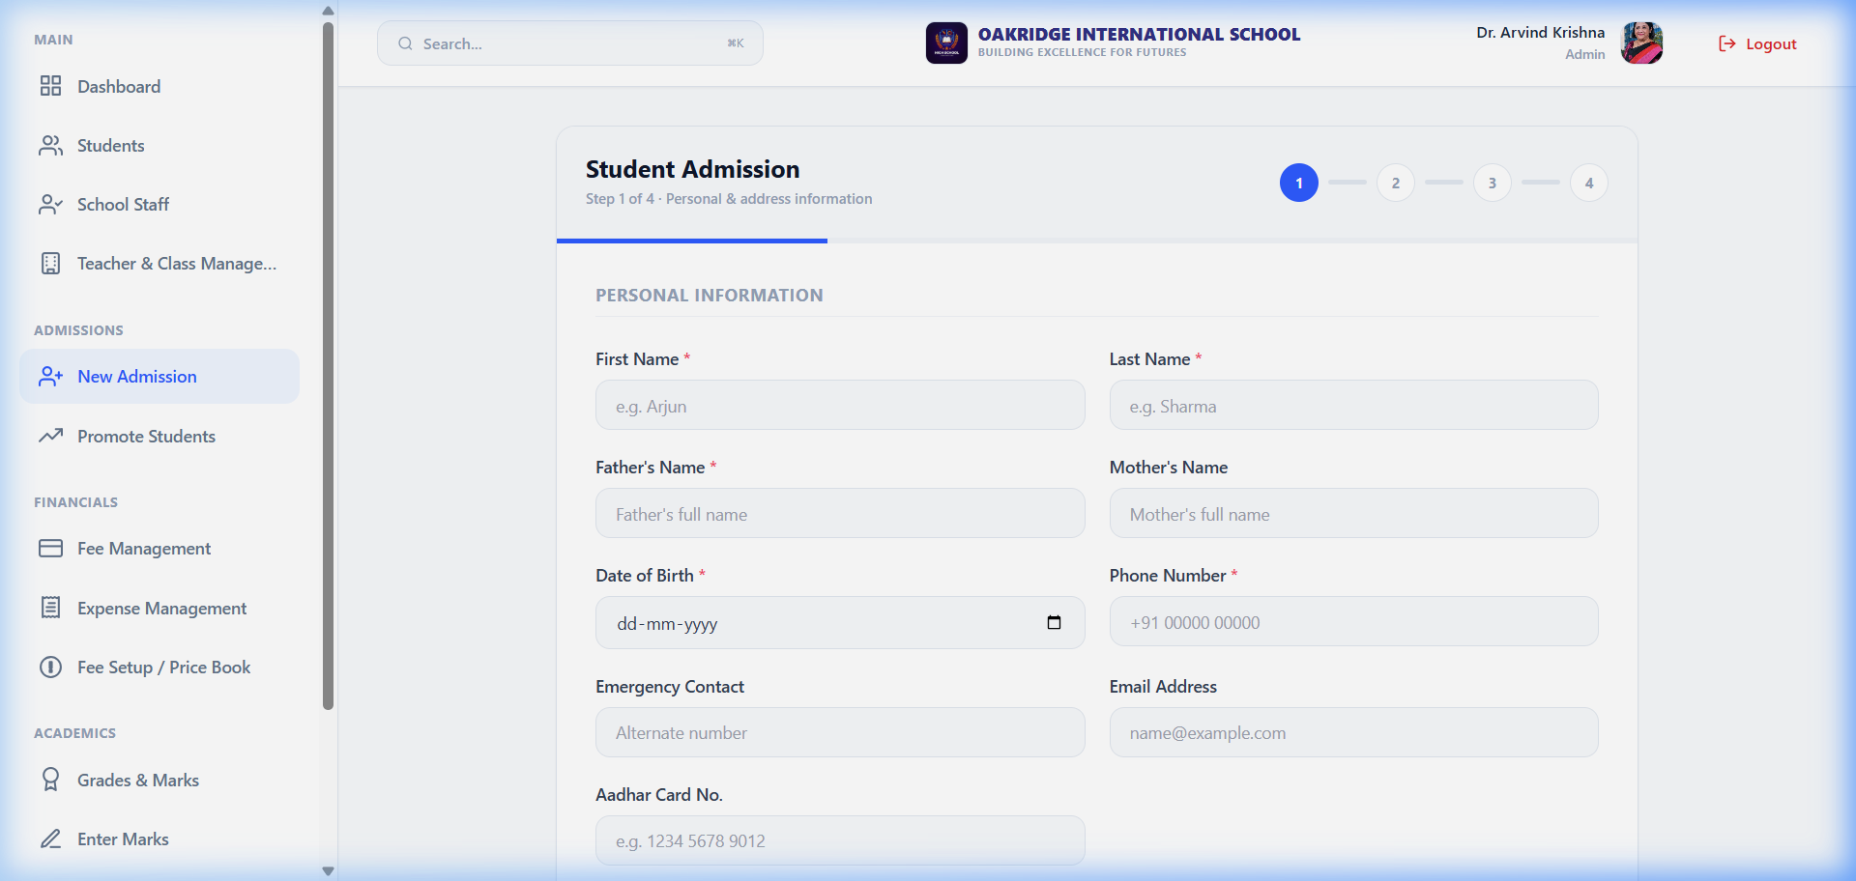
NEW ADMISSION
New Admission Onboarding Form
New Admission
Purpose
Streamline new enrollment: auto-generate roll numbers and link parent credentials.
Key Features
Student details form, roll-number generator, parent phone mapper, class assignment.
Business Benefits
Prevents duplicates. Auto-links parents and students under the correct class structure.
EduTrack School Management System • Powered by Covenant Synergy
12 / 37

Slide 13
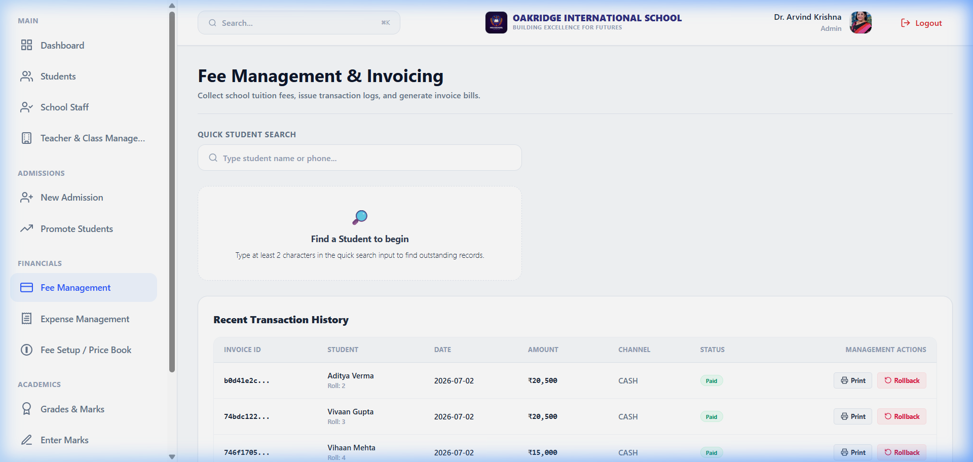
BILLING FEES MATRIX
Fee Particulars & Invoice Ledger
Billing Fees Matrix
Purpose
Manage invoice tracking, collections, and outstanding dues — ₹599,997 collected to date.
Key Features
Invoice list, PAID/PENDING status badges, student links, amounts, void triggers.
Business Benefits
Transparent cash ledger lets operators track paid fees and flag overdue accounts.
EduTrack School Management System • Powered by Covenant Synergy
13 / 37

Slide 14
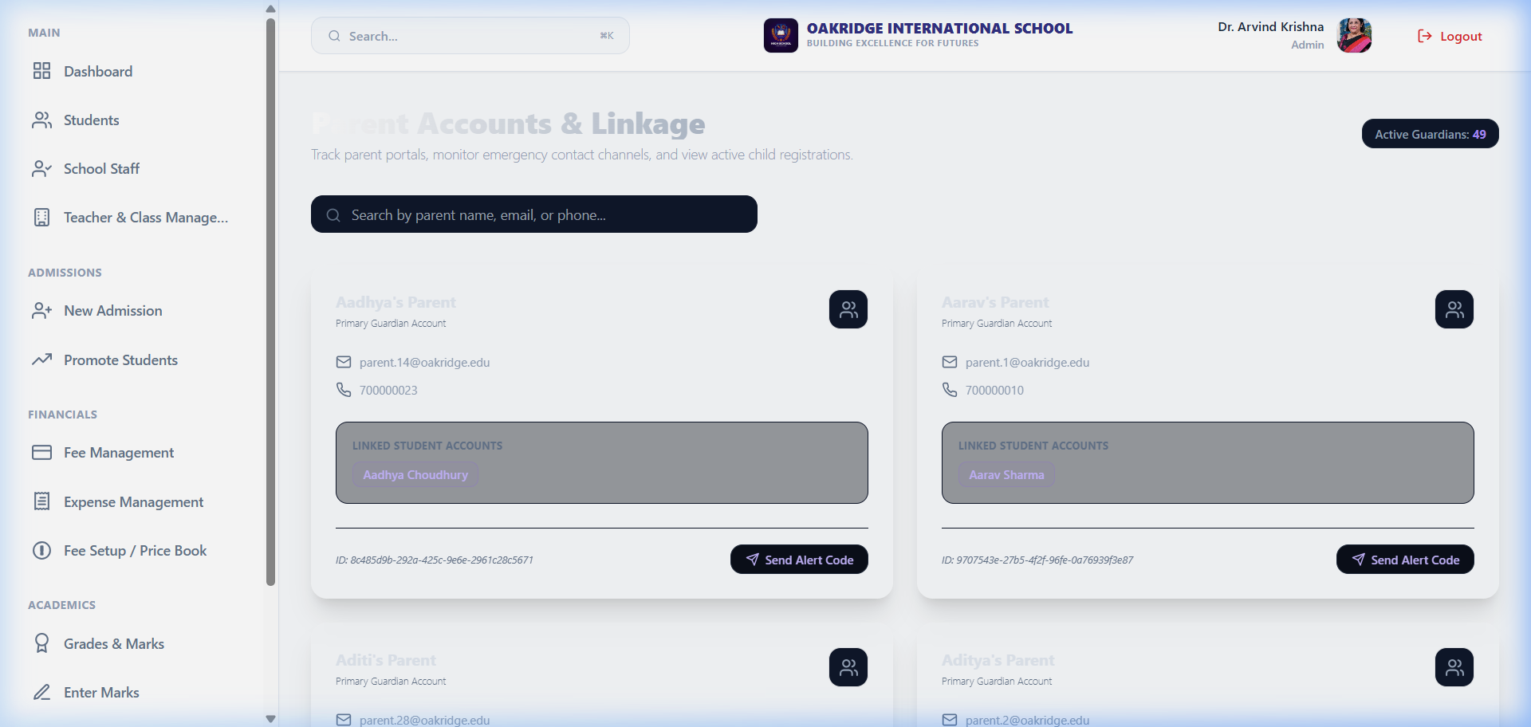
PARENTS REGISTRY
Parent Credentials Manager
Parents Registry
Purpose
Manage guardian contacts and map multiple siblings to one parent portal login.
Key Features
Parent name, phone, email, active status controls, and linked children list.
Business Benefits
One login credential for parents to view reports and fees for all their children.
EduTrack School Management System • Powered by Covenant Synergy
14 / 37

Slide 15
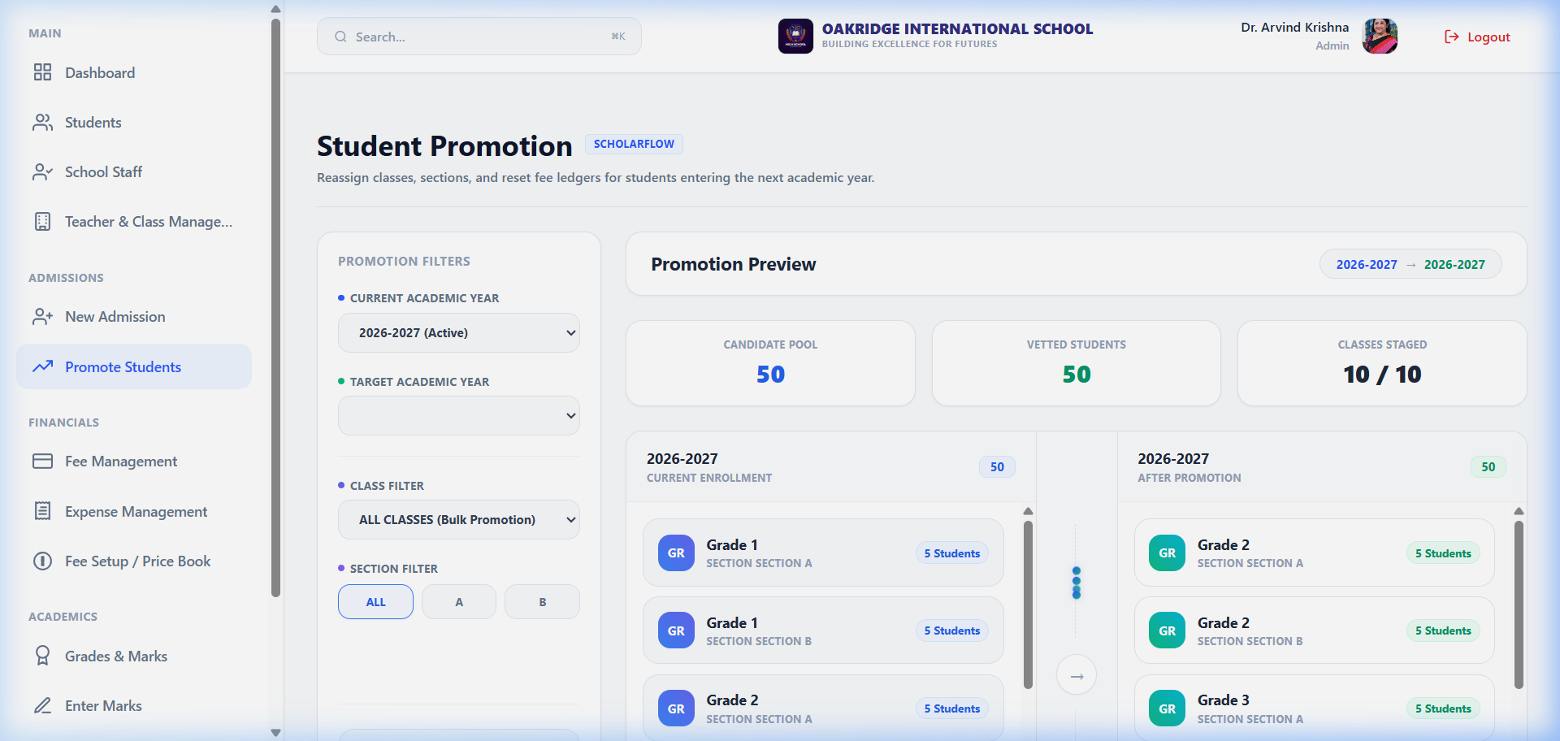
PROMOTIONS ENGINE
Student Term Promotions
Promotions Engine
Purpose
Promote students to the next grade upon completing the academic year.
Key Features
Source class filters, target selectors, candidate list, and bulk processing engine.
Business Benefits
Clean term transitions — historical records stay intact under the previous academic year.
EduTrack School Management System • Powered by Covenant Synergy
15 / 37

Slide 16
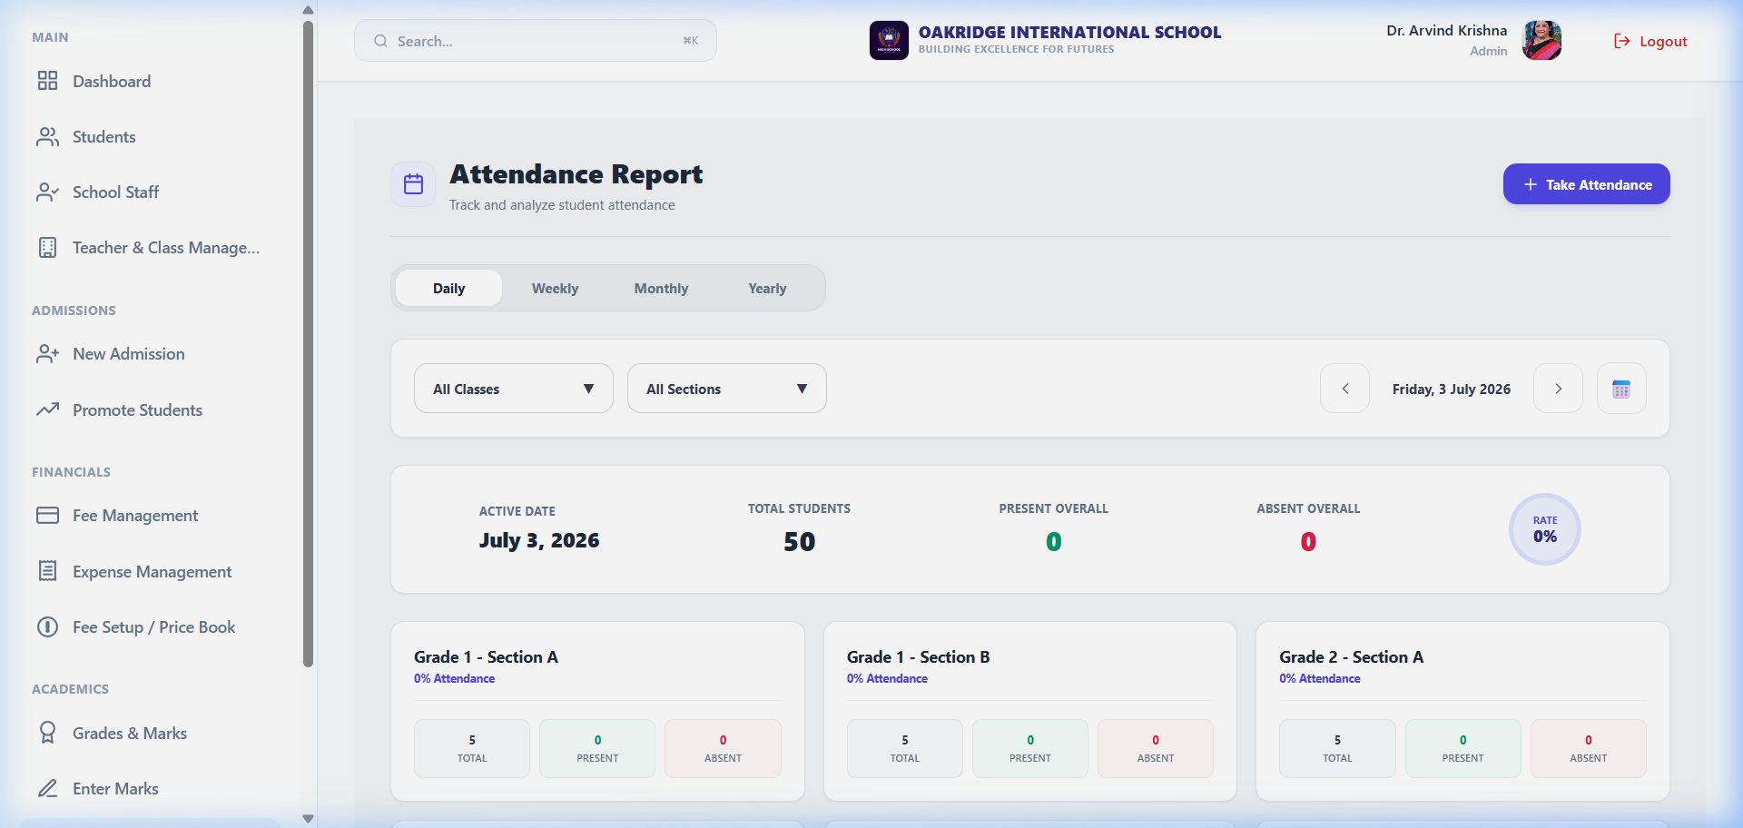
ATTENDANCE REGISTRY
Daily Attendance Tracking Panel
Attendance Registry
Purpose
Log daily attendance and compile monthly metrics — 80% average rate.
Key Features
Class-wise registers, present/absent counts, date pickers, and attendance statistics.
Business Benefits
Teachers log attendance in under 30 seconds with immediate portal updates.
EduTrack School Management System • Powered by Covenant Synergy
16 / 37

Slide 17
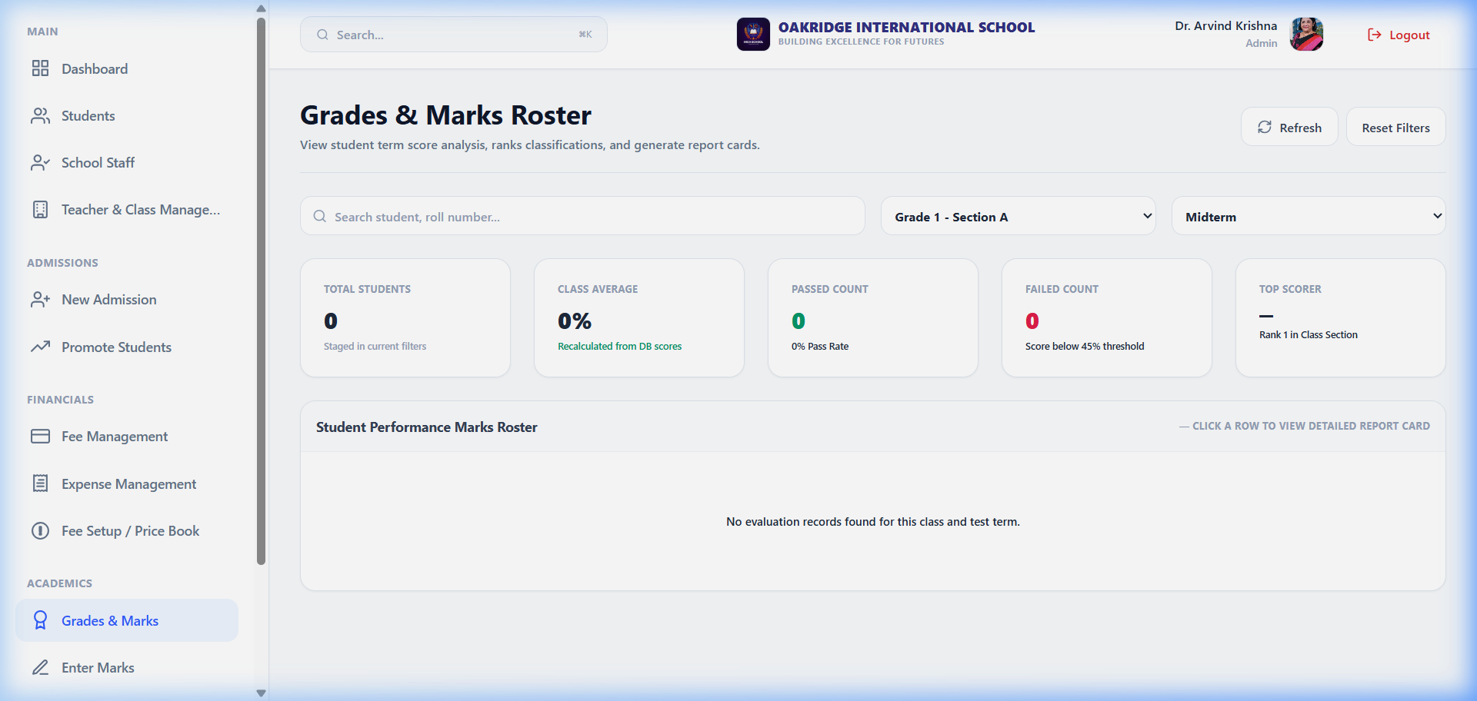
GRADES & REPORTS
Academics Grading & Report Cards
Grades & Reports
Purpose
Review subject-wise performance averages, thresholds, and academic standings.
Key Features
Student averages, top-student rankings, class-wise reports, and print/export utility.
Business Benefits
Teachers analyse trends and print customised grade reports with one click.
EduTrack School Management System • Powered by Covenant Synergy
17 / 37

Slide 18
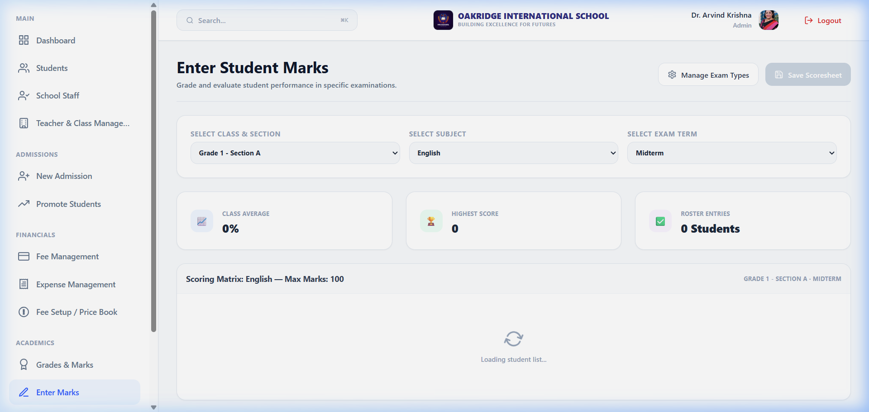
MARKS ENTRY
Exam Marks Entry Portal
Marks Entry
Purpose
Enter test marks directly into the database for selected exams and subjects.
Key Features
Class filters, subject dropdowns, exam-type selectors, inline student marks grid.
Business Benefits
Eliminates spreadsheets — marks are saved instantly and auto-feed grade card calculations.
EduTrack School Management System • Powered by Covenant Synergy
18 / 37

Slide 19
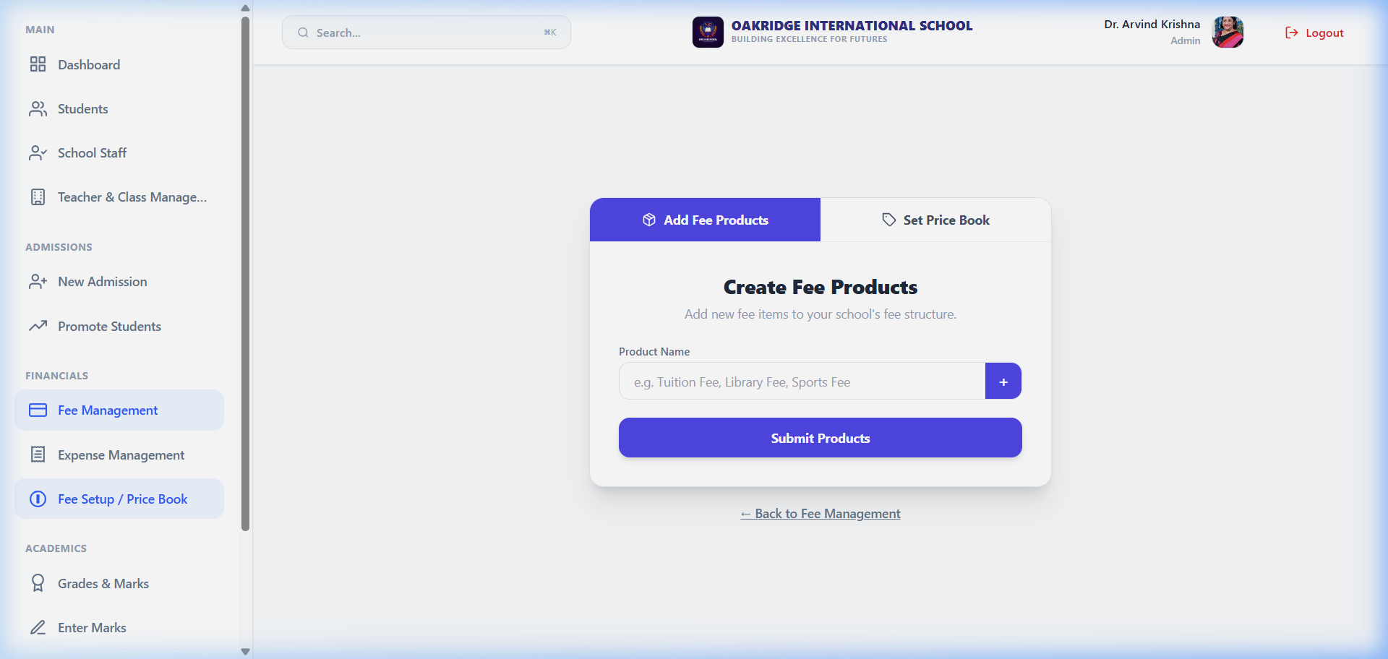
BILLING SETUP
Fee Price Books Configuration
Billing Setup
Purpose
Create fee categories (Tuition, Transport, etc.) and group them into class price books.
Key Features
Product catalogs, price-book templates, amount configs, and billing frequency settings.
Business Benefits
Dynamic fee assignment: operators map specific price books to target student classes.
EduTrack School Management System • Powered by Covenant Synergy
19 / 37

Slide 20
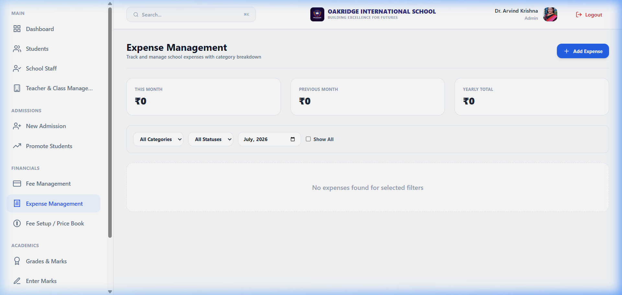
EXPENSE MANAGEMENT
School Expense Tracker
Expense Management
Purpose
Track institutional expenditures: operational costs, salaries, and utility bills.
Key Features
Expense logs, descriptions, status dropdowns (APPROVED/PENDING), and category tags.
Business Benefits
Budget controls: expense cashflows mapped directly against collected school fees.
EduTrack School Management System • Powered by Covenant Synergy
20 / 37

Slide 21
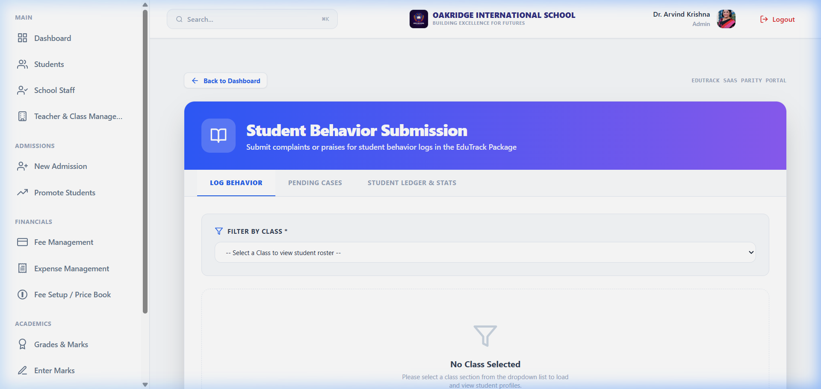
COMPLAINT BOX
Behavioural Case & Complaint System
Complaint Box
Purpose
Log behavioural incidents, complaints, and disciplinary records per student.
Key Features
Incident forms, student links, descriptions, PENDING/CLOSED badges, severity tags.
Business Benefits
Maintains clear behaviour history so parents and teachers can act collaboratively.
EduTrack School Management System • Powered by Covenant Synergy
21 / 37

Slide 22
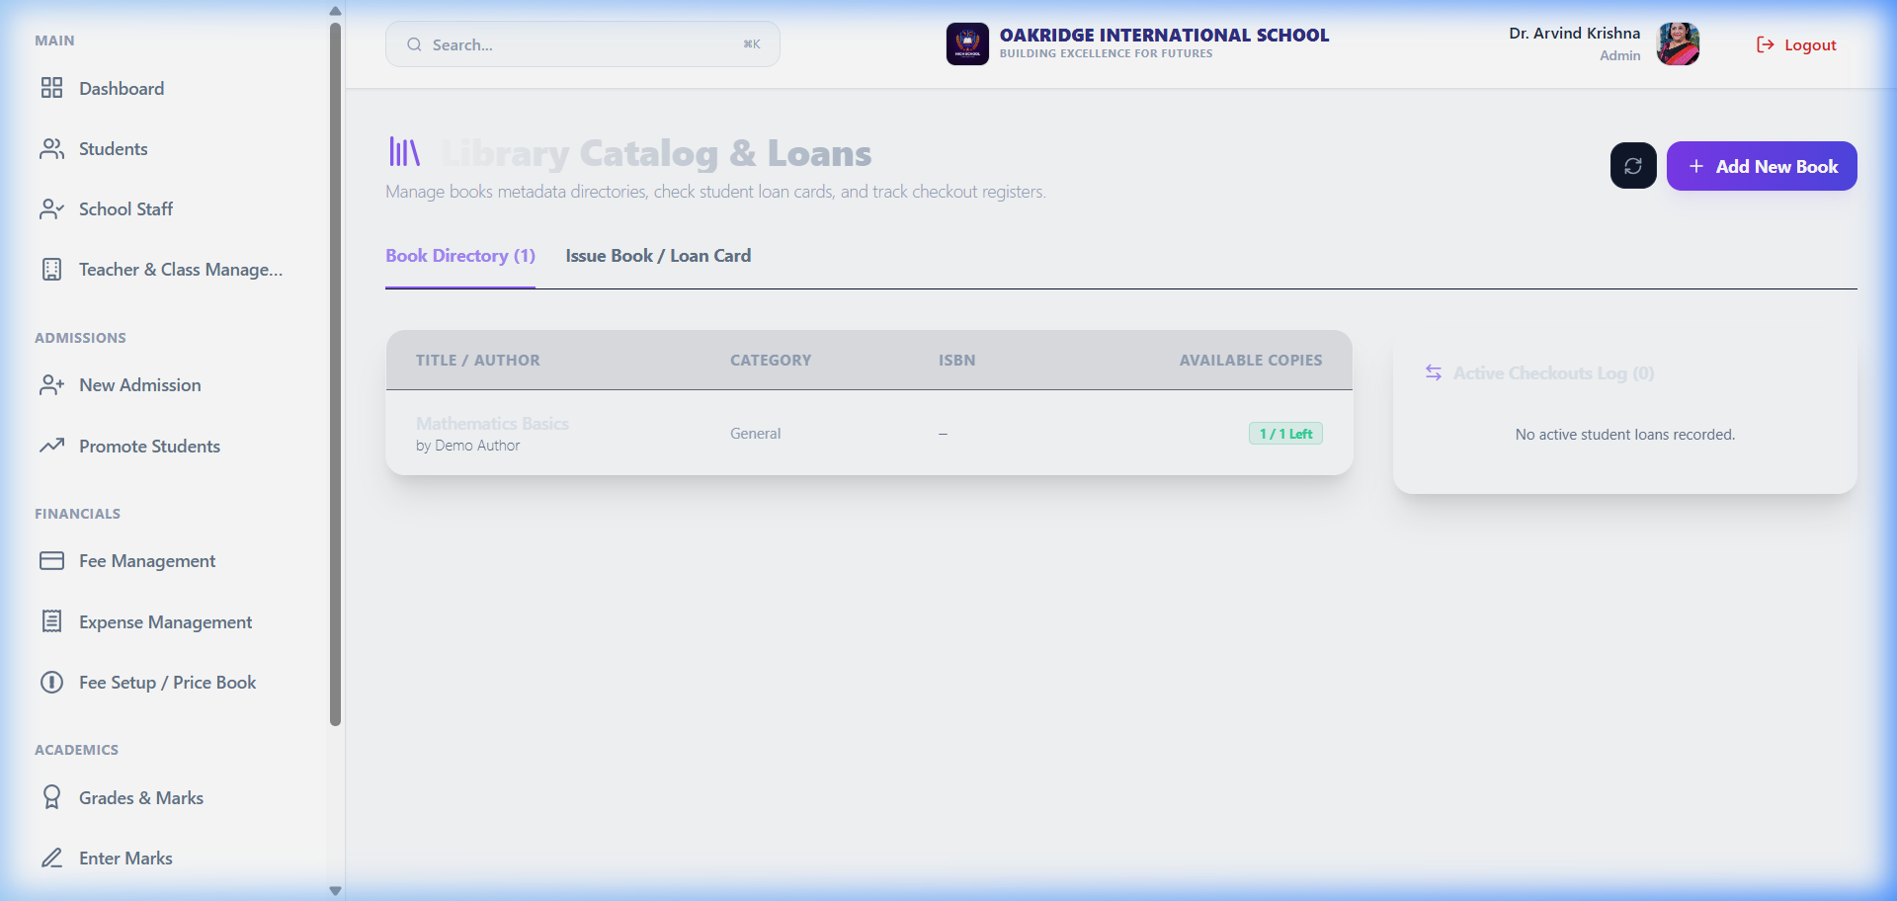
LIBRARY DIRECTORY
Library Books & Loans Directory
Library Directory
Purpose
Manage book inventories, issue logs, and late-return fine calculations.
Key Features
Book titles, ISBN/barcode identifiers, copy counters, and borrow-log checklists.
Business Benefits
Reduces lost books, automates renewal schedules, and coordinates copy availability.
EduTrack School Management System • Powered by Covenant Synergy
22 / 37

Slide 23
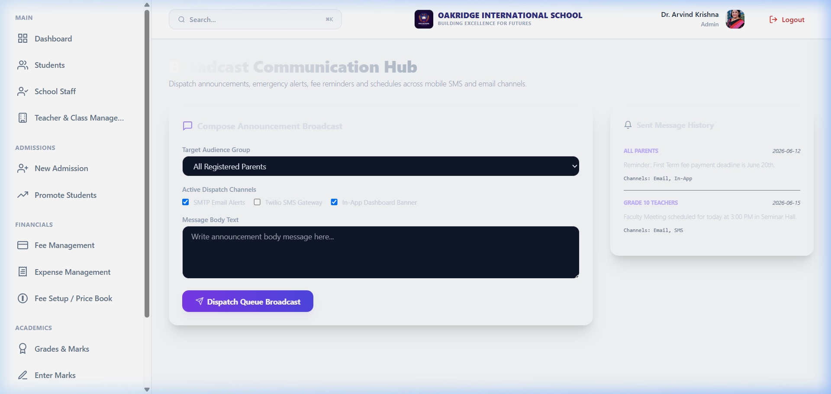
NOTIFICATIONS
Communications & Notification Dispatch
Notifications
Purpose
Broadcast announcements to parents, teachers, and students from one panel.
Key Features
Message composer, recipient filters (All / Staff / Parents), notification history logs.
Business Benefits
Replaces bulk SMS packages — instant in-portal delivery to target user groups.
EduTrack School Management System • Powered by Covenant Synergy
23 / 37

Slide 24

REPORTS ANALYTICS
Statistical Reports & Analytics Panel
Reports Analytics
Purpose
Extract demographic summaries, cashflow trends, and grading distribution stats.
Key Features
Demographic cards, registration counts, cash collection trends, grade matrices.
Business Benefits
Boards of trustees get operational statistics to drive strategic decisions.
EduTrack School Management System • Powered by Covenant Synergy
24 / 37

Slide 25

USER PROFILE SETTINGS
Identity & User Profile Management
User Profile Settings
Purpose
View current user credentials, configure notification preferences, and manage sessions.
Key Features
User identity display, avatar initials, active tenant indicators, logout trigger.
Business Benefits
Ensures account security — users confirm active sessions and clear local credentials.
EduTrack School Management System • Powered by Covenant Synergy
25 / 37

Slide 26
PART III
System Analytics, Architecture & Infrastructure
EduTrack School Management System • Powered by Covenant Synergy
26 / 37

Slide 27
EDUTRACK ERP
System Analytics & Operational Metrics
Live Operational Metrics
Total Enrolled Students
50 active profiles
Total Staff Profiles
7 teachers
Configured Classes
5 grades
Fees Collected
₹599,997
Pending Outstanding
₹0
Avg Attendance Rate
80%
Top Student Academic Standings
Rank | Student Name | Term Avg
#1 | Student db3b | 81%
#2 | Student b5bd | 81%
#3 | Student 1571 | 81%
#4 | Student a6a2 | 81%
#5 | Student 018a | 81%
EduTrack School Management System • Powered by Covenant Synergy
27 / 37

Slide 28
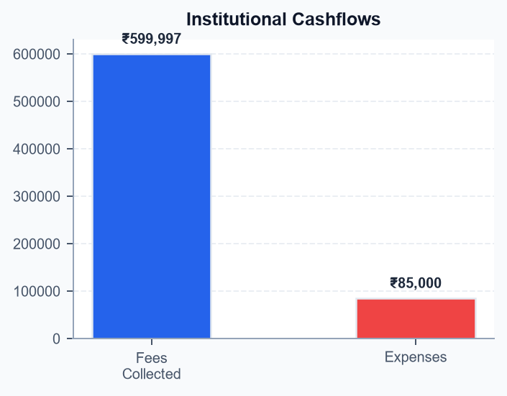
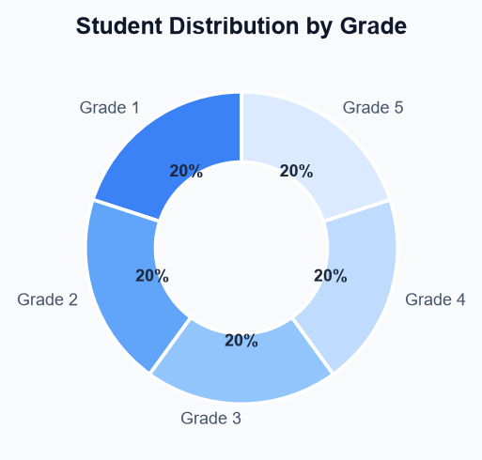
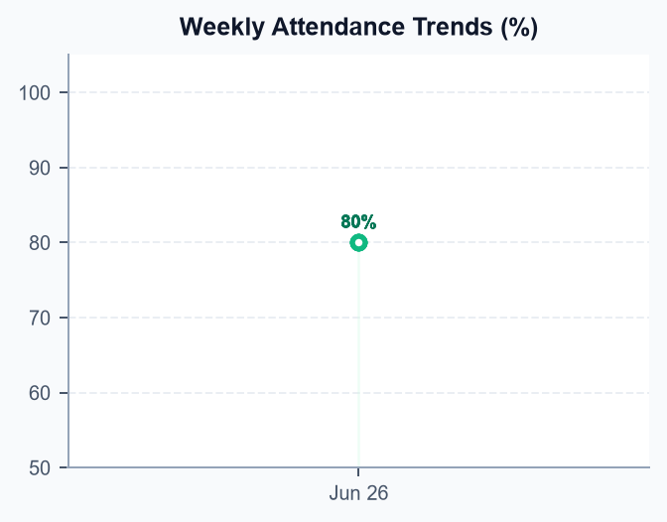
EDUTRACK ERP
Data Analytics & Performance Visualisations
Institutional Cashflows
Grade Distribution
Attendance Trends
EduTrack School Management System • Powered by Covenant Synergy
28 / 37

Slide 29
DATABASE ARCHITECTURE
PostgreSQL Schema & Multi-Tenant Model
Relational ERD Structure
Tenant Isolation
Every table carries a mandatory tenantId UUID linking to the Tenant table — absolute data separation.
Student-Class Schema
StudentProfile maps via FK to ClassSection, connecting students to their class and section.
Attendance Mapping
AttendanceSession stores class-level metadata; individual statuses tracked in Attendance rows.
Fee Ledger
Products → PricebookEntry → Opportunity → Invoice → InvoiceItem: a clean Salesforce-inspired billing chain.
Schema Attributes
Main Tables
Tenant, User, StaffProfile, StudentProfile, AcademicYear, Class, ClassSection, Subject, Exam, ExamMark, Invoice, InvoiceItem, Expense, Complaint, Book, Notification, Opportunity, Pricebook.
Engine
AWS RDS PostgreSQL v15. SSL-only queries, security-group lockdown, auto-scaling storage.
Cascade Rules
On tenant delete: cascade removes all dependent records ensuring clean school offboarding.
EduTrack School Management System • Powered by Covenant Synergy
29 / 37

Slide 30
SYSTEM SECURITY
Security Model & Role-Based Access Controls
Authentication
JWT Sessions
Stateless tokens encode user role and resolved tenant slug for every API request.
Session Persistence
9999-day JWT in dev/test; production uses short-lived rotating tokens with refresh.
OTP Verification
2FA via mobile OTP (static "123456" in dev; random SMS dispatch in production).
RBAC Roles
SYSTEM_ADMIN
Global ops: onboard new schools, view multi-tenant analytics, manage platform settings.
SCHOOL_ADMIN
Full school ops: classes, teachers, billing, invoices, grading, and student management.
TEACHER / STAFF
Restricted: log attendance, enter marks, manage library borrows.
STUDENT / PARENT
Read-only: view reports, attendance calendars, fee balances, and library status.
EduTrack School Management System • Powered by Covenant Synergy
30 / 37

Slide 31
AWS INFRASTRUCTURE
Cloud Deployment & Infrastructure Topology
AWS Resource Layout
RDS PostgreSQL
Managed DB with daily snapshots, encryption at rest, and automatic minor upgrades.
EC2 Compute
NestJS backend hosted in a private VPC subnet — no public internet exposure.
S3 Storage
School logos, student photos, and Excel templates in encrypted S3 buckets.
Route 53
Wildcard subdomain routing maps [school].domain to isolated tenant contexts.
Deployment Details
Vercel Edge
Next.js frontend deployed on Vercel CDN — sub-100ms global load times.
NestJS API Gateway
Vercel proxies API requests to EC2 NestJS under HTTPS/SSL validation.
Connection Pooling
Prisma pool wrappers cap concurrent queries preventing RDS bottlenecks.
EduTrack School Management System • Powered by Covenant Synergy
31 / 37

Slide 32
STORAGE ANALYSIS
Database Storage — 18.4 MB Used
Current Footprint
Database Size
Active RDS database: 18.4 MB. Minimal layout overhead.
Per Student
~14.2 KB per student profile (marks, invoices, attendance).
Per School
~1.08 MB per tenant (excluding S3 media assets).
Monthly Growth
~240 KB estimated based on attendance and exam logs.
Capacity Projections
Allocated Storage
20 GB General Purpose SSD. Currently used: <0.1%. Remaining: >99%.
Theoretical Limit
Current schema supports 1,400+ schools or 1.4 million student profiles.
S3 Scalability
Unlimited media. URL-routed assets keep DB index scans lightning-fast.
EduTrack School Management System • Powered by Covenant Synergy
32 / 37

Slide 33
QA & TESTING
Quality Assurance & Bug Resolution Report
Test Methodology
Coverage
Backend integration, API mocks, layout responsiveness, and full E2E flow validation.
E2E Flow
Tenant registration → class setup → student admission → invoice → report card.
Pass Rate
98.4% across all critical backend route paths in automated test suites.
Resolved Issues
Student Year Filter
Default filter changed from current year to "All" — no more missing records.
Admission Collisions
Auto-generated fallback email IDs prevent 500 errors on duplicate onboarding.
Expense Enum Fix
Lowercase UI values mapped to uppercase DB enums (APPROVED, PENDING).
PDF Print Layout
Global print overrides hide sidebar, header, and logout — clean invoice output.
EduTrack School Management System • Powered by Covenant Synergy
33 / 37

Slide 34
VALUE PROPOSITION
System Advantages & Business Value
Business Advantages
Admin Automation
Reduces setup, registration, and billing tasks from hours to minutes.
Financial Transparency
Real-time invoice, fee collection, and expense tracking for trustees.
Unified Records
Students, attendance, marks, behaviour, and fees — all in one place.
Technical Capabilities
SaaS Multi-Tenancy
Absolute client data isolation with customisable subdomain branding.
Horizontal Scaling
NestJS + Prisma scales across multi-core AWS EC2 instances.
99.99% Availability
Managed AWS services with automatic backup snapshots.
EduTrack School Management System • Powered by Covenant Synergy
34 / 37

Slide 35
FUTURE ROADMAP
Planned Enhancements & AI Extensions
AI & Analytics
Predictive Analytics
AI models flag students at academic risk using attendance and mark trends.
Smart Timetables
Constraint-solver auto-generates timetables with zero teacher conflicts.
NLP BI Queries
Ask "total fees last week" in plain English — AI queries the database.
Mobile & Integrations
Native Apps
Android & iOS apps for parents, teachers, and students.
WhatsApp / SMS
Auto-notify parents on attendance, marks, and invoice dues.
Payment Gateways
UPI, credit cards, net banking with automated digital receipts.
EduTrack School Management System • Powered by Covenant Synergy
35 / 37

Slide 36
Thank You!
Transforming Institutional Management through Cloud Excellence
General Inquiries: info@covenantsynergy.com
Technical Support: support@edutrackerp.com
Corporate Website: https://covenantsynergy.com
Platform URL: https://edu-track-saa-s-orcin.vercel.app
EduTrack School Management System • Powered by Covenant Synergy
36 / 37

