Slide 1
File Processing

Slide 2
OBJECTIVES
In this chapter you will learn:
To create, read, write and update files.
Sequential access file processing.
Random-access file processing.

Slide 3
Introduction
Data files
Can be created, updated, and processed by C programs
Are used for permanent storage of large amounts of data
Storage of data in variables and arrays is only temporary

Slide 4
Data Hierarchy
Data Hierarchy:
Bit – smallest data item
Value of 0 or 1
Byte – 8 bits
Used to store a character
Decimal digits, letters, and special symbols
Field – group of characters conveying meaning
Example: your name
Record – group of related fields
Represented by a struct or a class
Example: In a payroll system, a record for a particular employee that contained his/her identification number, name, address, etc.

Slide 5
Data Hierarchy
Data Hierarchy (continued):
File – group of related records
Example: payroll file
Database – group of related files

Slide 6
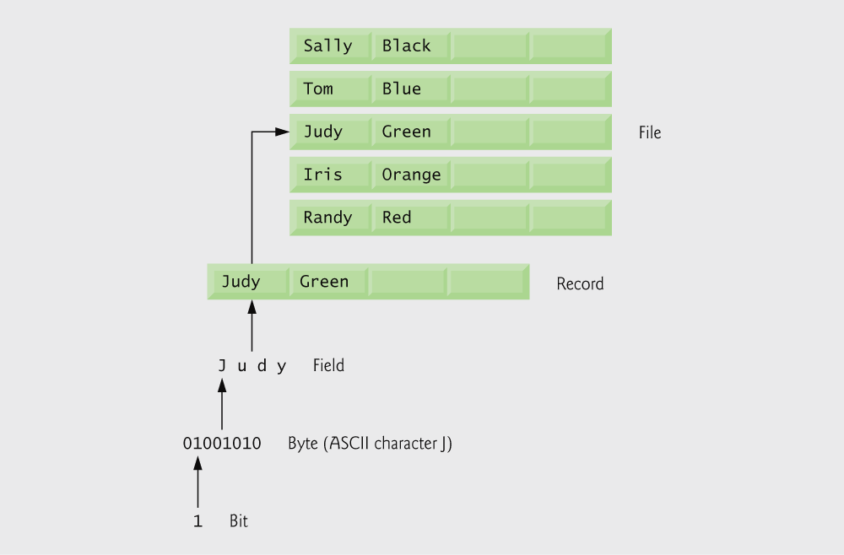
Data hierarchy.

Slide 7
Data Hierarchy
Data files
Record key
Identifies a record to facilitate the retrieval of specific records from a file
Sequential file
Records typically sorted by key

Slide 8
Files and Streams
C views each file as a sequence of bytes
File ends with the end-of-file marker
Or, file ends at a specified byte
Stream created when a file is opened
Provide communication channel between files and programs
Opening a file returns a pointer to a FILE structure
Example file pointers:
stdin - standard input (keyboard)
stdout - standard output (screen)
stderr - standard error (screen)

Slide 9
Files and Streams
Read/Write functions in standard library
fgetc
Reads one character from a file
Takes a FILE pointer as an argument
fgetc( stdin ) equivalent to getchar()
fputc
Writes one character to a file
Takes a FILE pointer and a character to write as an argument
fputc( 'a', stdout ) equivalent to putchar( 'a' )
fgets
Reads a line from a file
fputs
Writes a line to a file
fscanf / fprintf
File processing equivalents of scanf and printf

Slide 10
Creating a Sequential-Access File
Creating a File
FILE *cfPtr;
Creates a FILE pointer called cfPtr
cfPtr = fopen(“clients.dat", “w”);
Function fopen returns a FILE pointer to file specified
Takes two arguments – file to open and file open mode
If open fails, NULL returned

Slide 11
Creating a Sequential-Access File
fprintf
Used to print to a file
Like printf, except first argument is a FILE pointer (pointer to the file you want to print in)
feof( FILE pointer )
Returns true if end-of-file indicator (no more data to process) is set for the specified file
fclose( FILE pointer )
Closes specified file
Performed automatically when program ends
Good practice to close files explicitly
Details
Programs may process no files, one file, or many files
Each file must have a unique name and should have its own pointer

Slide 12
FILE pointer definition creates new file pointer
fopen function opens a file; w argument means the file is opened for writing

Slide 13
feof returns true when end of file is reached
fprintf writes a string to a file
fclose closes a file

Slide 14
End-of-file key combinations for various popular operating systems.

Slide 15
File opening modes.

Slide 16
Reading Data from a Sequential-Access File
Reading a sequential access file
Create a FILE pointer, link it to the file to read
cfPtr = fopen( “clients.dat", "r" );
Use fscanf to read from the file
Like scanf, except first argument is a FILE pointer
fscanf( cfPtr, "%d%s%f", &accounnt, name, &balance );
Data read from beginning to end
rewind( cfPtr )
Repositions file position pointer to beginning of file (byte 0)
File position pointer
Indicates number of next byte to be read / written
Not really a pointer, but an integer value (specifies byte location)
Also called byte offset

Slide 17
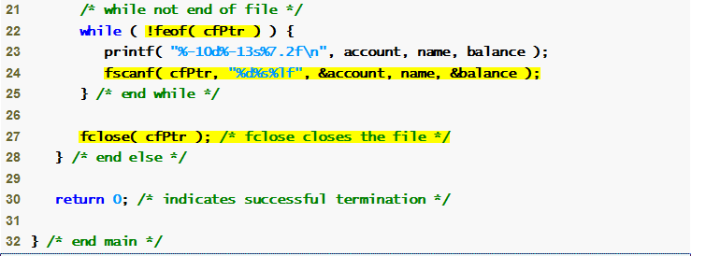
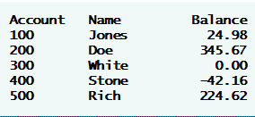
fopen function opens a file; r argument means the file is opened for reading
fscanf function reads a string from a file

Slide 21
rewind function moves the file pointer back to the beginning of the file

Slide 23
Reading Data from a Sequential-Access File
Sequential access file
Cannot be modified without the risk of destroying other data
Fields can vary in size
Different representation in files and screen than internal representation
1, 34, -890 are all ints, but have different sizes on disk

Slide 24
Random-Access Files
Random access files
Access individual records without searching through other records
Instant access to records in a file
Data can be inserted without destroying other data
Data previously stored can be updated or deleted without overwriting
Implemented using fixed length records
Sequential files do not have fixed length records

Slide 25
Creating a Random-Access File
Data in random access files
Unformatted (stored as "raw bytes")
All data of the same type (ints, for example) uses the same amount of memory
All records of the same type have a fixed length
Data not human readable

Slide 26
Creating a Random-Access File
Unformatted I/O functions
fwrite
Transfer bytes from a location in memory to a file
fread
Transfer bytes from a file to a location in memory
Example:
fwrite( &number, sizeof( int ), 1, myPtr );
&number – Location to transfer bytes from
sizeof( int ) – Number of bytes to transfer
1 – For arrays, number of elements to transfer
In this case, "one element" of an array is being transferred
myPtr – File to transfer to or from

Slide 27
Creating a Random-Access File
Writing structs
fwrite( &myObject, sizeof (struct myStruct), 1, myPtr );
sizeof – returns size in bytes of object in parentheses
To write several array elements
Pointer to array as first argument
Number of elements to write as third argument

Slide 29
fopen function opens a file; wb argument means the file is opened for writing in binary mode
fwrite transfers bytes into a random-access file

Slide 30
Writing Data Randomly to a Random-Access File
fseek
Sets file position pointer to a specific position
fseek( pointer, offset, symbolic_constant );
pointer – pointer to file
offset – file position pointer (0 is first location)
symbolic_constant – specifies where in file we are reading from
SEEK_SET – seek starts at beginning of file
SEEK_CUR – seek starts at current location in file
SEEK_END – seek starts at end of file

Slide 32
fseek searches for a specific location in the random-access file

Slide 34
Reading Data from a Random-Access File
fread
Reads a specified number of bytes from a file into memory
fread( &client, sizeof (struct clientData), 1, myPtr );
Can read several fixed-size array elements
Provide pointer to array
Indicate number of elements to read
To read multiple elements, specify in third argument

Slide 36
fread reads bytes from a random-access file to a location in memory

Slide 39
Function textFile creates a text file containing all account data

Slide 40
Function updateRecord changes the balance of a specified account

Slide 42
Function deleteRecord removes an existing account from the file

Slide 44
Function newRecord adds a new account to the file

