Slide 1
C – Printf and Scanf Functions
Abu Sayeed
Assistant Professor
Department of Computer Science & Engineering

Slide 2
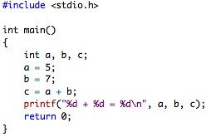
C - Printf() and Scanf() functions
printf() and scanf() functions are inbuilt library functions in C which are available in C library by default.
These functions are declared and related macros are defined in “stdio.h” which is a header file.
We have to include “stdio.h” file as shown in below C program to make use of these printf() and scanf() library functions.

Slide 3
Here is an explanation of the different lines in this program:
The line int a, b, c; declares three integer variables named a, b and c. Integer variables hold whole numbers.
The next line initializes the variable named a to the value 5.
The next line sets b to 7.
The next line adds a and b and "assigns" the result to c. The computer adds the value in a (5) to the value in b (7) to form the result 12, and then places that new value (12) into the variable c. The variable c is assigned the value 12. For this reason, the = in this line is called "the assignment operator."
The printf statement then prints the line "5 + 7 = 12." The %d placeholders in the printf statement act as placeholders for values. There are three %d placeholders, and at the end of the printf line there are the three variable names: a, b and c. C matches up the first %d with a and substitutes 5 there. It matches the second %d with b and substitutes 7. It matches the third %d with c and substitutes 12. Then it prints the completed line to the screen: 5 + 7 = 12. The +, the = and the spacing are a part of the format line and get embedded automatically between the %d operators as specified by the programmer.

Slide 4
Printf() function
C printf() function:
The printf statement allows you to send output to standard out. For us, standard out is generally the screen (although you can redirect standard out into a text file or another command).
printf() function is used to print the “character, string, float, integer, octal and hexadecimal values” onto the output screen.
We use printf() function with %d format specifier to display the value of an integer variable.
Similarly %c is used to display character, %f for float variable, %s for string variable, %lf for double and %x for hexadecimal variable.
To generate a newline,we use “\n” in C printf() statement.
Note:
C language is case sensitive. For example, printf() and scanf() are different from Printf() and Scanf(). All characters in printf() and scanf() functions must be in lower case.

Slide 5
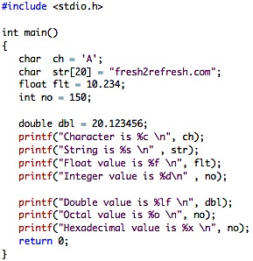
Example program printf() function
Output:
Character is A
String is fresh2refresh.com Float value is 10.234000 Integer value is 150
Double value is 20.123456
Octal value is 226
Hexadecimal value is 96

Slide 6
format specifier
You can see the output with the same data which are placed within the double quotes of printf statement in the program except
%d got replaced by value of an integer variable (no),
%c got replaced by value of a character variable (ch),
%f got replaced by value of a float variable (flt),
%lf got replaced by value of a double variable (dbl),
%s got replaced by value of a string variable (str),
%o got replaced by a octal value corresponding to integer variable (no),
%x got replaced by a hexadecimal value corresponding to integer variable
\n got replaced by a newline.

Slide 7
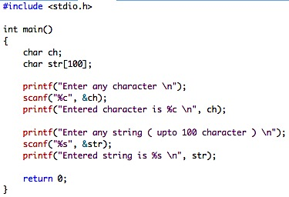
Example program : printf() and scanf() functions
scanf() function:
The scanf function allows you to accept input from standard in, which for us is generally the keyboard.
scanf() function is used to read character, string, numeric data from keyboard
Consider below example program where user enters a character. This value is assigned to the variable “ch” and then displayed.
Then, user enters a string and this value is assigned to the variable ”str” and then displayed.
Enter any character
a
Entered character is a
Enter any string ( upto 100 character )
hai
Entered string is hai

Slide 8
Example program : printf() and scanf() functions
The format specifier %d is used in scanf() statement. So that, the value entered is received as an integer and %s for string.
Ampersand is used before variable name “ch” in scanf() statement as &ch , this operator is called address of operator.

Slide 9
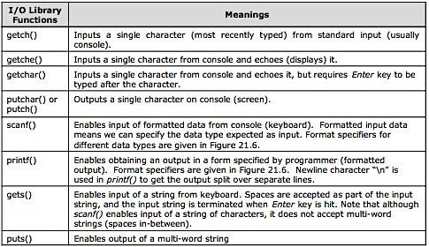
Basic IO Functions

