Slide 1
Operators And Expression: Precedence And Associativity Of Operators
Abu Sayeed
Assistant Professor
Department of Computer Science & Engineering

Slide 2
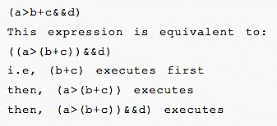
Precedence And Associativity Of Operators
Precedence of operators
If more than one operators are involved in an expression then, C has predefined rule of priority of operators. This rule of priority of operators is called operator precedence.
In C, precedence of arithmetic operators(*,%,/,+,-) is higher than relational operators(==,!=,>,<,>=,<=) and precedence of relational operator is higher than logical operators(&&, || and !). Suppose an expression:

Slide 3
Associativity of operators
Precedence And Associativity Of Operators
Associativity indicates in which order two operators of same precedence(priority) executes. Let us suppose an expression:
Here, operators == and != have same precedence. The associativity of both == and != is left to right, i.e., the expression in left is executed first and execution take pale towards right. Thus, a==b!=c equivalent to :
The expression a=b=c is parsed as a=(b=c), and not as (a=b)=c because of right-to-left associativity.

Slide 4
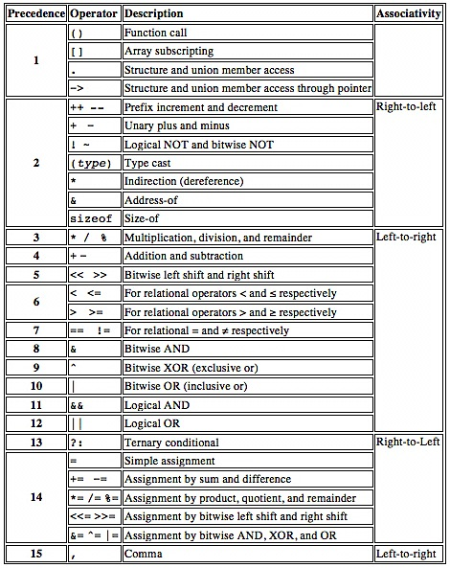
Left-to-Right
The following table lists the precedence and associativity of C operators.
Operators are listed top to bottom, in descending precedence.

