Slide 1
Pointers

Slide 2
Overview
What is pointer?
Pointer Declaration
Passing Pointer to Function
Operations in Pointers

Slide 3
What is pointer?
Pointers are variables that contain memory addresses as their values.
A variable name directly references a value.
A pointer indirectly references a value. Referencing a value through a pointer is called indirection.
A pointer variable must be declared before it can be used.

Slide 4
Concept of Address and Pointers
Memory can be conceptualized as a linear set of data locations.
Variables reference the contents of a locations
Pointers have a value of the address of a given location
ADDR1
Contents1
ADDR2
ADDR3
ADDR4
ADDR5
ADDR6
*
*
*
ADDR11
Contents11
*
*
ADDR16
Contents16

Slide 5
EXAMPLE FOR POINTER:
int X = 547;
HERE:
Variable name
Contents
Location
X
547
4000
ptr
4000
4036
According to above figure, By the help of ptr variable we stored the address of variable X in address 4036

Slide 6
Pointers are used in following variables
Variables of any basic data type
An Array
Functions
Structures, and
Unions

Slide 7
Advantages of Pointers
To point to different data structures
To achieve clarity and simplicity
More compact and efficient coding
To return multiple values via functions
Dynamic memory Allocation

Slide 8
Declaring a Pointer Variable
In previous example, ptr points to the variable x. We say that ptr is an integer pointer.
Similarly, we have character pointer, floating pointer, long pointer, … .

Slide 9
Declaring a Pointer Variable
To declare ptr as an integer pointer:
int *ptr;
To declare ptr as a character pointer:
char *ptr;

Slide 10
Use of & and *
When is & used?
When is * used?
& -- "address operator" which gives or produces the memory address of a data variable
* -- "dereferencing operator" which provides the contents in the memory location specified by a pointer
Notes:
Instructor:
Use the & when you wish to know the address of a variable.
Use the * when you wish to return the value stored in the variable as an address, then look in that address and return its data
Narrator:
With the introduction of pointers, we now have the & and the * being used for various operations. The & is used when you wish to know the address of a variable. This is known as the address operator. The *, or dereferencing operator, provides the contents of the memory location specified by a pointer. This operation takes the value stored in the pointer as an address, looks in that address and returns the data stored there.

Slide 11
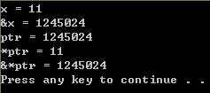
#include <stdio.h>
#include <stdlib.h>
int main()
{
int x;
int *ptr;
x = 10;
ptr = &x;
*ptr = *ptr + 1;
printf("x = %d\n", x);
printf("&x = %d\n", &x);
printf("ptr = %d\n", ptr);
printf("*ptr = %d\n", *ptr);
printf("&*ptr = %d\n", &*ptr);
system("PAUSE");
return 0;
}

Slide 12
Pointers in Functions
Previously in function, we learn to pass value to function by
Passing/call by Value
1. int cubebyvalue(int); 2. main(){ 3. int a,d; 4. printf("\na = "); 5. scanf("%d", &a); 6. 7. d = cubebyvalue(a); 8. printf("\n\n%d,%d", a,d); 9. 10. return 0; 11. } 12. int cubebyvalue(int x) 13. { 14. return(x * x * x); 15. }
Passing/call by reference
1. int cubebyreference(int*); 2. main(){ 3. int a,d; 4. printf("\na = "); 5. scanf("%d", &a); 6. 7. d=cubebyreference(&a); 8. 9. printf("\n\n %d,%d", a,d); 10. 11. return 0; 12. } 13. void cubebyreference(int *xPtr){ 14. return(*xPtr =*xPtr * *xPtr * *xPtr); 15. }

Slide 13
Pointers are often passed to a function as an argument
This is to allow data item can be accessed by the function and returned to the program

Slide 14
Arithmetic and Logical Operations on Pointers
A pointer may be incremented or decremented
An integer may be added to or subtracted from a pointer.
Pointer variables may be subtracted from one another.
Pointer variables can be used in comparisons, but usually only in a comparison to NULL.

Slide 15
When an integer is added to or subtracted from a pointer, the new pointer value is changed by the integer times the number of bytes in the data variable the pointer is pointing to.
For example, if the pointer valptr contains the address of a double precision variable and that address is 234567870, then the statement:
valptr = valptr + 2;
would change valptr to 234567886

Slide 16
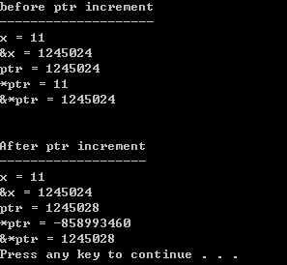
#include <stdio.h>
#include <stdlib.h>
int main()
{
int x;
int *ptr;
x = 10;
ptr = &x;
*ptr = *ptr + 1;
printf("before ptr increment\n");
printf("--------------------\n");
printf("x = %d\n", x);
printf("&x = %d\n", &x);
printf("ptr = %d\n", ptr);
printf("*ptr = %d\n", *ptr);
printf("&*ptr = %d\n\n\n", &*ptr);
ptr = ptr +1;
printf("After ptr increment\n");
printf("-------------------\n");
printf("x = %d\n", x);
printf("&x = %d\n", &x);
printf("ptr = %d\n", ptr);
printf("*ptr = %d\n", *ptr);
printf("&*ptr = %d\n", &*ptr);
system("PAUSE");
return 0;
}

Slide 17
Pointers and One-Dimensional Array
Array name is a pointer to the first element.
Address of first array element is &x[0] or x.
Address of 2nd element is &x[1] or (x+1).
So, address for i element is &x[i] or (x+i).
Then to retrieve the content of i element is x[i] or *(x+i).

Slide 18
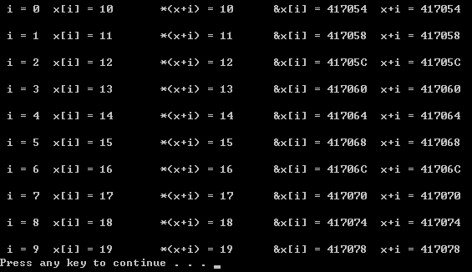
#include <stdio.h>
#include <stdlib.h>
int main()
{
static int x[10] = {10,11,12,13,14,15,16,17,18,19};
int i;
for (i = 0; i <= 9; ++i)
{
printf("\n i = %d\tx[i] = %d\t*(x+i) = %d", i, x[i], *(x+i));
printf("\t &x[i] = %X\t x+i = %X\n", &x[i], (x+i));
}
system("PAUSE");
return 0;
}

Slide 19
Pointer and Multidimensional Arrays
Since one dimensional array can be represented by pointer (the array name)
Pointer can also used in representing multidimensional array.

Slide 20
A multidimensional array can be declare as below:
Noted that for
int x[ ][20];
It become
int (*x)[20];
Datatype (*ptr)[expression1] [expression2]…[expression i]

Slide 21
To retrieve content of one dimensional array for array declared using pointer, it will be
*(arrayname + i)
Example:
to retrieve x[2][5] in array declared using pointer, the code will be
*(*(x+2)+5)

Slide 22
Array and String
Since array name is the pointer to the first element,
When dealing with strings, the retrieval of the strings can be done by calling the content pointer to the array
* arrayname

Slide 23


#include <stdio.h>
#include <stdlib.h>
char x[] = "Externally";
int main()
{
static char y[ ] = "Internally";
printf("\n%s", x);
printf("\n%s\n", y);
system("PAUSE");
return 0;
}
#include <stdio.h>
#include <stdlib.h>
char *x = "Externally";
int main()
{
static char *y = "Internally";
printf("\n%s", x);
printf("\n%s\n", y);
system("PAUSE");
return 0;
}

Slide 24
Dynamic Memory Allocation
Previously, the number of elements already been defined when declaring the array
But since a array name is actually a pointer to the first element, it is possible to define array as a pointer variable rather than as a conventional array.
In other meaning, you may no need to fixed the number of elements within an array.

Slide 25
This is called Dynamic Memory Allocation
Generally it is done using a C function called malloc (under stdlib.h)
arrayname = (datatype *) malloc (quantity * sizeof(datatype));

Slide 26
Reordering the content of Array
The content of the array is entered by user.
Sometime an ordered list / content are required for further operation or output.
The reordering can be done by comparing two elements in the array and swap their position if needed.
The process need to carry out to compare and swap all the element to be in ordered.

Slide 27
#include <stdio.h>
#include <stdlib.h>
void reorder(int n, int *x);
int main()
{
int i, n, *x;
printf("\nHow many numbers will be entered?");
scanf("%d", &n);
printf("\n");
x = (int*)malloc(n * sizeof(int));
for(i = 0; i < n; ++i)
{ printf("i = %d\t x = ", i+1);
scanf("%d", x+i);
}
reorder(n, x);
printf("\n\nReordered list of Numbers:\n\n");
for (i = 0; i < n; ++i)
{
printf("i = %d\t x = %d\n", i+1, *(x+i));
}
system("PAUSE");
return 0;
}
/*Display the ordered list of numbers*/
/*rearrange the list of numbers*/
void reorder(int n, int *x)
{
int i, item, temp;
/*find the smallest of al remaining elements*/
for(item = 0; item < n - 1; ++item)
{
for (i=item+1; i < n; ++i)
{
if (*(x+i) < *(x+item))
{
/*interchange two elements*/
temp = *(x+item);
*(x+item) = *(x+i);
*(x+i) = temp;
}
}
}
}

Slide 28
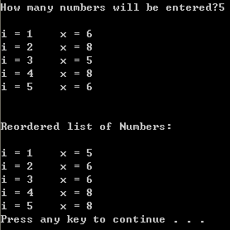

Slide 29
Advance Reordering Algorithm
Beside the reordering technique shown, there are others more complicated technique to reordering the elements in a list / array.
These techniques are called sorting algorithm
Will be learn in Data Structure and Algorithm (Senior called it C++ class).

Slide 30
END

