Slide 1
Let C
Review class 1
Dr. Md. Al Mamun

Slide 2
C Basic
• Variable declarations: int i ; float f ;
• Intialization: char c=’A’; int x=y=10;
• Operators: +,−,∗,/,%
• Expressions: int x,y,z;
x=y∗2+z∗3;
• Function: int factorial (int n); /∗function takes int, returns int∗/

Slide 3
Integer Types
Standard integer types with its storage sizes and value ranges:
Type | Storage Size | Value Range
char | 1 byte | -128 to 127 or 0 to 255
Unsigned char | 1 byte | 0 to 255
signed char | 1 byte | -128 to 127
int | 2 or 4 bytes | -32,768 to 32,767 or -2,147,483,648 to 2,147,483,647
unsigned int | 2 or 4 bytes | 0 to 65,535 or 0 to 4,294,967,295
short | 2 bytes | -32,768 to 32,767
unsigned short | 2 bytes | 0 to 65,535
long | 4 byte | -2,147,483,648 to 2,147,483,647
unsigned long | 4 bytes | 0 to 4,294,967,295

Slide 4
Floating-Point Types
#include <stdio.h>
#include <float.h>
int main()
{
printf("Storage size for float : %d \n", sizeof(float));
printf("Minimum float positive value: %E\n", FLT_MIN ); printf("Maximum float positive value: %E\n", FLT_MAX ); printf("Precision value: %d\n", FLT_DIG );
return 0;
}
Output Storage size for float : 4 Minimum float positive value: 1.175494E-38 Maximum float positive value: 3.402823E+38 Precision value: 6

Slide 5
Defining Constant
#include <stdio.h>
#define LENGTH 10
#define WIDTH 5
#define NEWLINE '\n’
int main() {
int area;
area = LENGTH * WIDTH;
printf("value of area : %d", area);
printf("%c", NEWLINE);
return 0;
}

Slide 6
Defining Constant
#include <stdio.h>
int main() {
const int LENGTH = 10;
const int WIDTH = 5;
const char NEWLINE = '\n';
int area;
area = LENGTH * WIDTH;
printf("value of area : %d", area);
printf("%c", NEWLINE);
return 0;
}

Slide 7
C Operators
Operator performs mathematical or logical operations on the variables
• Arithmetic Operators
• Relational Operators
• Logical Operators
• Bitwise Operators
• Assignment Operators
• Misc Operators

Slide 8
Arithmetic Operators
#include <stdio.h>
main() {
int a = 21; int b = 10; int c ;
c = a + b;
printf("Line 1 - Value of c is %d\n", c );
c = a - b;
printf("Line 2 - Value of c is %d\n", c );
c = a * b;
printf("Line 3 - Value of c is %d\n", c );
c = a / b; printf("Line 4 - Value of c is %d\n", c );
c = a % b;
printf("Line 5 - Value of c is %d\n", c );
c = a++;
printf("Line 6 - Value of c is %d\n", c );
c = a--;
printf("Line 7 - Value of c is %d\n", c );
}

Slide 9
Relational Operators
#include <stdio.h>
void main() {
int a = 21;
int b = 10;
int c ;
if( a == b )
printf("Line 1 - a is equal to b\n" );
else
printf("Line 1 - a is not equal to b\n" ); if ( a < b )
printf("Line 2 - a is less than b\n" );
else
printf("Line 2 - a is not less than b\n" ); if ( a > b )
printf("Line 3 - a is greater than b\n" );
else
printf("Line 3 - a is not greater than b\n" );
/* Lets change value of a and b */
a = 5; b = 20;
if ( a <= b )
printf("Line 4 - a is either less than or equal to b\n" ); if ( b >= a )
printf("Line 5 - b is either greater than or equal to b\n" );
}

Slide 10
Logical Operators
#include <stdio.h> main()
{ int a = 5;
int b = 20;
int c ;
if ( a && b )
printf("Line 1 - Condition is true\n" );
if ( a || b )
printf("Line 2 - Condition is true\n" );
/* lets change the value of a and b */
a = 0; b = 10;
if ( a && b )
printf("Line 3 - Condition is true\n" );
else
printf("Line 3 - Condition is not true\n" );
if ( !(a && b) )
printf("Line 4 - Condition is true\n" );
}

Slide 11
Bitwise Operators (Example)
A = 00111100 (60) B = 00001101 (13)
(A & B) will give 12, which is 0000 1100
(A | B) will give 61, which is 0011 1101
(A ^ B) will give 49, which is 0011 0001
(~A ) will give -60, which is 1100 0011
A << 2 will give 240, which is 1111 0000
A >> 2 will give 15, which is 0000 1111

Slide 12
Bitwise Operators (Example)
#include <stdio.h>
Void main() {
unsigned int a = 60;
unsigned int b = 13;
int c = 0;
/* 60 = 0011 1100 */
/* 13 = 0000 1101 */
c = a & b; /* 12 = 0000 1100 */
printf("Line 1 - Value of c is %d\n", c );
c = a | b; /* 61 = 0011 1101 */
printf("Line 2 - Value of c is %d\n", c );
c = a ^ b; /* 49 = 0011 0001 */
printf("Line 3 - Value of c is %d\n", c );
c = ~a; /*-61 = 1100 0011 */
printf("Line 4 - Value of c is %d\n", c );
c = a << 2; /* 240 = 1111 0000 */
printf("Line 5 - Value of c is %d\n", c );
c = a >> 2; /* 15 = 0000 1111 */
printf("Line 6 - Value of c is %d\n", c );
}

Slide 13
Assignment Operators
Operator | Description
+ | C = A + B will assign value of A + B in C
+= | C += A is equivalent to C = C + A
-= | C -= A is equivalent to C = C - A
*= | C *= A is equivalent to C = C * A
/= | C /= A is equivalent to C = C / A
%= | C %= A is equivalent to C = C % A
<<= | C <<= 2 is same as C = C << 2
>>= | C >>= 2 is same as C = C >> 2
&= | C &= 2 is same as C = C & 2
^= | C ^= 2 is same as C = C ^ 2
|= | C |= 2 is same as C = C | 2

Slide 14
Misc Operators
Operator | Description | Example
sizeof() | Returns the size of an variable.
& | Returns the address of an variable.
* | Pointer to a variable.
?: | Conditional Expression | (a>b)?1:0

Slide 15
Operators Precedence in C
Category | Operator | Associativity
Postfix | () [] -> . ++ - - | Left to right
Unary | + - ! ~ ++ - - (type)* & sizeof | Right to left
Multiplicative | */ % | Left to right
Additive | +- | Left to right
Shift | << >> | Left to right
Relational | <<= >>= | Left to right
Equality | == != | Left to right
Bitwise AND | & | Left to right
Bitwise XOR | ^ | Left to right
Bitwise OR | | | Left to right
Logical AND | && | Left to right
Logical OR | || | Left to right
Conditional | ?: | Right to left
Assignment | = += -= *= /= %= >>= <<= &= ^= |= | Right to left
Comma | . | Left to right

Slide 16
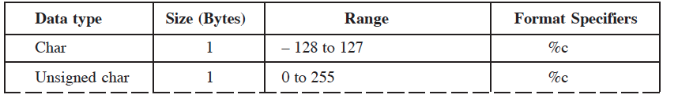
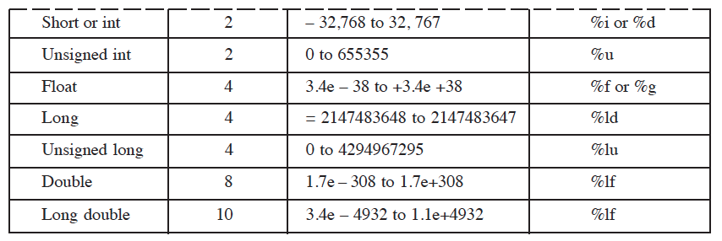

Slide 17
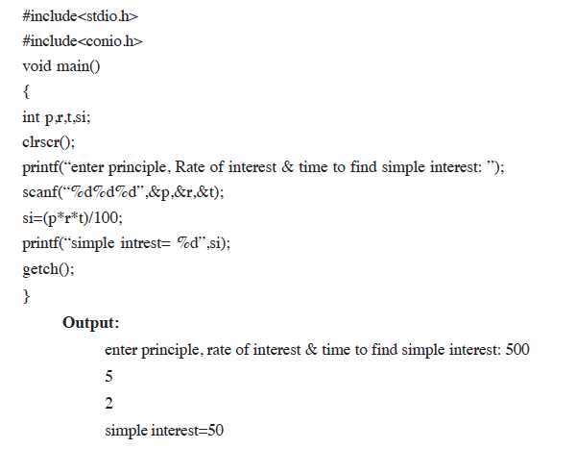
Find the simple interest

Slide 18

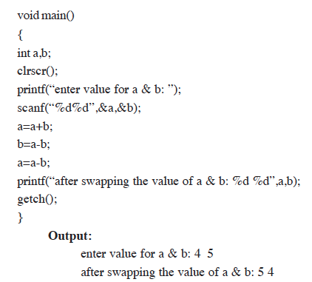
Swap two variable without 3rd Variable

Slide 19
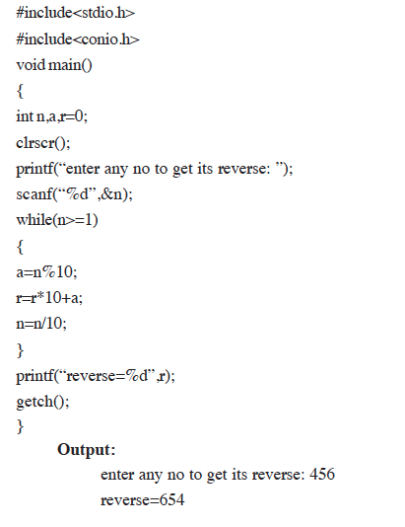
Find the reverse of a number

Slide 20
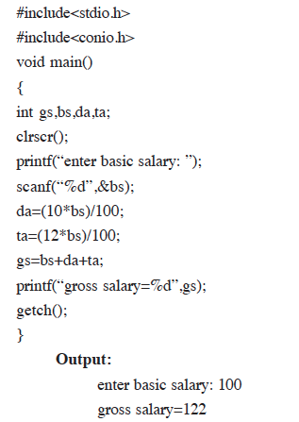
Find the gross salary

Slide 21
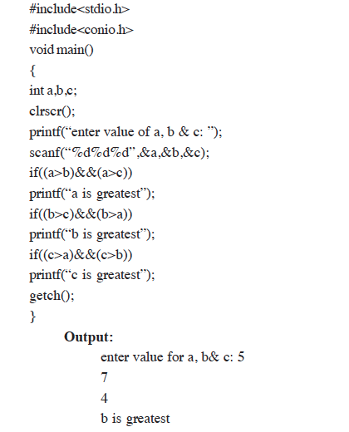
Find the biggest among 3 numbers

Slide 22
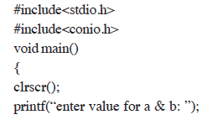
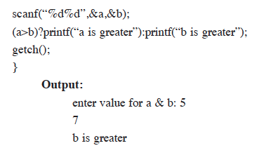
Use of ?:

Slide 23
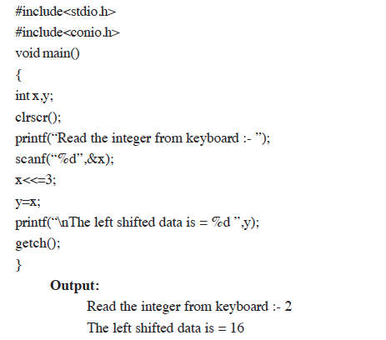
Shift the given data by 2 bits to the left

Slide 24
Let C Decision Making and Branching

Slide 25
If statement
Condition
False
True
Statement/ Expression

Slide 26
Syntax
if(boolean_expression)
{
/* statement(s) will execute if the boolean expression is true */
}

Slide 27
If else statement
Condition
False
True
Statement/ Expression
Statement/ Expression

Slide 28
Syntax
if(boolean_expression)
{ /* statement(s) will execute if the boolean expression is true */
}
else
{ /* statement(s) will execute if the boolean expression is false */
}

Slide 29
The if...else if...else Statement
T
F
T
F
F T
F
Condition
Statement/ Expression
Condition
Statement/ Expression
Condition
Statement/ Expression
Statement/ Expression

Slide 30
Syntax
if(boolean_expression 1)
{
/* Executes when the boolean expression 1 is true */
} else if( boolean_expression 2)
{
/* Executes when the boolean expression 2 is true */
} else if( boolean_expression 3)
{
/* Executes when the boolean expression 3 is true */
}
else
{
/* executes when the none of the above condition is true */
}

Slide 31
Nested if statements Nested if statements
You can use one if or else if statement inside another if or else if statement(s)
Syntax:
if( boolean_expression 1)
{
/* Executes when the boolean expression 1 is true */
if(boolean_expression 2)
{
/* Executes when the boolean expression 2 is true */
}
}

Slide 32
Nested if statements
T T T
F
Condition
Condition
Condition
Statement/ Expression

Slide 33
switch statement switch statement
A switch statement allows a variable to be tested for equality against a list of values.
Syntax:
switch(expression){
case constant-expression :
statement(s); break; /* optional */
case constant-expression :
statement(s); break; /* optional */
……
/* you can have any number of case statements */
default : /* Optional */
statement(s);
}

Slide 34
switch statement
Condition
Case 1
Case 2
Default
Statement/ Expression
Statement/ Expression
Statement/ Expression

Slide 35
Example
#include <stdio.h>
int main () {
/* local variable definition */
char grade = 'B';
switch(grade) {
case 'A' :
printf("Excellent!\n" );
break;
case 'B' :
case 'C' :
printf("Well done\n" );
break;
case 'D' :
printf("You passed\n" );
break;
case 'F' :
printf("Better try again\n" );
break;
default :
printf("Invalid grade\n" );
}
printf("Your grade is %c\n", grade );
return 0; }

Slide 36
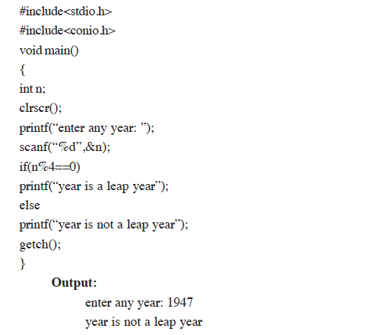
Find the given year is leap year or not

Slide 37
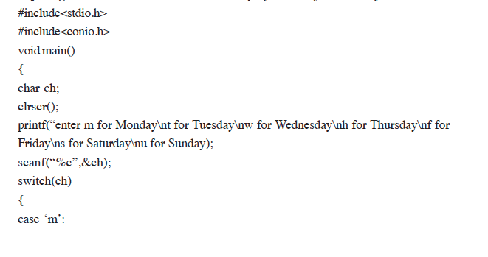
Use switch statement to display Monday to sunday

Slide 38
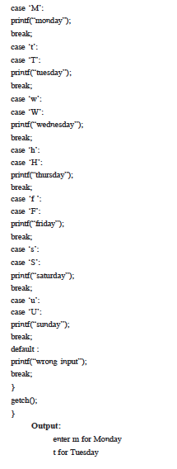


Slide 39
While Loop
Condition
False
True
Statement/ Expression

Slide 40
For Loop
Initialization
Condition
False
True
Statement/ Expression
Update

Slide 41
Nested for
for ( init; condition; increment )
{
for ( init; condition; increment )
{
statement(s);
}
statement(s);
}

Slide 42
Nested while
while(condition)
{
while(condition)
{
statement(s);
}
statement(s);
}

Slide 43
Nested do…..while
do
{
statement(s);
do {
statement(s);
}while( condition );
}while( condition );

Slide 44
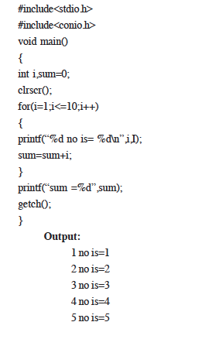
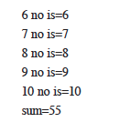
Display the first 10 natural number and their sum

Slide 45
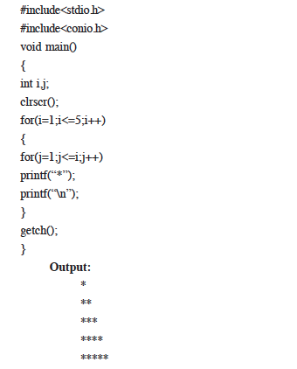
Print Square sequence 1

Slide 46
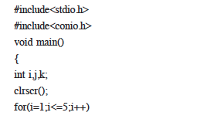
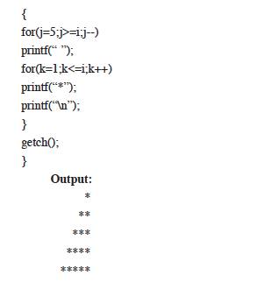
Print Square sequence 2

Slide 47
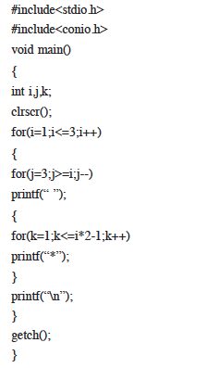

Print Square sequence 3

Slide 48
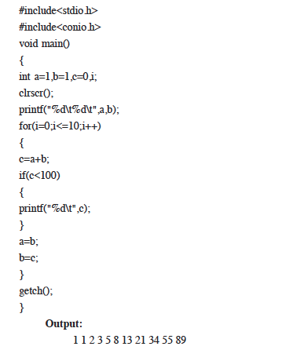
Print the Fibonacci series up to 100

Slide 49
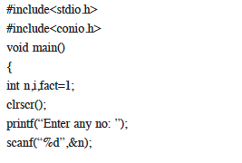
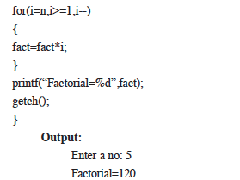
Find the factorial of a number

Slide 50
Example
#include <stdio.h>
int main () {
/* local variable definition */
int i, j;
for(i=2; i<100; i++)
{ for(j=2; j <= (i/j); j++)
if(!(i%j)) break; // if factor found, not prime
if(j > (i/j))
printf("%d is prime\n", i);
}
return 0; }

Slide 51
Output
2 is prime
3 is prime
5 is prime
7 is prime
11 is prime
13 is prime
17 is prime
19 is prime
23 is prime
29 is prime
31 is prime
37 is prime
41 is prime
43 is prime
47 is prime
53 is prime
59 is prime
61 is prime

Slide 52
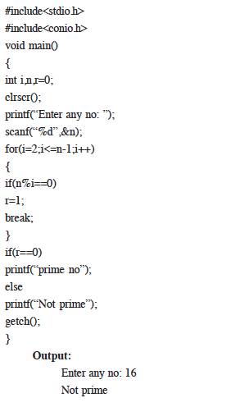
Find a given number is prime or not

Slide 53
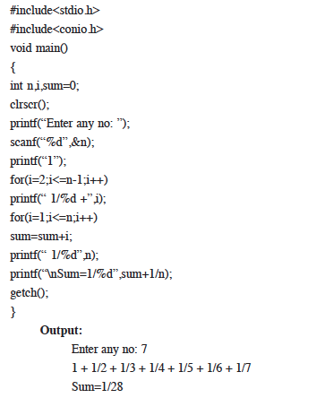
Print sum of series 1+1/2+1/3+…1/n

Slide 54
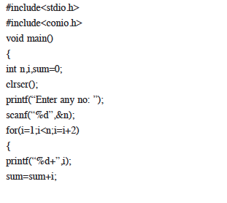
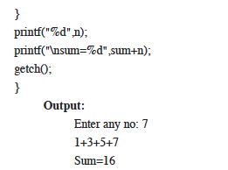
Display sum of 1+3+5+…..+n

Slide 55
break statement
Statement/ Expression
Condition
True
False
break

Slide 56
Example
#include <stdio.h>
int main () {
/* local variable definition */
int a = 10;
/* while loop execution */
while( a < 20 ) {
printf("value of a: %d\n", a);
a++; if( a > 15)
{
/* terminate the loop using break statement */
break;
}
}
return 0;
}

Slide 57
continue statement
Statement/ Expression
Condition
True
False
continue

Slide 58
Example
#include <stdio.h> int main () {
/* local variable definition */ int a = 10;
/* do loop execution */
do
{ if( a == 15) {
/* skip the iteration */ a = a + 1;
continue; }
printf("value of a: %d\n", a); a++;
}while( a < 20 );
return 0;
}

Slide 59
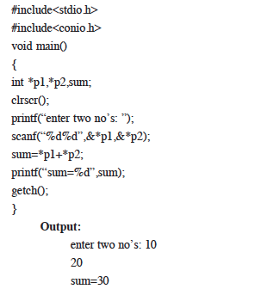
Add two numbers using pointer

Slide 60
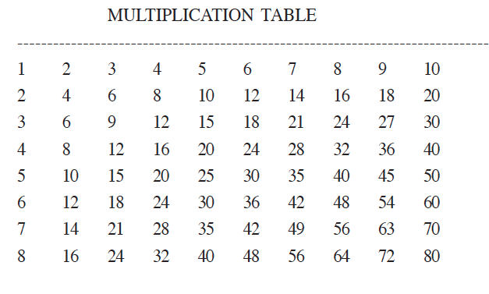
Evaluate the equation y=xn when n is a non-negative integer.
Print the multiplication table from 1*1 to 12*10 like

Slide 61
