Slide 1
Strings

Slide 2
What is string?
Strings are actually one-dimensional array of characters terminated by a null character '\0'.
The following declaration and initialization create a string consisting of the word "Hello".
The size of the character array containing the string is one more than the number of characters.

Slide 3
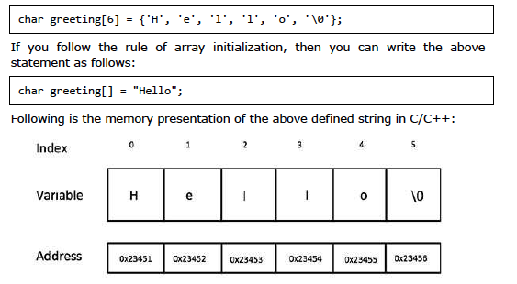

Slide 4
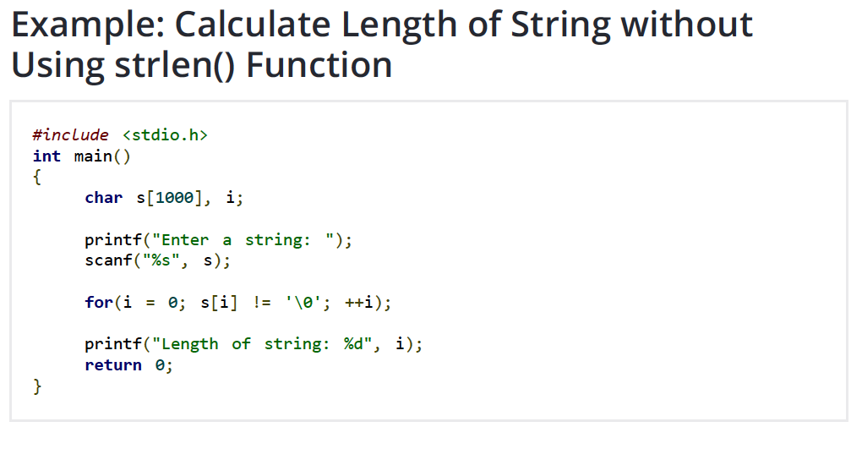

Slide 5
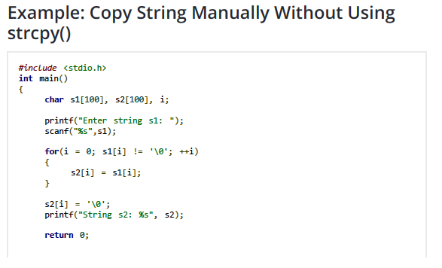

Slide 6
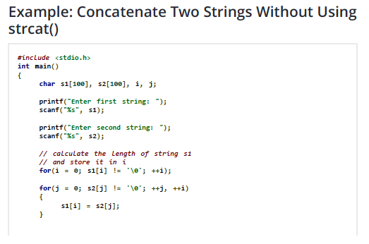


Slide 7
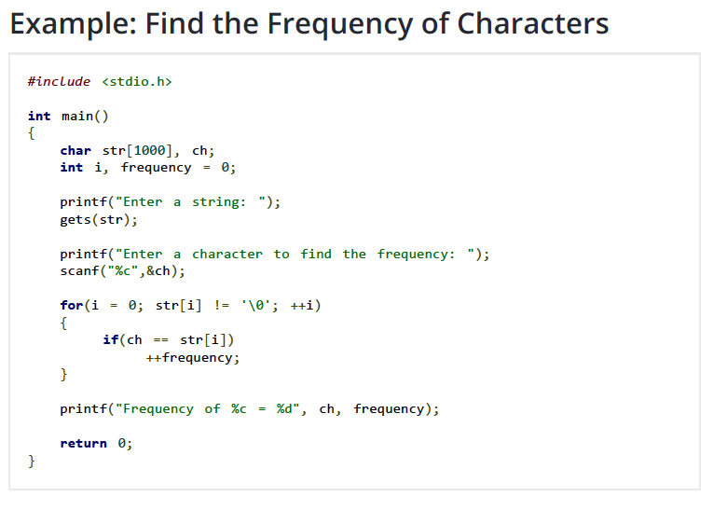

Slide 8
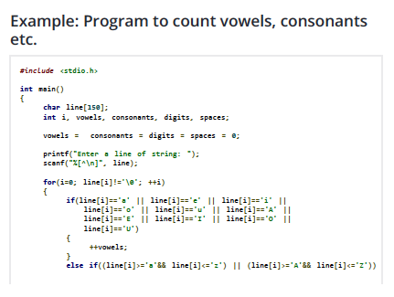
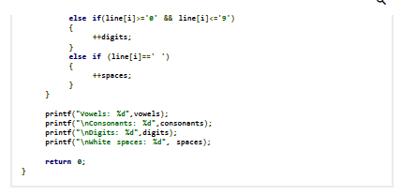

Slide 9
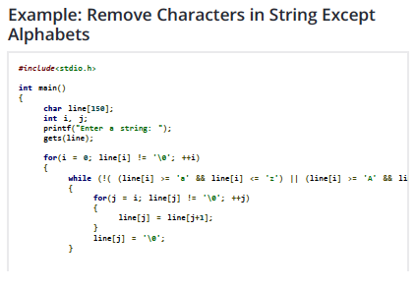

Slide 10
