Slide 1
Character and Strings

Slide 2
Overview
Fundamentals of Strings and Characters
Character Handling Library
String Conversion Function
Standard Input/Output Library Functions
String Manipulation Functions
Comparison Functions
Search Functions
Memory Functions

Slide 3
A. Fundamentals of Strings and Characters
Characters
Building blocks of programs
Every program is a sequence of meaningfully grouped characters
Character constant
An int value represented as a character in single quotes
'z' represents the integer value of z
Strings
Series of characters treated as a single unit
Can include letters, digits and special characters (*, /, $)
String literal (string constant) - written in double quotes
"Hello"
Strings are arrays of characters
String a pointer to first character
Value of string is the address of first character

Slide 4
Fundamentals of Strings and Characters
String definitions
Define as a character array or a variable of type char *
char color[] = "blue";
char *colorPtr = "blue";
Remember that strings represented as character arrays end with '\0'
color has 5 elements
Inputting strings
Use scanf
scanf("%s", word);
Copies input into word[]
Do not need & (because a string is a pointer)
Remember to leave room in the array for '\0'

Slide 5
B. Character Handling Library
Character handling library
Includes functions to perform useful tests and manipulations of character data
Each function receives a character (an int) or EOF as an argument
The following slides contain a table of all the functions in <ctype.h>
When using functions from the character-handling library, include the <ctype.h> header.

Slide 6
Character-handling library functions. (Part 1 of 2.)

Slide 7
Character-handling library functions. (Part 2 of 2.)

Slide 8
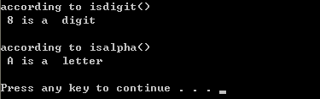
isdigit() & isalpha()
1. #include <stdio.h>
2. #include <stdlib.h>
3. #include <ctype.h>
4. int main()
5. {
6.
7. printf("according to isdigit()\n %s digit \n\n", isdigit( '8' ) ? "8 is a " : "8 is not a ");
8.
9. printf("according to isalpha()\n %s letter \n\n", isalpha( 'A' ) ? "A is a " : "A is not a ");
10.
11. system("PAUSE");
12.
13. return 0;
14.
15. }

Slide 9
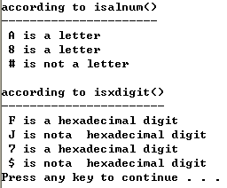
isalnum() & isxdigit()
1. #include <stdio.h>
2. #include <stdlib.h>
3. #include <ctype.h>
4. int main()
5. {
6. printf("according to isalnum()");
7. printf("\n----------------------");
8. printf("\n %s letter ", isalnum( 'A' ) ? "A is a" : "A is not a");
9. printf("\n %s letter ", isalnum( '8' ) ? "8 is a" : "8 is not a");
10. printf("\n %s letter ", isalnum( '#' ) ? "# is a" : "# is not a");
11.
12. printf("\n\naccording to isxdigit()");
13. printf("\n-----------------------");
14. printf("\n %s hexadecimal digit ", isxdigit( 'F' ) ? "F is a" : "F is nota ");
15. printf("\n %s hexadecimal digit ", isxdigit( 'J' ) ? "J is a" : "J is nota ");
16. printf("\n %s hexadecimal digit ", isxdigit( '7' ) ? "7 is a" : "7 is nota ");
17. printf("\n %s hexadecimal digit ", isxdigit( '$' ) ? "$ is a" : "$ is nota ");
18.
19. printf("\n");
20. system("PAUSE");
21.
22. return 0;
23. }

Slide 10
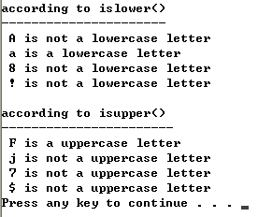
islower() & isupper()
1. #include <stdio.h>
2. #include <stdlib.h>
3. #include <ctype.h>
4. int main()
5. {
6. printf("according to islower()");
7. printf("\n----------------------");
8. printf("\n %s lowercase letter ", islower( 'A' ) ? "A is a" : "A is not a");
9. printf("\n %s lowercase letter ", islower( 'a' ) ? "a is a" : "a is not a");
10. printf("\n %s lowercase letter ", islower( '8' ) ? "8 is a" : "8 is not a");
11. printf("\n %s lowercase letter ", islower( '!' ) ? "! is a" : "! is not a");
12. printf("\n\naccording to isupper()");
13. printf("\n-----------------------");
14. printf("\n %s uppercase letter ", isupper( 'F' ) ? "F is a" : "F is not a");
15. printf("\n %s uppercase letter ", isupper( 'j' ) ? "j is a" : "j is not a");
16. printf("\n %s uppercase letter ", isupper( '7' ) ? "7 is a" : "7 is not a");
17. printf("\n %s uppercase letter ", isupper( '$' ) ? "$ is a" : "$ is not a");
18. printf("\n");
19. system("PAUSE");
20. return 0;
21. }

Slide 11
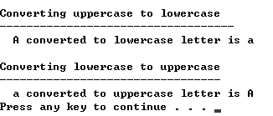
tolower() & toupper()
1. #include <stdio.h>
2. #include <stdlib.h>
3. #include <ctype.h>
4. int main()
5. {
6. printf("\nConverting uppercase to lowercase");
7. printf("\n-----------------------------------");
8. printf("\n A converted to lowercase letter is %c", tolower( 'A' ));
9. printf("\n\nConverting lowercase to uppercase");
10. printf("\n---------------------------------");
11. printf("\n a converted to uppercase letter is %c", toupper( 'a' ));
12.
13. printf("\n");
14. system("PAUSE");
15. return 0;
16. }

Slide 12
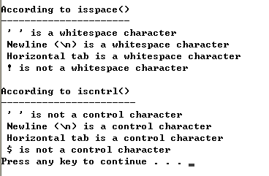
isspace() & iscntrl()
1. #include <stdio.h>
2. #include <stdlib.h>
3. #include <ctype.h>
4. int main()
5. {
6. printf("\nAccording to isspace()");
7. printf("\n----------------------");
8. printf("\n %s whitespace character ", isspace( ' ' ) ? "\' \' is a" : "\' \' is not a");
9. printf("\n %s whitespace character ", isspace( '\n' ) ? "Newline (\n) is a" : "Newline (\n) is not a");
10. printf("\n %s whitespace character ", isspace( '\t' ) ? "Horizontal tab is a" : "Horizontal tab is not a");
11. printf("\n %s whitespace character ", isspace( '!' ) ? "! is a" : "! is not a");
12. printf("\n\nAccording to iscntrl()");
13. printf("\n-----------------------");
14. printf("\n %s control character ", iscntrl( ' ' ) ? "\' \' is a" : "\' \' is not a");
15. printf("\n %s control character ", iscntrl( '\n' ) ? "Newline (\n) is a" : "Newline (\n) is not a");
16. printf("\n %s control character ", iscntrl( '\t' ) ? "Horizontal tab is a" : "Horizontal tab is not a");
17. printf("\n %s control character ", iscntrl( '$' ) ? "$ is a" : "$ is not a");
18. printf("\n");
19. system("PAUSE");
20. return 0;
21. }

Slide 13
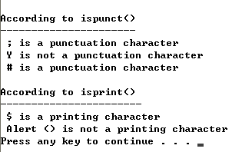
ispunct() & isprint()
1. #include <stdio.h>
2. #include <stdlib.h>
3. #include <ctype.h>
4.
5. int main()
6. {
7. printf("\nAccording to ispunct()");
8. printf("\n----------------------");
9. printf("\n %s punctuation character ", ispunct( ';' ) ? "; is a" : "; is not a");
10. printf("\n %s punctuation character ", ispunct( 'Y' ) ? "Y is a" : "Y is not a");
11. printf("\n %s punctuation character ", ispunct( '#' ) ? "# is a" : "# is not a");
12.
13. printf("\n\nAccording to isprint()");
14. printf("\n-----------------------");
15. printf("\n %s printing character ", isprint( '$' ) ? "$ is a" : "$ is not a");
16. printf("\n %s printing character ", isprint( '\a' ) ? "Alert (\a) is a" : "Alert (\a) is not a");
17.
18. printf("\n");
19. system("PAUSE");
20.
21. return 0;
22. }

Slide 14
C. Standard Input/Output Library Functions
Functions in <stdio.h>
Used to manipulate character and string data

Slide 15
Standard input/output library character and string functions.

Slide 16
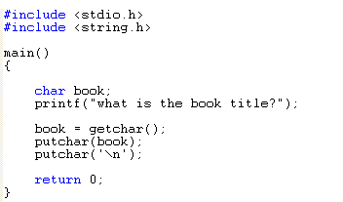
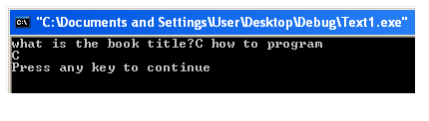
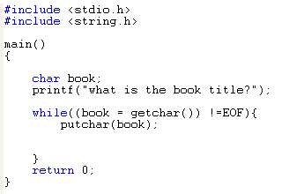

getchar() & putchar()

Slide 17
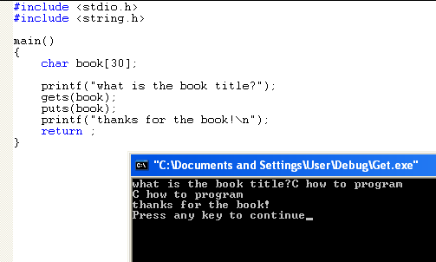
gets() & puts()

Slide 18
sprintf() & sscanf()
char *box;
sprintf(box,”This is a sprintf”);
puts(box);
char *box=“This is a sscanf”;
char *fox;
sscanf(box,”%s”,fox);
puts(fox);

Slide 19
D. String Manipulation Functions of the String Handling Library
String handling library has functions to
Manipulate string data
Search strings
Tokenize strings
Determine string length

Slide 20
String-manipulation functions of the string-handling library.

Slide 21
strcpy() & strncpy()
strcpy
Copies its second argument ( a string ) into its first argument ( a char array that must be large enough to store the string and its terminating null char )
strncpy
Equivalent to strcpy, except that strncpy specifies the number of char to be copied from the string into the array

Slide 22

Example
#include <stdio.h>
#include <stdlib.h>
#include <string.h>
int main()
{
char x[] = "Happy Birthday to You";
char y[25];
char z[15];
printf("\nThe string in array x is: %s", x);
printf("\nThe string in array y is: %s", strcpy(y,x));
strncpy(z,x,14);
z[14] = '\0';
printf("\nThe string in array z is: %s", z);
printf("\n");
system("PAUSE");
return 0;
}

Slide 23
strcat() & strncat()
strcat
Appends its second argument ( a string) to its first argument ( a char array containing a string).
strncat
Appends a specified number of characters from the second string to the first string.

Slide 24
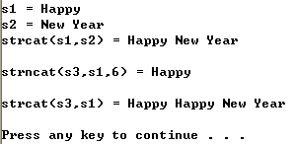
Example
#include <stdio.h>
#include <stdlib.h>
#include <string.h>
int main()
{
char s1[] = "Happy ";
char s2[] = "New Year ";
char s3[40] = "";
printf("\ns1 = %s", s1);
printf("\ns2 = %s", s2);
printf("\nstrcat(s1,s2) = %s\n", strcat(s1,s2));
printf("\nstrncat(s3,s1,6) = %s\n", strncat(s3,s1,6));
printf("\nstrcat(s3,s1) = %s \n", strcat(s3,s1));
printf("\n");
system("PAUSE");
return 0;
}

Slide 25
E. Comparison Functions of the String-Handling Library
Comparing strings
Computer compares numeric ASCII codes of characters in string
Appendix D has a list of character codes

Slide 26
String-comparison functions of the string-handling library.

Slide 27
strcmp
Compares its first string argument with its second string argument, character by char
Return 0 if string are equal
Return –ve value if the first string is < second string and +ve value if the first string > second string
strncmp
Equivalent to strcmp, except compares up to a specified numbers of char.

Slide 28
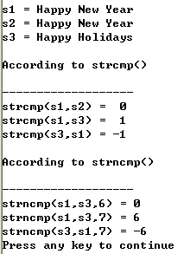
Example
#include <stdio.h>
#include <stdlib.h>
#include <string.h>
int main()
{
const char *s1 = "Happy New Year";
const char *s2 = "Happy New Year";
const char *s3 = "Happy Holidays";
printf("\ns1 = %s",s1);
printf("\ns2 = %s",s2);
printf("\ns3 = %s",s3);
printf("\n\nAccording to strcmp()");
printf("\n\n-------------------");
printf("\nstrcmp(s1,s2) = %2d", strcmp(s1,s2));
printf("\nstrcmp(s1,s3) = %2d", strcmp(s1,s3));
printf("\nstrcmp(s3,s1) = %2d", strcmp(s3,s1));
printf("\n\nAccording to strncmp()");
printf("\n\n-------------------");
printf("\nstrncmp(s1,s3,6) = %d", strncmp(s1,s3,3));
printf("\nstrncmp(s1,s3,7) = %d", strncmp(s1,s3,9));
printf("\nstrncmp(s3,s1,7) = %d", strncmp(s3,s1,9));
printf("\n");
system("PAUSE");
return 0;
}

Slide 29
String-manipulation functions of the string-handling library. (Part 1 of 2.)

Slide 30
String-manipulation functions of the string-handling library. (Part 2 of 2.)

Slide 31
strchr
Searches for the first occurrence of a character in a string. If the char is found, strchr returns a pointer to the char in the string, otherwise, return NULL

Slide 32

Example
#include <stdio.h>
#include <stdlib.h>
#include <string.h>
int main()
{
const char *string = "This is a test";
char character1 = 'a';
char character2 = 'z';
if (strchr(string, character1)!= NULL)
printf("\"%c\" was found in \"%s\".\n", character1, string);
else
printf("\"%c\" was not found in \"%s\".\n", character1, string);
if (strchr(string, character2)!= NULL)
printf("\"%c\" was found in \"%s\".\n", character2, string);
else
printf("\"%c\" was not found in \"%s\".\n", character2, string);
printf("\n");
system("PAUSE");
return 0;
}

Slide 33
strcspn
Determines the length of the initial part of the string in its first argument that does not contain any character from the string in its second arguments

Slide 34

Example
#include <stdio.h>
#include <stdlib.h>
#include <string.h>
int main()
{
const char *string1 = "The value is 3.14159";
const char *string2 = "1234567890";
printf("\nString1 = %s", string1);
printf("\nString2 = %s", string2);
printf("\nThe length of the initial segment of string1 \n containing no characters from string2 = %u", strcspn(string1, string2));
printf("\n");
system("PAUSE");
return 0;
}

Slide 35
strpbrk
Searches its first string argument for the first occurrence of any char in its second string argument
If a char from the second argument is found, strpbrk returns a pointer to the char in the first argument, otherwise return NULL

Slide 36

Example
#include <stdio.h>
#include <stdlib.h>
#include <string.h>
int main()
{
const char *string1 = "This is a test";
const char *string2 = "beware";
printf("\n of the characters in \"%s\"", string2);
printf("\n \'%c\'appear earliest in \"%s\"",*strpbrk(string1,string2), string1);
printf("\n");
system("PAUSE");
return 0;
}

Slide 37
strrchr
Searches for the last occurrence of the specified char in string.
If the char is found, strrchr returns a pointer to the char in the string, otherwise, return NULL

Slide 38

Example
#include <stdio.h>
#include <stdlib.h>
#include <string.h>
int main()
{
const char *string1 = "A zoo has many animals including zebras";
int c = 'z';
printf("\nThe remainder of string1 beggining with the");
printf("\nlast occurrence of character %c is: %s", c, strrchr(string1,c));
printf("\n");
system("PAUSE");
return 0;
}

Slide 39
strspn
Determines the length of the initial part of the string in its first argument that contains only char from the string in its second argument.
The function returns the length of the segment.

Slide 40
strspn returns the length of the initial segment of string1 that contains only characters from string2

Slide 41
strstr
Searches for the first occurrence of its second string argument in its first string argument.
If the second string is found in the first string, a pointer to the location of the string in the first argument is returned.
char *str1 = “borland International”;
char *str2=“Inter”;
printf(“%s”,strstr(str1,str2));

Slide 42
strtok
To break a string into a series of tokens

Slide 43
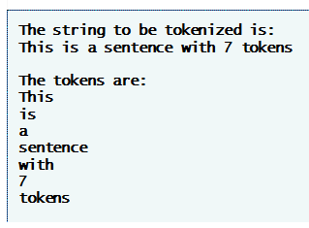

strtok “tokenizes” string by breaking it into tokens at each space
Calling strtok again and passing it NULL continues the tokenizing of the previous string

Slide 44
Memory functions of the string-handling library.

Slide 45
memcpy copies the first 17 characters from object s2 into object s1

Slide 46
memmove copies the first 10 characters from x[5] into object x by means of a temporary array

Slide 47
memcmp compares the first 4 characters of objects s1 and s2

Slide 48
memchr locates the first occurrence of the character r inside the first 16 characters of object s

Slide 49
memset copies the character b into the first 7 characters of object string1

Slide 50
Other functions of the string-handling library.

Slide 51
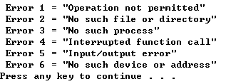
strerror()
#include <stdio.h>
#include <stdlib.h>
#include <string.h>
int main()
{
printf("\n Error 1 = \"%s\"", strerror(1));
printf("\n Error 2 = \"%s\"", strerror(2));
printf("\n Error 3 = \"%s\"", strerror(3));
printf("\n Error 4 = \"%s\"", strerror(4));
printf("\n Error 5 = \"%s\"", strerror(5));
printf("\n Error 6 = \"%s\"", strerror(6));
printf("\n");
system("PAUSE");
return 0;
}
strerror returns an error message based on the number passed to it

Slide 52
strlen returns the length of string1

Slide 53
References
Problem Solving using C, Uckan, Yuksel, Mc Graw Hill, 1999.
C How to Program, Deitel&Deitel, Prentice-Hall, 5th Edition, 2007.

Slide 54
END

