Slide 1
Smartphone Predictor
Team No : 12
Team Name : Team Rocket
Team Members :
1) Shivam Singh – 2018201015
2) Neelesh Bhakt – 2018201022
3) Tarpit Sahu – 2018201089
4) Anurag Chaturvedi - 2018201024

Slide 2
Description
Given various attributes of smartphones, predict brand and model.
Expectation
Scrape web data to obtain features.
Smartphone Predictor

Slide 3
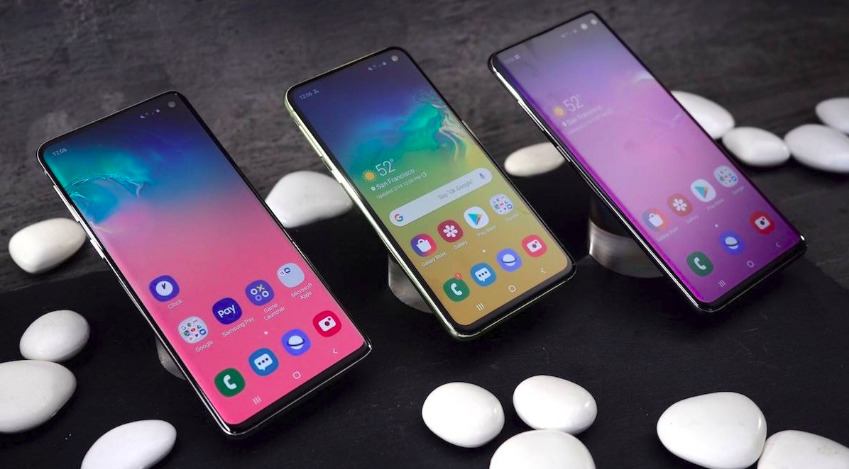
Motivation for smartphone prediction
It is convenient to have an idea of phone brand and model,
before purchasing and diving deep into the different
specifications of mobiles.
Smartphone Predictor

Slide 4
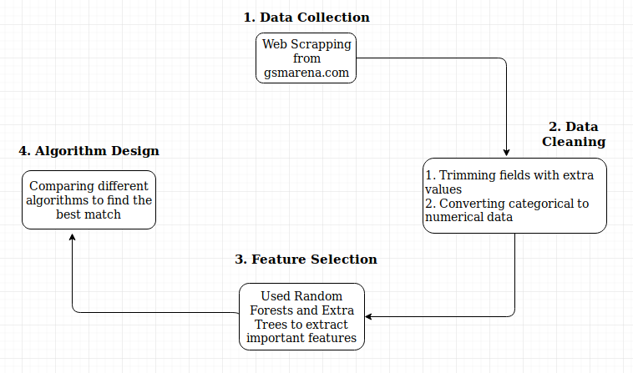
Different phases in project :
Smartphone Predictor

Slide 5
Different phases in project :
1. Data Collection
2. Data Cleaning
3. Visualization and Feature Selection
4. Algorithm Design
Smartphone Predictor

Slide 6
Data Collection
There is very less data (in structured form) present on the internet. Therefore, it was necessary to design our own dataset in order to proceed further. This phase deals about the methods used to collect the data.
We chose www.gsmarena.com website to collect information about various Smartphones. The website was chosen because it contains data about almost every mobile phone, plus the structure of web page is apt for crawling.
Smartphone Predictor

Slide 7
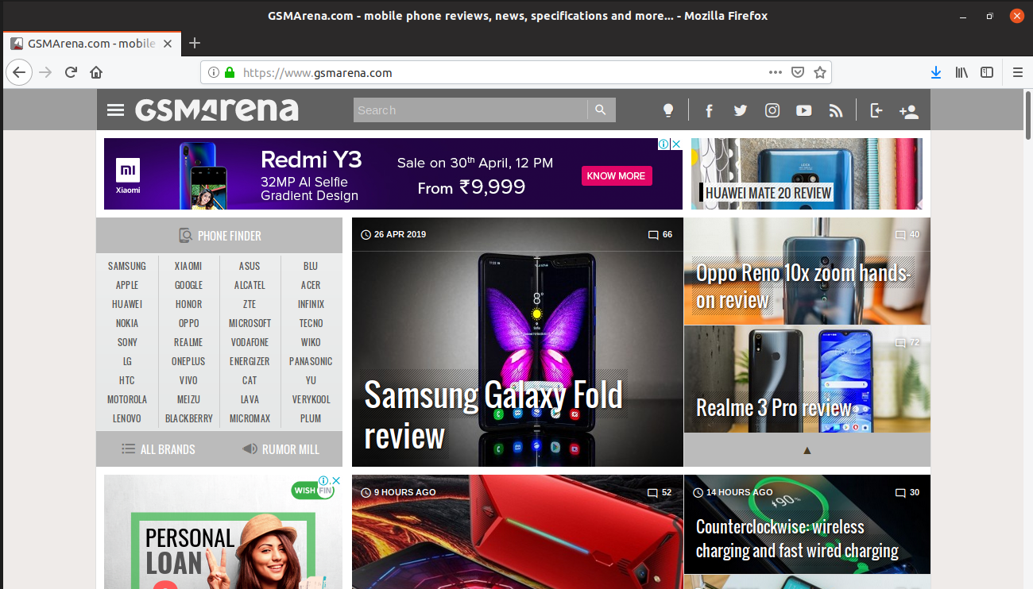
Data Collection
Link : https://www.gsmarena.com/
Smartphone Predictor

Slide 8
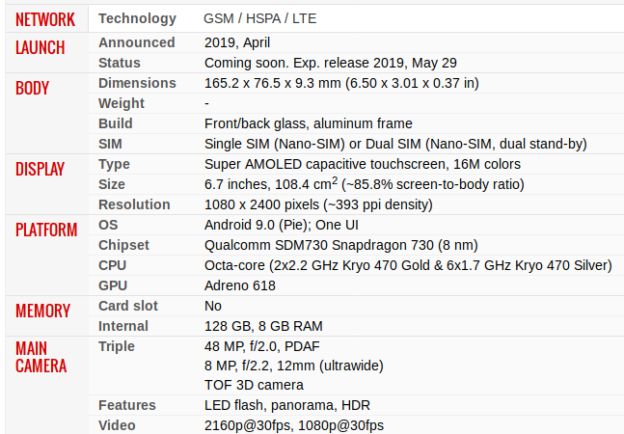
Data Collection
Smartphone Predictor

Slide 9
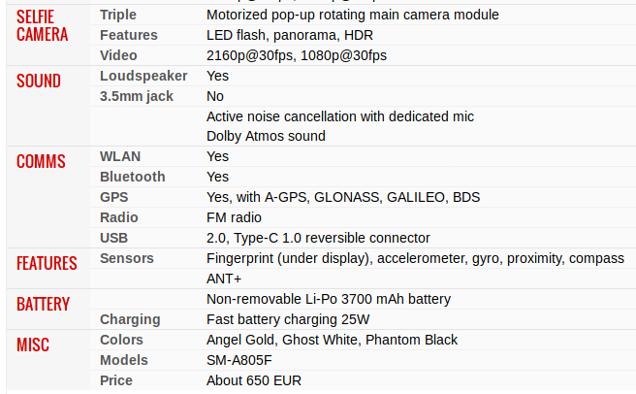
Data Collection
Smartphone Predictor

Slide 10
Data Collection
We developed a web-crawler written in Python which is capable of reading the source code of the webpages and extract out relevant information from it.
Smartphone Predictor

Slide 11
Different phases in project :
1. Data Collection
2. Data Cleaning
3. Visualization and Feature Selection
4. Algorithm Design
Smartphone Predictor

Slide 12
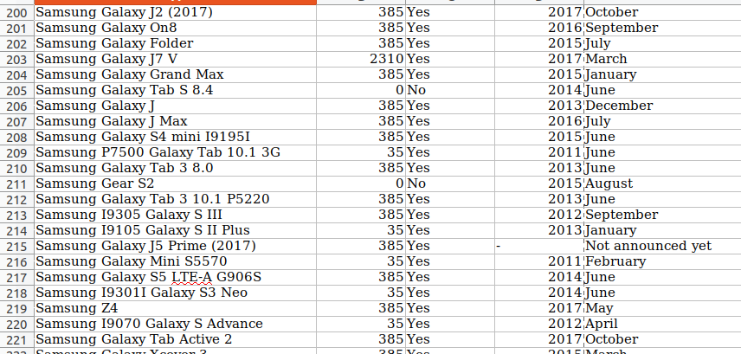
Data Cleaning
Smartphone Predictor

Slide 13
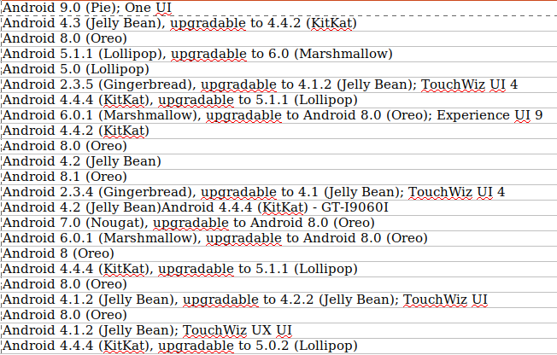
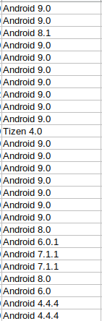
Data Cleaning
Smartphone Predictor

Slide 14
Different phases in project :
1. Data Collection
2. Data Cleaning
3. Visualization and Feature Selection
4. Algorithm Design
Smartphone Predictor

Slide 15
Visualization and Feature Selection
We performed following three ways of Feature Selection :
1. Uni-variate Selection
2. Feature Importance
3. Correlation Matrix with Heatmap
Smartphone Predictor

Slide 16
Visualization and Feature Selection
1. Uni-variate Selection
Statistical tests can be used to select those features that
have the strongest relationship with the output variable.
The scikit-learn library provides the SelectKBest class
that can be used with a suite of different statistical tests
to select a specific number of features.
Smartphone Predictor

Slide 17
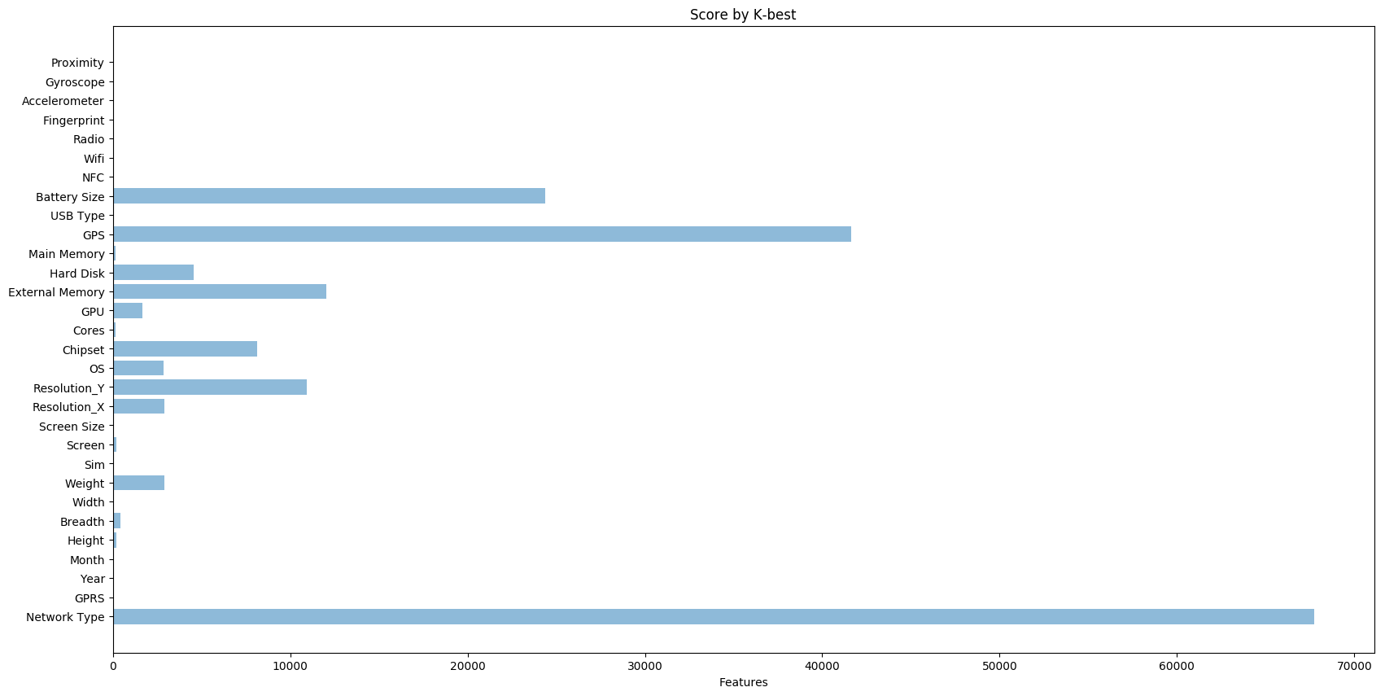
Visualization and Feature Selection
1. Uni-variate Selection
Smartphone Predictor

Slide 18
Visualization and Feature Selection
2. Feature Importance
We used the feature importance of each feature of our dataset by using the feature importance property of the model.
Feature importance gave us a score for each feature of our data, the higher the score more important or relevant is the feature towards the output variable.
Feature importance is an inbuilt class that comes with Tree Based Classifiers, we will be using Extra Tree Classifier for extracting the top 14 features for the dataset.
Smartphone Predictor

Slide 19
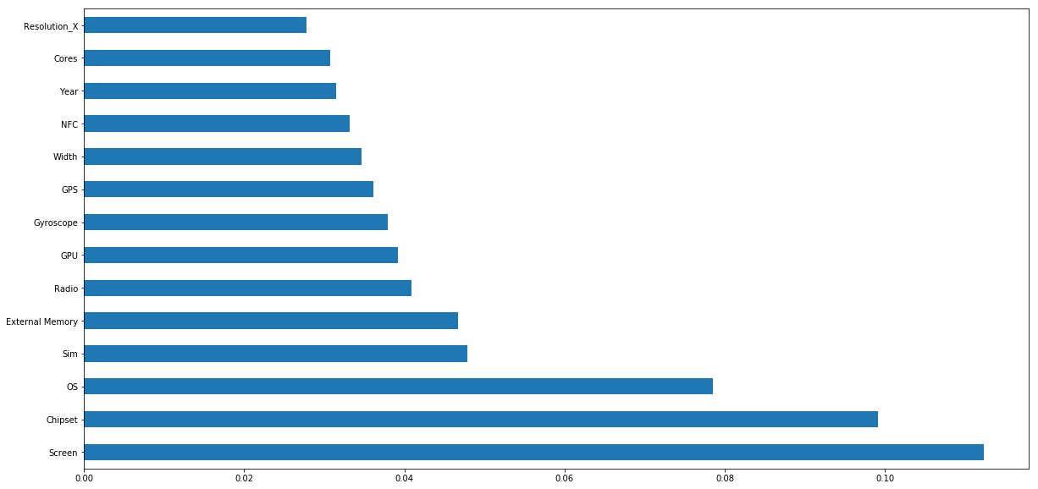
Visualization and Feature Selection
2. Feature Importance
Univariate
Smartphone Predictor

Slide 20
Visualization and Feature Selection
3. Correlation Matrix with Heatmap
Correlation states how the features are related to each other or the target variable.
Correlation can be positive (increase in one value of feature increases the value of the target variable) or negative (increase in one value of feature decreases the value of the target variable)
Heatmap makes it easy to identify which
features are most related to the target variable,
we will plot heatmap of correlated features using the seaborn library.
Smartphone Predictor

Slide 21
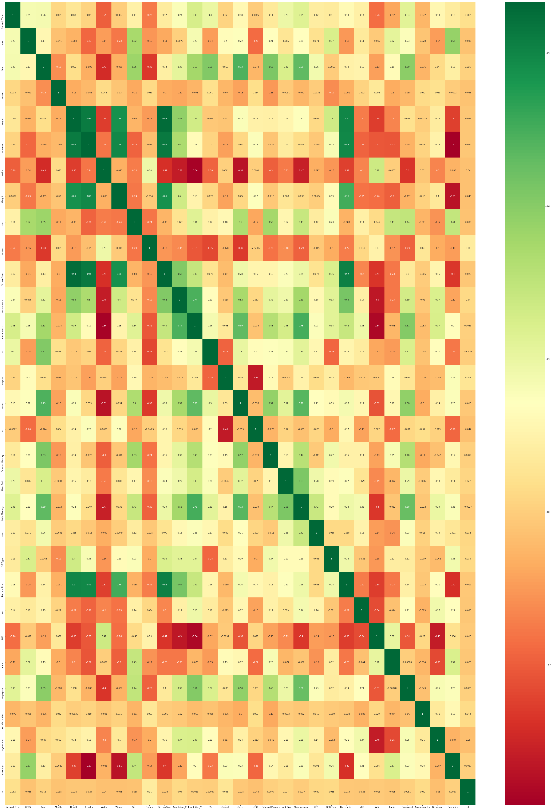
Visualization and Feature Selection
Correlation Matrix with Heat-Map
Smartphone Predictor

Slide 22
Different phases in project :
1. Data Collection
2. Data Cleaning
3. Visualization and Feature Selection
4. Algorithm Design
Smartphone Predictor

Slide 23
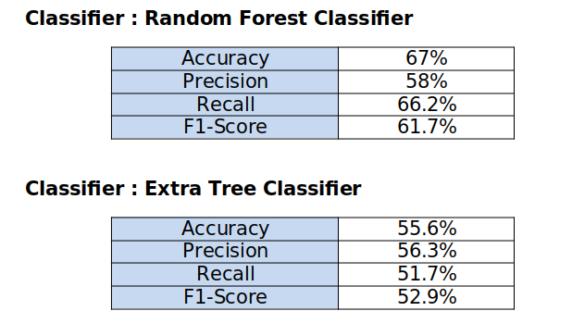
Algorithm Design
Smartphone Predictor

Slide 24
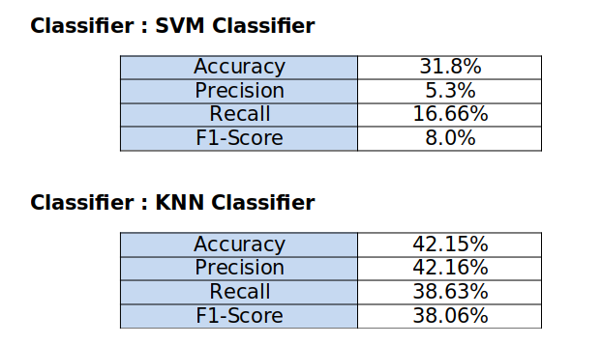
Algorithm Design
Smartphone Predictor

Slide 25

Thank You
Smartphone Predictor

