Slide 1

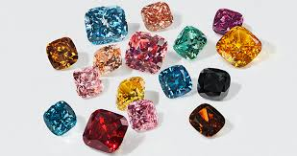
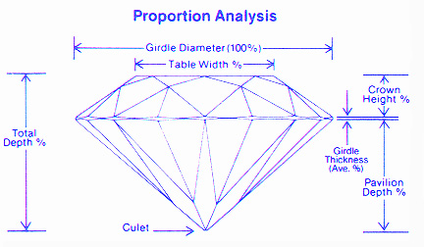
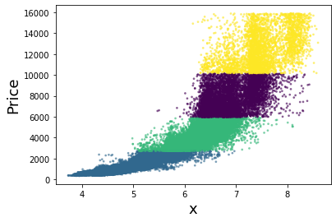
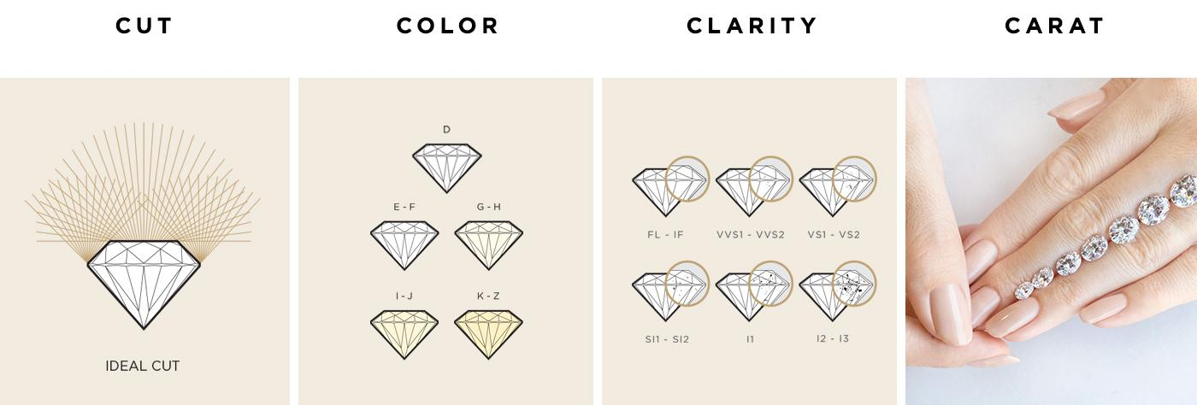
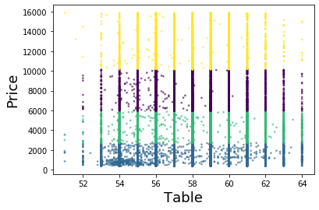
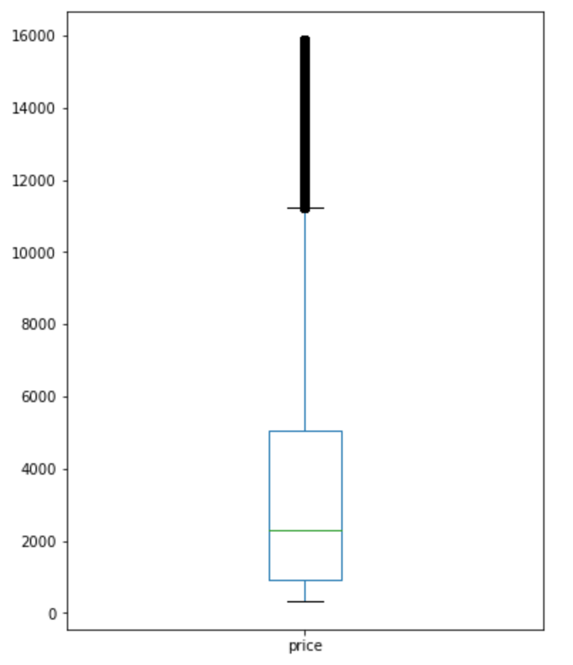
Diamond Prices
Liz Bolthouse, Seth Olson
Diamond prices aren’t objective
Diamonds are a commodity controlled by a near-monopoly. Their prices are thus manipulated to the benefit of the cartel. With a guideline appropriate features for a given price class of diamonds, consumers can better judge if they are paying an appropriate price for a diamond they wish to purchase.
The data set wasn’t perfect
This data set required modification before use. While it had no missing data, 2350 rows had a Z score greater than 3, and were removed as outliers. The final dataframe was 51,590 rows and 11 columns. The data was also normalized since the predictor variables differed from each other by four orders of magnitude.
Clustering >>> Regression
Clustering was selected because the results would be more equally based on all of the predictors. The elbow method determined four centroids to be optimal. Running the K-Means algorithm then sorted the diamonds into four clusters.
Diamonds are valued by size
The most significant factors in determining cluster assignment were price, dimensions (x, y, z), and carat. This indicates that larger, heavier diamonds are worth more than smaller, lighter ones. This contrasts with attributes prized by jewellers, like cut and color, which were not as significant. It is possible that the current marketplace values cut and color only amongst diamonds of similar sizes.
Visualization proved some outliers still existed
The scatter plot of X dimension vs price reflects the correlation found in the clustering. The table scatter plot shows no signs of correlation. The box plot shows a large number of high outliers in the price data. This is common with monetary data.
For diamonds, bigger is better
Diamonds are primarily grouped in this model by price dimensions, and carat. Secondary findings include that more expensive diamonds have a table width percent of between 54 and 60 percent. Less significant factors like color may matter if consumers are comparing diamonds of similar sizes.
Dataset Used
https://www.kaggle.com/shivam2503/diamonds
Diamond Facts
https://www.diamonds.pro/education/

