Slide 1
X!teADS
- Let your fingers do the walking -
A product of Team X!te

Slide 2
Problem
How to reach the appropriate target customer segment to promote the product ?
When to order the board you need?
How to expose your billboard to the most valuable customer?
What is the value of your billboard ?
How long are you supposed to wait ?

Slide 3

Solution ?

Slide 4

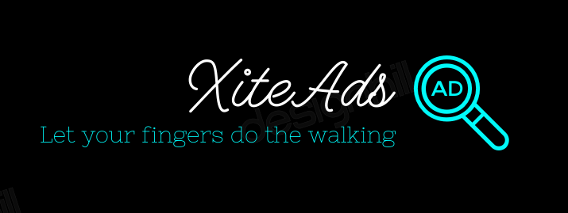

Slide 5
What is X!teADS ?
We introduce a web application( and a mobile app) which brings billboard booking to your fingertips.
We provide the best value for your billboard & digital billboard based on it’s location, reach density.
We provide the best target market segement.
We provide you with the optimized advertising plan & media scheduling.

Slide 6
Market Analysis
Key Customers
Board owners
Board Customers
Segmentation (physiographical)
Normal billboard Customers
Digital billboard Customers
Market needs of board owners
To identify new opportunities
To identify the demand and the value of the board
Market needs of board customer
To find a suitable option for the budget at hand
To handle payments easily
To grasp the target audience
Future market
People get persuaded to implement billboards in their unused lands and spaces
Competition
Emerging Media
Advertising Space

Slide 7
Business Model

Slide 8
Revenue Generation
Billboard owner
Charge on Ad posting
Charge to activate premium owner package
Billboard Customer
Charge to activate premium customer package
Insurance
Charged based on plans (non - premium)
Commission on rental paid
Charged when designing and printing

Slide 9


Demonstration

Slide 10
Thank You!
Team X!te

