Slide 1
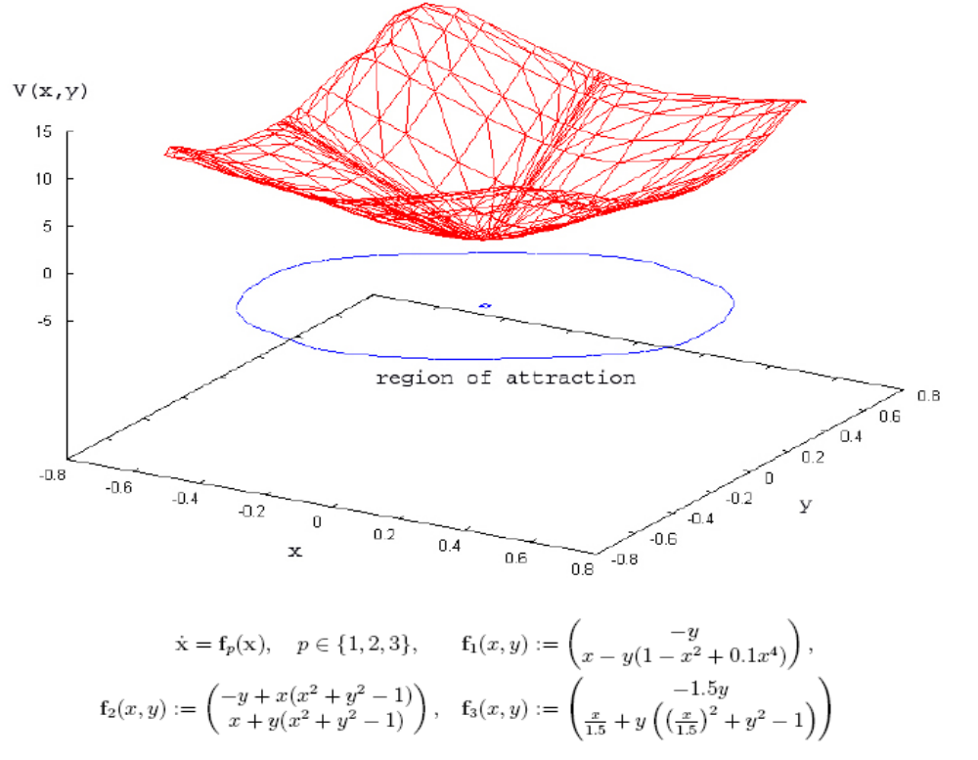
An algorithm to construct Lyapunov-functions
Sigurður F. Hafstein

Slide 2
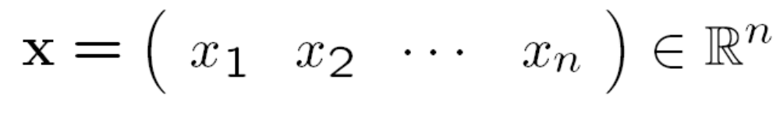
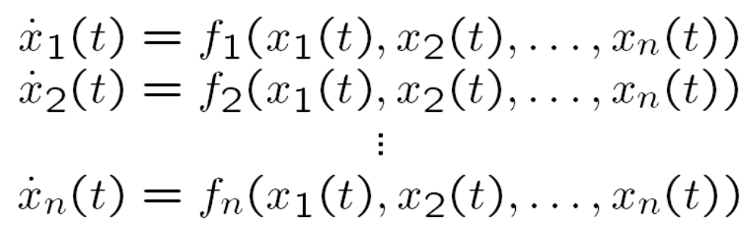
Dynamical systems
The state of a dynamical system is most often characterized by an n-dimensional vector
and the equations of motion are modeled by
coupled first-order ordinary differential equations

Slide 3

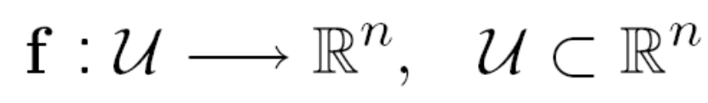
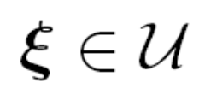
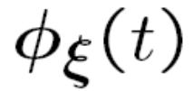
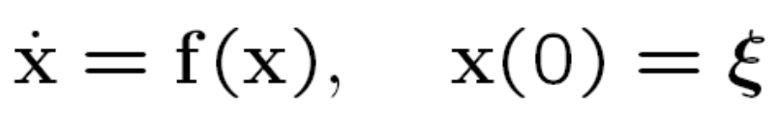
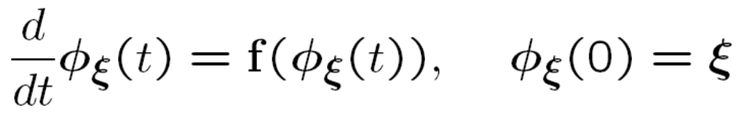
Dynamical systems
It is more convenient to write the dynamical system
(equivalently) as a vector equation
where
is a given function. Under moderate regularity
conditions there is for every initial state a unique solution to

Slide 4
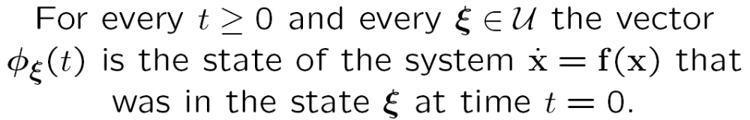
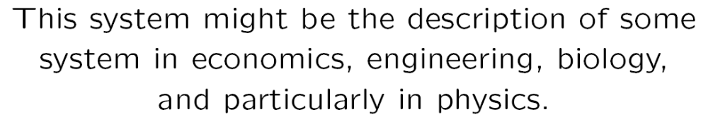
Dynamical systems

Slide 5
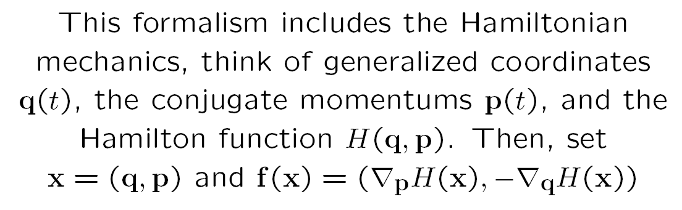
Dynamical systems

Slide 6


Dynamical systems
There is no general recipie to solve differential equations, but in physics we have something else that is extremely useful to understand and predict system behaviour
Conservation Laws
The ENERGY of a physical system is a scalar quantity that is associated with every state of the system
= the energy of the system in state

Slide 7
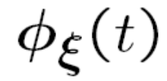
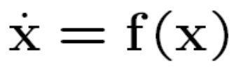

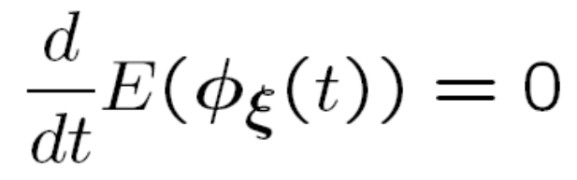
Dynamical systems
Let be the solution to the idealized
closed physical system
Then, by conservation of energy, we have
or equivalently

Slide 8
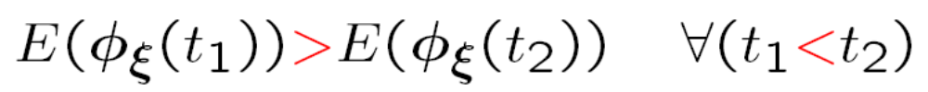
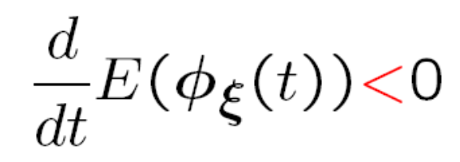
Dynamical systems
Let be the solution to the non-idealized
closed physical system
Then, by dissipation of energy, we have
or equivalently

Slide 9
Energy vs. Lyapunov-functions
Real physical systems end up in a state where the energy of the system is at a local minimum.
Such a state is called a stable equilibrium
If we have a differential equation that does not possess an energy, can we do something similar?
Answer by Lyapunov 1892 and Massera 1956
YES !

Slide 10
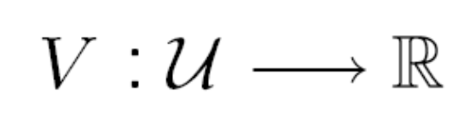
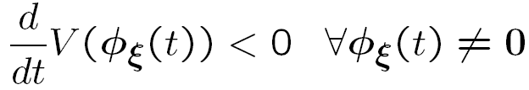
Definition of a Lyapunov-function
Seien
is a Lyapunov-function, if
and

Slide 11
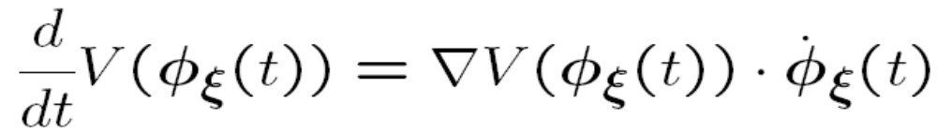


Does this make sense ?
so from
the inequality above follows!

Slide 12
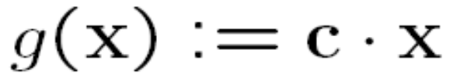
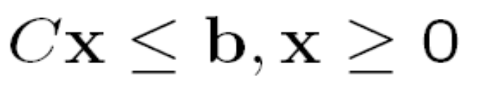
Linear programming
Let
Linear programming problem:
minimize
under the constraints
Solvable, e.g., with the Simplex-algorithm !

Slide 13
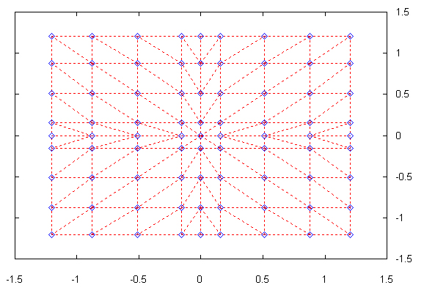

The linear programming problem
The blue points are the gridpoints of
We define the Lyapunov-function through its values at the gridpoints in

Slide 14

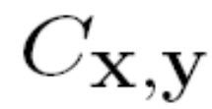

The linear programming problem
Variables:
and
for all neighbouring

Slide 15
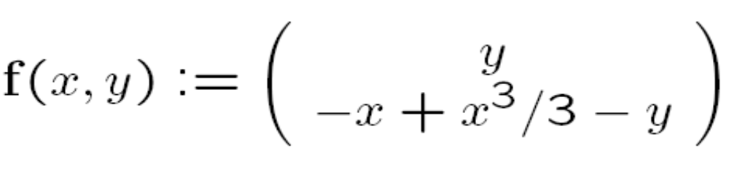

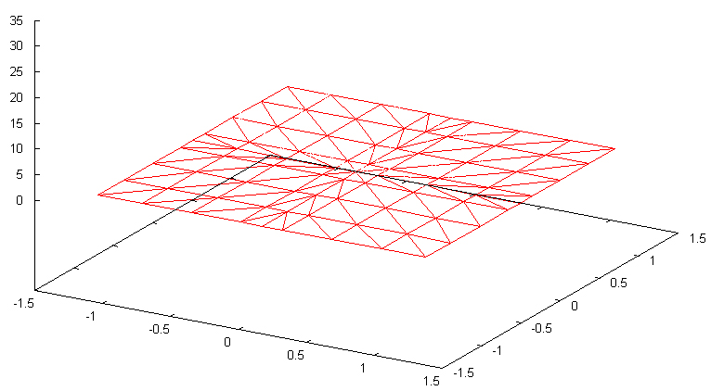


Example:
where
Partition of the domain of V:

Slide 16


Example:
where
Grid :

Slide 17

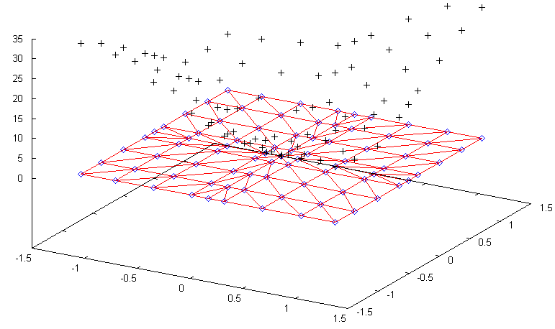
Example:
where
Values for , that fulfill the constraints

Slide 18
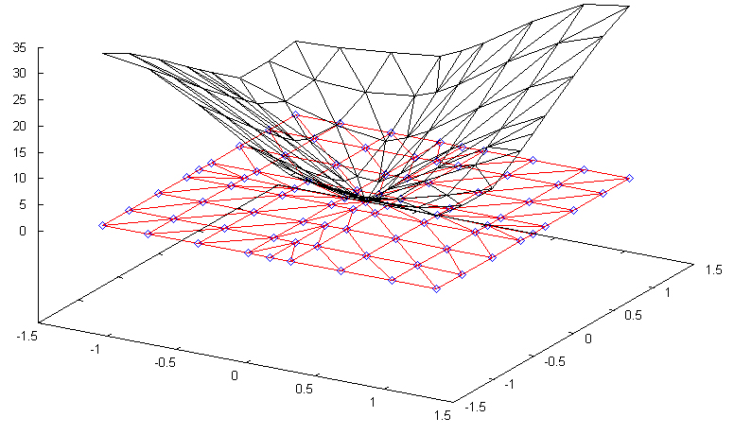
Example:
where
Convex interpolation delivers a Lyapunov-function

Slide 19
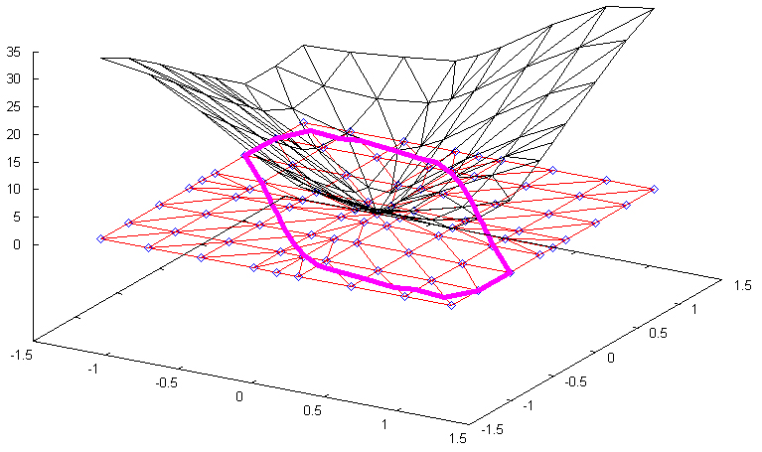
Example:
where
Region of attraction:

Slide 20






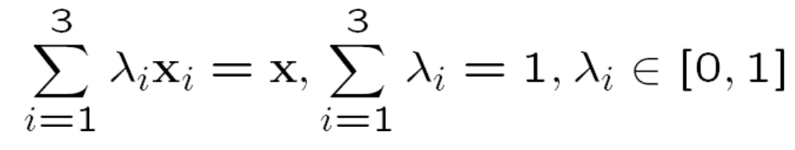
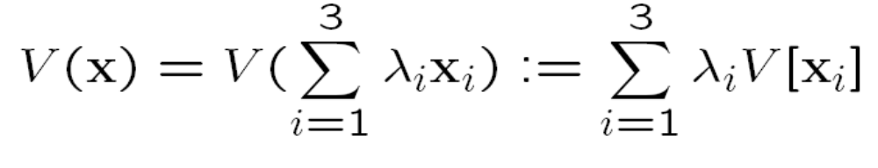
The linear programming problem
Let
be the vertices
of and
be in the triangle
Then we can write as a convex combination
and we define

Slide 21
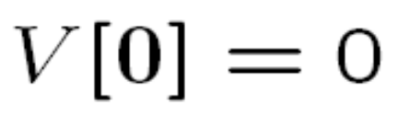
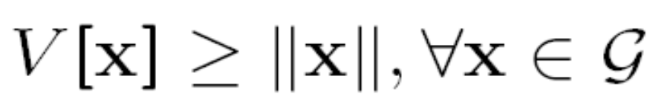
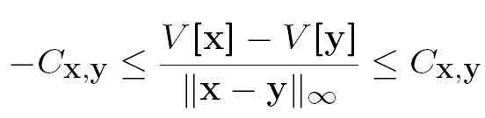

The constraints
LC2:
and
LC3:
for all neighbouring

Slide 22
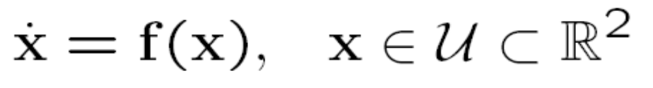
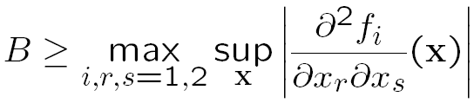
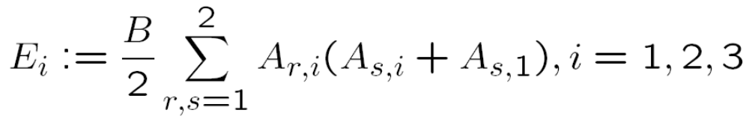
LC4
We are considering:
We need a few constants:

Slide 23

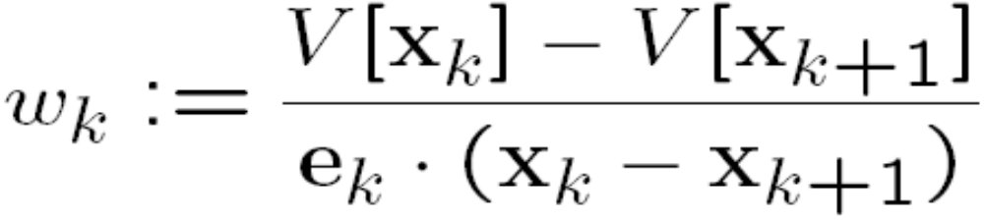
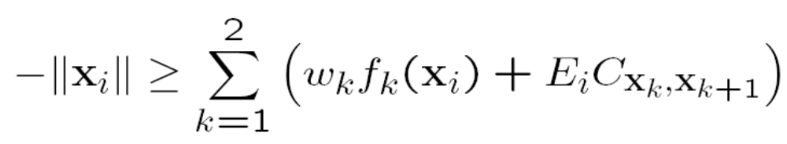

LC4
We set for
LC4:
for

Slide 24
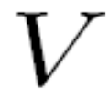
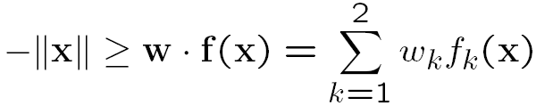
is a Lyapunov-function
Assume that we have a solution to
the linear programming problem.
We show that:
Remember:

Slide 25
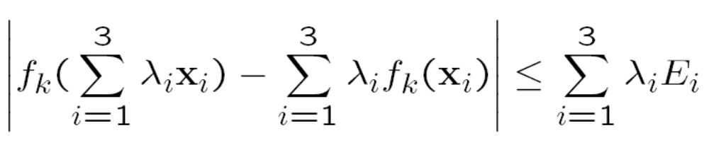

is a Lyapunov-function
One first proves that:
for

Slide 26
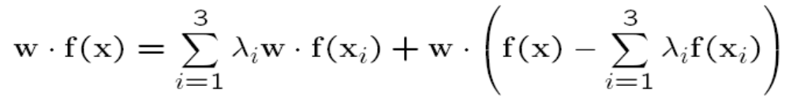

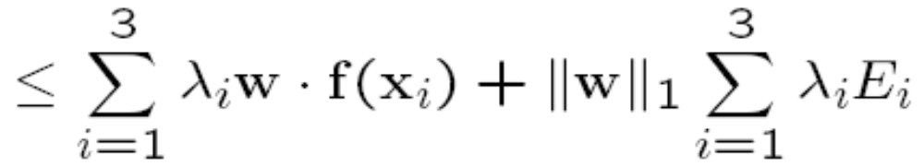
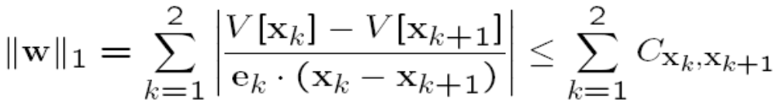
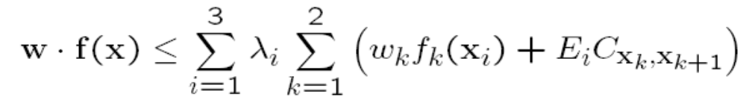
is a Lyapunov-function
LC3 gives us:
so

Slide 27
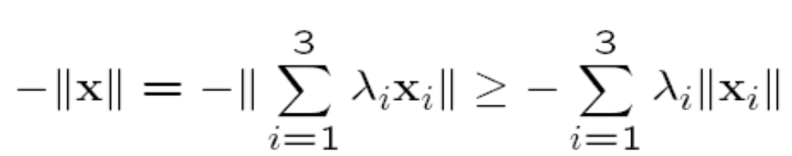
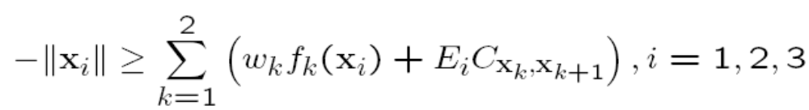

is a Lyapunov-function
From
and LC4
and the inequality
it follows that

Slide 28






is a Lyapunov-function
There is nothing special about our triangle, so
for all
in every triangle
, where
is the
gradient of
in the triangle
It follows that:
for all in the domain of , hence
is a Lyapunov-function !

Slide 29


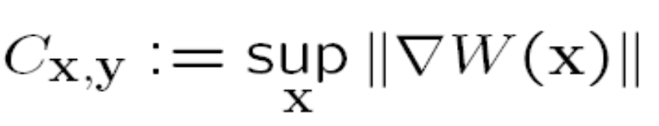
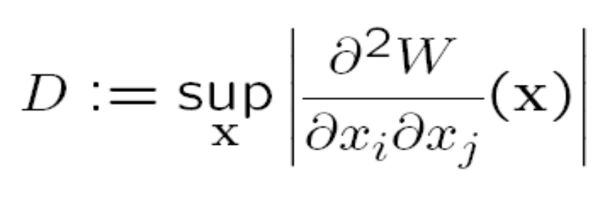

Why the algorithm always succeeds
Fact: there does exist a Lyapunov-function,
such that
We set:
and

Slide 30
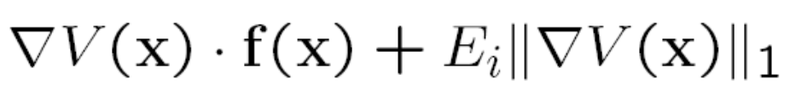



Why the algorithm always succeeds
It follows:
If and is small enough, then this
inequality is fulfilled !
We can generate a Lyapunov-function

Slide 31
Summary
An algorithm to construct Lyapunov-functions for general ODEs was presented
This algorithm will always succeed in generating a Lyapunov-function if one exists.
It is therefore possible to automatically generate „energy“ for a variety of non-physical systems

Slide 32


Generated Lyapunov-function

Slide 33


Slide 34


Parameteriserte Lyapunov-Funktion

Slide 35

Parameteriserte Lyapunov-Funktion

Slide 36

Generated Lyapunov-function

Slide 37

Generated Lyapunov-function

Slide 38

Generated Lyapunov-function

