Slide 1


SMART INDIA HACKATHON 2026
TITLE PAGE
Problem Statement ID – SIH26173
Problem Statement Title- ITantra -Indian Multilingual TTS & STT Aided Neural Transceiver Radio Access for low bitrate links
Theme-Miscellaneous
PS Category- Software
Team ID- SIH26-A0H-T088
Team Name- INFIX

Slide 2
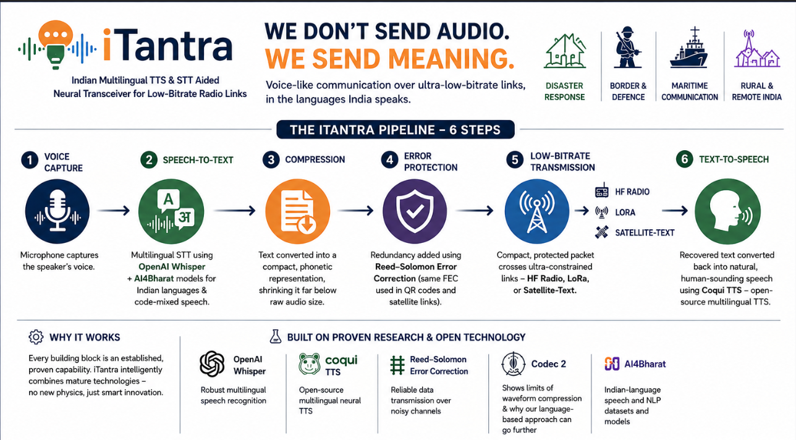
iTantra — Don’t Send Audio. Send Meaning.
INFIX
Proposed solution: Convert speech to text, compress the language representation, transmit it over an ultra-low-bitrate link, and reconstruct natural speech at the receiver.
How it addresses the problem: HF radio, LoRa and satellite-text links may provide only hundreds of bits/s, making conventional voice transmission impractical.
Innovation & uniqueness: Treats the problem as language communication rather than audio compression.
India-focused design: Supports multilingual and code-mixed speech, allowing natural communication in Indian languages.
Applications: Disaster response • Defence/tactical communication • Maritime safety • Rural/remote connectivity.
@SIH Idea submission

Slide 3
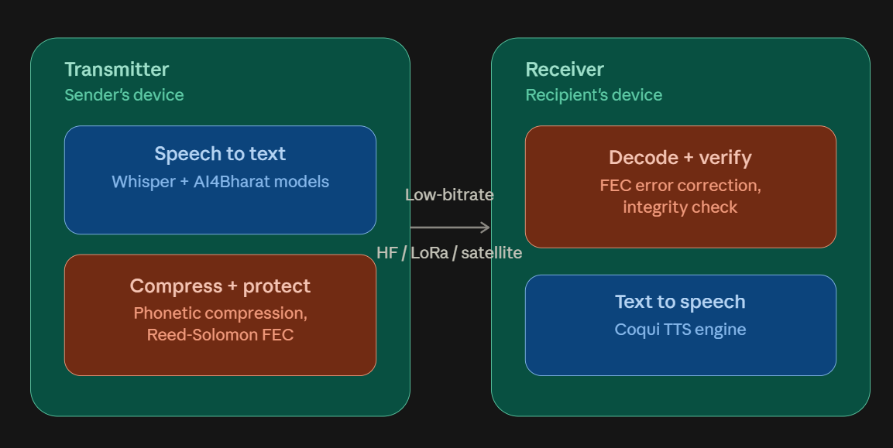
TECHNICAL APPROACH
INFIX
1. Voice Capture → Microphone captures speech.
2. Speech-to-Text → our multilingual STT engine converts that speech into text. For this, we use OpenAI Whisper, a robust multilingual speech recognition model, further adapted with AI4Bharat's open Indian-language speech models to handle regional languages and code-mixed speech accurately.
3. Compression → Text can be compressed further using compact/phonetic representation.
4. Error Protection →we add redundancy using Reed–Solomon error correction
5. Low-Bitrate Link → Compressed information crosses HF radio, LoRa or constrained satellite-text channels.
6. Text-to-Speech → at the other end, the recovered text is converted back into natural-sounding speech using Coqui TTS, an open-source multilingual neural text-to-speech engine capable of producing natural, human-like Indian-language voices.
Communication Mode: Push-to-talk / one-direction-at-a-time, reflecting low-bitrate radio limitations.

Slide 4
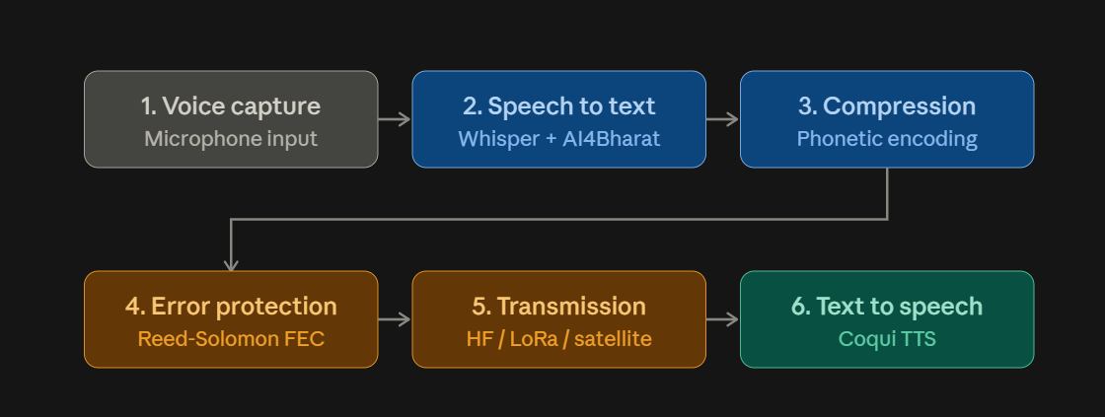
FEASIBILITY AND VIABILITY
INFIX
Feasibility: Uses established capabilities in STT, neural TTS, language processing, compression and error correction.
Deployment: Can operate as an edge/software layer connected to existing constrained radio systems.
Challenge — noisy speech: Noise can reduce STT accuracy.
Mitigation: Noise-robust preprocessing, language-aware models, domain vocabulary and confidence scoring.
Challenge — channel errors: Corrupted text can alter meaning.
Mitigation: Forward error correction, integrity checks and retransmission when feasible.
Challenge — very low bitrate: Normal simultaneous phone-call behaviour is not possible.
Mitigation: Short push-to-talk messages and aggressive text/phonetic compression.

Slide 5
RESEARCH AND REFERENCES
INFIX
OpenAI Whisper – Robust multilingual speech recognition (Radford et al., 2022). github.com/openai/whisper
Coqui TTS – Open-source multilingual neural text-to-speech with voice cloning. github.com/coqui-ai/TTS
Reed–Solomon Error Correction – Classical forward error correction used in QR codes, CDs, and satellite links; implemented via the reedsolo library.
Codec2 – Open-source low-bitrate voice codec (~700bps), illustrating the compression ceiling of waveform-based approaches. rowetel.com/codec2.html
AI4Bharat – Open Indian-language speech and NLP datasets/models. ai4bharat.org

Slide 6
IMPACT AND BENEFITS
INFIX
Disaster response: Voice-like communication when cellular towers/broadband are unavailable.
Defence & border areas: Natural-language communication over bandwidth-starved radio links.
Maritime safety: Communication for fishermen and coast-guard users over constrained radio.
Rural connectivity: Voice-like communication over LoRa or satellite-text tiers.
Social benefit: Reduces dependence on typing, especially during stressful situations.
Economic benefit: Works with low-bandwidth infrastructure instead of requiring continuous high-speed connectivity.
National value: Multilingual communication suited to India’s linguistic diversity and difficult-to-connect regions.

Slide 7

INFIX
@SIH Idea submission

