Slide 1
SCNS
B
Smart Campus
Navigation System
4
5
A
D
2
E
1
2
8
C
Graph modeling, shortest paths
and multi-floor navigation
Dijkstra on an explicit directed graph
Aaditya Shah
BTech CSE, Manipal University Jaipur
Data Structures and Algorithms project
19 October 2026
Notes:
Introduce SCNS as an application of directed graph modeling and shortest-path search. The first half explains the exact DSA core, followed by the system and demo. The weighted graph on this cover is conceptual and uses illustrative cost units. MUJ outdoor records come from OSM. The indoor building is an original educational example rather than a surveyed MUJ floorplan.
Sources:
https://github.com/shagatron/SCNS/blob/136667f690398ffdb1073222d8acf2cce2ad2638/backend/app/routing/dijkstra.py
https://github.com/shagatron/SCNS/blob/136667f690398ffdb1073222d8acf2cce2ad2638/backend/app/services/educational_indoor.py

Slide 2
Graph model and problem formulation
Directed weighted graph
B
G = (V, E), w(e) > 0
4
5
V represents junctions, gates and room access.
E records permitted movement and direction.
A
D
2
E
1
2
8
C
Optimization objective
P* = argmin Σ w(e), e in P
P connects S to T
Adjacency list for the same graph
A: [(B, 4), (C, 2)] B: [(D, 5)]
C: [(B, 1), (D, 8)] D: [(E, 2)]
E: []
S and T are eligible anchor sets. Missing or disconnected anchors produce no route.
Conceptual graph. Weights are illustrative cost units.
02
Notes:
A vertex is a topological point such as a gate, corridor junction or room-access point. An edge is an explicit directed movement. The directed graph can contain paired edges, but a reverse movement must exist explicitly. Multiple valid source and destination anchors become sets S and T. The objective minimizes the sum of strictly positive eligible edge costs. The adjacency list shown matches the conceptual diagram. Crossing lines and nearby points are not automatically connected. Disconnected or unanchored endpoints can correctly return no route.
Sources:
https://github.com/shagatron/SCNS/blob/136667f690398ffdb1073222d8acf2cce2ad2638/backend/app/routing/dijkstra.py
https://github.com/shagatron/SCNS/blob/136667f690398ffdb1073222d8acf2cce2ad2638/backend/app/routing/mixed.py

Slide 3
Data structures and their operations
Structure | Stored state | Main operation | Cost
Adjacency list | node → outgoing Arc list | Expand one node | O(out-degree)
Binary min-heap | (rank, serial, node) | Push / extract minimum | O(log H)
best hash map | node → current best rank | Compare and relax | Expected O(1)
previous hash map | node → incoming Arc | Follow predecessor | Expected O(1)
Sets | Seen IDs, sources, targets | Uniqueness / membership | Expected O(1)
Dynamic lists | Ordered route nodes / edges | Append, then reverse | O(L) total route work
Data flow
arcs → adjacency → heap + best → previous → ordered path
H = heap entries. L = returned path length. UUIDs identify records, not physical coordinates.
03
Notes:
These structures appear in the actual pure routing engine. adjacency is a defaultdict of outgoing Arc lists. best stores rank tuples and previous stores incoming Arc records. The heap frontier holds rank, serial counter and node. seen rejects duplicate edges. Endpoint and closure sets support membership. Final node and edge lists preserve order for maps and instructions. Dictionary and set costs are expected constant time. heapq uses a list-backed binary heap, so this project does not need a custom tree or linked-list class.
Sources:
https://github.com/shagatron/SCNS/blob/136667f690398ffdb1073222d8acf2cce2ad2638/backend/app/routing/dijkstra.py

Slide 4
Dijkstra: relaxation, ranking and termination
best = zero rank for every source
heap = sorted source entries
heapify(heap)
previous = {}; terminal = None
while heap:
rank, serial, u = heappop(heap)
if terminal and rank.cost > terminal.cost: break
if rank != best[u]: continue
if u is a target:
compare terminal by cost and priorities
continue
for arc in adjacency[u]:
candidate = extend(rank, arc)
if candidate improves best[arc.target]:
best[arc.target] = candidate
previous[arc.target] = arc
heappush(heap, candidate entry)
return reconstructed terminal, or no route
Relaxation rule
d[v] = min(
d[v],
d[u] + w(u,v)
)
Correctness invariant
Positive costs make every path extension non-decreasing. A current minimum frontier entry cannot hide a cheaper path through a more expensive prefix.
Python-style summary. The production engine compares full ranks after the primary cost.
04
Notes:
This pseudocode summarizes the actual multi-source engine. The initial ranks have zero primary cost. Source entries are sorted, then heapified in place. A popped stale entry is skipped. Reaching a target updates a terminal candidate using target and source priorities, then skips expanding that terminal. The search still considers equal-primary-cost candidates and stops when the next primary cost exceeds the terminal cost. Relaxation compares full rank tuples, where secondary source and accumulated path priorities never override a lower primary cost. The theorem depends on non-negative weights, while the implementation imposes the stricter positive finite-Arc contract.
Sources:
https://github.com/shagatron/SCNS/blob/136667f690398ffdb1073222d8acf2cce2ad2638/backend/app/routing/dijkstra.py
https://doi.org/10.1007/BF01386390

Slide 5
Worked example: state changes during search
Popped state | Relaxation | Best known state
A, cost 0 | B = 4, C = 2 | A0, B4, C2
C, cost 2 | B = 3, D = 10 | B3, C2, D10
B, cost 3 | D = 8 | D8
Old B, cost 4 | Skip stale rank | No change
D, cost 8 | E = 10 | E10
E, cost 10 | Target candidate | Final cost 10
B
4
5
A
D
2
E
1
2
8
C
Selected path
A → C → B → D → E
Predecessor chain
2 + 1 + 5 + 2 = 10 cost units
E ← D ← B ← C ← A
05
Notes:
Follow the order rather than just the highlighted result. A discovers B at 4 and C at 2. C improves B to 3 and reaches D at 10. B improves D to 8. Old B at 4 remains in the queue but is stale, so it causes no update. D reaches E at cost 10. The queue can also contain an old D at 10. The exact ordering of equal-cost stale entries is secondary to the valid best-rank checks. previous yields E-D-B-C-A backward, then the engine reverses it. This example was checked with the downloaded production function during report verification.
Sources:
https://github.com/shagatron/SCNS/blob/136667f690398ffdb1073222d8acf2cce2ad2638/backend/app/routing/dijkstra.py

Slide 6
Heap representation and route reconstruction
Binary min-heap after expanding C
Ranking and predecessor state
B, cost 3
best[u] = (cost, source_priority,
path_priority, origin)
heap entry = (rank, serial, node)
B, cost 4
D, cost 10
node = target; nodes = [node]
edges = []
while node in previous:
arc = previous[node]
edges.append(arc.id)
node = arc.source
nodes.append(node)
return nodes[::-1], edges[::-1]
children(i) = 2i+1, 2i+2
parent(i) = floor((i-1)/2)
Lazy update: push the improved rank.
Skip old entries when they are popped.
O(log H) per heap operation. O(L) reconstruction time and output space.
06
Notes:
After expanding C, B at 3, B at 4 and D at 10 may all exist. The heap invariant compares parent and child ranks. In a zero-based list, children are 2i+1 and 2i+2, with parent floor((i-1)/2). The implementation uses lazy updates: improving B adds a new entry instead of searching and decreasing a key. A serial counter avoids comparing payloads when ranks tie. best ranks include cost, source priority, accumulated edge priority and source origin. Target priority joins the terminal comparison. Route reconstruction follows Arc.source backward and reverses the node and edge lists in O(L).
Sources:
https://github.com/shagatron/SCNS/blob/136667f690398ffdb1073222d8acf2cce2ad2638/backend/app/routing/dijkstra.py
https://docs.python.org/3.12/library/heapq.html

Slide 7
Algorithm selection and complexity analysis
Method / representation | Appropriate use | Time or storage | Role in SCNS
BFS | Fewest edges, equal weights | O(V + E) time | Comparison / reference check
DFS | Reachability exploration | O(V + E) time | Comparison, not the router
Binary-heap Dijkstra | Minimum positive-weight cost | O((V + E) log V) time | Production routing engine
Adjacency matrix | Dense graph representation | O(V²) storage | Rejected for sparse topology
Bounds for the implemented lazy heap
Search: O((V + E) log(V + E)) Working space: O(V + E)
Preprocessing adds O(S log S) source ordering and at most O(E log E) outgoing ordering.
V = vertices, E = directed arcs, S = source nodes (S ≤ V). These are theoretical bounds.
07
Notes:
BFS is sufficient for the unit-weight educational traversal objective and is used only as an independent reference in the report audit. The application still reuses Dijkstra. DFS can explore reachability but does not guarantee a minimum weighted route. An adjacency matrix uses quadratic storage and can be useful for a dense graph, while the campus graph is sparse. The common binary-heap bound is O((V+E) log V) under simple-graph assumptions. The actual lazy heap permits O(E+S) candidates, giving conservative O((V+E)log(V+E)) search work. Outgoing sorting contributes sum d+ log d+, bounded by O(ElogE), and source sorting adds O(SlogS). No measured latency is claimed.
Sources:
https://github.com/shagatron/SCNS/blob/136667f690398ffdb1073222d8acf2cce2ad2638/backend/app/routing/dijkstra.py
https://github.com/shagatron/SCNS/blob/136667f690398ffdb1073222d8acf2cce2ad2638/backend/app/services/educational_indoor.py

Slide 8
Cost policies and constrained pathfinding
Policy | Edge cost w(e) | What Dijkstra minimizes
Metric shortest | Eligible stored metres | Total stored path distance
Directions only | 1 for each eligible edge | Number of traversals
Fastest | Supported baseline seconds | Estimated duration
Same endpoints: University Entrance to E05
513.10 m / 13 edges
799.32 m / 9 edges
Metric shortest
Directions only
Before search: closures exclude edges. Step-free excludes stairs and unknown accessibility.
GPS / QR starts require confirmation. Missing metrics stay unknown.
E05 = mapped entrance 10828149259. Recorded OSM-derived lengths remain estimates.
08
Notes:
The mixed graph passes the chosen optimization cost through Arc.distance_m, but tracks real physical totals separately. Metric shortest uses supported stored metres, allowing estimated outdoor lengths. Directions only assigns one per eligible traversal and can select a physically longer path with fewer edges. Fastest requires supported seconds and does not run in Directions-only mode. The recorded University Entrance to E05 query gives 513.10 metres over 13 edges under metric and 799.32 metres over 9 edges under Directions only. Filter closures and accessibility before search. GPS and QR determine a confirmed start, not a new pathfinding algorithm.
Sources:
https://github.com/shagatron/SCNS/blob/136667f690398ffdb1073222d8acf2cce2ad2638/backend/app/routing/mixed.py
https://github.com/shagatron/SCNS/blob/136667f690398ffdb1073222d8acf2cce2ad2638/docs/testing/educational-indoor-demo.md
https://github.com/shagatron/SCNS/blob/136667f690398ffdb1073222d8acf2cce2ad2638/docs/operations/geolocation.md
https://github.com/shagatron/SCNS/blob/136667f690398ffdb1073222d8acf2cce2ad2638/docs/operations/qr-markers.md

Slide 9
System architecture and published graph lifecycle
Browser
React + TypeScript
FastAPI
Graph assembly + routing
PostgreSQL / PostGIS
Releases + durable jobs
Private storage
Originals + derivatives
Bounded worker
Claims queued jobs
Dataset lifecycle
Editable draft
Validation
Review
Immutable release
Version checks prevent stale edits. Transactions avoid partial imports. Audits retain actions.
09
Notes:
The browser uses React and TypeScript. FastAPI validates requests and assembles the eligible graph. PostgreSQL/PostGIS stores the catalog, topology, revisions and immutable release artifacts. Durable worker jobs also live in PostgreSQL. API and worker share private storage, while the worker claims queued jobs from the database. The diagram does not imply direct API-to-worker messaging. Imports and graph edits change drafts. Validation and review precede publication. Version checks, transactional imports and audits preserve consistency. Public routing reads the selected immutable release, with current restriction eligibility applied. Educational topology is read-only application data, separate from campus releases.
Sources:
https://github.com/shagatron/SCNS/blob/136667f690398ffdb1073222d8acf2cce2ad2638/compose.yaml
https://github.com/shagatron/SCNS/blob/136667f690398ffdb1073222d8acf2cce2ad2638/backend/app/routing/mixed.py
https://github.com/shagatron/SCNS/blob/136667f690398ffdb1073222d8acf2cce2ad2638/docs/operations/publication.md
https://github.com/shagatron/SCNS/blob/136667f690398ffdb1073222d8acf2cce2ad2638/docs/operations/imports.md

Slide 10

MUJ source data and the public experience
OSM-derived record | Count
Buildings / destinations | 51 / 55
Graph nodes | 295
Directed edges | 700
Entrance anchors | 22
Weak components | 29
Unanchored destinations | 33
Directory search and place actions feed the planner.
Maps and text directions use the same computed path.
Data limits: 33 destinations have no eligible anchor. Library and cross-campus gaps remain.
Source attribution: © OpenStreetMap contributors. UI image uses simulated repository metadata.
10
Notes:
These v2 preparation counts come from the pinned OSM conversion and component inventory, not a live presentation database count. There are 51 buildings, 55 destinations, 295 nodes, 700 directed edges and 22 entrance anchors, with 29 weak components and 33 unanchored destinations. Weak connectivity ignores direction. A footprint or nearby path is not enough to invent an entrance. The current Central Library anchor and hostel-campus crossing remain unsupported for normal public routing. The screenshot is a repository fixture render using simulated MUJ branding metadata. The actual application supports directory search, filtering and pagination, route policies, text directions, QR and user-triggered position confirmation. Preserve OSM attribution.
Sources:
https://github.com/shagatron/SCNS/blob/136667f690398ffdb1073222d8acf2cce2ad2638/docs/data/muj-connectivity-v2/README.md
https://github.com/shagatron/SCNS/blob/136667f690398ffdb1073222d8acf2cce2ad2638/docs/data/muj-connectivity-review.md
https://github.com/shagatron/SCNS/blob/136667f690398ffdb1073222d8acf2cce2ad2638/frontend/src/features/public/CampusExplorer.tsx
https://www.openstreetmap.org/copyright

Slide 11
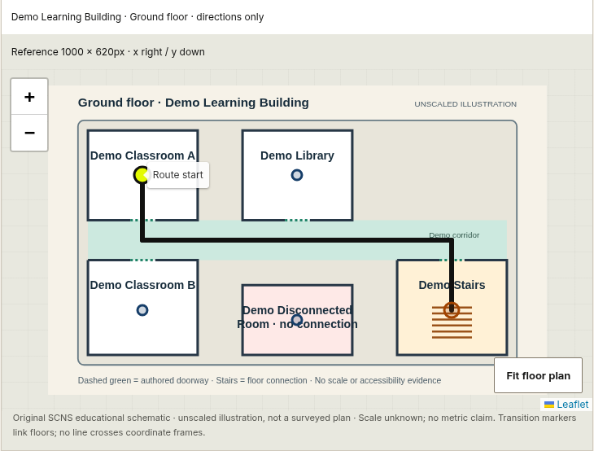
Indoor model: explicit topology across two floors
Model and graph counts
2 floors, 7 rooms, 15 nodes
13 paired links = 26 directed arcs
One intentionally isolated room
Explicit floor transition
ground-stairs ↔ first-stairs
edge cost = 1 traversal
Each floor has its own pixel frame.
Distance = unknown. ETA = unavailable.
Original educational layout. This is not an actual MUJ floorplan or verified accessible route.
11
Notes:
The MUJ explorer exposes Outdoor and Indoor demo modes in the same map section. The indoor school layout is original and fictional. It includes 15 nodes: seven rooms and eight corridor or stair nodes. Thirteen paired links create 26 directed arcs. Every edge costs one traversal and one room is isolated. Ground and first floor have separate local coordinate frames. A graph edge explicitly connects ground-stairs and first-stairs. Illustration pixels supply rendering positions, not metres. The service reads no campus database or approval records and calls the same pure Dijkstra function.
Sources:
https://github.com/shagatron/SCNS/blob/136667f690398ffdb1073222d8acf2cce2ad2638/backend/app/services/educational_indoor.py
https://github.com/shagatron/SCNS/blob/136667f690398ffdb1073222d8acf2cce2ad2638/frontend/src/features/public/CampusExplorer.tsx

Slide 12
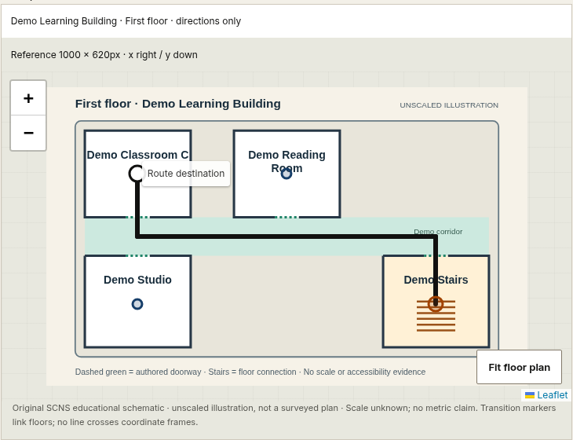
Indoor routing outcomes and recovery behavior
Query | Computed result
A to Library | 3 traversals
A to C | 9, stair ascent
C to A | 9, stair descent
A to A | 0, physical totals unknown
A to isolated room | No route, clear highlight
Versioned requests reject stale layouts and foreign room IDs.
Floor switching and reload recovery keep the route explicit.
A topological route can be known even when its physical length is unavailable.
12
Notes:
The route request carries the source room, destination room and expected graph version. The service rejects stale versions, foreign room IDs and extra unsupported fields. Same-floor A to Library uses three traversals. A to C uses nine with stairs going up, while C to A uses nine going down. A to itself returns zero traversals with unknown physical totals. The isolated room has no path and no highlight. The interface keeps outdoor and indoor choices, results and errors separate and recomputes shared routes after reload. Text directions remain usable when the map is hidden.
Sources:
https://github.com/shagatron/SCNS/blob/136667f690398ffdb1073222d8acf2cce2ad2638/backend/app/services/educational_indoor.py
https://github.com/shagatron/SCNS/blob/136667f690398ffdb1073222d8acf2cce2ad2638/docs/testing/educational-indoor-demo.md

Slide 13
Verification, acceptance cases and demonstration
Recorded evidence | Result
Backend units, unchanged service | 276 passed
PostGIS / API checks, reused | 33 passed
Frontend unit suite | 76 passed
Source browser cases across runs | 91 passed, 1 skip
Built Docker browser journeys | 75 passed, 1 skip
Live demo sequence
1. MUJ metric route: about 513 m
2. Directions only: about 799 m
3. Indoor A to Library: 3 traversals
4. Indoor A to C: 9 with stairs
5. Isolated room: no route
Focused graph audit
All 49 room pairs matched independent BFS. The worked weighted path returned cost 10.
Recorded cloud evidence. Physical access, real GPS and current Windows state need separate checks.
13
Notes:
The table cites the recorded final integrated indoor delivery. Backend 276 units and PostGIS/API 33 are reused for unchanged code. Frontend has 76 passing tests. Browser source evidence provides 91 distinct passing cases across the broad run and corrected affected rerun with one existing skip, not one uninterrupted all-green run. Built Docker has 75 passes and one skip. The report audit independently compared all 49 room pairs to BFS and checked the conceptual weighted example. Neither suite results nor screenshots certify the current Windows database or physical routes. During the live demo, show metric versus traversal policy and then same-floor, cross-floor and isolated-room cases.
Sources:
https://github.com/shagatron/SCNS/blob/136667f690398ffdb1073222d8acf2cce2ad2638/docs/testing/educational-indoor-demo.md
https://github.com/shagatron/SCNS/blob/136667f690398ffdb1073222d8acf2cce2ad2638/backend/app/services/educational_indoor.py

Slide 14
Conclusions, limits and next steps
Computational contribution
Current limits
Directed graph with positive movement costs
Adjacency lists and a binary min-heap
Hash maps for relaxation and reconstruction
Cost objectives with explicit no-route states
MUJ entrance mapping remains incomplete
The indoor layout is fictional and unscaled
No live tracking or field access certification
Next steps
References
Authorized plans and entrance surveys
Reviewed tunnel and indoor transitions
Device testing and a valid A* heuristic
SCNS source: commit 136667f
Dijkstra (1959), doi:10.1007/BF01386390
Python 3.12 heapq documentation
github.com/shagatron/SCNS
14
Notes:
The project demonstrates DSA through a working web application. It models movement explicitly, selects eligible arcs, optimizes a stated cost and reconstructs the exact route. The current public dataset is incomplete, and the indoor layout is educational. GPS is a fresh-fix confirmed-start feature rather than continuous tracking. Next work should obtain authorized real MUJ floorplans, current entrance and tunnel evidence and wider device checks. A* is a possible future optimization only if a valid heuristic is available. It is not implemented. The reference source for this deck is SCNS commit 136667f, and the main algorithm sources are the production Dijkstra file, mixed cost service and educational topology service.
Sources:
https://github.com/shagatron/SCNS/blob/136667f690398ffdb1073222d8acf2cce2ad2638/backend/app/routing/dijkstra.py
https://github.com/shagatron/SCNS/blob/136667f690398ffdb1073222d8acf2cce2ad2638/backend/app/routing/mixed.py
https://github.com/shagatron/SCNS/blob/136667f690398ffdb1073222d8acf2cce2ad2638/backend/app/services/educational_indoor.py
https://doi.org/10.1007/BF01386390
https://docs.python.org/3.12/library/heapq.html

