Slide 1
Data Analysis Portfolio

Slide 2
Professional Background:
Charismatic and highly skilled Medical Doctor with over six years of professional experience, committed to providing excellent patient care and contributing to policy formulation in a government-owned hospital. Additionally, I have dedicated seven years to volunteering with a humanitarian organization, focusing on grassroots initiatives. Driven by my passion for information technology, I concurrently pursued training in data analysis, Python programming, and data science at an entry level. I possess exceptional interpersonal skills, strong leadership qualities, and a results-oriented mindset, as demonstrated by my diverse background in health, agriculture and education.
I hold a bachelor's degree in Medicine and Surgery from the prestigious University of Jos, Plateau state, Nigeria. Furthermore, I have obtained certifications in Servant Leadership and Strategies for Personal Growth and Development through YALINETWORK
.

Slide 3
Project Description:
This project presents a thorough analysis of the provided dataset comprising medical records of 299 patients diagnosed with heart failure. By adhering to this framework, the project aims to reveal valuable insights that can enhance the understanding and management of heart failure, as well as investigate the correlations between clinical characteristics and heart failure outcomes

Slide 4
Key questions:
What is the measurement that best represents age, serum creatinine, serum sodium, and ejection fraction?
What is the relationship between age and diabetes, hypertension, and smoking?
What is the impact of age on average serum creatinine and serum sodium?
What is the impact of smoking on hypertension or diabetes?
What is the variation between raised creatinine and decreased ejection fraction in heart failure, and what is the impact of heart failure on death events?

Slide 5
Findings & Insights

Slide 6
What is the measurement that best represents age, serum creatinine, serum sodium, and ejection fraction?
The chart illustrates that the average age of the patients is 61, with a maximum age of 95 and a minimum age of 40. The mean serum creatinine, serum sodium, and ejection fraction are 1,137 and 38, respectively. Furthermore, the chart also indicates that the maximum values for serum creatinine, serum sodium, and ejection fraction are 9,136 and 80, while the minimum values are 1,113 and 14, respectively

Slide 7
What is the relationship between age and diabetes,hypertensive and smoking?
The charts illustrates the correlation between gender and health conditions. Among the participants, 44 females and 61 males were found to be hypertensive, while 61 females and 133 males were not hypertensive. Additionally, 55 females and 70 males were identified as diabetic, whereas 50 females and 124 males were nondiabetic. Furthermore, 4 females and 92 males reported smoking, while 101 females and 102 males did not smoke

Slide 8
What is the impact of age on average serum creatinine and serum sodium?
According to the charts, there is no variation with age in the average serum sodium and ejection fraction. Similarly, when comparing age alone with the average serum sodium, there is no significant difference. However, it is worth noting that individuals aged 52 years exhibit the highest average serum creatinine levels.

Slide 9
What is the impact of smoking on hypertension or diabetes?
As depicted in the aforementioned charts, among the diabetic patients, 30 smoke while 95 do not smoke. In contrast, among the non-diabetics, 108 do not smoke and 66 smoke. Similarly, for the hypertensive individuals, 30 smoke while 75 do not smoke. Conversely, among the non-hypertensive individuals, 66 smoke and 128 do not smoke

Slide 10
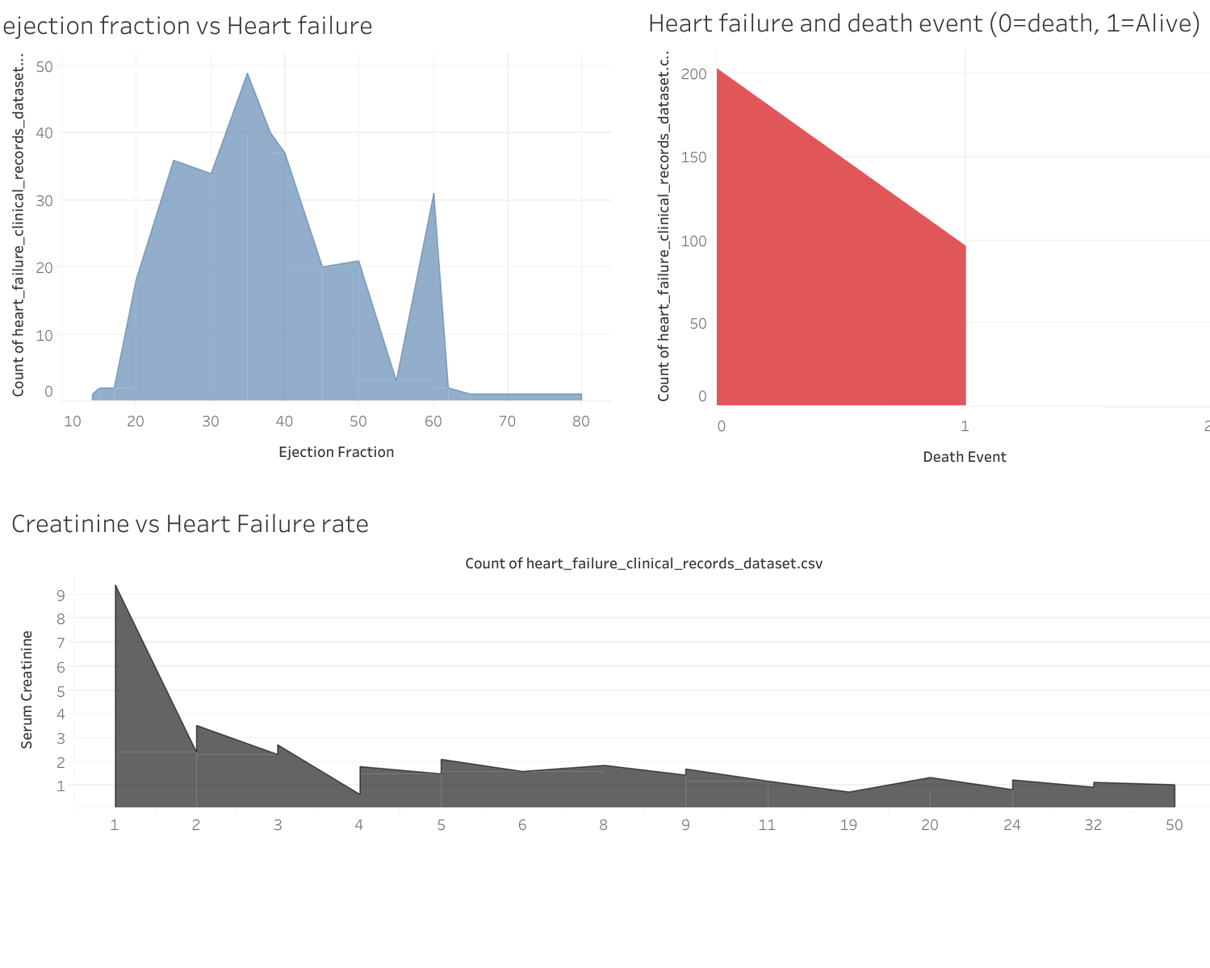
What is the variation between raised creatinine and decreased ejection fraction in heart failure, and what is the impact of heart failure on death events?
The charts show an increase in heart failure with a decrease in ejection fraction and an increase in serum creatinine. Death event show geometric increase with heart failure

Slide 11
Summary of findings:
Males have the highest rate of hypertension, diabetes, and smokers.
The level of serum creatinine, increased serum sodium and ejection fraction have a similar impact across all age groups.
An increase in serum creatinine and decrease in ejection fraction have an impact on cardiac failure.
Death events occurs as a result of cardiac failure

Slide 12
Recommended actions:
Based on the detailed analysis of the medical records of 299 patients who had heart failure, where each patient profile has 13 clinical features, the following recommendations are been suggested:
To enhance detailed clinical evaluation and investigation of more male genders with consideration of their ejection fraction, creatinine, diabetic status, hypertensive status, and smokers, as these are popular among the males with more death events.
Ensure close monitoring and control of ejection fraction and creatinine as they are the favorite clinical features seen to determine heart failure severity.
Evaluation of serum creatinine and ejection fraction should include all age groups who develop heart failure, as there is no variation with respect to age

Slide 13
Thank you

