Slide 1
Internet of Things Assignment Number 01 Authors: Shaghayegh Ghasemi 9639035 Hassan Kazemi Tehrani 9629041

Slide 2
What is PWM?
3
Let’s talk about PWM and it’s applications in microcontrollers

Slide 3
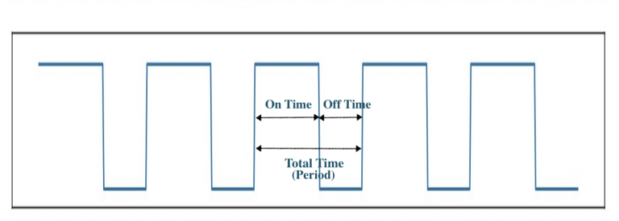
What is PWM in microcontroller ?
Pulse Width Modulation (PWM) is a digital technology that uses the amount of power delivered to a device that can be changed.
It generates analogue signals by using a digital source.
A PWM signal is basically a square wave which is switched between on and off state.
The duty cycle and frequency of a PWM signal determine its behavior.

Slide 4
PWM Applications
Adjust Brightness of Screen using PWM
Control brightness in smart lighting systems by controlling voltage to LED driver connected with LED bulbs
Drive buzzer with different loudness
Control speed of the motor
Control the direction of a servo
Provide an analog output
Generate audio signal
Telecommunication: Encode message

Slide 5
What is ADC?
3
Let’s talk about ADC and it’s applications in microcontrollers

Slide 6
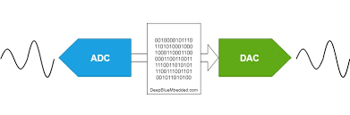
What is ADC in microcontroller ?
Analog to Digital Convertor (ADC) is a converter which converts the analog (continuously variable) signal to digital signal.
A/D converter is a linkage between the analog world of transducers and discreet world of processing the signal and handling the data.
The input (analog) to this system can have any value in a range and are directly measured.
But for output (digital) of an N-bit A/D converter, it should have only 2^{N} discrete values.

Slide 7
ADC Applications
Everything in the physical world is an analog signal:
Sound
Light
Temperature
Pressure
Force
Position
Acceleration
Field
Physical
Phenomena
Voltage or
Current
ADC Counts
Engineering Units
Sensor
ADC
Software

Slide 8
THANKS!
You can find us at:
Shaghayegh5ghasemi@gmail.com
Shayanthrn@gmail.com

