Slide 1
Internet of Things Assignment Number 01 Authors: Shaghayegh Ghasemi 9639035 Hassan Kazemi Tehrani 9629041

Slide 2
ESP8266 Power Consumption
7
Let’s talk about ESP8266 functioning modes

Slide 3
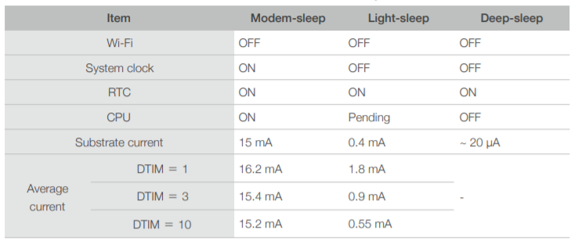
TYPES OF SLEEP
There are four types of sleep modes for the ESP8266: No-sleep, Modem-sleep, Light-sleep, and Deep-sleep.
They all have different functions.

Slide 4
NO-SLEEP
7

Slide 5
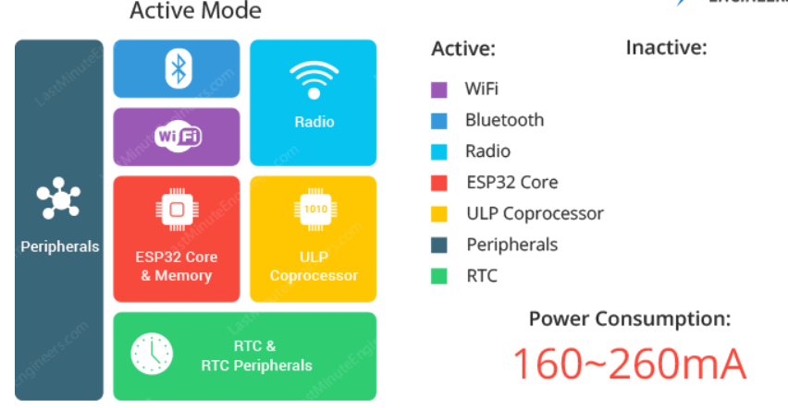
NO-SLEEP
The normal mode is also known as Active Mode. In this mode all the features of the chip are active.
As the active mode keeps everything (especially the WiFi module, the Processing Cores and the Bluetooth module) ON at all times, the chip requires more than 240mA current to operate.
Obviously, this is the most inefficient mode and will drain the most current. So, if we want to conserve power we have to disable them (by leveraging one of the other power modes) when not in use.

Slide 6
MODEM-SLEEP
7

Slide 7
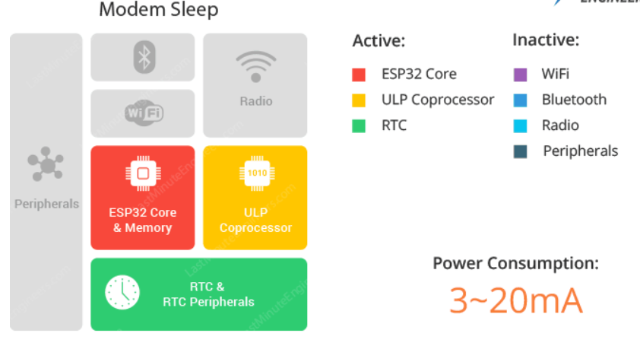
Modem-Sleep
Modem-sleep is the default mode for the ESP8266. However, it's only enabled when you're connected to an access point.
In modem sleep mode everything is active while only WiFi, Bluetooth and radio are disabled.
To keep WiFi/Bluetooth connections alive, the CPU, Wi-Fi, Bluetooth, and radio are woken up at predefined intervals.
In order to save power, ESP32 disables the Wi-Fi module between two DTIM Beacon intervals and wakes up automatically before the next Beacon arrival.

Slide 8
What is DTIM beacon mechanism?
DTIM is acronym for Delivery Traffic Indication Message.
In this mechanism, the access point(AP)/router transmits beacon frames periodically. Each frame contains all the information about the network. It is used to announce the presence of a wireless network and synchronize all the connected members.

Slide 9
LIGHT-SLEEP
7

Slide 10
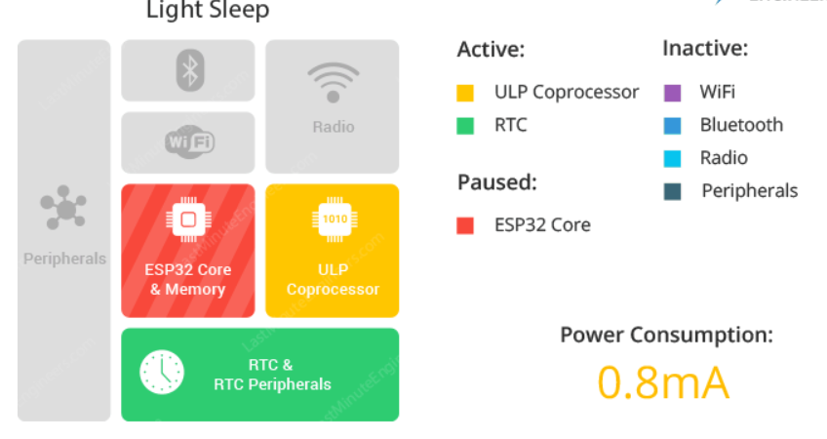
Light-Sleep
Light-sleep performs the same function as Modem-sleep, but also turns off the system clock and suspends the CPU. The CPU isn't off; it's just idling.
During light sleep mode, the CPU is paused by powering off its clock pulses, while RTC and ULP-coprocessor are kept active. This results in less power consumption than in modem sleep mode which is around 0.8mA.
Before entering light sleep mode, ESP32 preserves its internal state and resumes operation upon exit from the sleep. It is known Full RAM Retention.

Slide 11
DEEP-SLEEP
7

Slide 12
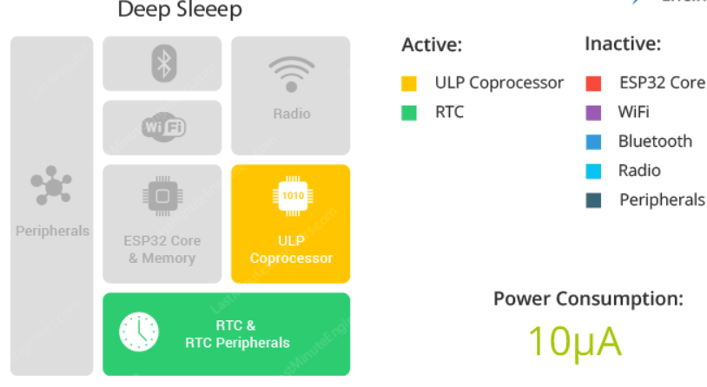
Deep-Sleep
Everything is off but the Real Time Clock (RTC), which is how the computer keeps time. Since everything is off, this is the most power efficient option.
During deep sleep mode, the main CPU is powered down, while the ULP co-processor does sensor measurements and wakes up the main system, based on the measured data from sensors.
In Deep sleep mode, power is shut off to the entire chip except RTC module. So, any data that is not in the RTC recovery memory is lost, and the chip will thus restart with a reset. This means program execution starts from the beginning once again.

Slide 13
HIBERNATION MODE
7

Slide 14
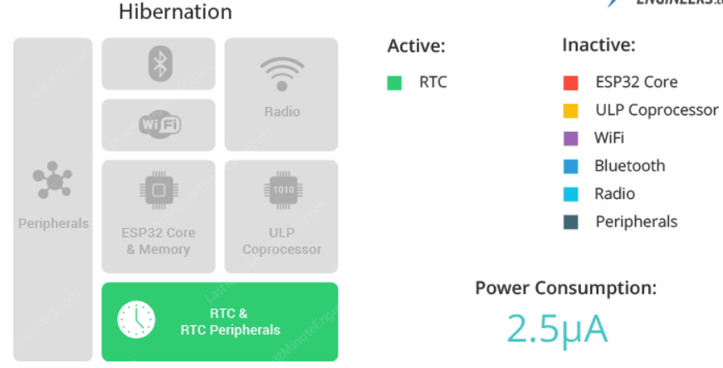
Hibernation Mode
Unlike deep sleep mode, in hibernation mode the chip disables internal 8MHz oscillator and ULP-coprocessor as well. The RTC recovery memory is also powered down, meaning there’s no way we can preserve any data during hibernation mode.
Everything else is shut off except only one RTC timer on the slow clock and some RTC GPIOs are active. They are responsible for waking up the chip from the hibernation mode.

Slide 15
THANKS!
You can find us at:
Shaghayegh5ghasemi@gmail.com
Shayanthrn@gmail.com

