Slide 1
Weather Analysis with colud computing!
Homa Badiee, Shaghayegh Shafiee, Asal Khoshghamat
Course : Cloud computing , Ferdowsi University
Professor : Dr.Sobati Moghadam

Slide 2
Why we need to analyze the weather?
Climate Change and Global Warming
Environmental Impact and Ecosystem Changes

Slide 3
Why Cloud Computing?
01
02
03
04
05
Enhanced Security and Compliance
Accessibility and Collaboration
Advanced Data Processing
Scalability
Flexibility

Slide 4
Dataset Factors
05
01
Precipitation type
01
Maximum temperature
02
06
02
Precipitation probability
Minimum temperature
07
New York
03
07
03
Date
temperature
06
04
04
humidity
05

Slide 5
Project Parts
Data set
Mapper
The weather conditions of New York in the last 30 days.
Mapper runs over the set and separate the data we are looking for
Weather Analysis
Reducer
Check the data that the mapper sent then analyze the weather, check if the weather is hot and also take the average for the duplicate date and also we check anomaly
Runner
Run the Mapper and Reducer

Slide 6
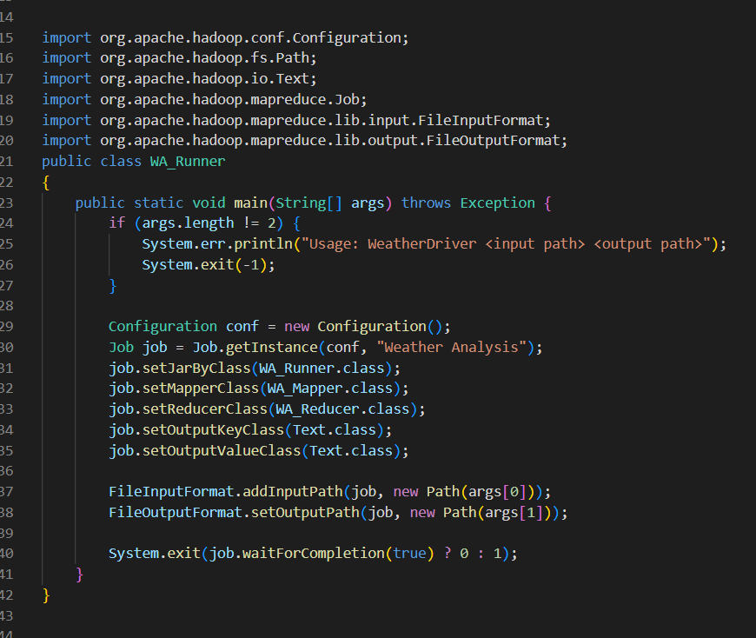


Code Explanation
Runner

Slide 7
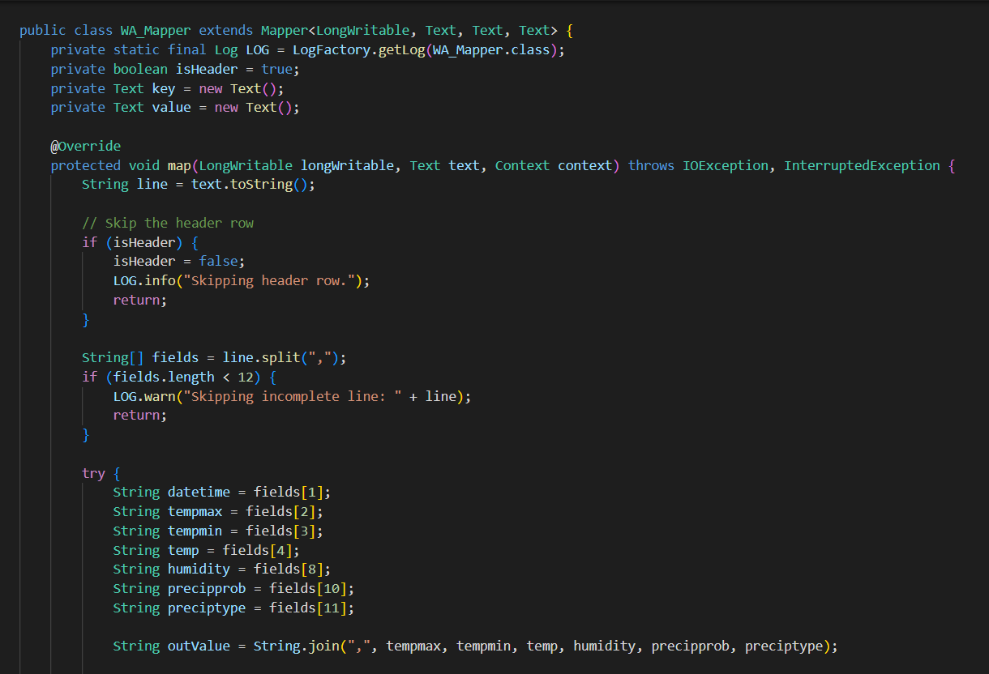
Code Explanation
Mapper

Slide 8
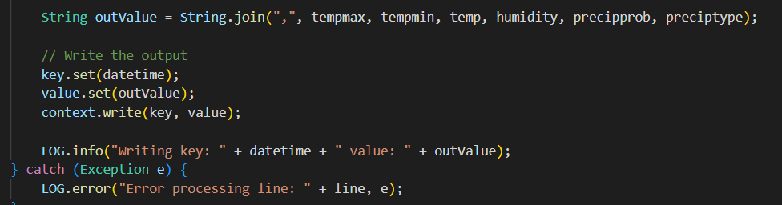
Code Explanation
Mapper

Slide 9
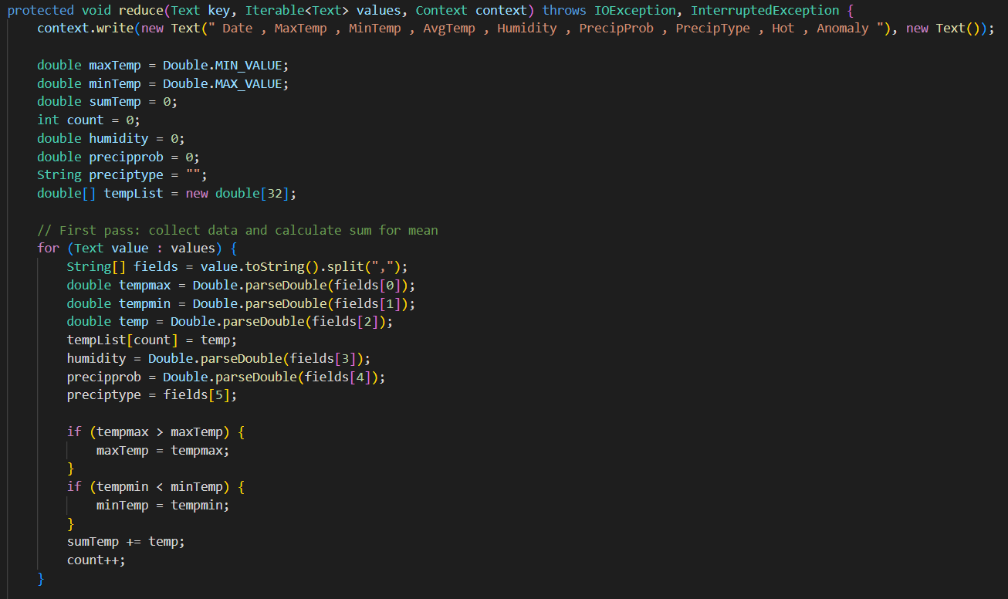

Code Explanation
Reducer

Slide 10
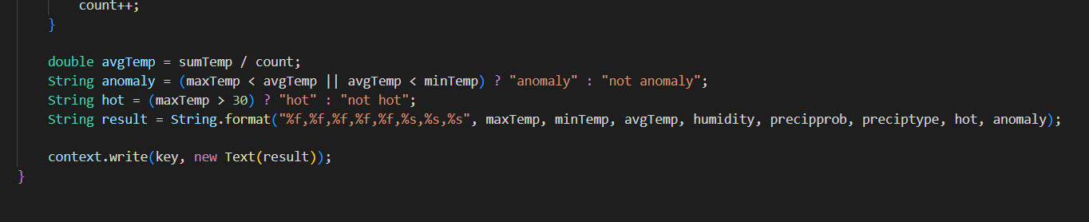
Code Explanation
Reducer

Slide 11
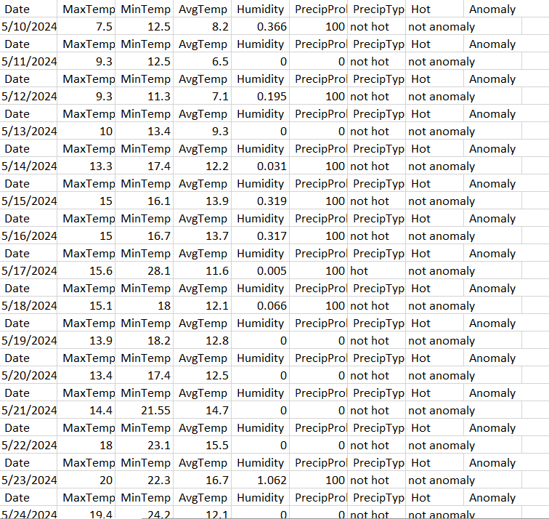
Result

Slide 12
Resurces
Data set
Sample Project
Visual Crossing
Geeks For Geeks

Slide 13
Thanks for your attention

