Slide 1
LITERATURE REVIEW, BACKGROUND STUDY , AND GAP ANALYSIS
MST. UMME AYMAN
LECTURER (SENIOR SCALE), DEPT OF CSE
DAFFODIL INTERNATIONAL UNIVERSITY

Slide 2
WHAT IS A LITERATURE REVIEW?
A literature review is a critical analysis of existing research works related to a specific topic. It helps to :
Understand what has already been done
Avoid duplication
Identify research gaps

Slide 3
WHY LITERATURE REVIEW IS IMPORTANT?
Refine the research problem
Choose appropriate methods
Identify limitations of existing approaches
Justify the novelty of your research

Slide 4
WHAT IS BACKGROUND STUDY?
Basic concepts
Terminologies
Technologies involved
Theoretical foundations
Examples:
What is Machine learning?
What is NLP?

Slide 5
SOURCES FOR BACKGROUND STUDY
Textbooks
Review Articles
Online Sources
Technical Blogs
Course Materials

Slide 6
SOURCES FOR LITERATURE REVIEW
IEEE Xplore
Springer Link
ACM Digital Library
Elsevier
Google Scholar

Slide 7
LITERATURE REVIEW VS BACKGROUND STUDY
Background Study | Literature Review
General knowledge | Research-focused
Textbooks, surveys | Research papers
Broad overview | Critical analysis
Explains concepts | Compares methods

Slide 8
HOW TO READ A RESEARCH PAPER EFFICIENTLY
Abstract
Introduction
Methodology
Results
Limitations/Future Work

Slide 9
WHAT IS RESEARCH GAP?
A research gap is a missing, unexplored, or weakly addressed area in existing research. It answers “what is still not solved “.
Additional key points:
It highlights limitations in current studies
It identifies areas where existing methods perform poorly
It shows problems that are under-studied or ignored

Slide 10
WHY DOES RESEARCH GAP HAPPENS?
Limited Dataset
Outdated techniques
Narrow application domains
Lack of real world dataset
Lack of explainability

Slide 11
TYPES OF RESEARCH GAPS
Methodological Research Gap
- Old or inefficient techniques used
Data Gap
- Small, biased, or outdated datasets
Context Gap
- Problem not studied in a specific domain or region
Evaluation Gap
- Lack of proper metrics or validation

Slide 12
HOW TO FIND THE RESEARCH GAP?
How to find the Gap:
Read 5-10 recent papers (2023-2025).
Identify "Limitations": What did they fail to do?
Identify "Scope": Did they only test it in one country/language/environment?
Example: Fake news detection using traditional ML with English dataset.
Identified Gaps:
Traditional method is applied
Lack of Explainability
English Dataset Only

Slide 13
FROM GAP TO RESEARCH PROBLEM
Gap: Low performance of models for Bangla text
Research Problem: Improving classification performance for Bangla fake news detection
Possible Topic: Explainable Fake News Detection for Bangla News Articles Using Transformers

Slide 14
COMMON STUDENT MISTAKES
Copying literature review from others
Listing papers without comparison
Ignoring limitations
Choosing gaps without feasibility check
Using outdated papers

Slide 15
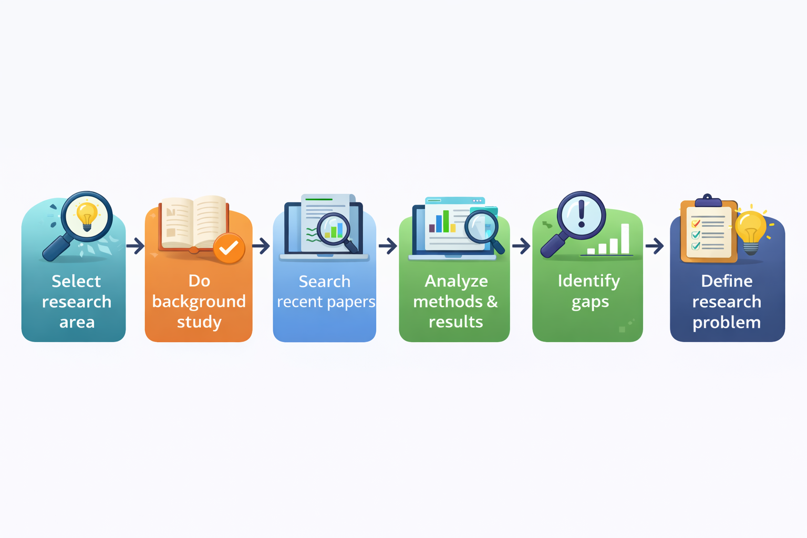
LITERATURE REVIEW WORKFLOW

Slide 16
SUMMARY
Background study builds understanding
Literature review analyzes existing research
Gap analysis identifies opportunities
Strong research starts with strong gaps

Slide 17
THANK YOU

