Slide 1
Research & Innovation in CSE
Introduction_research GAP_Scope
Dr. Arif Mahmud
Associate Professor & Associate Head
Department of CSE, Daffodil International University

Slide 2
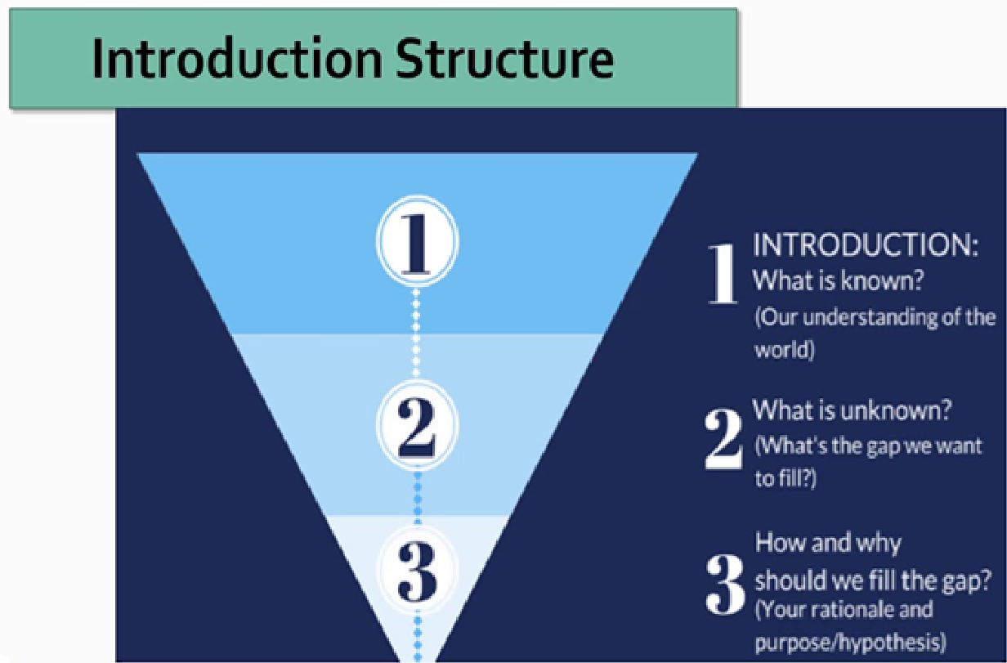
Introduction

Slide 3
Elements
The opening section – where you’ll introduce the reader to your research in high-level terms
The background to the study – where you’ll explain the context of your project
The research problem/problem statement – where you’ll explain the “gap” that exists in the current research
The research aims, objectives and questions – where you’ll clearly state what your research will aim to achieve
The significance/justification/motivation) – where you’ll explain why your research is worth doing and the value it will provide to the world
The Scope and Limitations – where you’ll acknowledge the boundary and potential limitations of your project and approach
The structure – where you’ll briefly outline the structure of your dissertation or thesis to help orient the reader

Slide 4
opening section
1 – A sentence or two introducing the overall field of your research.
2 – A sentence introducing your specific research problem.
3 – A sentence stating your research aims
4 – A sentence outlining the layout of the chapter.
Suggestion: 1 paragraph or 1 page is adequate

Slide 5
background
Use graph/chart/table to justify your problems.
Highlight numbers/percentage/amount mostly
Highlight recent problems (within last 1-3 years)
Year | Number of Robbery Cases | Number of Murder Cases | Number of Kidnapping Cases | Number of Theft Cases | Number of Burglary Cases | Source
2010 | 220 | 245 | 139 | 1915 | 555 | (“Crime Statistics,” 2010)
2011 | 294 | 259 | 118 | 2050 | 589 | (“Crime Statistics,” 2011)
2012 | 222 | 264 | 149 | 2240 | 592 | (“Crime Statistics,” 2012)
2013 | 241 | 270 | 165 | 2196 | 534 | (“Crime Statistics,” 2013)
2014 | 265 | 262 | 176 | 2130 | 650 | (“Crime Statistics,” 2014)
2015 | 205 | 239 | 146 | 1711 | 642 | (“Crime Statistics,” 2015)
2016 | 131 | 165 | 103 | 1516 | 547 | (“Crime Statistics,” 2016)
2017 | 103 | 218 | 85 | 1197 | 554 | (“Crime Statistics,” 2017)
2018 | 83 | 216 | 75 | 1290 | 613 | (“Crime Statistics,” 2018)
2019 | 10 | 19 | 9 | 127 | 49 | (“Crime Statistics,” 2019)

Slide 6
problem statement
2 paragraphs are adequate (address research gap in 1st paragraph and research statement in 2nd )
Example:
Quantitative-based empirical research on consumer acceptance of IoT-enabled security facilities in homes is currently scarce and underexplored.
It is vital to determine the factors that influence the intention to adopt IoT for home security at the households in Dhaka city

Slide 7
Research Questions and objectives
RQ1 – What skills development strategies and approaches are currently being used by web development companies?
RQ2 – How effective are each of these strategies and approaches?
RQ3 – What are the strengths and weaknesses of each of these strategies and approaches?
RO1 – To identify common skills development strategies and approaches utilized by web development companies
RO2 – To evaluate the effectiveness of these strategies and approaches.
RO3 – To compare and contrast these strategies and approaches in terms of their strengths and weaknesses.
N.B: Research questions should be measurable and have to answer in Discussion Chapter.
2-3 research questions/objectives are adequate at BSc level.

Slide 8
motivation
Be specific, concrete as much as possible
Highlight who and how will be benefitted
How your work is beneficial at individual, social, national or global level?
Example:
It is anticipated that burglary and other criminal attempts at households can be reduced if an IoT-empowered security system can thoroughly be introduced to the household of Dhaka city and more than 200 million people will be benefited.

Slide 9
Scope and Limitations
Define the boundary, I mean what to include and what to ignore (can be called assumptions).
Also define concrete and optional goals
Address the potential challenges and how to address those.

Slide 10
structure
Example:
This thesis is organized into six chapters. First, background information is supplied in chapter 1, which leads to problem statements, research questions, and objectives. Subsequently, chapter 2 looks at the current literature on adoption ideas. Furthermore, an acceptable model is chosen, together with argumentation for the relevance to the research's environment. In addition, a list of hypotheses is proposed following the research model. Afterward, chapter 3 provides a thorough explanation …

Slide 11
Research Gap
Dr. Arif Mahmud
Associate Professor & Associate Head
Department of CSE, Daffodil International University

Slide 12
What is a ‘gap in the literature’?
The gap, also considered the missing piece or pieces in the research literature, is the area that has not yet been explored or is under-explored. This could be a population or sample (size, type, location, etc.), research method, data collection and/or analysis, or other research variables or conditions.

Slide 13
Why is it important to identify a unique research gap?
Assume that you have completed your research work and published the findings only to find out that another researcher has already published something similar. How devastating would that be! Therefore, it is necessary to find out those problems in your research field which have not been addressed before. Not only would you be investing your funds and resources in the right project but also increasing the chances of your research findings getting published.

Slide 14
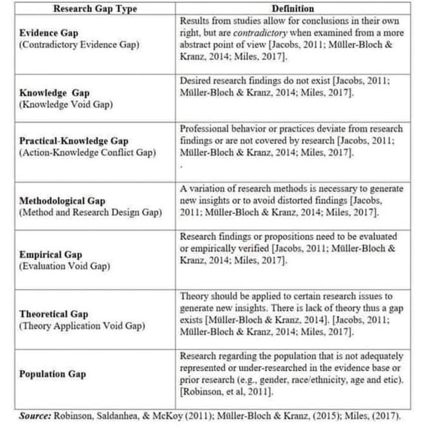
Types of Research Gaps

Slide 15
Examples
Evidence Gap : (Contradictory Evidence Gap) Results from studies allow for conclusions in their own right, but are contradictory when examined from a more abstract point of view [Jacobs, 2011; Müller-Bloch & Kranz, 2014; Miles, 2017].
2.Knowledge Gap : Desired research findings do not exist [Jacobs, 2011; Müller-Bloch & Kranz, 2014; Miles, 2017].
3.Practical-Knowledge Conflict Gap : Professional behavior or practices deviate from research findings or are not covered by research [Jacobs, 2011; Müller-Bloch & Kranz, 2014; Miles, 2017].
4.Methodological Gap : A variation of research methods is necessary to generate new insights or to avoid distorted findings [Jacobs, 2011; Müller-Bloch & Kranz, 2014; Miles, 2017].
5.Empirical Gap : Research findings or propositions need to be evaluated or empirically verified [Jacobs, 2011; Müller-Bloch & Kranz, 2014; Miles, 2017].
6.Theoretical Gap : Theory should be applied to certain research issues to generate new insights. There is lack of theory thus a gap exists [Müller-Bloch & Kranz, 2014; Jacobs, 2011; Müller-Bloch & Kranz, 2014; Miles, 2017].
7.Population Gap : Research regarding the population that is not adequately represented or under-researched in the evidence base or prior research [Robinson, et al, 2011].

Slide 16
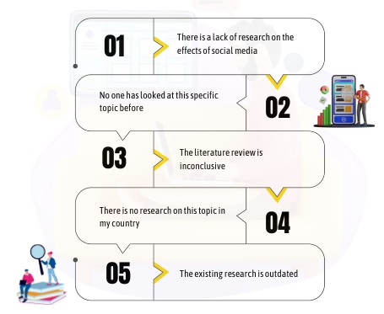
Common Research Gaps

Slide 17
How to Identify Research Gaps
Literature Review
Critical Analysis
Discussions with Peers and Mentors
Attending Conferences and Seminars
Engaging with Practitioners or Stakeholders
Utilizing Concept Mapping or Mind Mapping

Slide 18
Points to avoid
Too much description and analysis of the previously done studies must be avoided to keep the thesis research gap indicative and emblematic.
Avoid giving too much statistical information.
Avoid not reading enough. Identifying a research gap needs thorough reading, not skimping through facts.
Avoid failing to accurately identify the need for further study and the lack of a persuasive framework for the identification of the research gap.
Avoid not using enough citations for supporting the identified lacuna.
Avoid not stating the significance of the identified gaps.

Slide 19
Example
According to Macik (2017), the global research interest in IoT-related topics began around 2008. However, since 2013, several high-quality journals indexed in Scopus, Web of Science, and other databases have observed a considerable rise. Almost all of the publications are about IoT's technical development in computer and electrical engineering. A small amount of research related to this research (around 8.6%) is in management, social science, and others (Macik, 2017). This includes papers on consumer adoption of IoT in various nations (Luthra et al., 2018; Miazi et al., 2016). In addition, some research on smart homes and home automation has also been carried out (Yang et al., 2018; Park et al., 2017; Baudier et al., 2020). Furthermore, academics have focused on user adoption of IoT devices and services (Hsu & Lin, 2016; Hsu & Lin, 2018). It is important to note that household security issues are partially included as one of the elements or constructs in these papers (Hsu & Lin, 2016; Hsu & Lin, 2018; Yang et al., 2018; Luthra, et al., 2018; Miazi et al., 2016). Nonetheless, quantitative-based empirical research on consumer acceptance of IoT-enabled security facilities in homes is currently scarce and underexplored.

Slide 20
Further Resources
Müller-Bloch, C., & Kranz, J. (2015). A framework for rigorously identifying research gaps in qualitative literature reviews.
Kavuri, Anil Savio and Milne, Alistair K. L., Fintech and the Future of Financial Services: What Are the Research Gaps? (February 13, 2019). CAMA Working Paper No. 18/2019
Chandra. (2017). How to Write a Thesis : A Working Guide. Retrieved from https://www.student.uwa.edu.au/__data/assets/pdf_file/0007/1919239/How-to-write-a-thesis-A-working-guide.pdf
Oulu. (2012). GUIDELINES FOR WRITING A THESIS. Retrieved from https://www.oulu.fi/sites/default/files/content/Guidelines.pdf
Pubrica. (2021). Framework for the Identirication Of the Research Gap. Retrieved September 30, 2021, from Pubrica website: http://pubrica.com/academy/uncategorized/a-framework-for-the-identification-of-the-research-gap/
Tsoulfas, G. (2021). The Importance of Research. Journal of the American College of Surgeons, 232(5), 680–681. https://doi.org/10.1016/j.jamcollsurg.2021.02.003

Slide 21
Scope of The Study
Dr. Arif Mahmud
Associate Professor & Associate Head
Department of CSE, Daffodil International University

Slide 22
Scope and Delimitation
Scope refers to the range of the research project and the study limitations set in place to define the boundaries of the project and delimitation refers to the specific aspects of the research project that the study will focus on.
In simpler words, scope is the breadth of your study, while delimitation is the depth of your study.
1 paragraph is adequate.
Includes Introduction, Literature review (partly) and Methodology (mostly) chapters.

Slide 23
Scope Statement
A good scope statement will answer the following six questions:
Why – Purpose and objectives .
What – Topic, theory, model and variables.
Where – Location of data with collection procedure.
When – Timeframe and time dimension.
Who – Population, sample and sampling.
How – Methods, tools and analysis techniques.

Slide 24
Draft Writing
Purpose of the study | To enhance the adoption of IoT-enabled security devices to reduce burglary
Objectives | To determine the factors that influence the intention to adopt IoT for security purposes at the households in Dhaka city.
Conceptual model | Integration of PMT and ASE with perceived trust and personal innovativeness as moderators
Population | Household members who are the potential users of Dhaka city
Sample | Household head who are house owner and above 24 years of age
Sampling type | Purposive sampling
Unit of analysis | Individual
Geographical location | Dhaka city
Method | Quantitative study
Primary data | Survey
Data analysis technique | Partial least square of structured equation modeling
data analysis tool | SPSS V23 and SmartPLS V3.3.3
Evaluation technique | Measurement, structural, moderation analysis

Slide 25
How to Start Writing
Scope:
This study is to focus on…
This study covers the…
This study aims to…
Delimitation:
This study does not cover…
This study is limited to…
The following has been excluded from this study…

Slide 26
Example
The purpose of the study is to enhance the adoption of IoT-enabled security devices to reduce burglary. Therefore, the objective of this study is to measure the consumer adoption of IoT devices for security purposes through the support of the proposed conceptual model. Notably, two theoretical models namely PMT and ASE are integrated into the proposed model along with the inclusion of personal innovativeness and perceived trust as moderating variables. Besides, the scope of this study is limited only to those household members of Dhaka city who use IoT devices at their houses for security reasons. However, data will be collected only from the head of households since he/she is the ultimate decision-maker in these families. Specifically, purposive sampling will be employed in this study to collect data from a minimum of 166 samples using a cross-sectional survey. Importantly, this quantitative and empirical study is intended to complete within 3 years during the period 2019-2022. Finally, PLS-SEM will be used to analyze the data following measurement, structural, moderation using SPSS and SMARTPLS tools.

Slide 27
Further Resources
https://www.aje.com/arc/scope-and-delimitations-in-research/
https://www.youtube.com/watch?v=i_51xLDvi7o
https://www.enago.com/academy/scope-and-delimitations/
https://www.youtube.com/watch?v=nJbBp-u2sd4

Slide 28
Further Resources
Creswell, J. W. (2014). Research Design: Qualitative, Quantitative and Mixed Methods Approaches (4th ed.). Thousand Oaks, California: Sage.
Kothari, C.R. (2004). Research Methodology: Methods and Techniques (2nd ed.). Delhi: New Age International Publishers.
Bryman, A., & Bell, E. (2007). Business research methods (2nd ed.). New York: Oxford University Press.
Sekaran, U. (2003). Research methods for business: A skill-building approach (4th ed.). New York: John Wiley & Sons.

Slide 29

The End
Thank You

