Slide 1
TYPES OF RESEARCH & MODELS
MD MIZANUR RAHMAN
LECTURER (SENIOR SCALE), DEPT OF CSE
DAFFODIL INTERNATIONAL UNIVERSITY

Slide 2
WHAT IS RESEARCH?
University of Oxford, Research Services Research is defined as a process of investigation leading to new insights, effectively shared.
University of Cambridge, Research Policy Framework
Research is original investigation undertaken in order to gain knowledge and understanding.
Research is a systematic, creative, and original process of investigation undertaken with the goal of discovering new knowledge, gaining deeper understanding, or developing new applications. It involves critical inquiry, analysis, and experimentation, aimed at increasing the stock of knowledge about the natural world, human behavior, society, or technology.

Slide 3
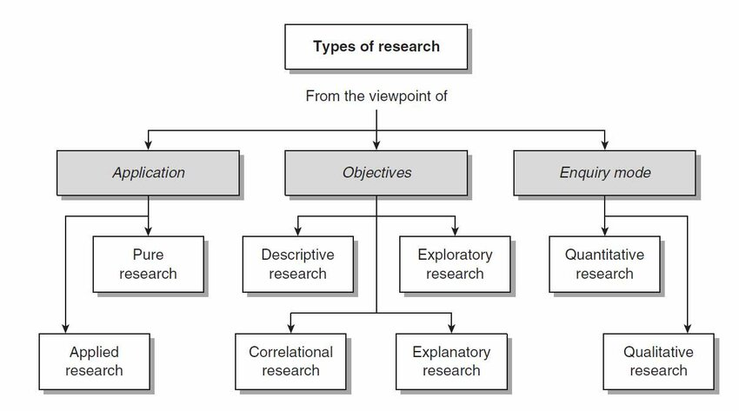
TYPES OF RESEARCH

Slide 4
BASIC (FUNDAMENTAL/PURE) VS APPLIED RESEARCH (APPLICATION VIEW)
Feature | Basic Research (Fundamental/Pure) | Applied Research (Action-Oriented)
Primary Intent | To expand the boundaries of human knowledge and understand "how nature works." | To solve a specific, practical problem or develop a commercial product.
Motivation | Curiosity-driven: Understanding the "Why" and "What." | Need-driven: Understanding the "How can we fix it?"
Scope | Broad and universal. Findings are often generalized across many fields. | Narrow and specific. Findings are applicable to a particular context or industry.
Time Horizon | Long-term. Benefits may not be realized for decades. | Short to Medium-term. Focused on immediate or near-future utility.
Success Metric | Number of citations, peer recognition, and theoretical breakthroughs. | Successful implementation, patent filing, or cost-saving for a business.
Analytic Focus | High abstraction; focuses on variables and laws of nature. | High pragmatism; focuses on variables that can be controlled to change an outcome.

Slide 5
CLASSIFICATION OF RESEARCH (OBJECTIVE VIEW)
Descriptive Research
Descriptive research describes what is happening or what exists without explaining why.
Example:
Studying how many students use AI tools in a university
Survey on internet usage patterns among Bangladeshi students
Exploratory Research
Exploratory research is conducted when the problem is not clearly defined and the researcher wants to explore new ideas.
Example:
Exploring how AI can help deaf students communicate
Interviewing farmers to understand unknown causes of crop disease

Slide 6
CLASSIFICATION OF RESEARCH (OBJECTIVE VIEW)
Correlational Research
Correlational research studies the relationship between two or more variables without manipulating them.
Example:
Studying the relationship between study time and exam results
Relationship between air pollution and respiratory diseases
Explanatory Research (Causal Research)
Explanatory research explains why and how something happens by identifying cause-and-effect relationships.
Example:
Investigating why deep learning models outperform traditional ML in cancer detection
Studying why students perform better in blended learning systems

Slide 7
QUALITATIVE VS. QUANTITATIVE RESEARCH (ENQUIRY VIEW)
Feature | Qualitative Research (The "Meaning") | Quantitative Research (The "Measurement")
Goal | To understand concepts, thoughts, or experiences. To explore "Why?" or "How?". | To test hypotheses, look at cause/effect, and make predictions. To answer "How many?" or "To what extent?".
Approach | Inductive: You observe first, then develop a theory or pattern. | Deductive: You start with a theory/hypothesis and test it.
Data Format | Text, video, audio, images, and open-ended observations. | Numbers, statistics, and measurable variables.
Sample Size | Small and non-representative (Deep-dive into a few cases). | Large and representative (Broad scan across a population).
Methodology | Interviews, focus groups, case studies, ethnography. | Surveys, controlled experiments, longitudinal studies, sensor data.
Data Analysis | Content or Thematic analysis (categorizing themes and patterns). | Statistical analysis (Mean, Median, Correlation, Regression).
Result Nature | Subjective, descriptive, and context-dependent. | Objective, numerical, and generalizable.

Slide 8
RESEARCH MODELS IN ENGINEERING & COMPUTING
1️⃣ Empirical Model (Data-Driven): Based on real data and experiments.
Example: Training a deep learning model using MRI images.
2️⃣ Theoretical Model: Based on mathematical formulas or conceptual frameworks.
Example: Developing a mathematical algorithm for optimization.
3️⃣ Simulation Model: Uses computer simulations to study systems.
Example: Simulating traffic flow in a smart city system.
4️⃣ Machine Learning / AI Model: Uses algorithms that learn from data automatically.
Example: CNN model for disease detection.
5️⃣ Hybrid Model: Combines multiple techniques (e.g., ML + statistical models).
Example: Deep learning + rule-based system for medical diagnosis.

Slide 9
RESEARCH PROCESS MODEL (GENERIC)
Problem Identification
Literature Review
Research Questions / Hypothesis
Methodology Design
Data Collection
Data Analysis
Results & Discussion
Conclusion & Future Work

Slide 10
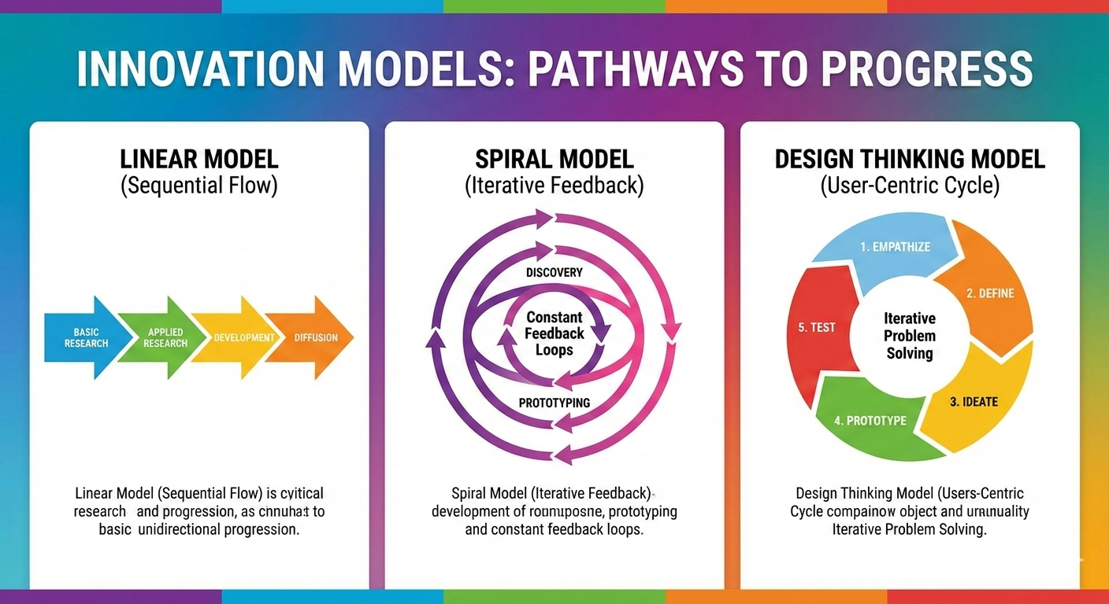
INNOVATION MODELS

Slide 11
INNOVATION MODELS – THE "HOW" OF PROGRESS
How does an idea move from the brain to the market?
The Technology Push: Research Design > Manufacturing > Marketing. (e.g., The invention of the Touchscreen).
The Market Pull: Market Need > Development > Manufacturing. (e.g., The demand for eco-friendly, biodegradable packaging).
The Triple Helix Model: The synergy between University (Research), Industry (Application), and Government (Policy/Funding).
Insight: FYDP is most successful when it sits at the intersection of these three.

Slide 12
THANK YOU

