Slide 1
Crime & Safety
In Singapore

Slide 2
Crime in Singapore
Singapore is known to be one of the safest countries in the world
Low crime does not mean no crime
Questions I want answered:
What is the trend of the crime cases recorded in Singapore?
Which crime is committed the most?
What are the various crimes in Singapore and their trend over the years?
Which age and citizenship groups are arrested the most in Singapore?
What is the correlation between the overall crime rate and the overall crime cases reported in Singapore?
What is the trend of the total arrested in Singapore and the total Crime Cases Recorded? Is there a relation between the two?

Slide 3
Datasets used
Overall Crime Cases and Crime Rate
Persons Arrested for Selected Major Offences
Total Persons (locals and foreigners) Arrested

Slide 4
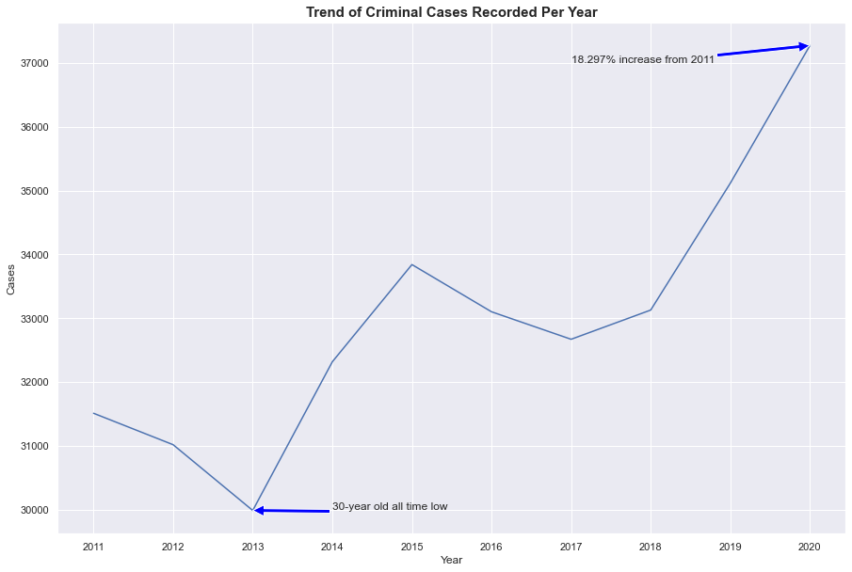
Overall Crime Cases and Crime Rate

Slide 5
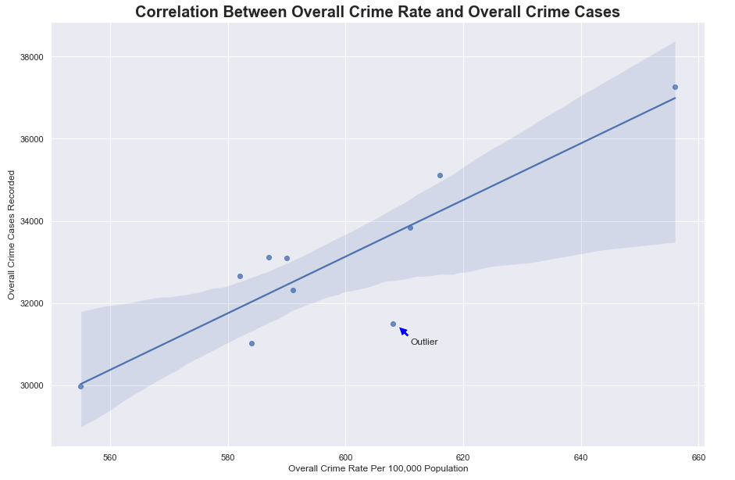
Overall Crime Cases and Crime Rate

Slide 6
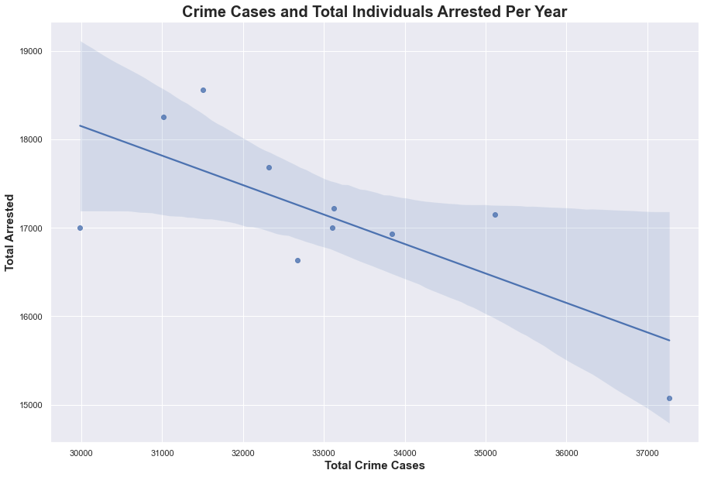
Merged (Overall Crime Cases and Arrested Per Year)

Slide 7
Insights
There has been a positive trend in the yearly crime cases recorded in Singapore (Increase in crime cases recorded)
There has thus been an overall increase in the crime rate in Singapore since 2011.
There is a strong correlation between the crime rate per 100,000 population and the number of crime cases reported, and thus the more crime cases reported the higher the crime rate
There is a negative correlation between the amount of people arrested and the amount of crime cases reported.

Slide 8
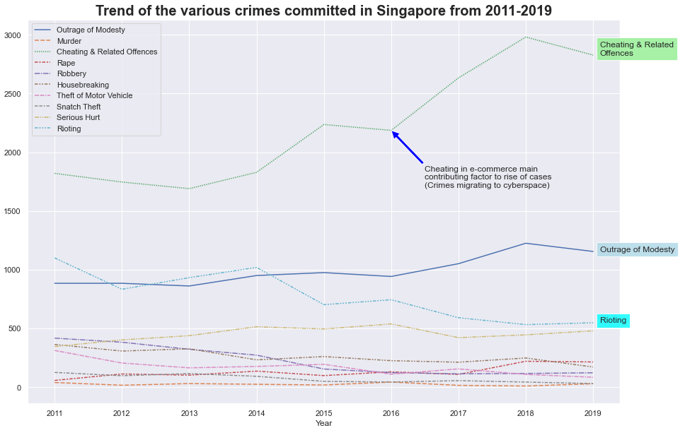
Persons Arrested for Selected Major Offences

Slide 9
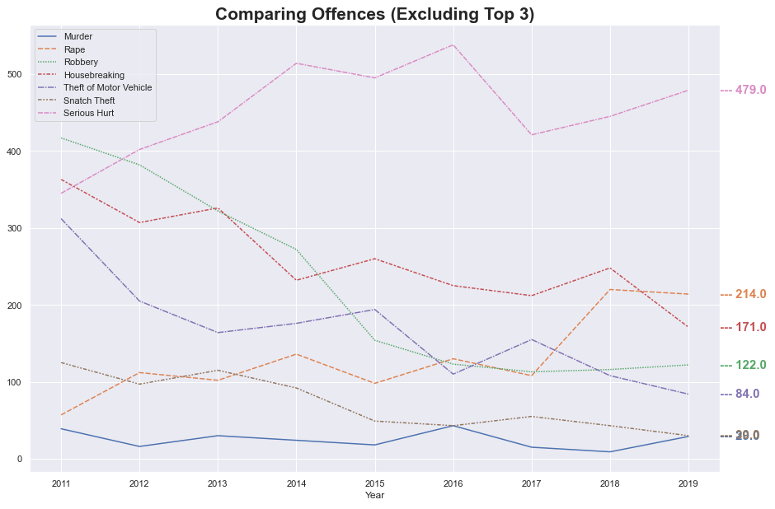
Persons Arrested for Selected Major Offences

Slide 10
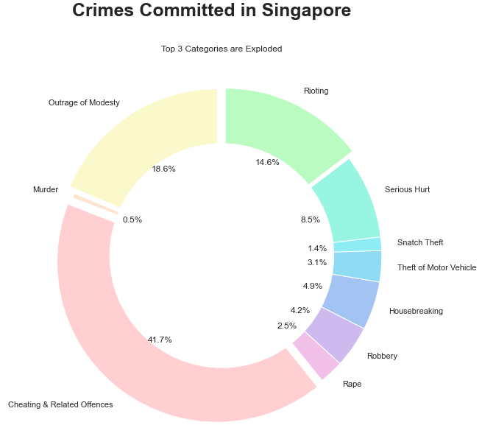
Persons Arrested for Selected Major Offences

Slide 11
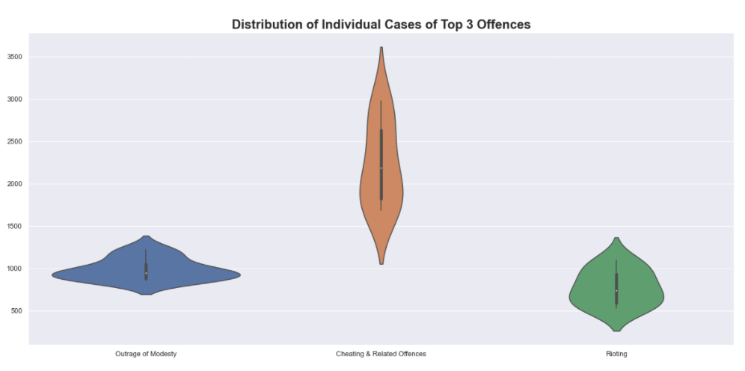
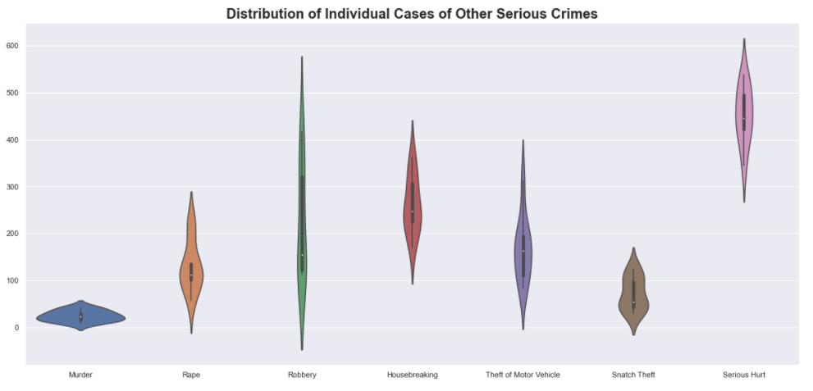
Persons Arrested for Selected Major Offences

Slide 12
Insights
Cheating & Related Offences - Top 3 - Significant increase over the years
Outrage of Modesty - Top 3 - Increased over the years
Rioting - Top 3 - Steady decrease over the years
Murder - Not a significant increase/decrease over the years
Rape - Steady increase over the years
Robbery - Highest percentage decrease since 2011 (over 70% decrease of robbery cases)
Housebreaking - Decrease over the years
Theft of Motor Vehicle - Decrease over the years
Snatch Theft - Decrease over the years
Serious Hurt - Steady increase over the years

Slide 13
Insights
Cheating and Related Offences make up over 40% of all crime committed in Singapore, the most amongst all other serious crimes recorded.
Ever since 2011, the number of crimes committed under Cheating & Related Offences has gone up quite significantly. This is attributed to the number of crimes easily committed in the cyberspace via scams and phishing links.

Slide 14
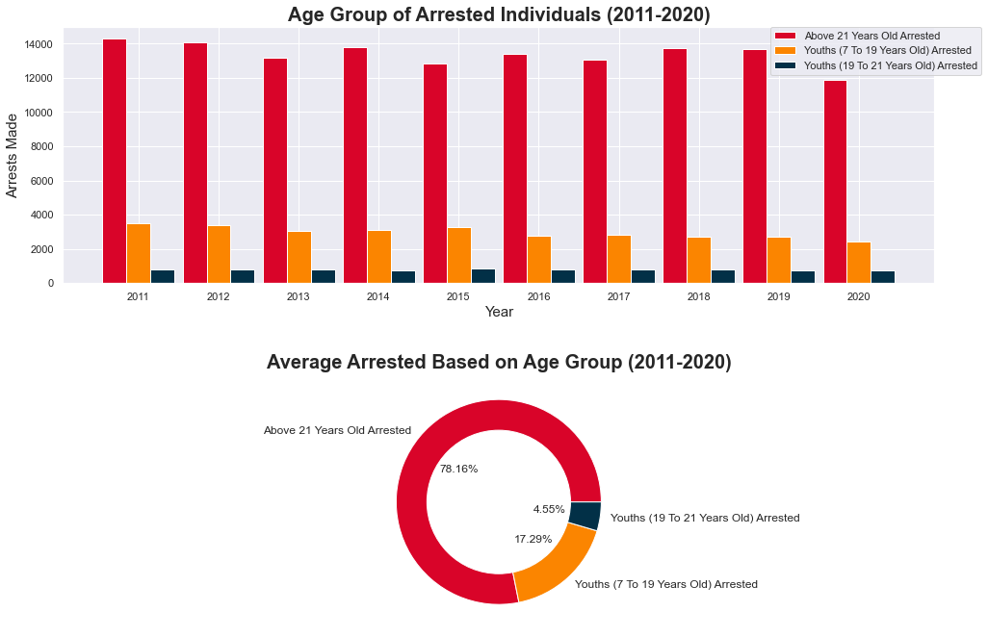
Total Persons (local and foreigners) Arrested

Slide 15
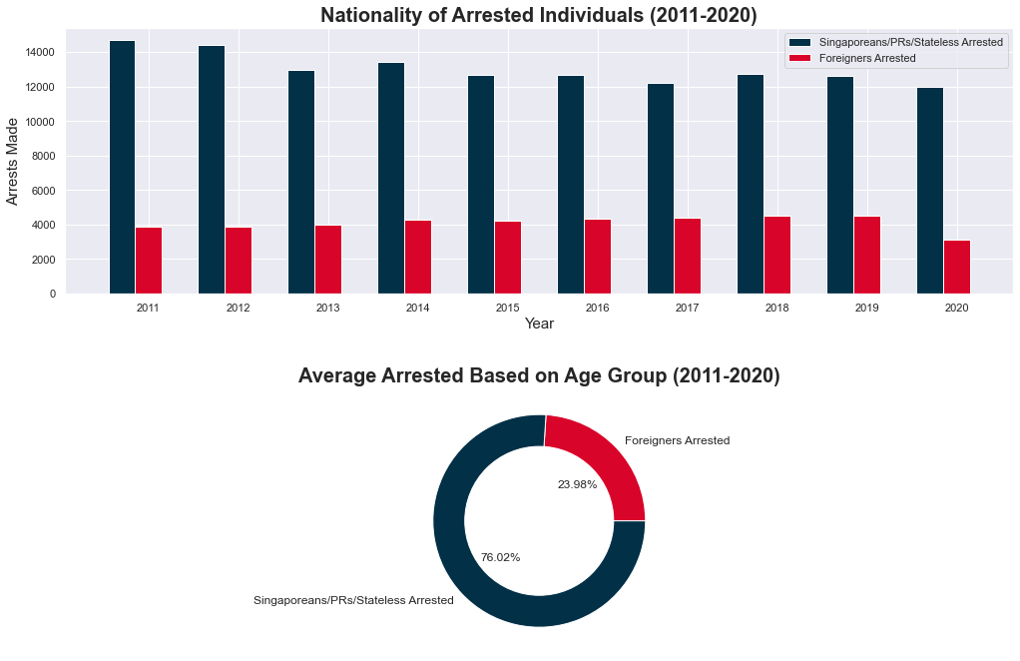
Total Persons (local and foreigners) Arrested

Slide 16
Insights
Youths (7-21 years old) make up and average of 21.81% arrested from the year 2011-2020, while the rest are above the age of 21 years old.
Foreigners make up an average of 23.99% of all arrests from 2011-2020, while the rest are Singaporeans/PR/Stateless individuals
Those aged above 21 years old are arrested the most in Singapore
Singaporeans/PRs/Stateless individuals are arrested the most in Singapore

Slide 17
Recommendations
Singapore Police Force (SPF) needs to buff up their cyber crimes division to investigate, identify, and arrest perpetrators as a large majority of Cheating & Related offences are cyber-related.
Educate youths and adults alike to identify scams and remain aware on what information they give out
Advisories to inform all foreigners and Singaporeans on what is considered illegal
Increased patrols and neighborhood watches to deter crimes such as rioting, robberies and snatch theft.

