Slide 1

Spotify Data Analysis

Slide 2

Project Objective And Overview :
- Analyze music streaming trends using PostgreSQL. - Compare performance of tracks on Spotify vs YouTube. - Identify top streamed songs and artists. - Gain business insights for music platforms.
- analyzing a Spotify dataset with various attributes about tracks, albums, and artists using SQL.
- It covers an end-to-end process of normalizing a denormalized dataset, performing SQL queries of varying complexity, and optimizing query performance.
- The primary goals of the project are to practice advanced SQL skills and generate valuable insights from the dataset.

Slide 3
Practice questions
Easy Level
Retrieve the names of all tracks that have more than 1 billion streams.
List all albums along with their respective artists.
Get the total number of comments for tracks where licensed = TRUE.
Find all tracks that belong to the album type single.
5.Count the total number of tracks by each artist.
Medium Level
Calculate the average danceability of tracks in each album.
Find the top 5 tracks with the highest energy values.
List all tracks along with their views and likes where official video = TRUE.
For each album, calculate the total views of all associated tracks.
Advanced Level
Find the top 3 most-viewed tracks for each artist using window functions.
Write a query to find tracks where the liveness score is above the average.
Use a WITH clause to calculate the difference between the highest and lowest energy values for tracks in each album.

Slide 4

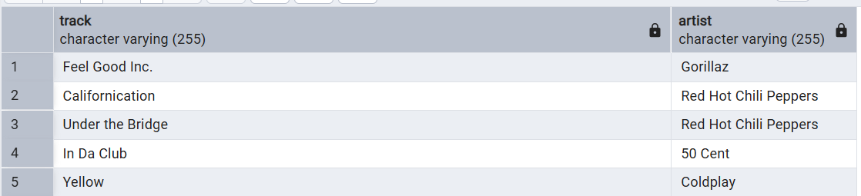
Easy level :
Question - 1
Retrieve the names of all tracks that have more than 1 billion streams.

Slide 5
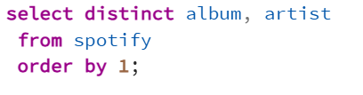
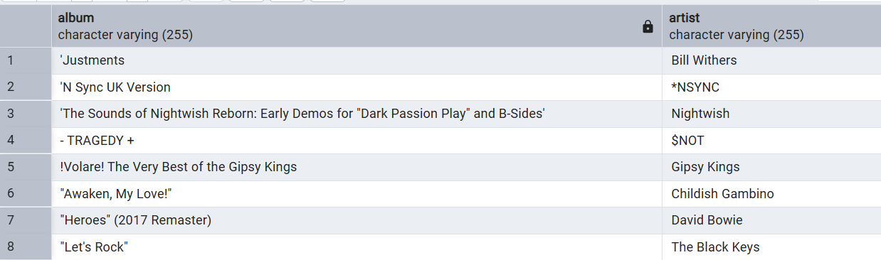
Question – 2
List all albums along with their respective artists.

Slide 6
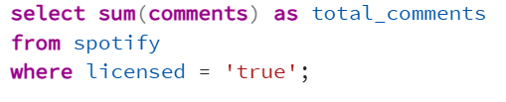
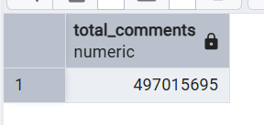
Question – 3
Get the total number of comments for tracks where licensed = TRUE.

Slide 7
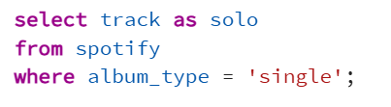
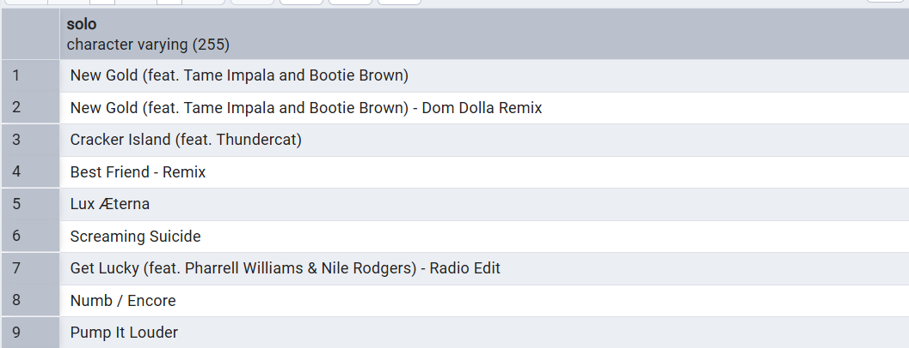
Question – 4
Find all tracks that belong to the album type single.

Slide 8
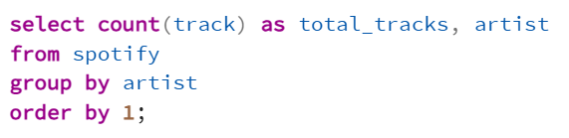
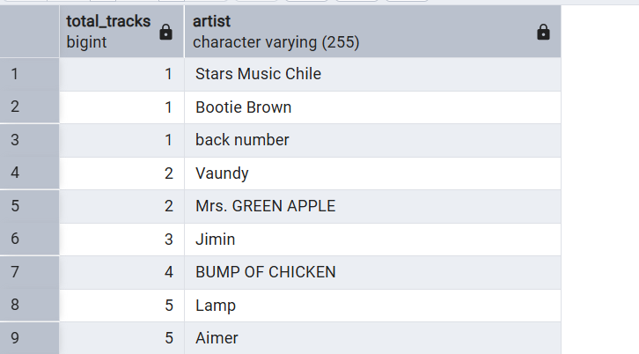
Question – 5
Count the total number of tracks by each artist.

Slide 9
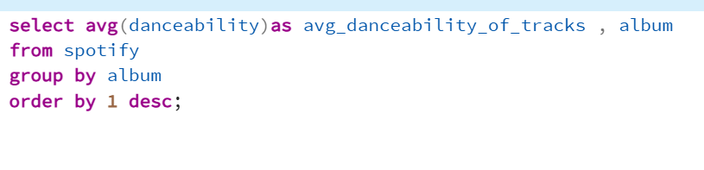
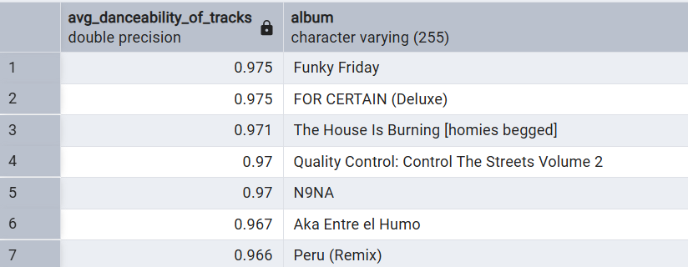
Medium level :
Question – 1
Calculate the average danceability of tracks in each album.

Slide 10
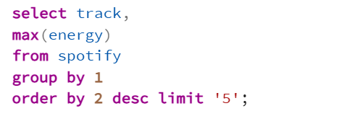
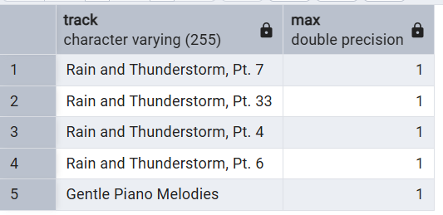
Question – 2
Find the top 5 tracks with the highest energy values.

Slide 11
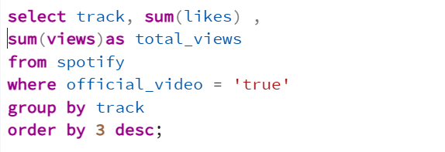
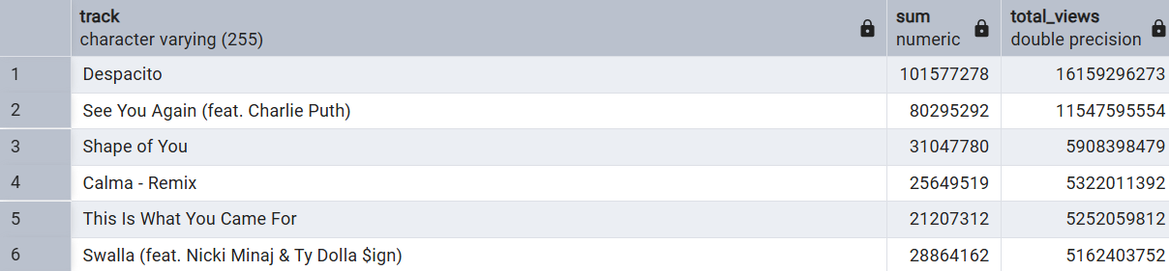
Question – 3
List all tracks along with their views and likes where official video = TRUE.

Slide 12
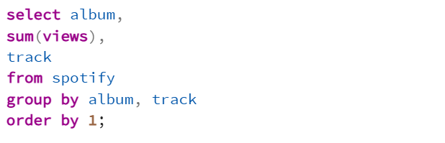
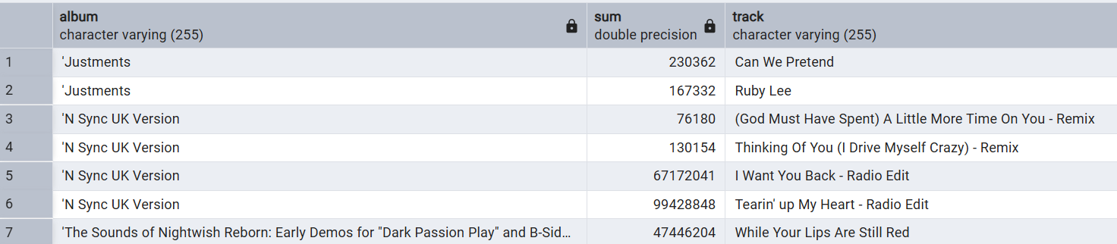
Question – 4
For each album, calculate the total views of all associated tracks.

Slide 13
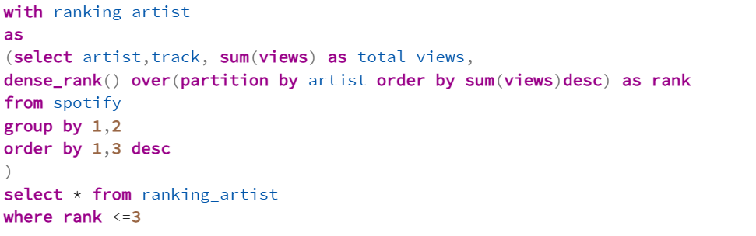
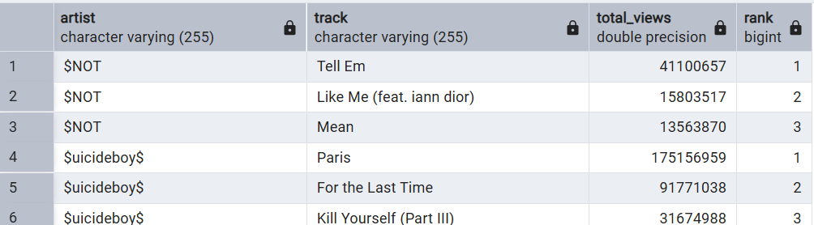
Advance level :
Question – 1
Find the top 3 most-viewed tracks for each artist using window functions.

Slide 14
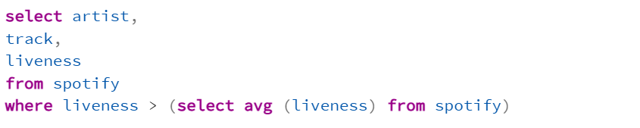
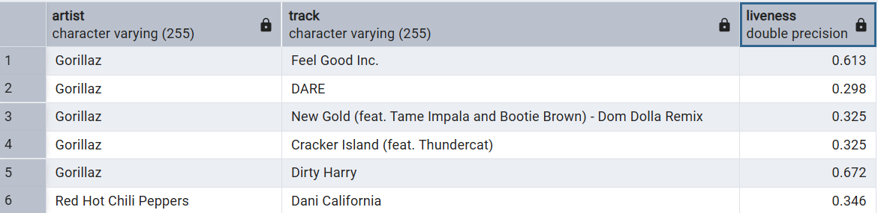
Question – 2
Write a query to find tracks where the liveness score is above the average.

Slide 15
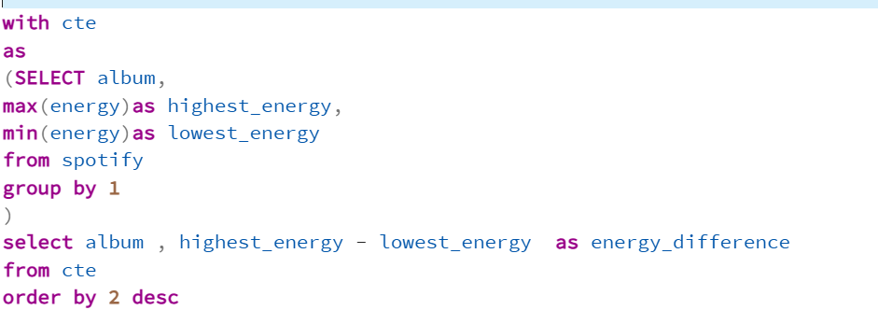
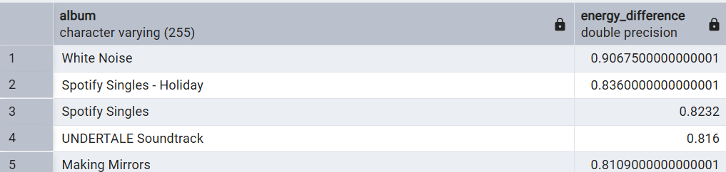
Question – 3
Use a WITH clause to calculate the difference between the highest and lowest energy values for tracks in each album.

Slide 16
Key Takeaways
- Spotify leads in overall stream count. - Some tracks perform better on specific platforms. - SQL provides powerful analysis. - Insights support artists and music strategy.
- In 20592 songs in the data , only 385 songs are over 1 B streams
- Total no. of comments on the licensed tracks are 497015695.
- Despacito is the track with the highest likes of 101577278 and highest views of 16159296273 in the data
- In 20592 tracks, 6364 tracks’ liveness is over the Average liveness of 0.19

Slide 17
Thank You!

