Slide 1
🎬IMDB Movies SQL Project
An SQL-based analysis of movies and director data
Presented by :
TEAM - PTID-CDA-SEP-25-763

Slide 2
🎯 Project Objective
• To explore and analyze a movie dataset using SQL queries.
• Perform joins, aggregations, and pattern-based data extraction.
• Understand relationships between movies, directors, and their performance.

Slide 3
💻 SQL Tasks Performed
Can you get all data about movies?
How do you get all data about directors?
Check how many movies are present in IMDB.
Find these 3 directors: James Cameron ; Luc Besson ; John Woo
Find all directors with name starting with S.
Count female directors.
Find the name of the 10th first women directors?
What are the 3 most popular movies?
What are the 3 most bankable movies?
What is the most awarded average vote since the January 1st, 2000?
Which movie(s) were directed by Brenda Chapman?
Which director made the most movies?
Which director is the most bankable?

Slide 4

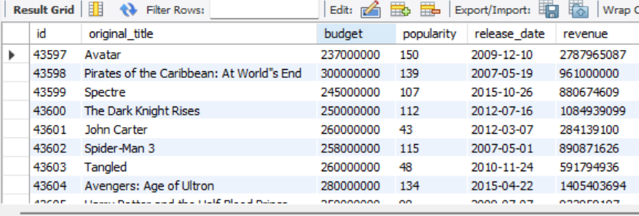
Query 1 :
Can you get all data about movies?

Slide 5

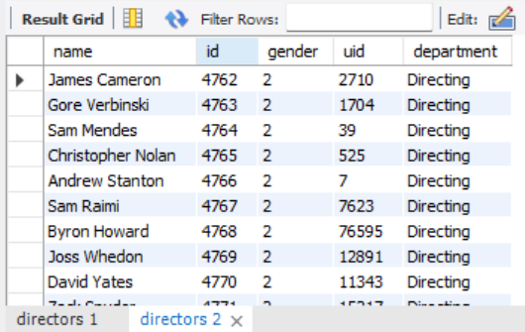
Query 2 :
How do you get all data about directors?

Slide 6
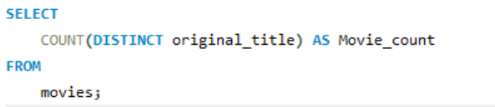
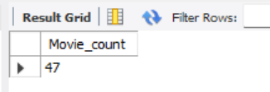
Query 3:
Check how many movies are present in IMDB

Slide 7
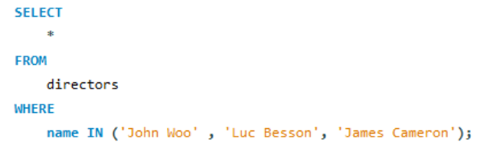

Query 4 :
Find these 3 directors: James Cameron ; Luc Besson ; John Woo

Slide 8

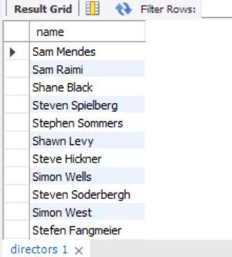
Query 5 :
Find all directors with name starting with S.

Slide 9
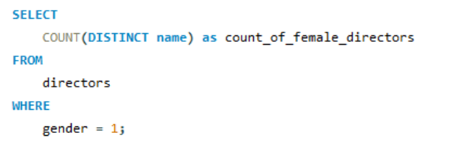
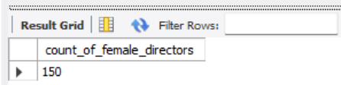
Query 6 :
Count female directors .

Slide 10
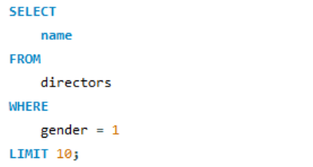
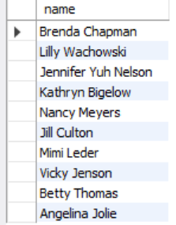
Query 7 :
Find the name of the 10th first women directors?

Slide 11
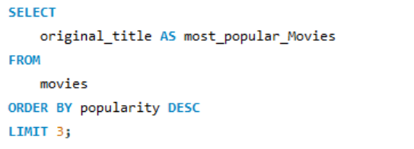
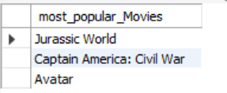
Query 8:
What are the 3 most popular movies?

Slide 12
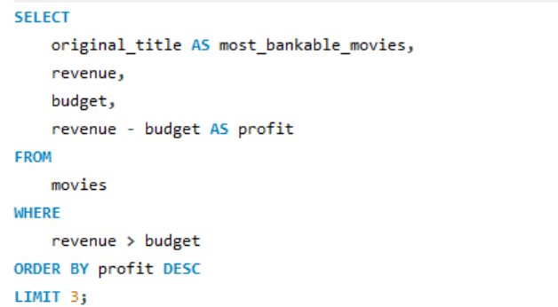
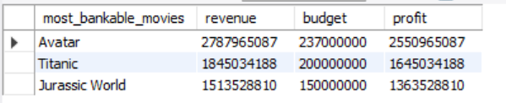
Query 9:
What are the 3 most bankable movies?

Slide 13
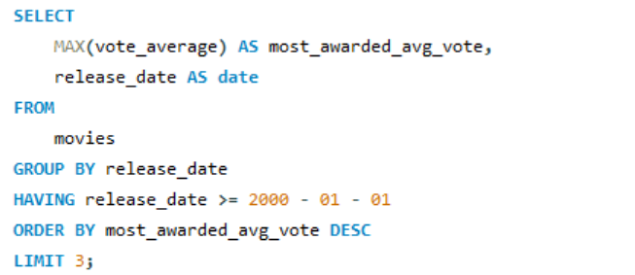
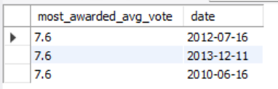
Query 10 :
What is the most awarded average vote since the January 1st, 2000?

Slide 14
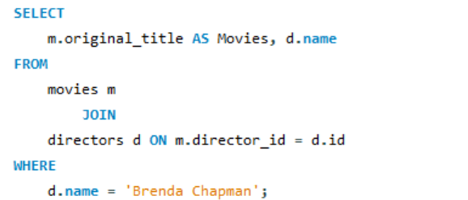
Query 11 :
Which movie(s) were directed by Brenda Chapman?
There was not enough data in the movies table regarding ‘Brenda Chapman’. Her Id was not there in that table.

Slide 15
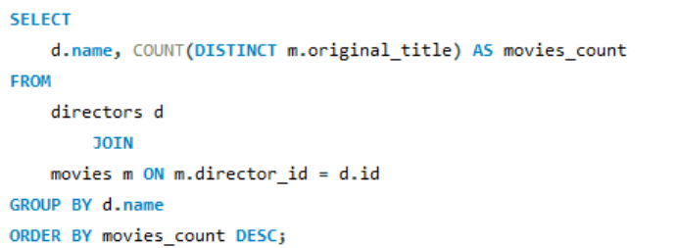
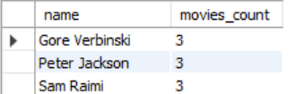
Query 12 :
Which director made the most movies?

Slide 16
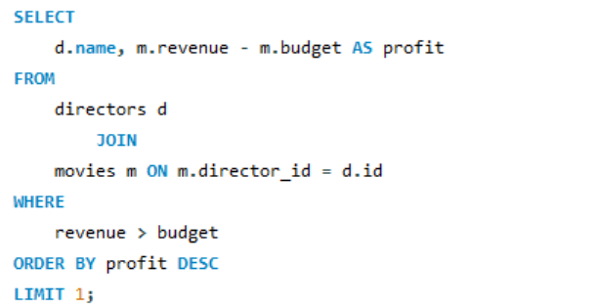
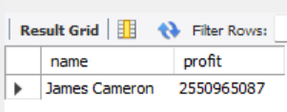
Query 13 :
Which director is the most bankable?

Slide 17
⚠️ Challenges Faced
Missing id of the director Brenda Chapman in the movies table .
Limited access to the commands like ALTER, CREATE and INSERT .

Slide 18
📊 Key Insights
There are 47 movies in the IMDB Dataset.
150 Female Directors are there in the Movies Industry.
Top – 3 Most popular movies includes : Jurassic World
Captain America : Civil War
Avatar
Top – 3 Most bankable movies are : Avatar (profit - 2550965087)
Titanic (profit - 1645034188)
Jurassic World (profit - 1363528810)
There was missing data (Id-4801) of the director named Brenda Chapman in the movies table.
The top 3 directors — Gore Verbinski, Peter Jackson, Sam Raimi — share a tie for the highest number of movies directed, with each contributing 3 films.
James Cameron is the most bankable director of the industry with the profit of 2550965087.

Slide 19
💡 Suggestions for Improvement
Improve Data Accuracy and Integration : Missing data (e.g., Brenda Chapman’s data) suggest the need for better data management systems. Enhancing database integration will ensure accurate performance analysis and decision-making.
Leverage Popular Franchises and Sequels : Since top-performing movies belong to established franchises (Avatar, Jurassic World, Captain America), investing in sequels or related storylines can help sustain audience engagement and revenue growth.
Invest in Proven Directors : Directors like James Cameron, Gore Verbinski, Peter Jackson, and Sam Raimi have shown consistent performance in delivering successful movies. Collaborating with such experienced directors or following their creative approach could increase profitability
Focus on High-Budget, High-Return Genres : Movies such as Avatar, Titanic, and Jurassic World demonstrate that large-scale productions with strong visual effects and universal appeal tend to generate massive revenues. Prioritizing such genres can enhance box office success.

Slide 20
🎬 Conclusion
This project demonstrates practical SQL skills in data extraction, filtering, and analysis.
Although the dataset presented challenges, the problem-solving approach reflects analytical thinking.
Key learning: Always structure data carefully before performing analysis.

