Slide 1
Transition to Cloud-Based Azure Storage at XYZ Bank

Slide 2
Current:
XYZ Bank has decided to transition from using a traditional Datawarehouse to a centralized, cloud-based Azure storage solution. To facilitate this shift, mechanisms have been established within On-Prem systems and other sources to transmit incremental daily snapshots of data to Azure Data Lake Storage.
Historically, the Marketing System (MS) accessed necessary datasets daily from the Datawarehouse to generate dashboards. With the bank’s strategic pivot, the MS team now needs to design a system to ingest these datasets daily from the centralized storage into their designated storage account. Additionally, they must perform the necessary operations on the datasets to ensure they are readily accessible for dashboarding purposes.
As Senior Azure Engineers, it is crucial that we collaborate to develop a scalable solution to meet the MS team’s requirements.

Slide 3
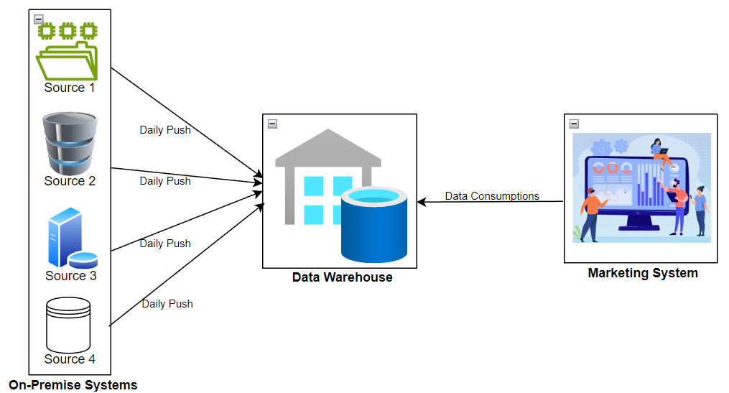

Slide 4
Solution

Slide 5

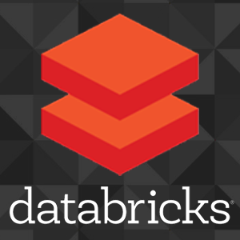
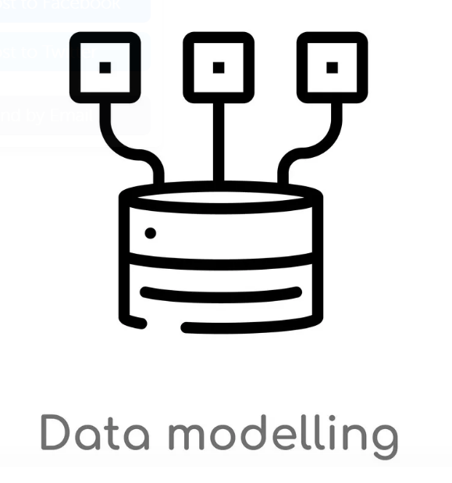
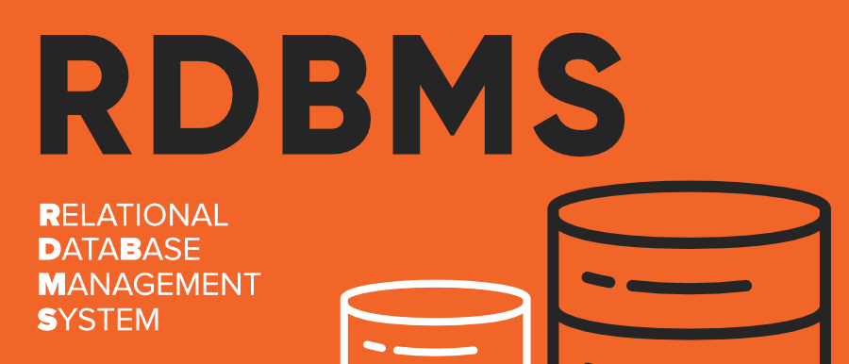
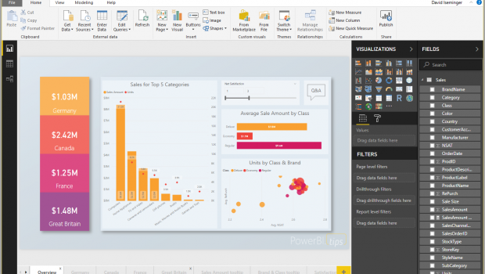
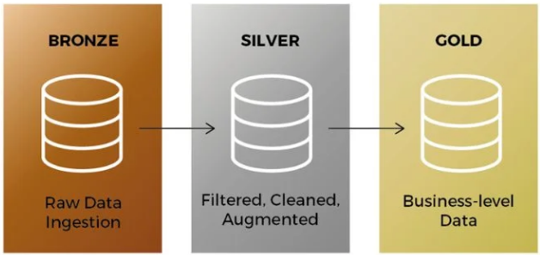
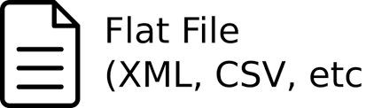

Architecture Overview
source1
Source 2
Source 3
Source 4

Slide 6
Architecture Overview
1. Data Sources: Data is coming from multiple sources and in different formats.
2. Azure Data Factory: Orchestration data ingestion from multiple sources
3. Azure Data Lake Storage:
i) Bronze layer : It is the landing zone where it stores the raw data.
ii) Silver layer: Transformations are performed in this layer.
iii) Gold Layer: It is the layer which stored the cleaned data and can be used for business.
4. Azure Databricks: It can be used for scalable data processing and transformation using pyspark, SQL.

Slide 7
Data Ingestion
Data Ingestion using azure data factory and azure data lake storage.
Azure Data Factory orchestrates data ingestion from multiple sources.
Azure Blob Storage provides scalable storage for ingested data.
Steps Involved:
Identify Data Sources: Databases, files, or streaming data.
Configure Data Ingestion Pipelines: Utilize Azure Data Factory to set up efficient pipelines.
Monitor and Manage: Ensure reliability and efficiency by monitoring and managing data ingestion.

Slide 8
Data Transformation
Optimizing Data Processing using medallion architecture in Azure Databricks
Bronze Layer (Raw Data Ingestion):
Raw data ingested from various sources using Azure Data Factory.
Azure data Lake Storage will act as landing zone.
Silver Layer (Data Refinement):
Data transformation utilizing Azure Databricks and PySpark.
Scalable data processing capabilities offered by Azure Databricks.
Gold Layer:
Data ready for consumption by stakeholders and applications

Slide 9
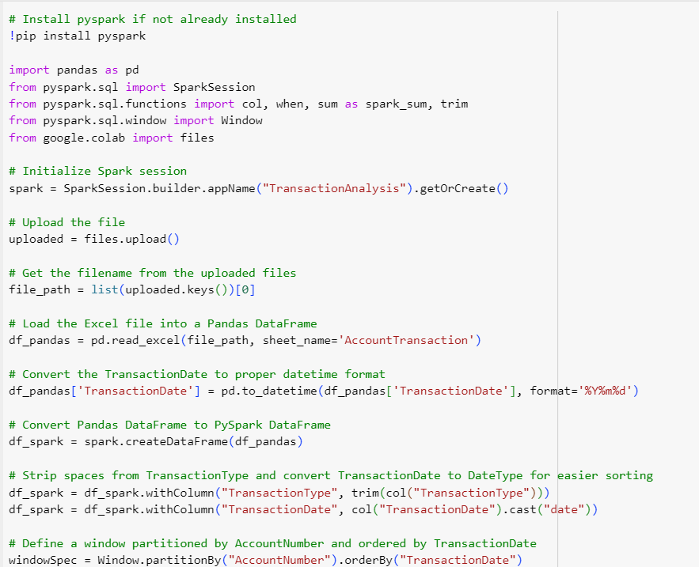
Assignment-2 Coding

Slide 10
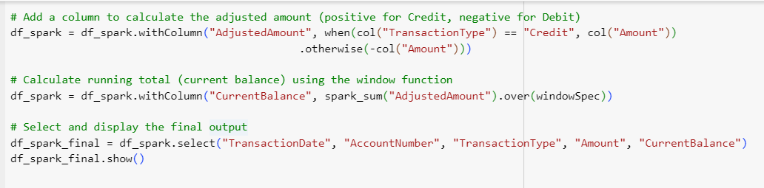

Slide 11
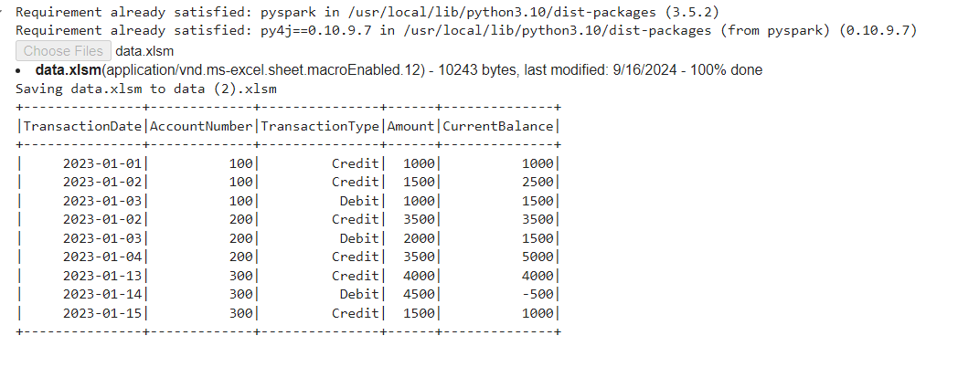
Output

Slide 12
Thank you

