Slide 1

Unstructured Data Management on Yelp Datasets
Shagun Garg
Ashish Devrani

Slide 2
What is Yelp?
User driven Web service which reveals honest and current insights on local businesses including restaurants, shopping centres, theme parks, etc.
A web based community which allows users to share the experiences they’ve had world-wide
A place to learn about any place in US and Canada
Allows users from anywhere in the world to rate and review any business or locations in the United States and Canada.
Eg. What’s the best pizza place in Boston? How good is Mike’s Pastry really?

Slide 3
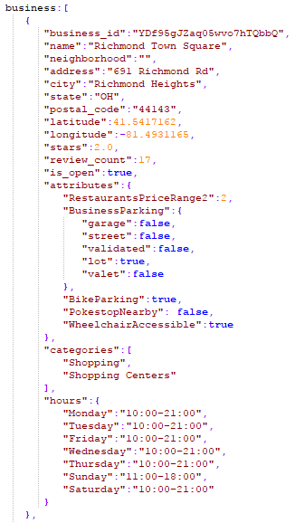
MongoDB Schema
Business
Our Observations:
Data clearly depicted based on the business case
Good use of location data in terms of Latitude and Longitude.
Many neighbourhood values were null.
Our Suggestions/Improvements:
Added a new attribute PokestopNearby based on the current trend of Pokemon Go.
Use Boolean values instead of 0 or 1 for fields like is_open

Slide 4
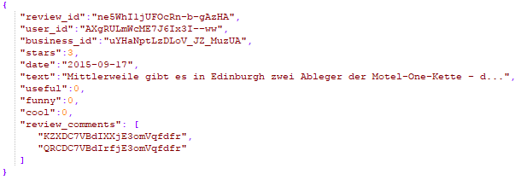
MongoDB Schema
Review
Our Observations:
Best example of referencing a document with other collections like business and user.
Didn’t really need the funny and cool documents.
Our Suggestions/Improvements:
Added a new document called review_comments to take comments on each review just like Amazon.
Referenced them with a newly created collection called comment.

Slide 5
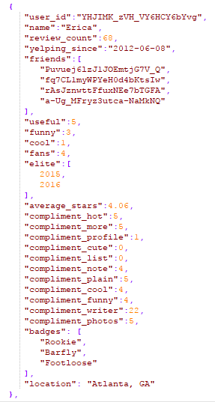
MongoDB Schema
User
Our Observations:
Friends array is too big in size which results in memory issues. Diverts towards a social media experience.
Multiple types of compliments.
Our Suggestions/Improvements:
Compliments should a document array.
Added new documents badges and location to improve the helpfulness of a review or a review comment.

Slide 6
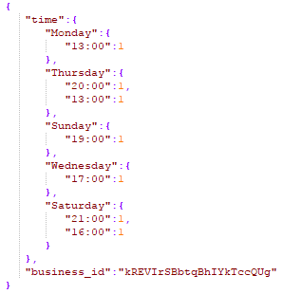


MongoDB Schema
Checkin, Photo and Tip
Our Observations:
Simple collections
Good use of checkin and tip collections
Our Suggestions/Improvements:
Labels for photos could be more creative in nature.
Checkin could also include user_id.

Slide 7

MongoDB Schema
Comment
Our Observations:
Requirement to include comments as part of each review to improve helpfulness
Our Suggestions/Improvements:
Comments will add an extra flavour to the reviews on top of the useful document which already exists.

Slide 8
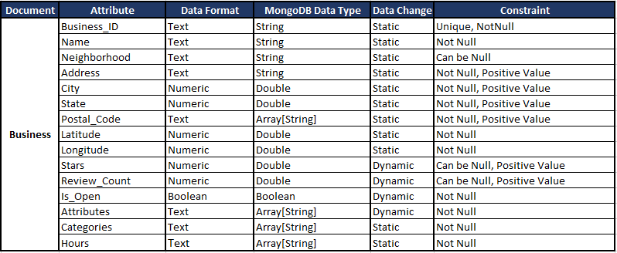
MongoDB Schema Constraints Business

Slide 9
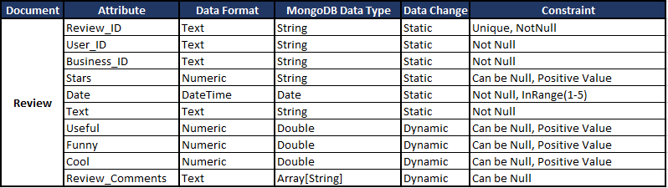
MongoDB Schema Constraints Review

Slide 10
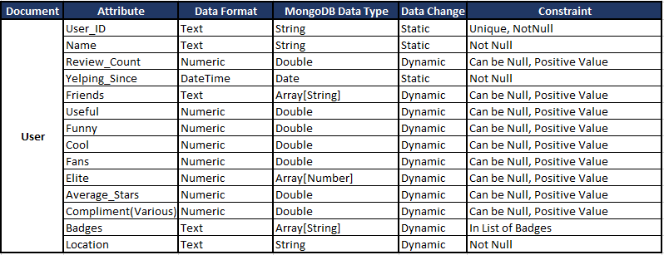
MongoDB Schema Constraints User

Slide 11
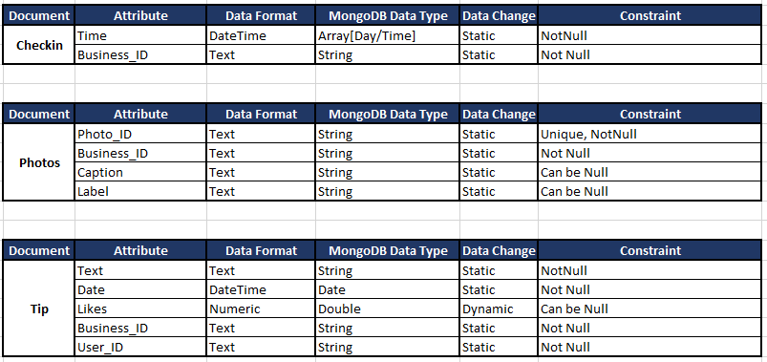
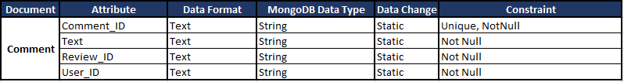
MongoDB Schema Constraints Checkin, Photos, Tip and Comment

Slide 12
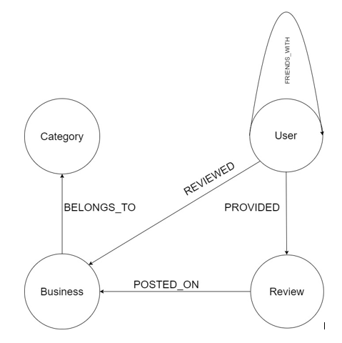
Neo4j Schema
Nodes:
Category
Business
User
Review
Relationships:
(User)-[:PROVIDED]->(Review)
(Review)-[:POSTED_ON]->(Business)
(User)-[:FRIENDS_WITH]->(User)
(User)-[:REVIEWED]->(Business)

Slide 13
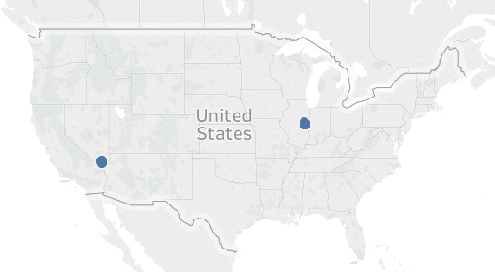
Data Preparation
Selected two cities from USA - One from east coast and one from west coast.
Cities chosen were North Las Vegas and Champaign.
Dataset truncated to avoid memory issues.

Slide 14
Data Preparation
The below query collects the documents that correspond to only the cities “North Las Vegas” and “Champaign”.
New corresponding collections were created hence.

Slide 15
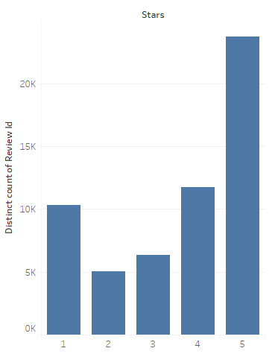
Understanding of the Data Rating Distribution of Reviews
The number of reviews corresponding to each review rating.
Maximum number of reviews in our data set are rated 5 stars.

Slide 16
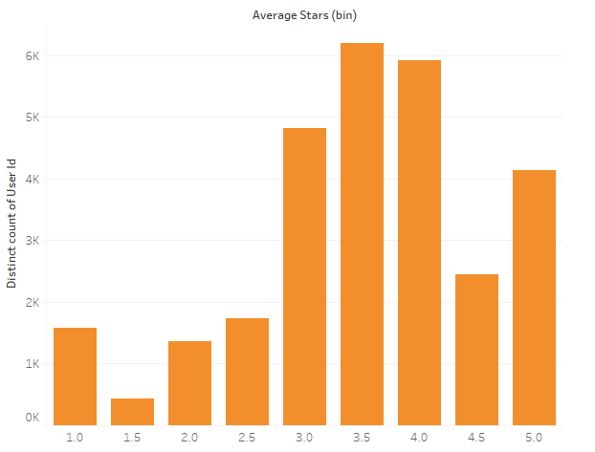
Understanding of the Data Rating Distribution of Users
The number of users corresponding to each user’s average rating.
Maximum number of users in our data set are rated approx. 3.5 stars.

Slide 17
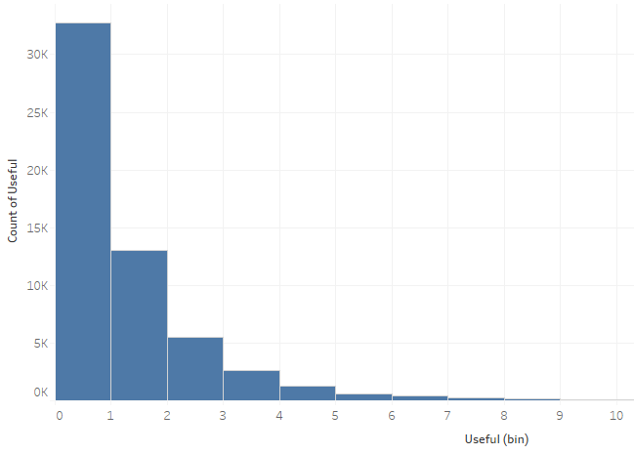
Understanding of the Data Usefulness of Reviews
The number of reviews corresponding to each bracket of usefulness.
Maximum number of reviews fall in 0 and 1 bracket.

Slide 18
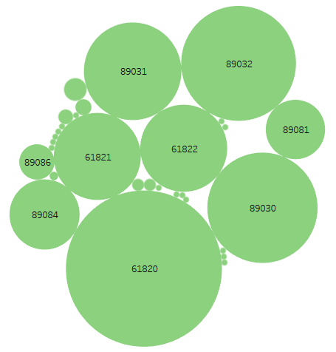
Understanding of the Data Postal Codes in North Las Vegas and Champaign
Spread of number of reviews in the city of North Las Vegas.
Maximum number of reviews fall in 61820.

Slide 19
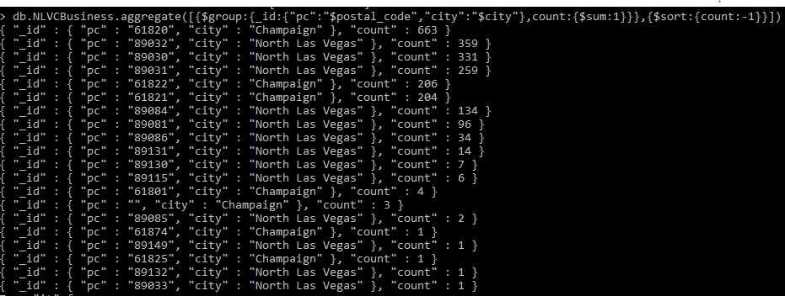
Understanding of the Data Postal Codes in North Las Vegas and Champaign
Spread of number of reviews in the cities of North Las Vegas and Champaign.
Maximum number of reviews fall in 61820.

Slide 20
Understanding of the Data Overview of the Database
Total number of Businesses = 2338
Total number of reviews = 57163
Total number of users = 28604

Slide 21
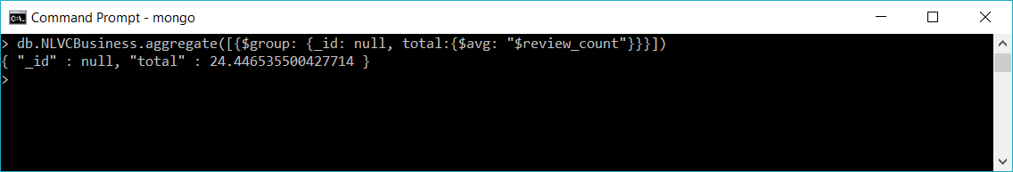
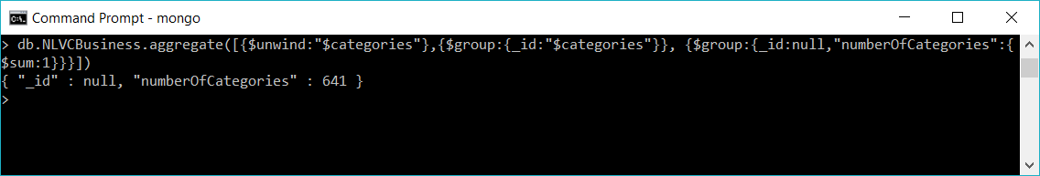
Understanding of the Data Overview of the Database
Average number of reviews per business = 24.44
Total number of categories = 641

Slide 22
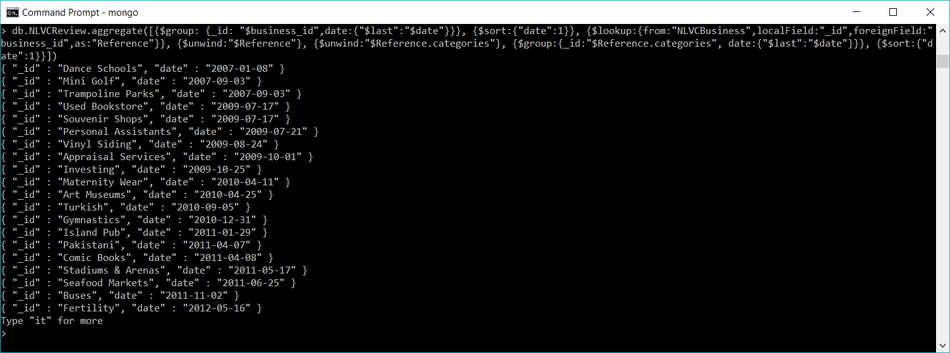
Understanding of the Data Overview of the Database
Date of the first review per category

Slide 23
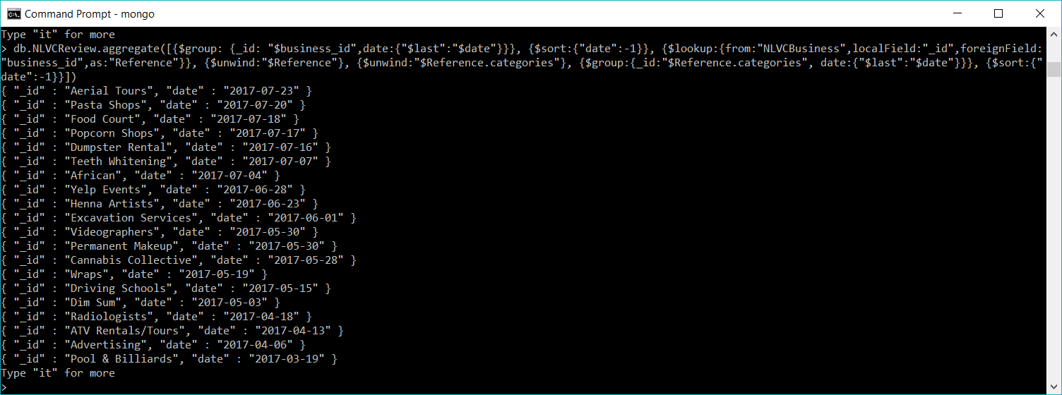
Understanding of the Data Overview of the Database
Date of the latest review per category

Slide 24
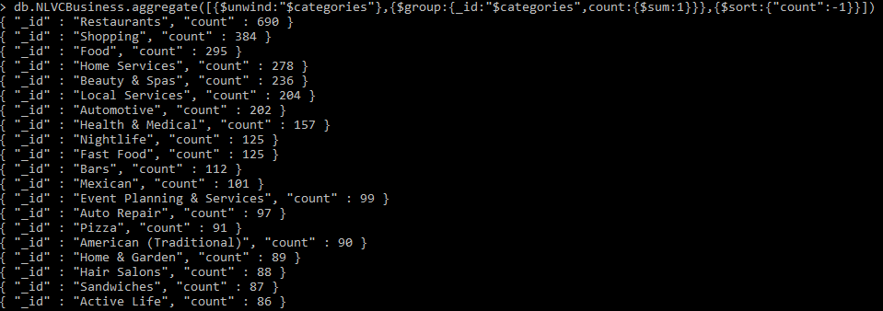
Understanding of the Data Overview of the Database
Number of reviews per category

Slide 25
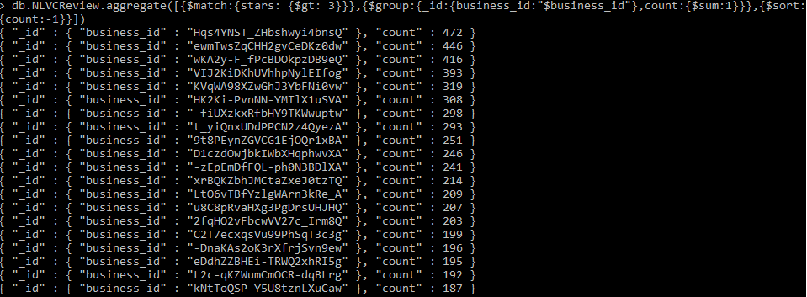
Understanding of the Data Review Trends
Review trends across businesses for rating greater than 3

Slide 26
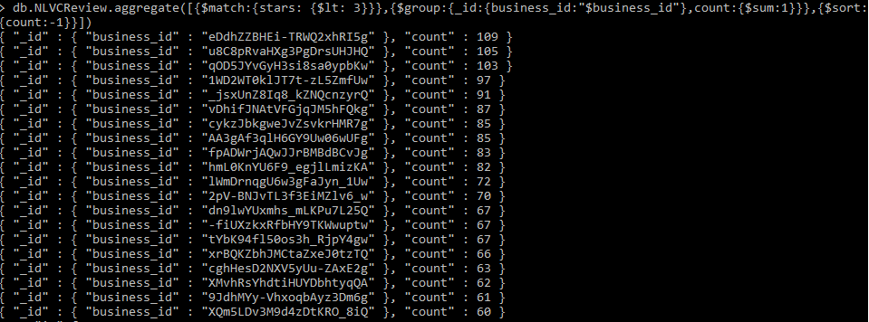
Understanding of the Data Review Trends
Review trends across businesses for rating less than 3

Slide 27
Understanding of the Data Review Trends
Data shows that there are more reviews that are rated more than 3 than the ones that are rated less than 3.
This shows that the overall response to the businesses in our database is positive.
But this can be concerning since this data set may contain reviews that might have been planted by the businesses themselves.
This can also lead to shunning down the opportunity of a business to improve their services based on constructive criticism.

Slide 28
Analytics MongoDB Metrics
Restaurants currently open in a neighborhood sorted by rating
To find these restaurants we have tried to use the geometry function of MongoDB to find the restaurants currently open in the 5 mile radius of a neighborhood and sort them by their rating.
We first added new documents location and coordinates to our existing collection.
Once, added we insert the longitude and latitude coordinates in the coordinates document.

Slide 29
Analytics MongoDB Metrics
Restaurants currently open in a neighborhood sorted by rating
db.NLVCBusiness.updateMany({longitude:{$exists:true},latitude:{$exists:true}},{ $set : { location: {type: "Point", coordinates: []}}})
db.NLVCBusiness.find({longitude:{$exists:true},latitude:{$exists:true}}).forEach( function(myDoc) { myDoc.location.coordinates.push(myDoc.longitude);myDoc.location.coordinates.push(myDoc.latitude);db.NLVCBusiness.save(myDoc);} )

Slide 30
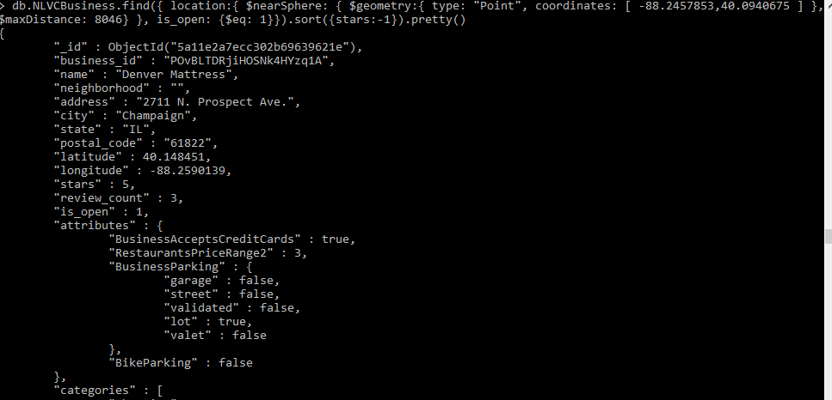
Analytics MongoDB Metrics
Restaurants currently open in a neighborhood sorted by rating

Slide 31
Analytics MongoDB Metrics
Restaurants in the vicinity of a geometrical point
var currentNeighborhood = db.NLVNeighborhoods.findOne( { geometry: { $geoIntersects: { $geometry: { type: "Point", coordinates: [ -88.2457853,40.0940675] } } } } )
db.NLVCBusiness.find( { location: { $geoWithin: { $geometry: currentNeighborhood.geometry } } } ).count()

Slide 32
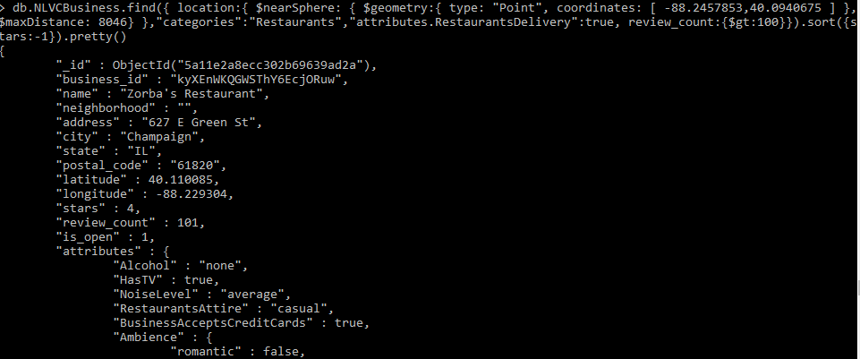
Analytics MongoDB Metrics
Most popular restaurants for delivery in a neighborhood

Slide 33
Analytics MongoDB Metrics
Users with highest average stars (useful>=67)(yelping_since> 1 year)
db.NLVCUser.aggregate([{$group:{_id:null,count:{$avg:"$useful"}}}])
{ "_id" : null, "count" : 66.60086001957768 }
db.NLVCUser.aggregate([{$group:{_id:null,count:{$stdDevPop:"$useful"}}}])
{ "_id" : null, "count" : 972.1800946045036 }
db.NLVCUser.aggregate([{$group:{_id:null,count:{$avg:"$review_count"}}}])
{ "_id" : null, "count" : 38.5215704097329 }
db.NLVCUser.aggregate([{$group:{_id:null,count:{$stdDevPop:"$review_count"}}}])
{ "_id" : null, "count" : 136.52953731917444 }

Slide 34
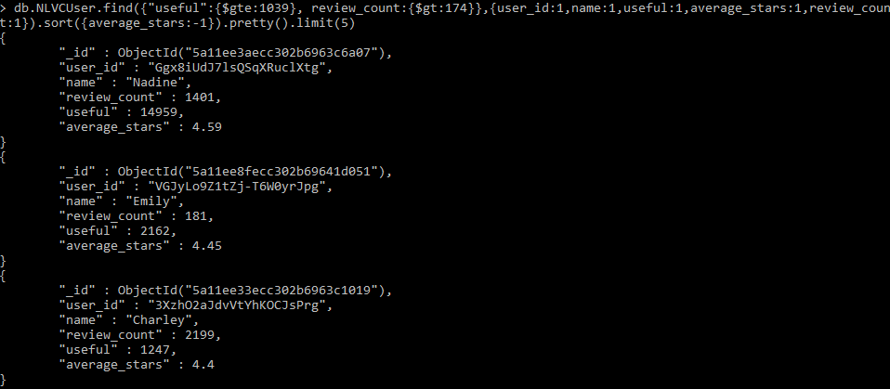
Analytics MongoDB Metrics
Users with highest average stars (useful>=67)(yelping_since> 1 year)

Slide 35
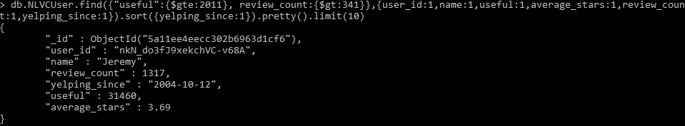
Analytics MongoDB Metrics
Oldest User
Most Recent User
Top 10 Old(2 years reviewing) frequent(50 reviews) users

Slide 36
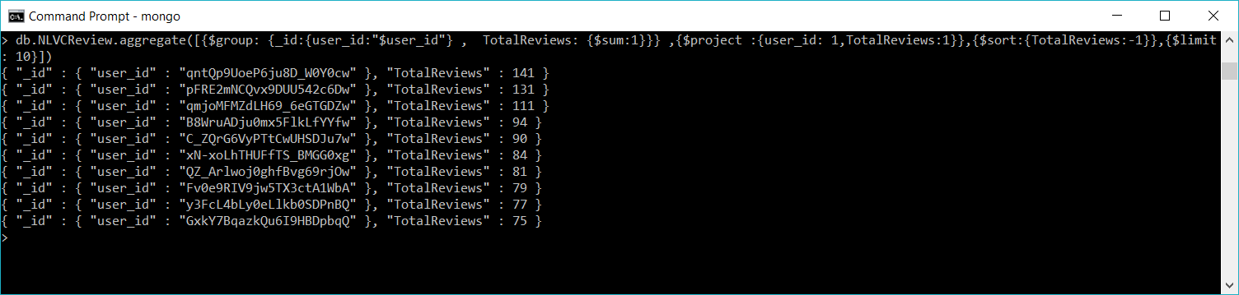
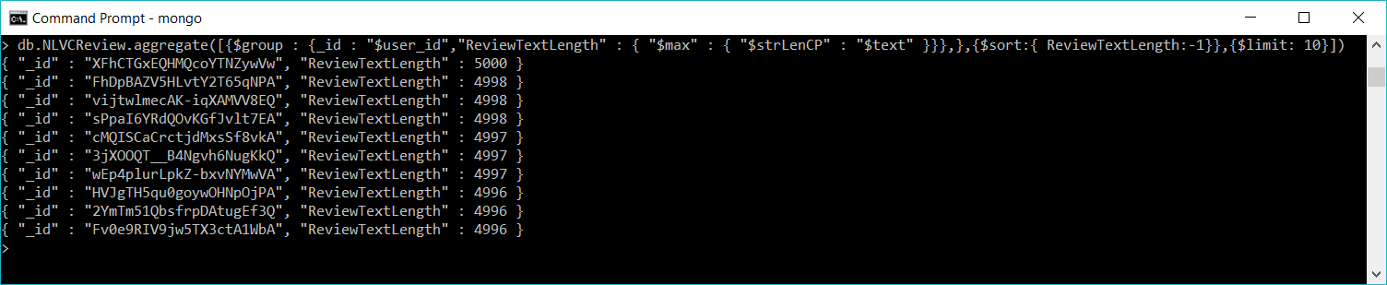
Analytics MongoDB Metrics
Top 10 most prolific users
Top 10 most verbose users

Slide 37
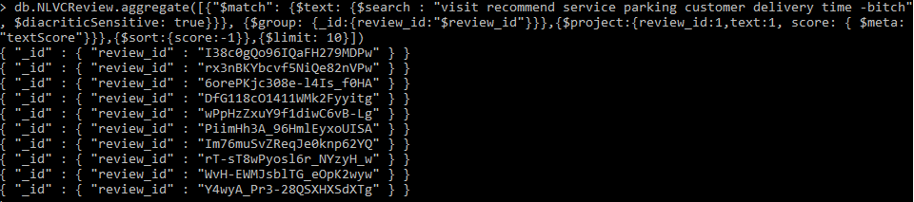
Analytics Helpfulness of a Review
Text based helpfulness
db.NLVCReview.aggregate([{"$match": {$text: {$search : "visit recommend service parking customer delivery time -bitch", $diacriticSensitive: true}}}, {$group: {_id:{review_id:"$review_id"}}},{$project:{review_id:1,text:1, score: { $meta: "textScore"}}},{$sort:{score:-1}},{$limit: 10}])

Slide 38
Analytics Helpfulness of a Review
Text based helpfulness
We have created a unique indexing for the document text.
After creating the indexing, we have used the $text method to search for helpful words like “visit recommend service parking customer delivery time” and exclude swear words like “bitch”.
The $text method by default ignores language-specific stop words, such as the and in English.
We are also doing a diacritic sensitive search which includes accent marks as well.
Based on the search for the helpful words, the $meta function calculates the text score for the text field.

Slide 39
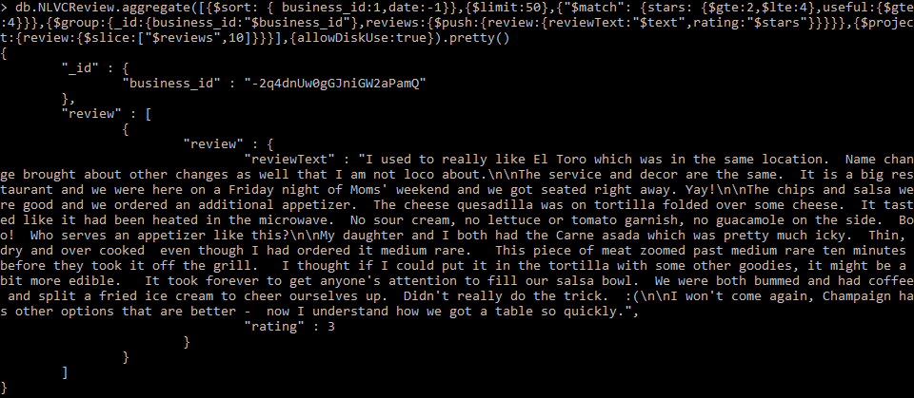
Analytics Helpfulness of a Review
Non-Text based helpfulness
db.NLVCReview.aggregate([{$sort: { business_id:1,date:-1}},{$limit:50},{"$match": {stars: {$gte:2,$lte:4},useful:{$gte:4}}},{$group:{_id:{business_id:"$business_id"},reviews:{$push:{review:{reviewText:"$text",rating:"$stars"}}}}},{$project:{review:{$slice:["$reviews",10]}}}],{allowDiskUse:true}).pretty()

Slide 40
Analytics Helpfulness of a Review
Non-Text based helpfulness
For this query, we have used the overall rating, i.e. stars to be between 2 and 4.
Second criteria is based on the review date. The latest reviews are only being taken.
The review date is calculated by sorting date in descending order and business identifier, i.e. business_id in ascending order.
We are also selecting the reviews that have been voted useful by more than 4 votes.

Slide 41
Analytics Helpfulness of a Review
The text-based approach and non-text based approach are not in agreement for our current dataset.
This is because there are many cases where a reviewer would have used helpful words to mention about his experience of visiting a business but it didn’t gain traction amongst the other users of Yelp and hence was not able to garner enough ratings or useful votes or maybe posted at an earlier date.
In an ideal use-case, both the approaches should go hand-in-hand so as to validate one’s findings with the other’s.
Also, to improve the helpfulness of a review we can add a comments collection to the dataset like we have done in our pseudo schema to provide another flavour towards knowing helpfulness for a review.

Slide 42
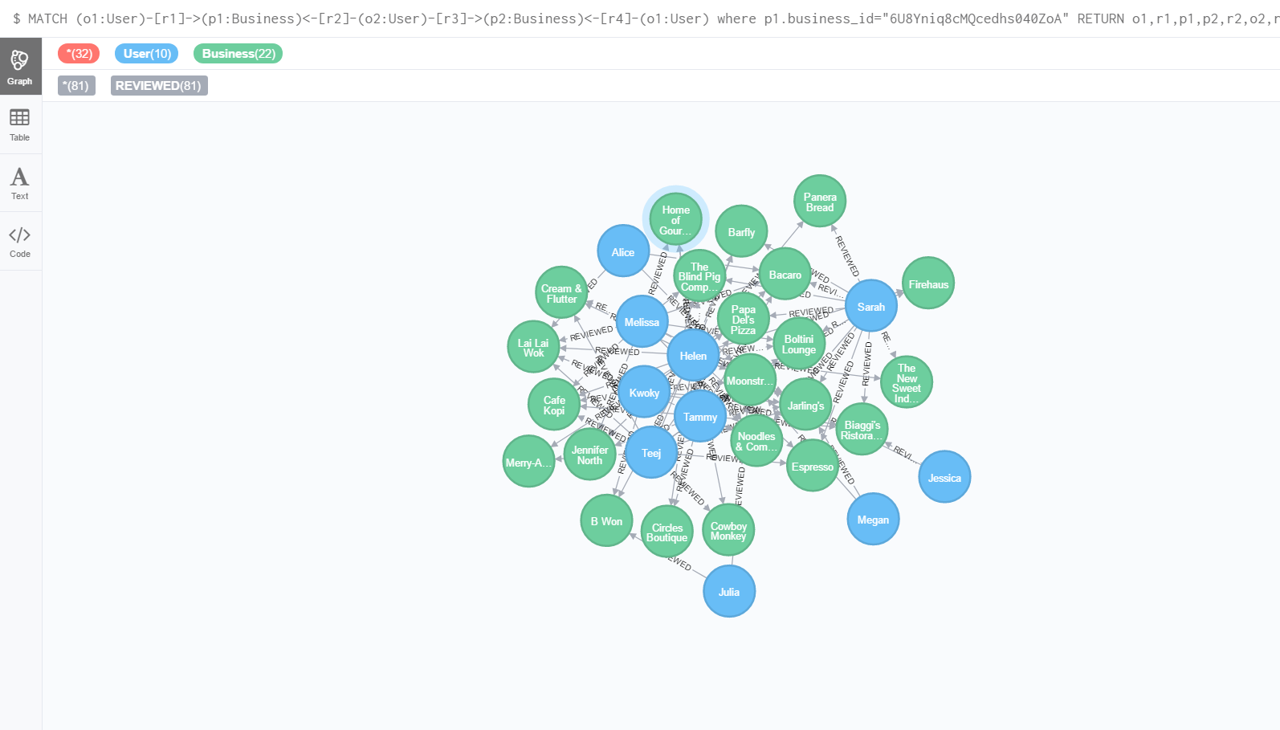
Analytics Review As a Mob
MATCH (o1:User)-[r1]->(p1:Business)<-[r2]-(o2:User)-[r3]->(p2:Business)<-[r4]-(o1:User)where p1.business_id="6U8Yniq8cMQcedhs040ZoA“ RETURN o1,r1,p1,p2,r2,o2,r3,r4 LIMIT 50

Slide 43
Analytics Review As a Mob
We are representing all the group of users, who reviewed similar businesses, since our User1-Business1-User2-Business2-User1, type connection will give only those pair of Businesses which have at least 2 users in common.
We are using a relationship between the nodes User and Business multiple times since we require group of users who have reviewed the same group of Businesses.
Reviewing as a mob behavior is noticed through our query for some businesses but we can only be absolutely certain about it once we analyze the complete yelp dataset.

Slide 44
Analytics Geographical Proximity
Match (b:Business)
where b.postal_code = "61820"
return stDev(b.stars)/avg(b.stars) as Coefficient_of_Variation
Match (b:Business)
where b.postal_code = "61821"
return stDev(b.stars)/avg(b.stars) as Coefficient_of_Variation

Slide 45
Analytics Geographical Proximity
We are calculating the coefficient of Variation(CV) also known as relative standard deviation (RSD).
The coefficient of Variation is a matrix which is defined as a measure of relative variability. It is the ratio of the standard deviation to the mean (average).
We are calculating these only for the postal code 61820.
If CV is less than 1, like in our case, it means that the ratings are not much varied in that particular geographical proximity.

Slide 46
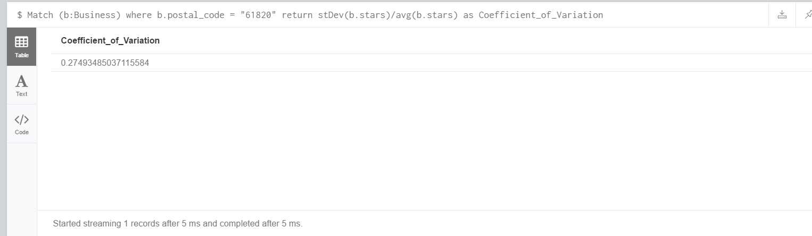
Analytics Geographical Proximity
Our value of 0.27 indicates that this region has uniformity in business ratings.

Slide 47
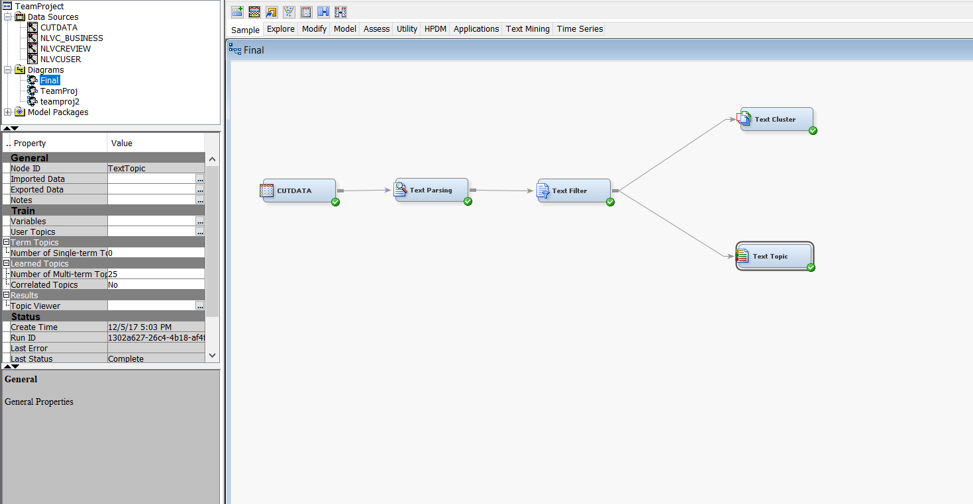
SAS
In text parsing, we parsed through the whole dataset and found out the words that were irrelevant for the analysis of reviews. So, in order to process our data, text parsing pallete helped us reduce our dataset by removing those type of words.
In text filtering, we filtered out all parts of speech except adjectives and defined synonyms for words that have the similar meaning.

Slide 48
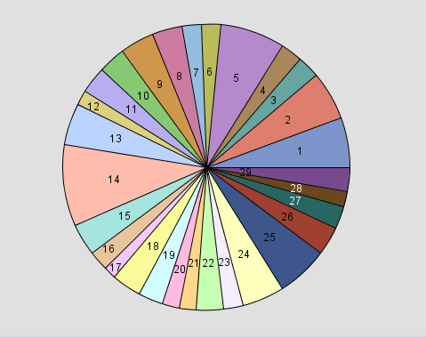
SAS
Text cluster help us cluster documents into disjoined sets of documents and report on the descriptive terms for those clusters.

Slide 49
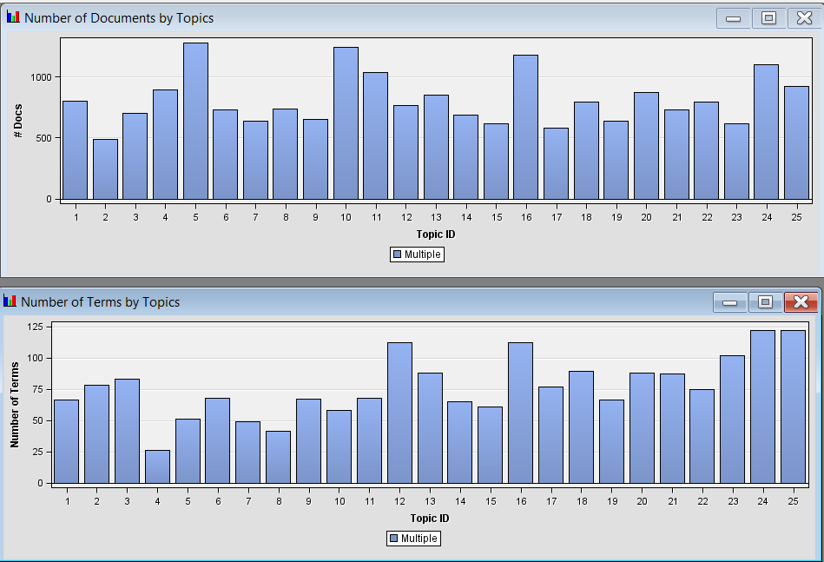
SAS
Text topic can help us explore the document collection by automatically associating terms and documents according to both discovered and user-defined topics

Slide 50

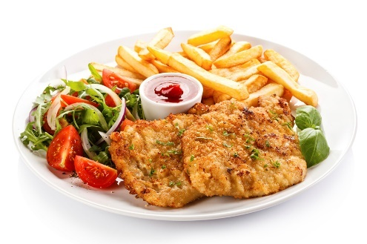

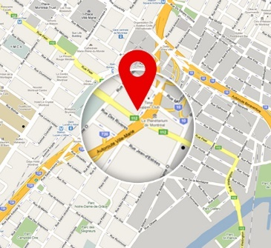
Hours:
Monday:10:00-21:00
Tuesday:10:00-21:00
Wednesday:10:00-21:00
Thursday:10:00-21:00
Friday:10:00-21:00
Saturday:10:00-21:00
Sunday:11:00-18:00
✓ Pokestop
✓ Wheelchair Accessible
✓ No Alcohol
✓ Smoking Area
✓ Live Sports Screening
✓ Valet Parking
✓ Private Dining
✓ Wi-fi
Address: 691 Richmond Rd, Richmond Heights. OH, 44143
Meal-O-Drama Restaurant
4.0/5
555 reviews
✓Delivery
✓Drive Thru
✓24-7 Open
Most helpful Reviews:
**“The fried chicken was melt in your mouth delicious and had a side of lobster mac n cheese, YUM.”
**“Delicious appetizers, the lobster wontons are to die for, I mean who doesn't love lobster, cheese, caviar and a mango sauce.”
**“I had the seafood spring rolls, lemon grass mussels, coconut shrimps and lobster wontons.”

Slide 51
Reviews
Most Recent Reviews:
John Nerd: 3.6/5
The sweet potato waffle and chicken entree was amazingly delicious all the way down to the side fruit and the whipped cheese crème
Crass Green: 4.2/5
The sea bass came with sun dried tomato, asparagus, artichoke heart blanco, and decorated with a quail egg on the top.
Most prolific Reviewers:
Bran Julia
J.Chambers
Kristin B.
Jane Hopper
Steve Harrington
Karen
Mike
Natalia Dyer
Bob Newby
Chief Hopper
Reviewers with highest average rating:
Rachel Green
Chandler Bing
Phoebe Buffay
Joey Tribbiani
Monica Geller
Ross Geller
Oldest Reviewer:
Christopher Nolan

Slide 52

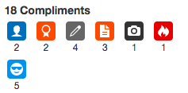



User
Tristan B.
ID: 233444
786 Reviews
Elite 2017
Reviews:
Chick-Fil-A: 5/5
The spicy chicken sandwich and waffle fries with chick fil a sauce are to die for, the drive thru is efficient, and the staff are very friendly.
Chipotle Mexican Grill: 4.5/5
Yummy burrito bowls with guacamole makes low carb dining deeelicious and an easy no brainer when I don't want to cook.

Slide 53
Location
Most Popular Restaurants in the neighborhood:
Chili's Bar and Grill: 4/5, 0.3 miles away
Longhorn: 3.5/5, 0.3 miles away
Dunkin Donuts: 4/5, 0.3 miles away
Chick-fill-A: 4.5/5, 0.5 miles away
Chipotle: 4.5/5, 0.5 miles away
Naan Stop: 3.8/5, 0.5 miles away
Mama Mia: 4.2/5, 0.8 miles away
Subway: 4/5,4.2/5, 0.8 miles away
Arby’s: 4.5/5,4.2/5, 1.2 miles away
Starbucks: 4/5, 1.2 miles away
Most Popular Restaurants for delivery in the neighborhood:
Naan Stop: 3.8/5, 0.5 miles away
Mama Mia: 4.2/5, 0.8 miles away
Subway: 4/5,4.2/5, 0.8 miles away
Arby’s: 4.5/5,4.2/5, 1.2 miles away
Starbucks: 4/5, 1.2 miles away
Burger King: 3.8/5, 0.5 miles away
Cafe Bombay: 4.2/5, 0.8 miles away
Bavaria Joint: 4/5,4.2/5, 0.8 miles away
Halal Brothers: 4.5/5,4.2/5, 1.2 miles away
McDonalds: 4/5, 1.2 miles away
Restaraunts currently open in the neighborhood sorted by rating:
Subway
Arby’s
Starbucks
Burger King
Cafe Bombay
Bawarchi

