Slide 1

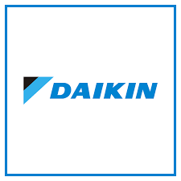
ENTITY-RELATIONSHIP DIAGRAM (ERD) FOR DAIKIN INDUSTRIES
Objective:
To design an ERD that streamlines operations by accurately modeling data relationships between customers, employees, orders, suppliers, and inventory.
Name : Shagun Seth
Roll No. : 055042
Section: K

Slide 2
PROBLEM STATEMENT
Daikin, a global leader in air conditioning and refrigeration solutions, faces challenges in managing its order processing, inventory tracking, supplier coordination, and service request handling due to fragmented data management. Inefficient tracking of customer orders, employee roles, and supplier relationships often leads to delays in procurement, stock mismanagement, and service inefficiencies. The lack of a well-structured system results in order duplication, inaccurate inventory levels, and delays in fulfilling customer service requests, ultimately affecting operational efficiency and customer satisfaction

Slide 3
PURPOSE OF CREATING THE ERD
To address the challenges, an Entity-Relationship Diagram (ERD) is being designed to provide a clear, structured representation of Daikin’s data flow. The ERD will help in:
Optimizing Order Management – Ensuring seamless tracking of orders from placement to fulfillment.
Enhancing Inventory Control – Keeping accurate stock levels and preventing shortages or excess inventory.
Strengthening Supplier Coordination – Streamlining procurement and ensuring timely stock replenishment.
Improving Customer Service – Efficiently handling service requests and tracking issue resolutions.
Reducing Data Redundancy & Errors – Establishing relationships between entities to maintain data integrity.
By implementing this ERD, Daikin can enhance operational efficiency, improve service quality, and support better decision-making based on structured and reliable data management.

Slide 4
KEY ENTITIES & RELATIONSHIPS
The ERD consists of key entities and their interactions:
Customer → Places service requests and orders.
Employee → Handles order processing and service requests.
Order & OrderDetails → Tracks purchases and products within each order.
Product → Represents items, linked to suppliers and inventory.
Supplier → Provides products, ensuring stock availability.
Inventory → Tracks stock levels to prevent shortages.
ServiceRequest → Connects customers with required services.
MISSION

Slide 5
OBSERVATIONS & INSIGHTS
Seamless Order Tracking: Orders are efficiently managed from placement to fulfillment.
Optimized Inventory Control: Live stock updates prevent shortages and overstocking.
Supplier Coordination: Strong supplier-product relationships streamline procurement.
Employee Role Mapping: Employees are linked to specific tasks for efficiency.
Enhanced Customer Service: Service requests are structured for quick resolution.

Slide 6
RECOMMENDATIONS FOR IMPROVEMENT
Process Automation: Implement digital workflows to reduce manual errors.
Real-Time Inventory Updates: Use live tracking to optimize stock management.
Enhanced Supplier Integration: Improve supplier collaboration to avoid delays.
Data Validation & Security: Establish rules to maintain system integrity.
Scalability & Expansion: Ensure the ERD can adapt to future business growth.

Slide 7
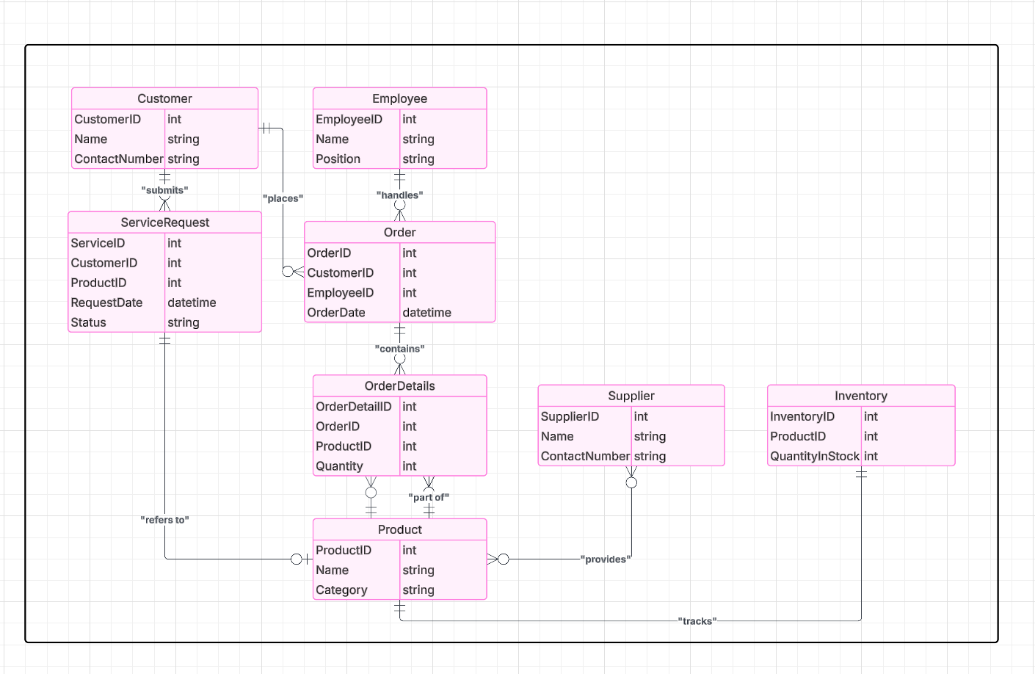
ENTITY-RELATIONSHIP DIAGRAM (ERD)

