Slide 1
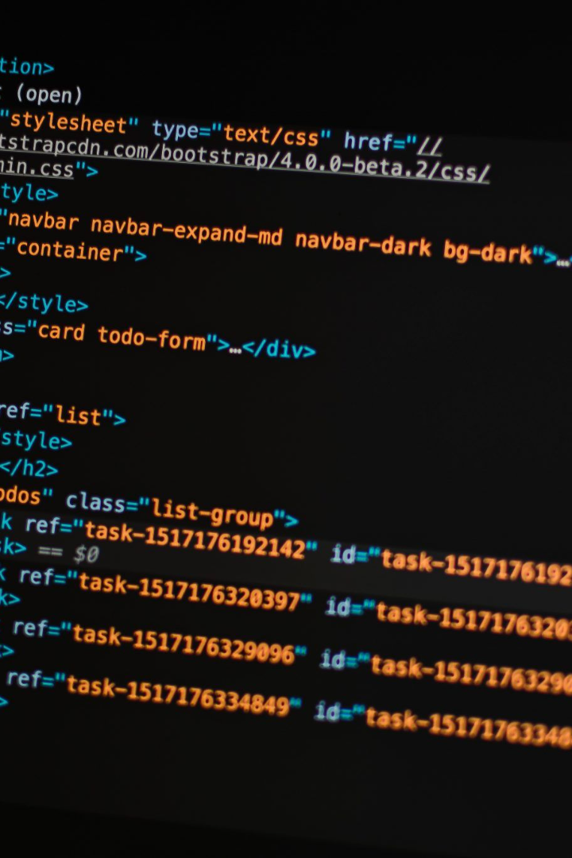
Multiple Disease Prediction System using Machine Learning in Python
We will be utilizing machine learning algorithms to build a web app that can predict various diseases such as Diabetes, heart disease, and Parkinson's. Deploying this app using Streamlit makes it accessible to anyone.
— Shagun Sharma

Slide 2


What is Multiple Disease Prediction System?
Multiple Disease Prediction System is an application that utilizes machine learning algorithms to predict the probability of having various diseases such as Diabetes, heart disease, and Parkinson's, based on the data provided.
Machine Learning
Healthcare
The use of machine learning algorithms allows the system to learn and improve from past data to make accurate predictions.
This system can be very useful in the healthcare industry where early predictions and preventive measures can save lives.

Slide 3
The use of Machine Learning
Machine Learning is used to make predictions based on past data. Here we are using various algorithms to make accurate predictions of diseases. Algorithms are used on patient data and the results can make a difference in a patient's quality of life.
Data Analysis
Model Training
Prediction System
These algorithms analyze patient data to make predictions. Essential indicators and parameters of a patient can help detect diseases much faster than traditional means of detection.
The machine learning model is trained and retrained from past data to make predictions. Continuous retraining improves the accuracy of the predictions being made.
The prediction system utilizes trained machine learning models and input from the patients to make accurate predictions of diseases.

Slide 4
Overview of the diseases that can be predicted
We can predict diseases such as Diabetes, heart disease, and Parkinson’s with a high degree of accuracy. These diseases are difficult to detect early on, and the presented symptoms can be unnoticed making it much harder to diagnose.
Heart disease
The system predicts the probability of having heart disease based on the user's family history, diet, exercise regime, and other relevant medical history. This system can save lives by predictive early detection.
1
2
3
Diabetes
Parkinson’s disease
The system can predict the probability of having diabetes based on the user's data relating to their weight, age, and family history. Early detection can help improve the quality of life of the patient.
Parkinson's can go unnoticed until it's too late. Utilizing the power of machine learning, we can make early predictions that can help improve the patient's quality of life.

Slide 5
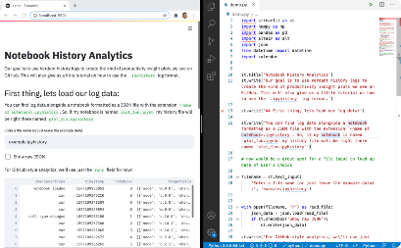
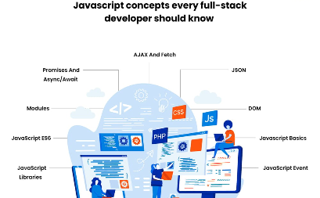
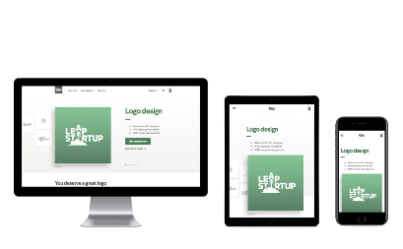
Building the web app using Streamlit
Streamlit is an open-source web application development tool for creating data-driven applications. You can use only a few lines of Python code to create a fully run web app. Streamlit is easy to learn with its simple syntax and interactive documentation.
Python
Full Stack
Responsive Web Design
Using the Python language, we can create the web-based app. Python has libraries and frameworks that make the process simple, quick, and efficient.
The result is a fully functional application that is user-friendly and efficient. The app uses an optimized code structure and design which makes it faster for the users to operate the system.
The web app is a responsive design that is optimized for different screen sizes. Anyone with access to the internet and a device can easily access the web app.

Slide 6
Deploying the web app
We can use Streamlit to deploy the web app so that anyone with an internet connection can use it. We can deploy the web app on cloud platforms such as Azure, AWS, or GCP.
1
Azure
Deploying the web app on the Azure cloud platform provides us with multiple scalable options so our app can adapt to demand.
2
AWS
Amazon web services are known for their reliability and scalability; deploying our app on AWS ensures that our app is always up and running even during high traffic times.
3
GCP
The Google Cloud Platform offers multiple service packs, enabling us with a superior infrastructure to sustain our web app based on our present needs while having access to future enhancements to your cloud app

Slide 7

Conclusion and potential future applications
Machine learning allows us to predict diseases that are challenging to detect early on. With the power of Streamlit, we can create a user-friendly web app that can assist in the healthcare industry. This tool can speed up the process of early detection and improve the quality of life of the patient. There are a lot of potential applications for future use such as predicting various types of cancer, diseases caused by drug and substance addiction, etc.
1
Early Detection
2
Accessibility
Early prediction of diseases is very crucial, which makes this tool an essential application for the healthcare industry.
This web app can be accessed from anywhere, making it beneficial to serve people around the world in providing better healthcare.
3
Potential for further development
This machine learning tool has phenomenal potential for further development that will benefit society in various aspects of healthcare.

