Slide 1

IILM UNIVERSITY
DATA ANALYTICS WITH PYTHON & POWER BI
Internship Presentation
Student Name
SHAGUN SRIVASTAVA
Enrollment Number
2410030277
Program & Semester
B.Tech CSE • 5th Semester
Organization Name
EduSkills Academy
School of Computer Science and Engineering • Greater Noida, U.P.

Slide 2
1. Internship Overview
Duration
Domain
Organization
8-week internship program
Data Analytics with Python & Power BI
EduSkills Academy
• Progressive learning from analytics fundamentals to practical project workflow.
• Covered Python, Pandas, SQL, Power BI, DAX, visualization, integration and collaboration.
• Included Sales Performance Analysis, Customer Behavior Analysis and a capstone dashboard.
IILM University • Internship Presentation
2

Slide 3
2. Internship Objectives
• Build practical proficiency in Python for data analysis.
• Perform data cleaning and preprocessing using Pandas.
• Use SQL fundamentals and advanced SQL techniques for data extraction.
• Create data visualizations and interactive dashboards using Power BI.
• Understand Power BI data modeling and DAX basics.
• Integrate Python, SQL and Power BI within an analytical workflow.
• Apply the learned skills to sales, customer behavior and e-commerce analysis.
IILM University • Internship Presentation
3

Slide 4
3. Technologies & Tools
Python
Pandas
SQL
Core programming & data analysis
Cleaning, preprocessing & analysis
Data extraction & analytical querying
Power BI
DAX
Python Visualization
Visualization, dashboards & BI
Power BI calculations & measures
Analytical visualizations
Power BI Service
Python + SQL
Python + Power BI
Publishing & collaboration
Integrated data extraction workflow
Connected analytics & dashboard workflow
IILM University • Internship Presentation
4

Slide 5
4. Project Workflow / Methodology
01
02
03
04
Data & Setup
Prepare
Extract
Analyze
Analytics fundamentals • Environment setup
Pandas cleaning • Preprocessing
SQL fundamentals • Advanced SQL
Python analysis • Power BI + DAX
05
06
07
08
Visualize
Integrate
Apply
Deliver
Interactive Power BI • Python visualization
Python + SQL • Python + Power BI
Sales & customer analysis projects
Capstone dashboard • Service & collaboration
IILM University • Internship Presentation
5

Slide 6
5. System Architecture
Logical workflow represented in the internship report
DATA INPUT
Business data • Datasets / SQL
DATA PREPARATION
Clean, transform • Python + Pandas
DATA EXTRACTION
Query & extract • SQL
ANALYSIS & MODELING
Analyze & calculate • Python + Power BI + DAX
VISUALIZATION
Interactive dashboards • Power BI + Python
INTEGRATION & COLLABORATION
Connect & share • Power BI Service
IILM University • Internship Presentation
6

Slide 7
6. Projects Covered
Real-World Project 1
Real-World Project 2
Capstone Project
Sales Performance Analysis Applied the analytics workflow to sales-oriented data and focused on turning data into useful analytical views.
Customer Behavior Analysis Applied data analytics concepts to understand customer-oriented information and present analytical insights.
E-commerce Sales & Customer Insights Dashboard Integrated the internship skills into an interactive dashboard-oriented project.
IILM University • Internship Presentation
7

Slide 8
7. Capstone Project
E-commerce Sales & Customer Insights Dashboard
• Capstone focus: organize e-commerce sales and customer information into an interactive analytical view.
• Data preparation: cleaning and preprocessing using the Python/Pandas workflow.
• Data extraction and analysis: SQL and Python-based analytical workflow.
• Dashboard layer: Power BI visualization, data modeling, interactivity and DAX basics.
• Integration and delivery: Python + Power BI workflow and Power BI Service collaboration.
Goal: transform business data into clear, interactive and decision-oriented insights.
IILM University • Internship Presentation
8

Slide 9
8. Learning Outcomes
Outcome 1
Outcome 2
Practical understanding of the data analytics lifecycle.
Working knowledge of Python and Pandas for data analysis.
Outcome 3
Outcome 4
Understanding of SQL for data extraction and analytical querying.
Ability to build visualizations and interactive Power BI dashboards.
Outcome 5
Outcome 6
Foundational understanding of Power BI data modeling and DAX.
Exposure to Python, SQL and Power BI integration.
Outcome 7
Outcome 8
Project experience in sales performance, customer behavior and e-commerce insights.
Understanding of Power BI Service, collaboration and project workflow.
IILM University • Internship Presentation
9

Slide 10
9. Conclusion
• The 8-week internship provided a structured progression from data analytics fundamentals to practical project work.
• The training connected Python, Pandas, SQL and Power BI into an end-to-end analytics workflow.
• Real-world projects strengthened application of sales and customer analysis concepts.
• The E-commerce Sales & Customer Insights Dashboard served as the capstone application of the learned skills.
• Overall, the internship strengthened practical foundations for data analysis, visualization and business intelligence.
Thank You
IILM University • Internship Presentation
10

Slide 11
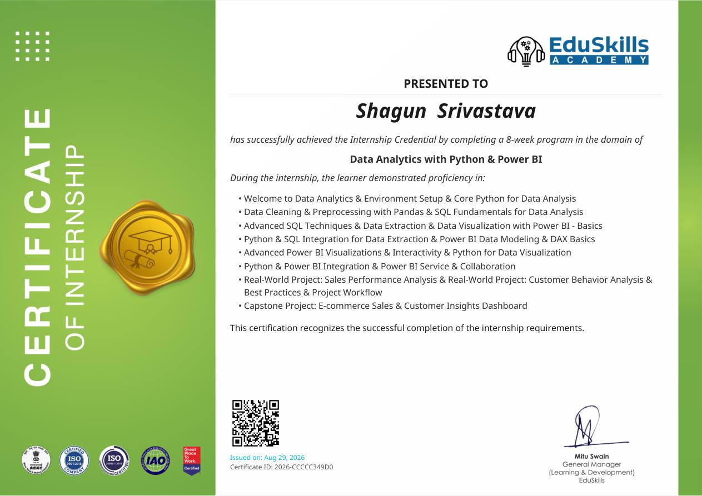
10. Internship Completion
8-week Internship • Data Analytics with Python & Power BI • Issued Aug 29, 2026
IILM University • Internship Presentation
11

