Slide 1


The Six-Year Itch
By Shagun Varma
Question: Does stock market performance support the "Six-Year Itch" theory?
A theory by political scientists, known as the six-year itch, refers to the phenomenon during the incumbent President's sixth year in office wherein the incumbent party loses a significant number of House and Senate seats. This could be because a President in their second term is not concerned about reelection and therefore does not push for economic growth. This could create pessimism in the market that is reflected in stock prices. Through the lens of stock prices, I would like to study the impact of the six-year itch on market optimism. I created three graphs:
A graph matching stock market crashes with the President at the time
A graph showing stock market returns by year of Presidency
A graph analyzing the VIX during the 2008 financial crisis.

Slide 2
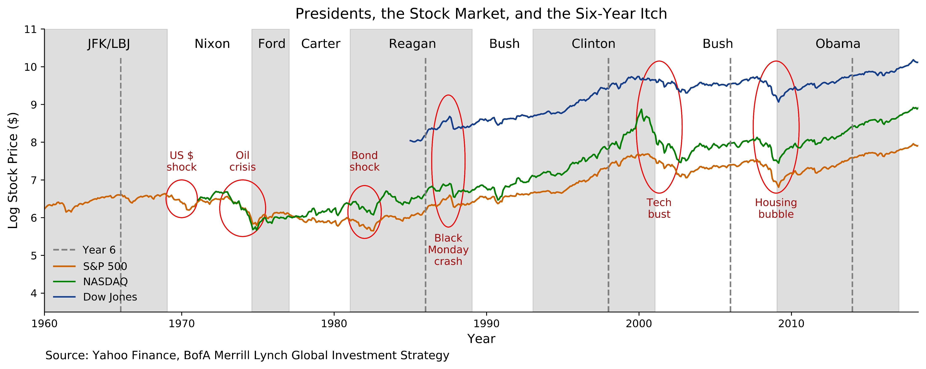
We see that for Reagan, Clinton and Bush, the stock market crashes fall after the 6-Year mark. This is in line with the six-year itch theory. However, there are instances where stock market crashes do not align with the theory. Reagan faced a Bond shock at the start of his presidency, and the stock market prices during the Obama presidency only went up. Moreover, the stock market crashes that "fit" the six-year itch theory are not entirely policy-related.
Furthermore, such a graph can be misleading. For instance, the mild 8-month recession during George H.W. Bush's presidency is not marked here. He did not get a second term because of slow economic growth during his presidency.
It may instead be more helpful to look at stock market returns by year of presidency instead of stock prices.

Slide 3
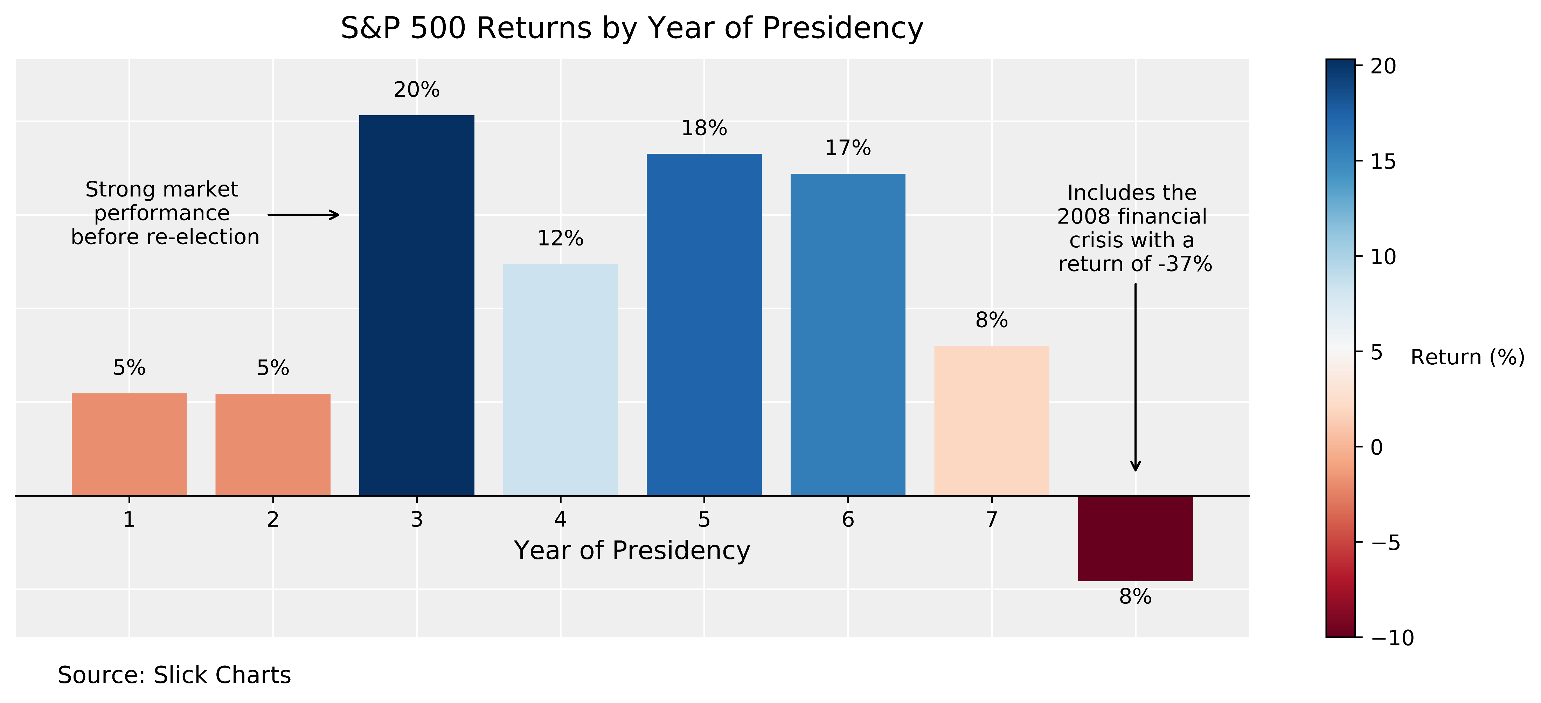
The data in this graph tells a completely different story, but makes logical sense. We see that in year 3, stock market performance is the strongest. This is because when presidents face re-election, they push for economic growth so that the public is in their favor and they are re-elected.
In year 6, we do not see a big drop in returns as would be expected with the six-year itch.
Interestingly in year 8, we see negative returns. We could explain this with the logic that in year 8, the president does not need to worry about re-election and therefore is not too concerned with economic growth. However, the reason that the returns in year 8 are this low is because the average includes the 2008 financial crisis with a return of -37%.
It would be interesting to take a look at what happened during 2008.

Slide 4
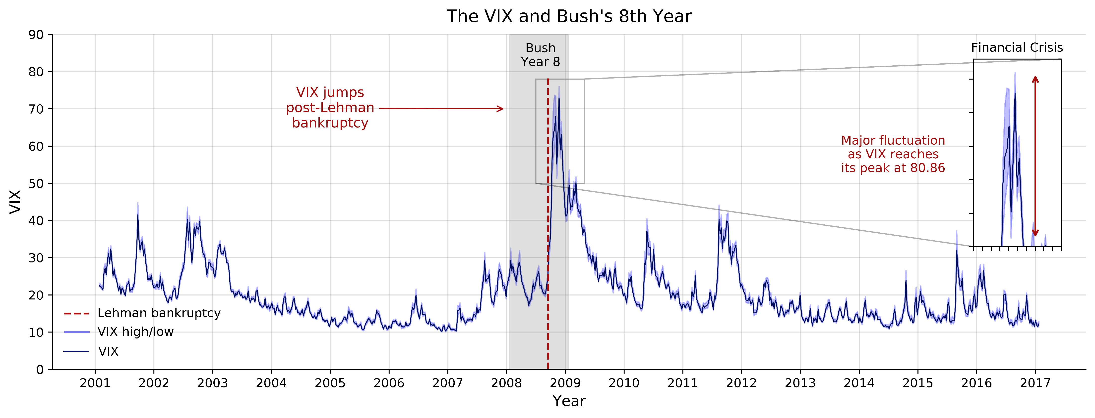
We see a major spike in the VIX in the eighth year of George W. Bush's presidency, right after Lehman Brothers filed for bankruptcy.
Economists are divided on the extent to which Bush is to blame, however, there is general agreement that Bush's lack of financial regulation lead to banks taking riskier choicesthat ultimately lead to the Lehman bankruptcy.
(Source: https://www.nytimes.com/2008/09/20/business/worldbusiness/20iht-prexy.4.16321064.html)
We see the economic effects in the major fluctuation of the VIX during Bush's eigth year. The VIX reached its peak at 80.86 - an all time high.
While we do not see the effects of the six-year itch here, the data from the three graphs demands more research into the eighth year of a president's term.

